Slide 1

Club Management
System
By Junaid Khan

Slide 2

About project
The club management system project in SQL involves designing a relational database to manage various aspects of a club's operations, including member information, event details, and financial transactions. The database typically consists of tables for members, events, registrations, and payments, enabling efficient data storage and retrieval. SQL queries facilitate tasks such as adding new members, tracking event participation, and generating financial reports. By implementing this system, clubs can streamline their administrative processes, enhance member engagement, and maintain accurate records, ultimately fostering a more organized and responsive environment.

Slide 3

Tables Present in My DataBase

Slide 4




Tables

Slide 5




Members
CREATE TABLE Members ( member_id INT PRIMARY KEY, first_name VARCHAR(50), last_name VARCHAR(50), email VARCHAR(100), phone_number VARCHAR(15), membership_date DATE NOT NULL, membership_type VARCHAR(20) CHECK (membership_type IN ('Regular', 'Premium')));INSERT INTO Members (member_id, first_name, last_name, email, phone_number, membership_date, membership_type) VALUES
(1, 'Junaid', 'khan', 'khanjunaid09@gmail.com', '1234567890', '2023-01-15', 'Regular’),(2, 'Svetlena', 'Singh', 'Svetlenasingh07gmail.com', '2345678901', '2023-02-10', 'Premium'),(3, 'afiya', 'kaptan', 'kaptabafiya21@gmail.com', '3456789012', '2023-03-05', 'Regular'),(4, 'afiya', 'kaptan', 'kaptabafiya21@gmail.com', '4567890123', '2023-04-20', 'Regular'),(5, 'minal', 'shaikh', 'minalshaikh43@gmail.com', '5678901234', '2023-05-15', 'Premium'),(6, 'supriya', 'yadav', 'yadavsupriya33@gmail.com', '6789012345', '2023-06-10', 'Regular'),(7, 'junaid', 'khan', 'khanjunaid09@gmail.com', '7890123456', '2023-07-25', 'Regular'),(8, 'prasad', 'kumbharkar', 'prasadkumbharkar67@gmail.com', '8901234567', '2023-08-30', 'Premium'),(9, 'sumit', 'sahelkar', 'sumit87@gmail.com', '9012345678', '2023-09-15', 'Regular'),(10, 'sahil', 'gupta', 'sahilgupta5@gmail.com', '0123456789', '2023-09-20', 'Regular'),(11, 'sumit', 'sahelkar', 'sumit87@gmail.com', '1234567891', '2023-10-01', 'Premium'),(12, 'jassdeep', 'kaur', 'jassdeep34@gmail.com', '2345678902', '2023-10-02', 'Regular'),(13, 'jasdeep', 'kaur', 'jassdeep34@gmail.com', '3456789013', '2023-10-03', 'Regular'),(14, 'Junaid', 'khan', 'khanjunaid09@gmail.com', '4567890124', '2023-10-04', 'Premium'),(15, 'Junaid', 'khan', 'khanjunaid09@gmail.com', '5678901235', '2023-10-05', 'Regular');
Tables

Slide 6




Payment
CREATE TABLE Payments ( payment_id INT PRIMARY KEY, member_id INT, amount DECIMAL(10, 2), payment_date DATETIME, payment_method VARCHAR(20) CHECK (payment_method IN ('Credit Card', 'Cash', 'PayPal', 'Bank Transfer')), event_id INT, FOREIGN KEY (member_id) REFERENCES Members(member_id), FOREIGN KEY (event_id) REFERENCES Events(event_id));INSERT INTO Payments (payment_id, member_id, amount, payment_date, payment_method, event_id) VALUES(1, 1, 50.00, '2024-01-10 12:00:00', 'Credit Card', 1),(2, 2, 335.00, '2024-04-05 10:00:00', 'Cash', 2),(3, 3, 75.00, '2024-06-01 14:00:00', 'Cash', 3),(4, 4, 799.00, '2024-02-18 15:30:00', 'Credit Card', 4),(5, 5, 200.00, '2024-03-10 08:45:00', 'Bank Transfer', 5),(6, 6, 200.00, '2024-05-20 19:15:00', 'Credit Card', 6),(7, 7, 15.00, '2024-07-08 17:00:00', 'Cash', 7),(8, 8, 200.00, '2024-08-12 13:00:00', 'Cash', 8),(9, 9, 60.00, '2024-09-10 16:00:00', 'Credit Card', 9),(10, 10, 20.00, '2024-10-20 18:30:00', 'Cash', 10),(11, 11, 290.00, '2024-12-10 12:00:00', 'Bank Transfer', 11),(12, 12, 45.00, '2024-07-15 09:00:00', 'PayPal', 12),(13, 13, 55.00, '2024-11-01 14:30:00', 'Credit Card', 13),(14, 14, 290.00, '2024-02-25 19:00:00', 'Cash', 14),(15, 15, 90.00, '2025-01-01 22:00:00', 'Credit Card', 15);
Tables

Slide 7




Reservations
CREATE TABLE Reservations ( reservation_id INT PRIMARY KEY, member_id INT, event_id INT, reservation_date DATETIME, number_of_tickets INT, FOREIGN KEY (member_id) REFERENCES Members(member_id), FOREIGN KEY (event_id) REFERENCES Events(event_id));INSERT INTO Reservations (reservation_id, member_id, event_id, reservation_date, number_of_tickets) VALUES(1, 1, 1, '2024-01-10 10:00:00', 2),(2, 2, 2, '2024-04-05 11:00:00', 4),(3, 3, 3, '2024-06-01 13:00:00', 1),(4, 4, 4, '2024-02-18 14:30:00', 3),(5, 5, 5, '2024-03-10 09:00:00', 5),(6, 6, 6, '2024-05-20 16:15:00', 2),(7, 7, 7, '2024-07-08 19:00:00', 4),(8, 8, 8, '2024-08-12 12:30:00', 2),(9, 9, 9, '2024-09-10 10:00:00', 1),(10, 10, 10, '2024-10-20 18:00:00', 3),(11, 11, 11, '2024-12-10 16:00:00', 4),(12, 12, 12, '2024-07-15 14:00:00', 6),(13, 13, 13, '2024-11-01 15:00:00', 2),(14, 14, 14, '2024-02-25 17:00:00', 5),(15, 15, 15, '2025-01-01 21:00:00', 3);
Tables

Slide 8




Events
INSERT INTO Events (event_id, event_name, event_date, location, capacity) VALUES(1, 'Annual Gala', '2024-01-15 19:00:00', 'Club House Ballroom', 150),(2, 'Spring BBQ', '2024-04-10 12:00:00', 'Club Garden', 100),(3, 'New Year’s Celebration', '2024-06-05 09:00:00', 'Club Sports Field', 200),(4, 'Monthly Book Club', '2024-02-20 18:00:00', 'Library Room', 30),(5, 'Cooking Class', '2024-03-15 08:00:00', 'City Park', 500),(6, 'Wine Tasting Night', '2024-05-22 18:30:00', 'Club Wine Cellar', 50),(7, 'Movie Night', '2024-07-10 20:00:00', 'Outdoor Cinema', 200),(8, 'Cooking Class', '2024-08-15 15:00:00', 'Club Kitchen', 20),(9, 'Art Exhibition', '2024-09-12 17:00:00', 'Gallery Room', 100),(10, 'Cooking Class', '2024-10-25 18:00:00', 'Lounge Area', 150),(11, 'Family Fun Day', '2024-12-15 16:00:00', 'Dining Hall', 80),(12, 'Family Fun Day', '2024-07-20 10:00:00', 'Club Playground', 150),(13, 'Movie Night', '2024-11-05 09:00:00', 'Fitness Center', 200),(14, 'Trivia Night', '2024-02-28 19:00:00', 'Game Room', 50),(15, 'New Year’s Celebration', '2025-01-01 21:00:00', 'Club House', 300);
Tables

Slide 9

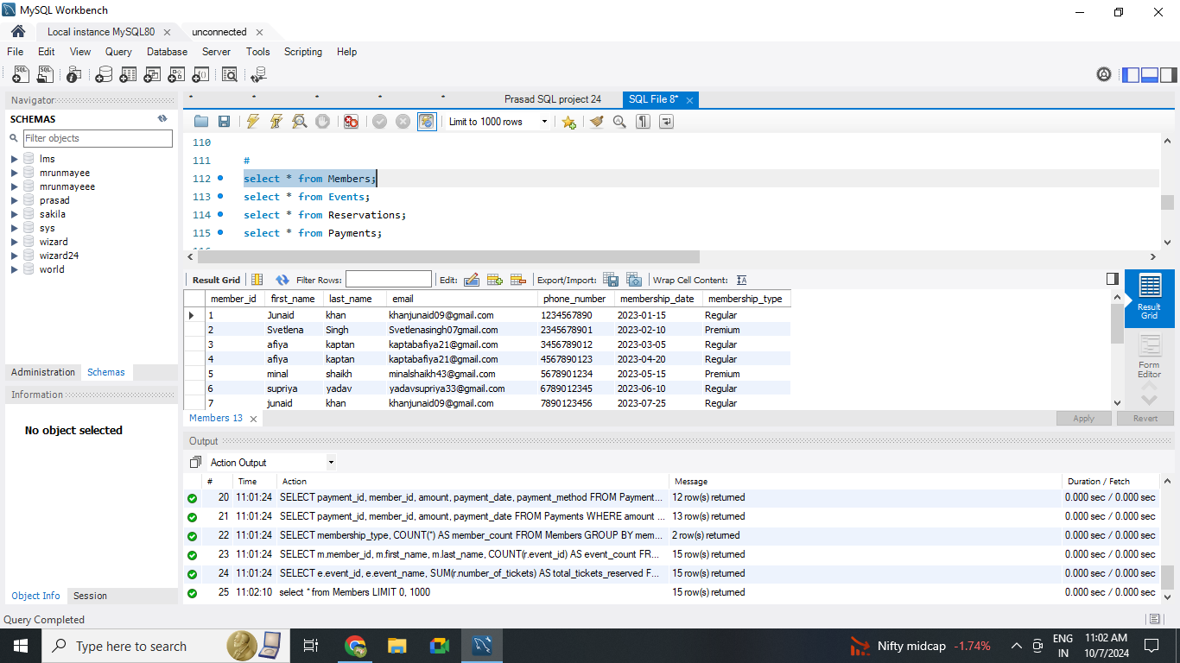
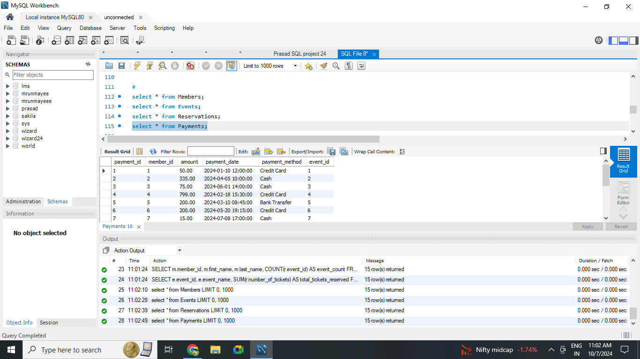
OutPut Of Member
OutPut of Payment

Slide 10

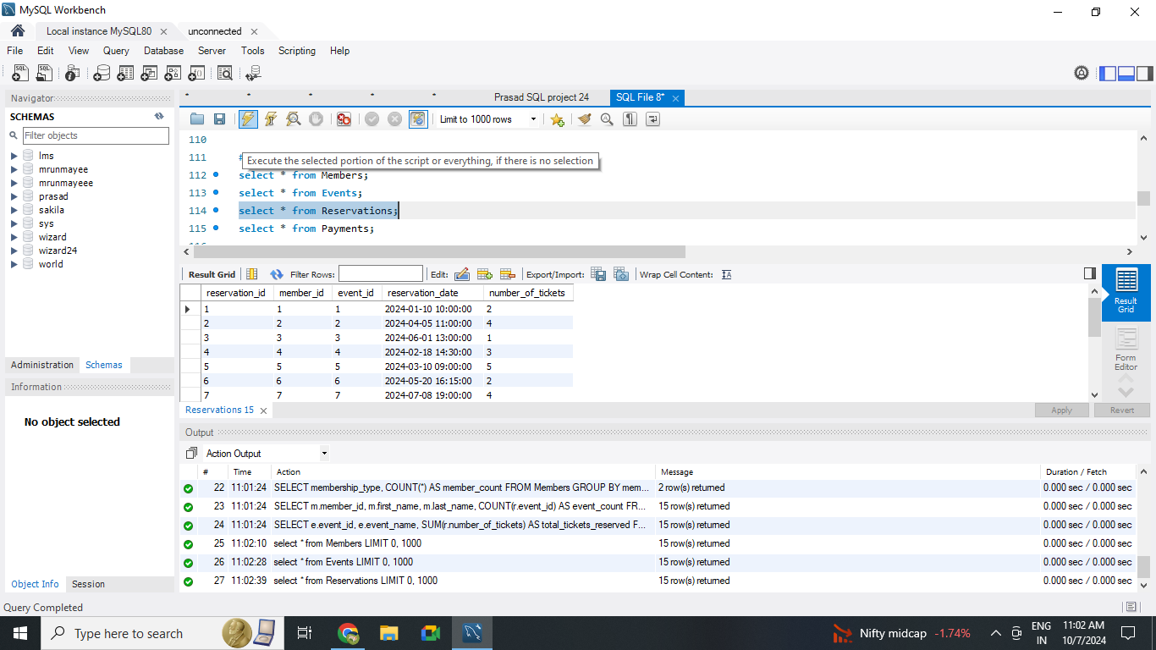
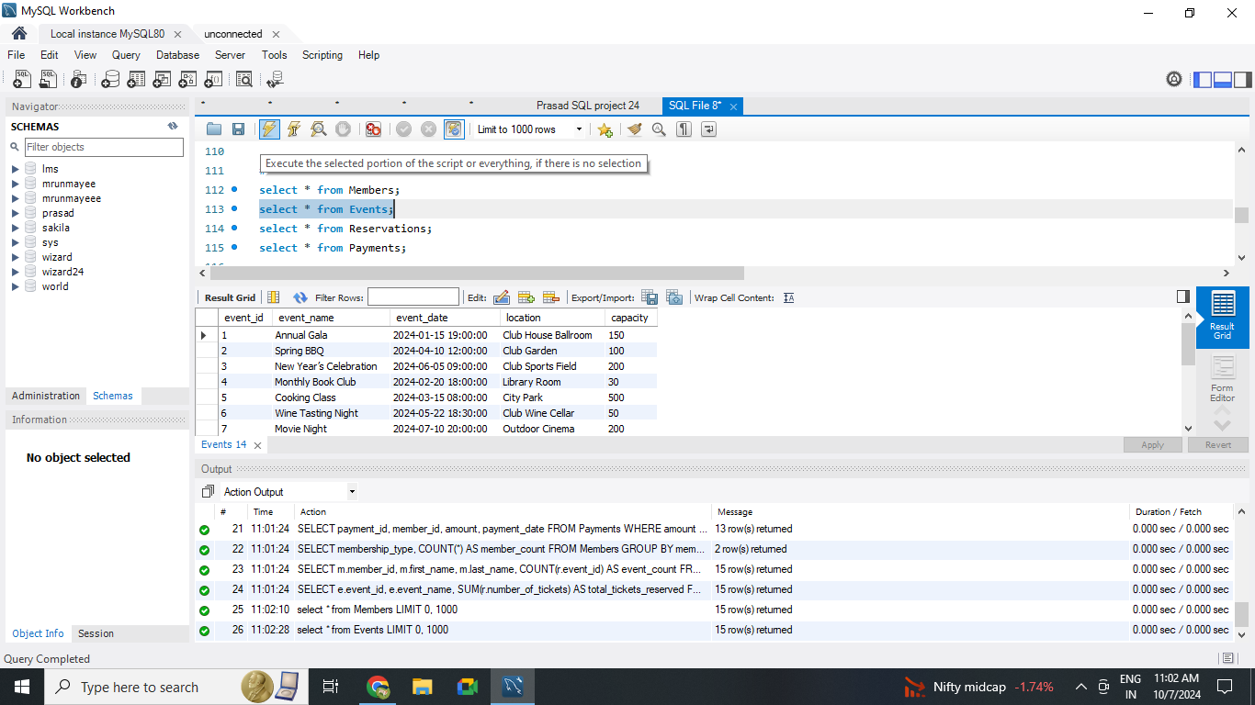
OutPut of reservations
OutPut of Events

Slide 11

QUERIES USED IN THE DATABASE
JOIN
WHERE
GROUP BY
ORDER BY
SUBQUERY

Slide 12
QUERIES USED IN THE DATABASE
JOIN
WHERE
GROUP BY
ORDER BY
SUBQUERY

Slide 13
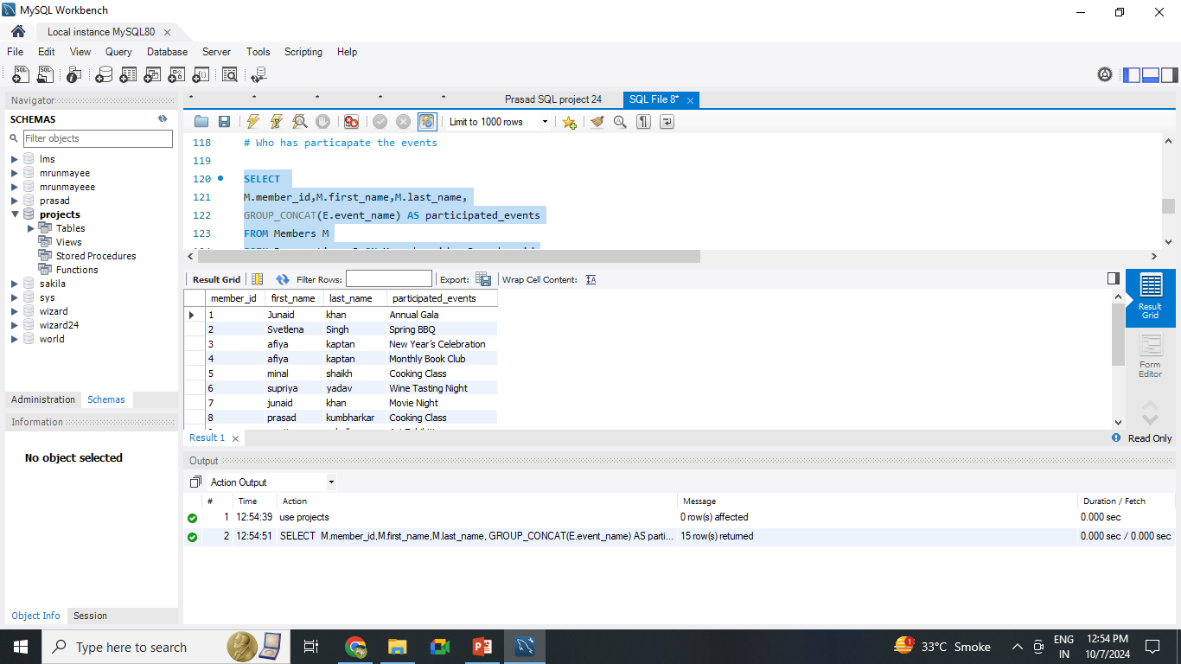
# Who has particapate the events
SELECT M.member_id,M.first_name,M.last_name,GROUP_CONCAT(E.event_name)
AS
participated_events
FROM
Members
MJOIN Reservations R ON M.member_id = R.member_id
JOIN
Events E ON R.event_id = E.event_id
GROUP BY
M.member_id;

Slide 14
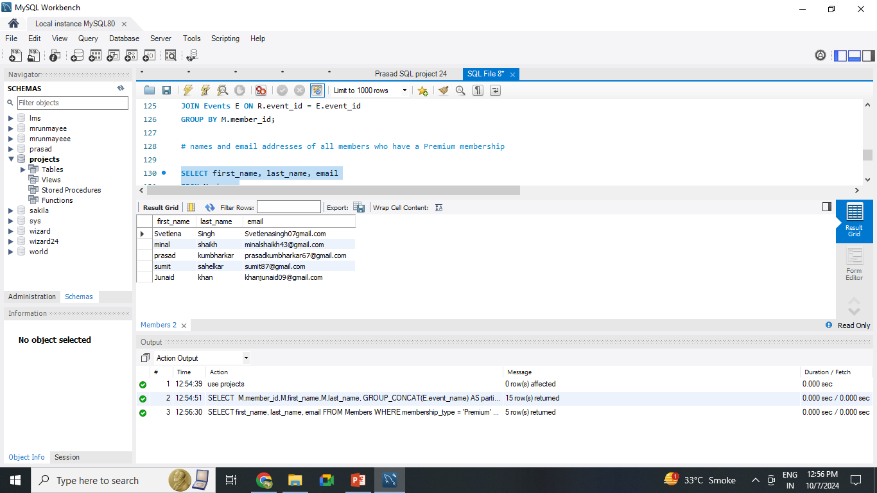
# names and email addresses of all members who have a Premium membership
SELECT
first_name, last_name, email
FROM Members
WHERE membership_type = 'Premium';

Slide 15
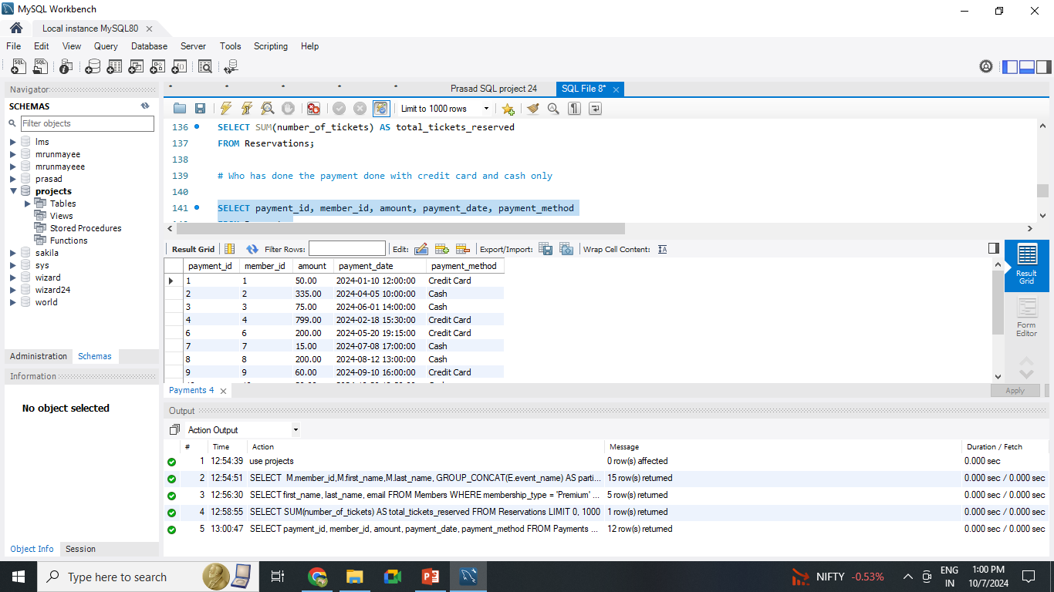
# Who has done the payment done with credit card and cash only
SELECT
payment_id, member_id, amount, payment_date, payment_method
FROM Payments
WHERE payment_method
IN
('Credit Card', 'Cash');

Slide 16
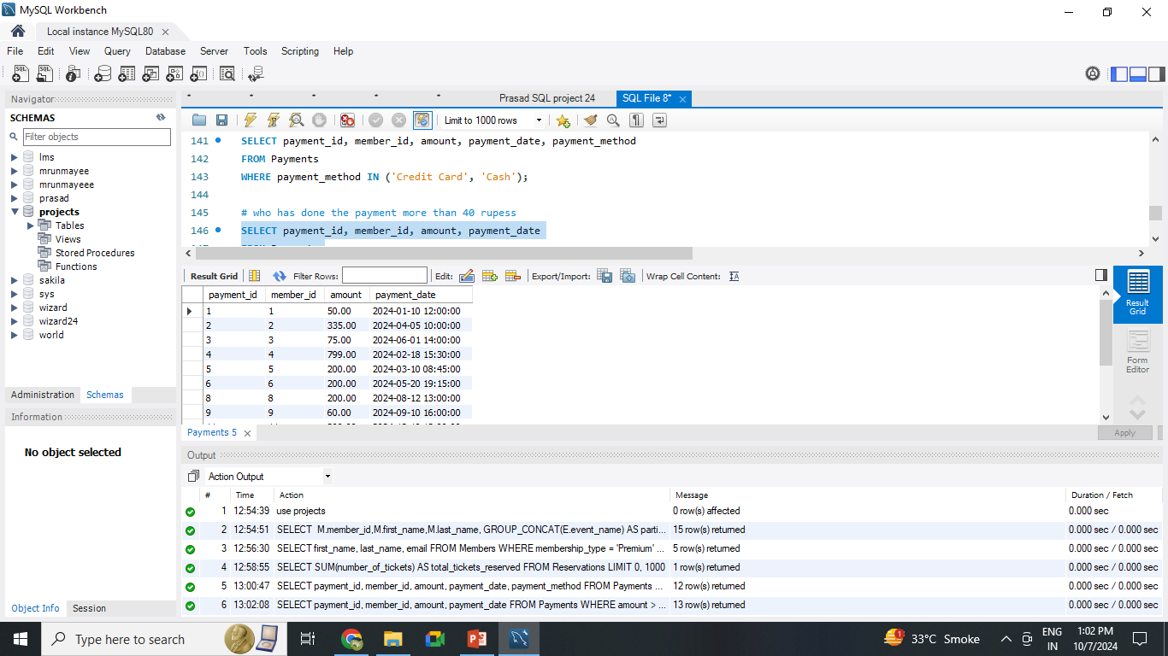
# who has done the payment more than 40 rupeess
SELECT
payment_id, member_id, amount, payment_date
FROM Payments
WHERE amount > 40;

Slide 17
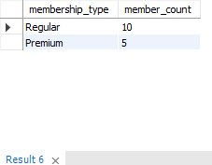
# How many members are there for each membership type (Regular vs. Premium)
SELECT
membership_type, COUNT(*) AS member_count
FROM
Members
GROUP BY
membership_type;

Slide 18
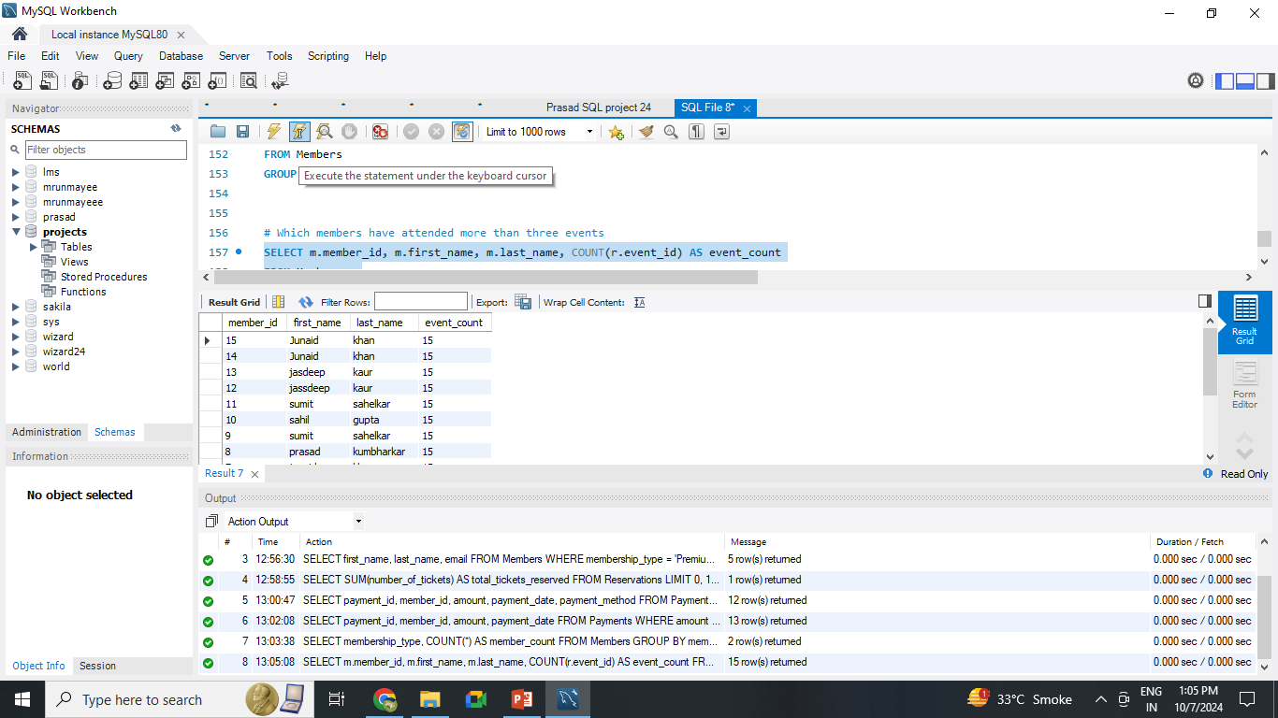
# Which members have attended more than three events
SELECT
m.member_id, m.first_name, m.last_name,
COUNT
(r.event_id) AS event_count
FROM Members m
JOIN Reservations r ON m.member_id
GROUP BY m.member_id, m.first_name, m.last_name
HAVING
COUNT(r.event_id) > 2;

Slide 19

# Which events had the highest attendance based on the number of tickets reserved
SELECT
e.event_id, e.event_name, SUM(r.number_of_tickets) AS total_tickets_reserved
FROM Events eJOIN Reservations r ON e.event_id = r.event_id
GROUP BY e.event_id, e.event_name
ORDER BY total_tickets_reserved
DESC;

Slide 20

THANK YOU !

