Slide 1

Mobile Application
Development with ANDROID

Slide 2


Android – Introduction
What is Android?
Android is
A software platform and operating system for mobile devices
Based on the Linux kernel
Developed by Google and later the OHA (Open Handset Alliance)
Unveiling of the Android platform was announced on 5 November 2007 with the founding of OHA
Allows writing managed code in the Java language

Slide 3
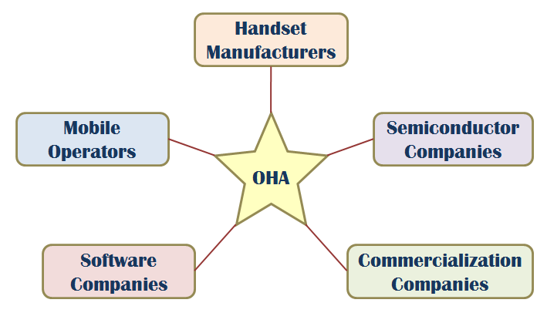
Android – Introduction
What is OHA ?
A business alliance consisting of 47 companies to develop open standards for mobile devices

Slide 4
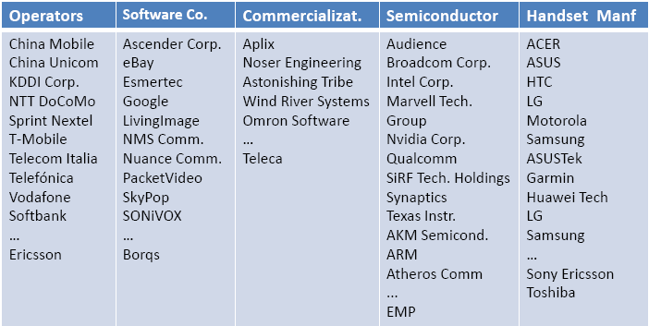
Android – OHA
Members of OHA

Slide 5
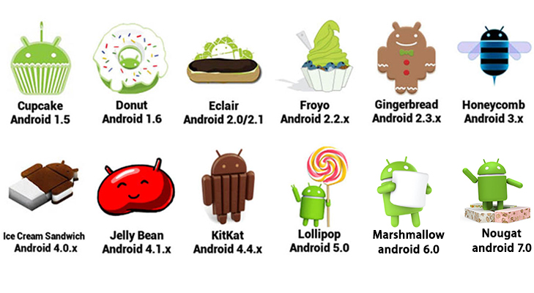
Android – Versions

Slide 6
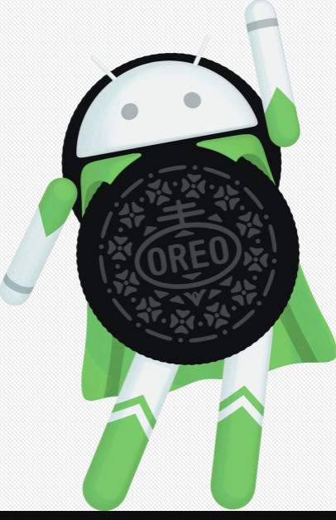
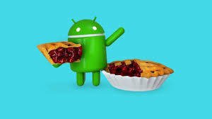

Slide 7
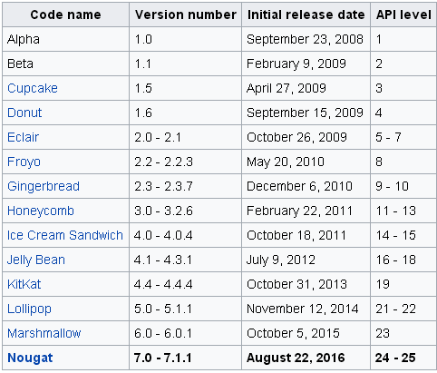
Android – Versions
Oreo | 8.0 | August 21, 2017 | 26
Pie | 9.0 | August 6 , 2018 | 28

Slide 8
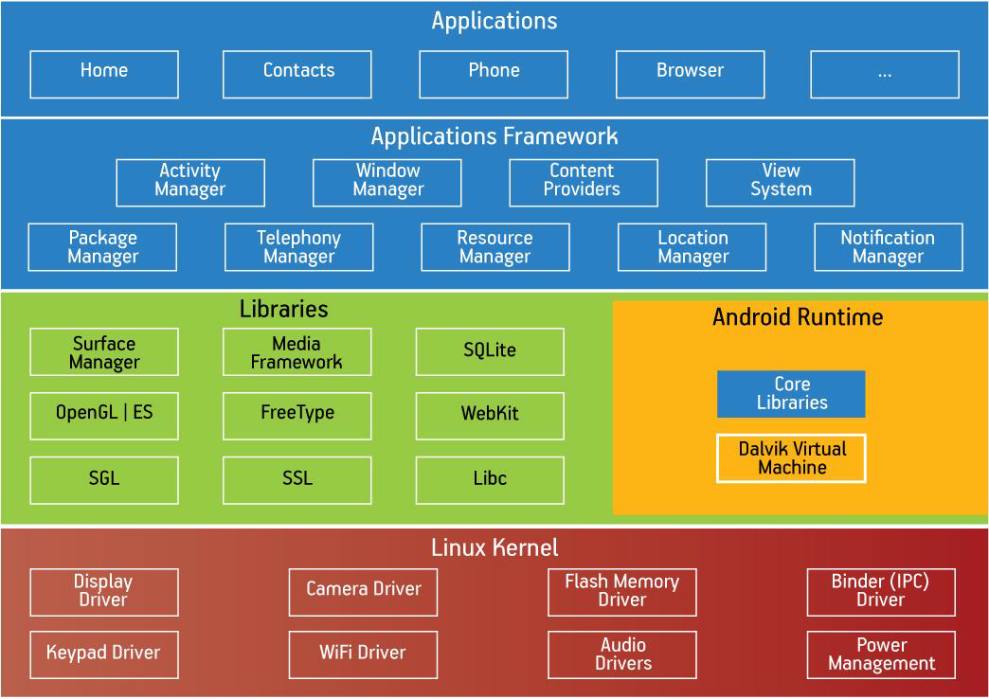
Android – Architecture

Slide 9
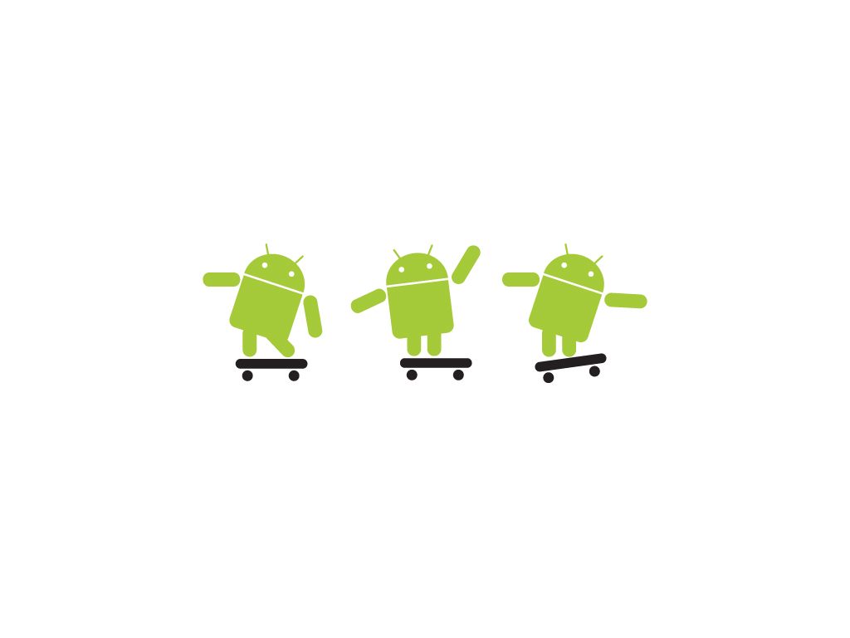
The Dalvik Runtime Optimized for Mobile Applications
Run multiple VMs efficiently
Each app has its own VM
Minimal memory footprint

Slide 10
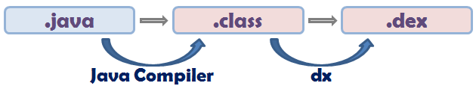
Android – Execution
Dalvik Virtual Machine
Executing the Dalvik Executable (.dex) format
.dex format is optimized for minimal memory footprint.
Compilation
Relying on the Linux Kernel for
Threading
Low-level memory management
10

Slide 11
Android applications compiled to Dalvik byte code
Write app in Java
Compiled in Java
Transformed to Dalvik bytecode
Linux OS
Loaded into Dalvik VM

Slide 12
Software development - IDE and Tools
Android SDK
Class Library
Developer Tools
Emulator and System Images
Documentation and Sample Code
Eclipse IDE + ADT (Android Development Tools)
Reduces Development and Testing Time
Makes User Interface-Creation easier
Makes Application Description Easier

Slide 13


