Slide 1
Activity
What is activity?
An activity presents a visual user interface (screen) for one focused endeavor the user can undertake
Examples - Individual activity
A list of menu items users can choose from Display of photographs along with their captions
Example - Sequence of activities
A text messaging application might have one activity that shows a list of contacts to send messages to, a second activity to write the message to the chosen contact, and other activities to review old messages or change settings

Slide 2
How an Activity is Started?
An activity is started in two ways
startActivity(Intent intent) - Used when starting an activity (calling an activity) does not expect a result
startActivityForResult(Intent intent) - Used when starting activity expects a result from the started activity
The responding activity (started activity or target activity) can look at the initial intent that caused it to be launched by calling its getIntent() method.

Slide 3
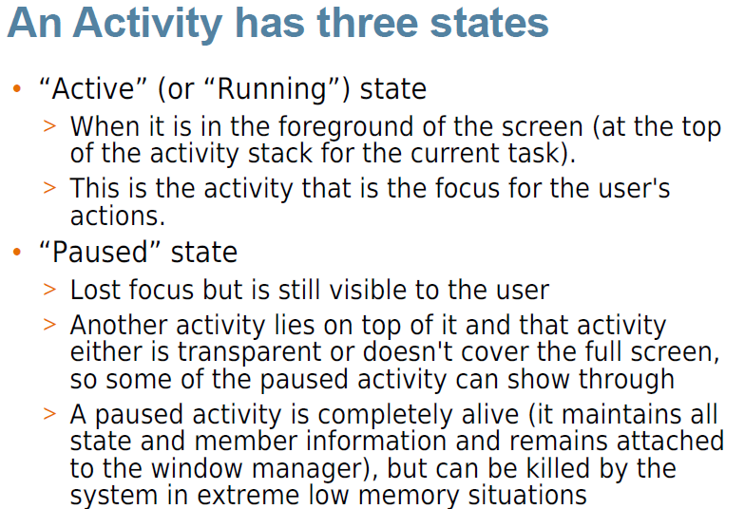
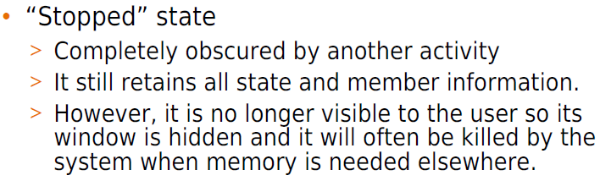

Slide 4
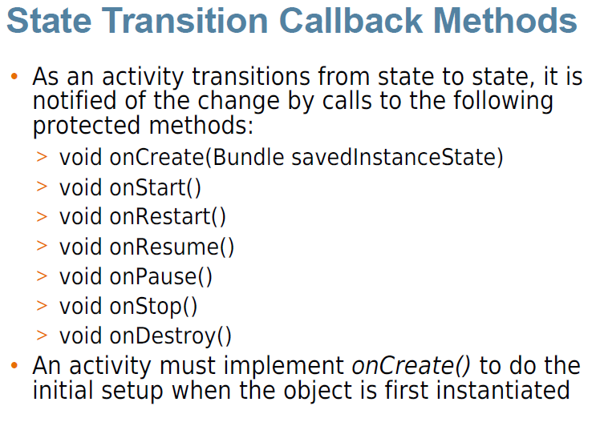

Slide 5
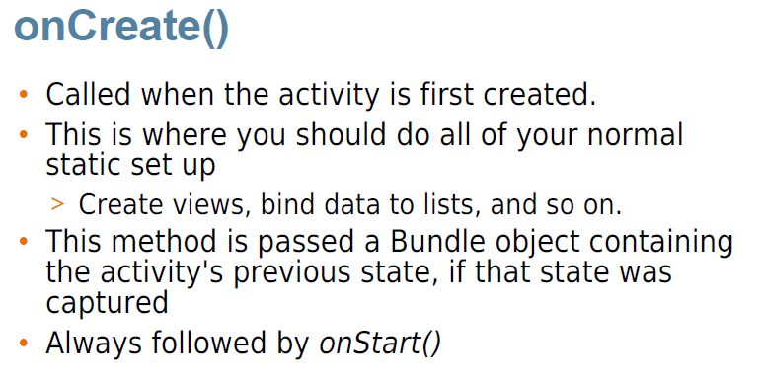

Slide 6
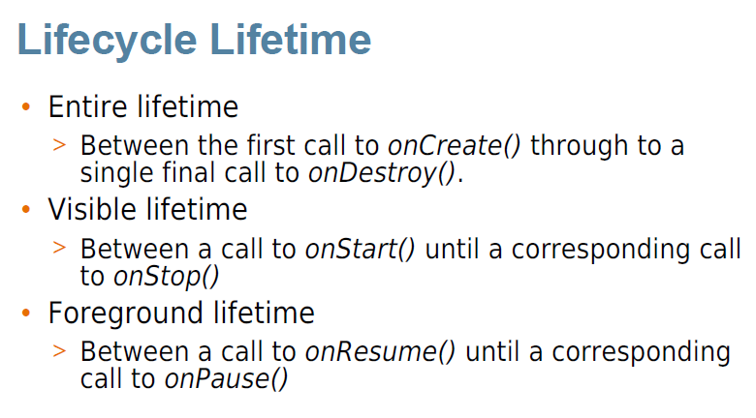

Slide 7
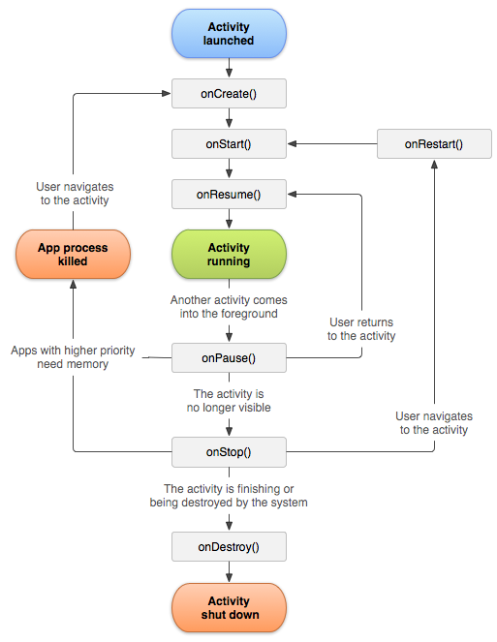
Activity Life Cycle
States of an Activity
“Active” (or “Running”) state
“Paused” state
“Stopped ” state [Killed by system]

Slide 8
