Slide 1
Application Components
Activities – visual user interface focused on a single thing a user can do
Services – no visual interface – they run in the background
Broadcast Receivers – receive and react to broadcast announcements
Content Providers – allow data exchange between applications

Slide 2
Activities
Basic component of most applications
Most applications have several activities that start each other as needed
Each is implemented as a subclass of the base Activity class

Slide 3
Activities – The View
Each activity has a default window to draw in (although it may prompt for dialogs or notifications)
The content of the window is a view or a group of views
Example of views: buttons, text fields, scroll bars, menu items, check boxes, etc.
View(Group) made visible via) method.

Slide 4
Services
Does not have a visual interface
Runs in the background indefinitely
Examples
Network Downloads
Playing Music
TCP/UDP Server
You can bind to a an existing service and control its operation

Slide 5
Broadcast Receivers
Receive and react to broadcast announcements
Extend the class BroadcastReceiver
Examples of broadcasts:
Low battery, power connected, shutdown, timezone changed, etc.
Other applications can initiate broadcasts

Slide 6
Content Providers
Makes some of the application data available to other applications
It’s the only way to transfer data between applications in Android (no shared files, shared memory, pipes, etc.)
Extends the class ContentProvider;
Other applications use a ContentResolver object to access the data provided via a ContentProvider

Slide 7
Intents
An intent is an Iobject with a message content.
Activities, services and broadcast receivers are started by intents. ContentProviders are started by ContentResolvers:
An activity is started by Context.startActivity(Intent intent) or Activity.startActivityForResult(Intent intent, int RequestCode)
A service is started by Context.startService(Intent service)
An application can initiate a broadcast by using an Intent in any of Context.sendBroadcast(Intent intent), Context.sendOrderedBroadcast(), and Context.sendStickyBroadcast()

Slide 8
Shutting down components
Activities
Can terminate itself via finish();
Can terminate other activities it started via finishActivity();
Services
Can terminate via stopSelf(); or Context.stopService();
Content Providers
Are only active when responding to ContentResolvers
Broadcast Receivers
Are only active when responding to broadcasts

Slide 9
Activity
What is activity?
An activity presents a visual user interface (screen) for one focused endeavor the user can undertake
Examples - Individual activity
A list of menu items users can choose from Display of photographs along with their captions
Example - Sequence of activities
A text messaging application might have one activity that shows a list of contacts to send messages to, a second activity to write the message to the chosen contact, and other activities to review old messages or change settings

Slide 10
How an Activity is Started?
An activity is started in two ways
startActivity(Intent intent) - Used when starting an activity (calling an activity) does not expect a result
startActivityForResult(Intent intent) - Used when starting activity expects a result from the started activity
The responding activity (started activity or target activity) can look at the initial intent that caused it to be launched by calling its getIntent() method.

Slide 11
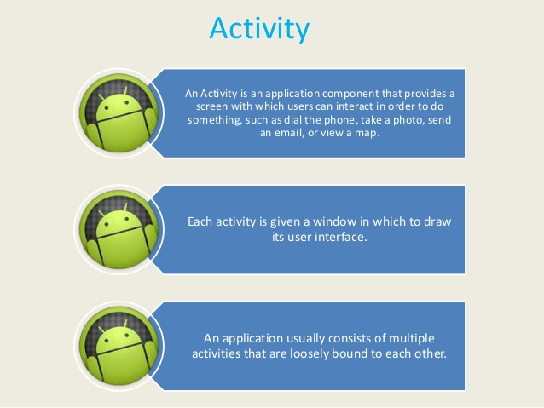

Slide 12
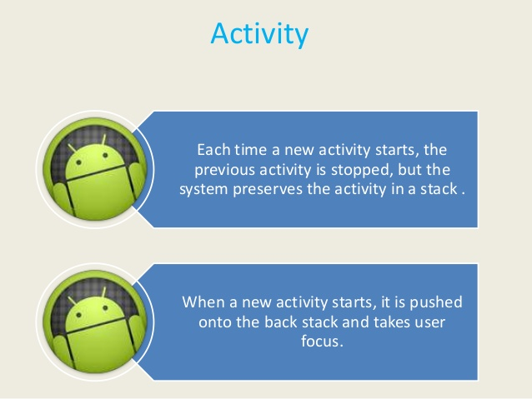

Slide 13
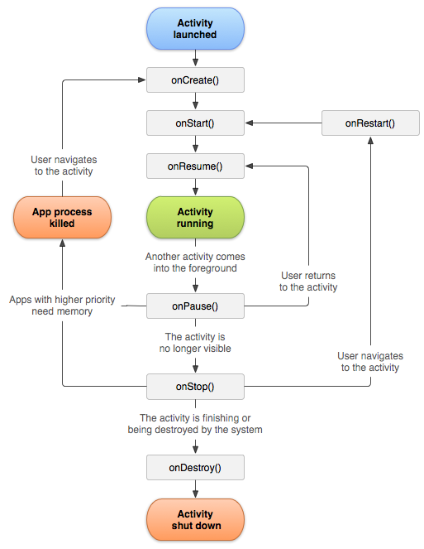
Activity Life Cycle
States of an Activity
“Active” (or “Running”) state
“Paused” state
“Stopped ” state [Killed by system]

Slide 14
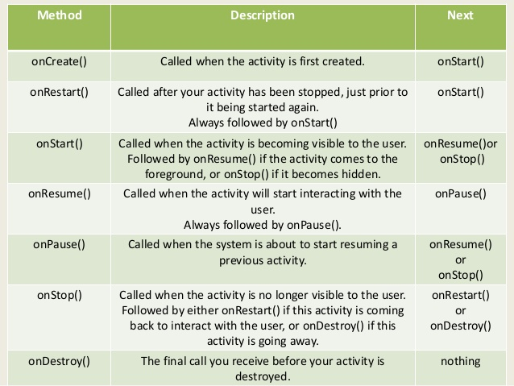

Slide 15
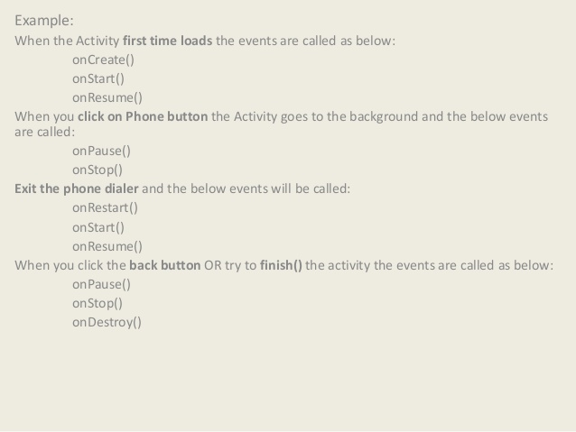

Slide 16
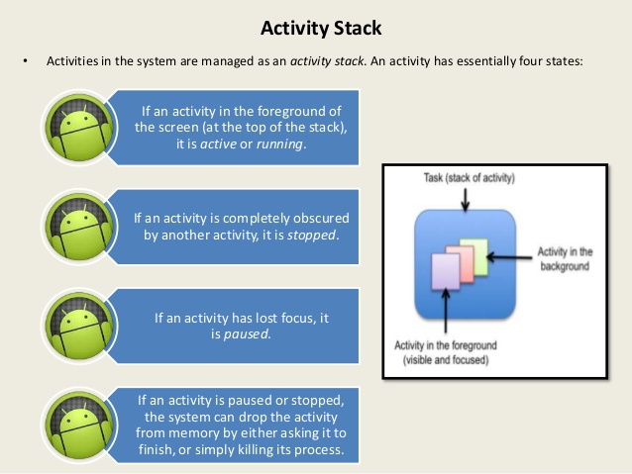

Slide 17
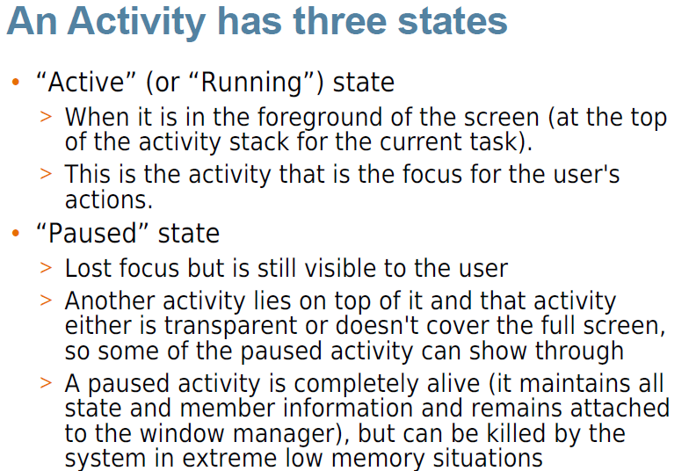
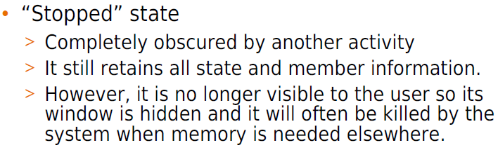

Slide 18
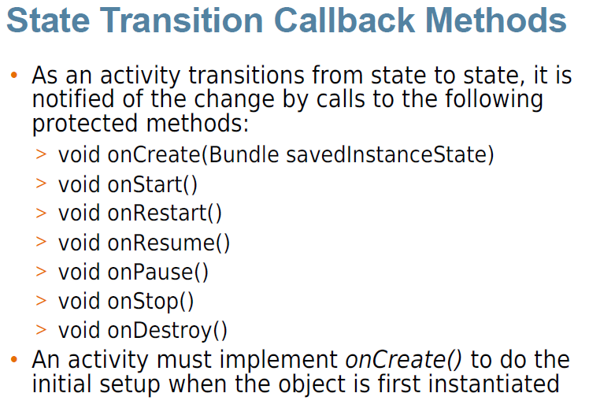

Slide 19
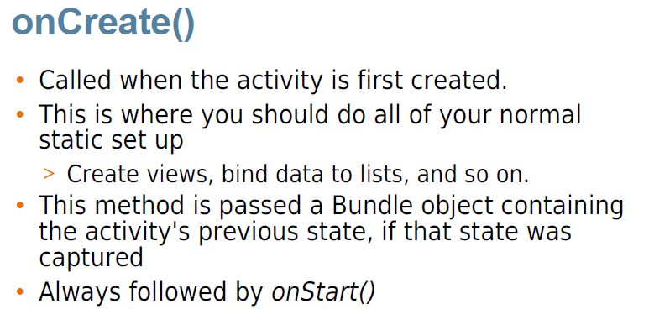

Slide 20
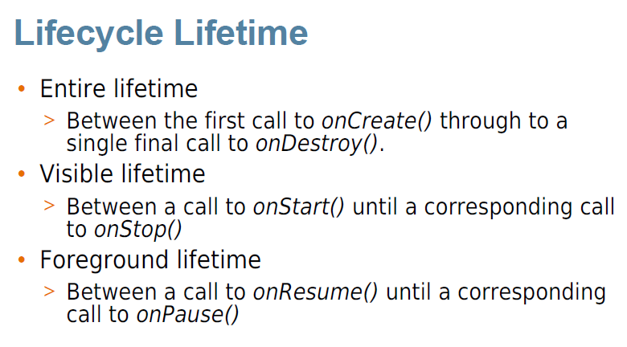

Slide 21
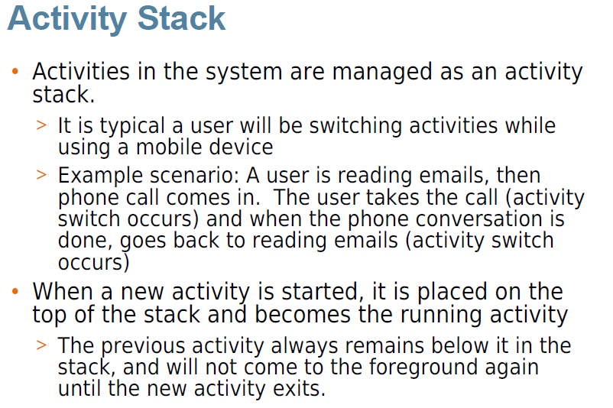

Slide 22
Activity Life Cycle Example
Java File
XML File

Slide 23
Activity Creation [ACT1]
Main Activity Java File
Main XML File
Second Activity Java File
Second XML File
String XML File
Manifest File

