Slide 1
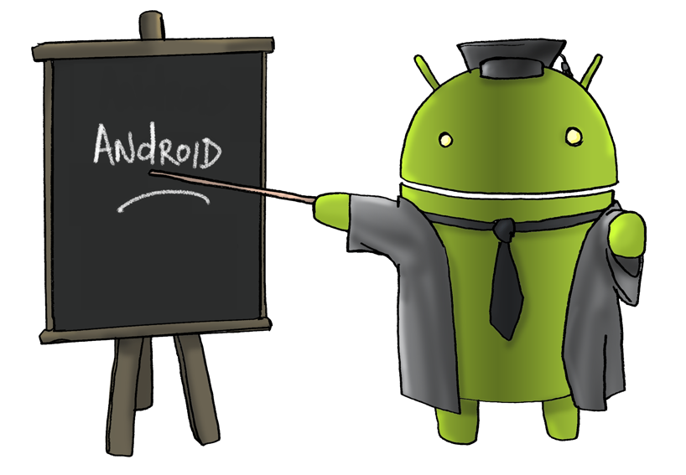
Intro to Android Development

Slide 2
ac·tiv·i·ty [ak-tiv-i-tee]
  noun, plural ac·tiv·i·ties.
  the state or quality of being active: There was not much activity in the stock market today. He doesn't have enough physical activity in his life.
  a specific deed, action, function, or sphere of action: social activities.
  work, especially in elementary grades at school, that involves direct experience by the student rather than textbook study.
  energetic activity; animation; liveliness.
  a use of energy or force; an active movement or operation.
    from http://dictionary.reference.com/browse/activity

Slide 3
Definition: Activity
Activity
  “An application usually consists of multiple activities that are loosely bound to each other.
  Typically, one activity in an application is specified as the "main" activity, which is presented to the user when launching the application for the first time.
  Each activity can then start another activity in order to perform different actions.”
    developer.android.com/guide/components/activities.html

Slide 4
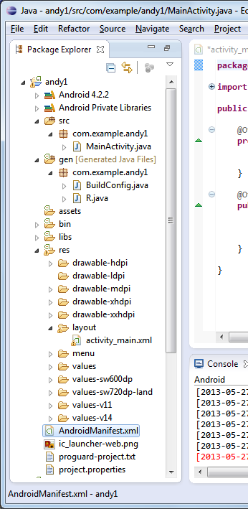
Creating a new Android Application Project using Eclipse
File --> New --> Project… --> Android --> Android Application Project

Slide 5
Definition: Activity
Activity
  “An Activity is an application component that provides a screen with which users can interact in order to do something, such as dial the phone, take a photo, send an email, or view a map.
  Each activity is given a window in which to draw its user interface.
  The window typically fills the screen, but may be smaller than the screen and float on top of other windows.”
    Ibid. (That’s fancy! I’m working on using op. cit.)

Slide 6
Creating a new Android Application Project using Eclipse
File --> New --> Project… --> Android --> Android Application Project

Slide 7
Definition: Activity
Activity
  “Each time a new activity starts, the previous activity is stopped, but the system preserves the activity in a stack (the "back stack").
  When a new activity starts, it is pushed onto the back stack and takes user focus.
  The back stack abides to the basic "last in, first out" stack mechanism, so, when the user is done with the current activity and presses the Back button, it is popped from the stack (and destroyed) and the previous activity resumes.”
    Ibid.

Slide 8
Creating a new Android Application Project using Eclipse
File --> New --> Project… --> Android --> Android Application Project

Slide 9
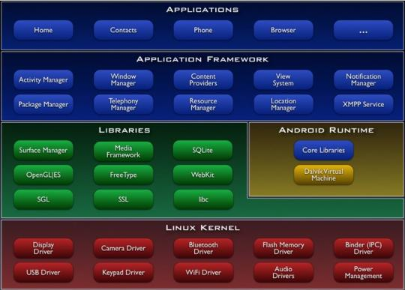


Slide 10
Layouts
AbsoluteLayout
DrawerLayout
FrameLayout
GridLayout
GridView
LinearLayout
ListView
RelativeLayout
SlidingPaneLayout
WebView

Slide 11
XML

Slide 12
xml – extensible markup language
Example:
  <?xml version="1.0" encoding="ISO-8859-1"?>
  <shiporder orderid="889923"
  xmlns:xsi="http://www.w3.org/2001/XMLSchema-instance"
  xsi:noNamespaceSchemaLocation="shiporder.xsd">
  <orderperson>John Smith</orderperson>
  <shipto name="Ola Nordmann"
  address="Langgt 23"
  city="4000 Stavanger"
  country="Norway“ />
  <item>
  <title>Empire Burlesque</title>
  <note>Special Edition</note>
  <quantity>1</quantity>
  <price>10.90</price>
  </item>
  <item>
  <title>Hide your heart</title>
  <quantity>1</quantity>
  <price>9.90</price>
  </item>
  </shiporder>
prolog

Slide 13
xml – extensible markup language
Example:
  <?xml version="1.0" encoding="ISO-8859-1"?>
  <shiporder orderid="889923"
  xmlns:xsi="http://www.w3.org/2001/XMLSchema-instance"
  xsi:noNamespaceSchemaLocation="shiporder.xsd">
  <orderperson>John Smith</orderperson>
  <shipto name="Ola Nordmann"
  address="Langgt 23"
  city="4000 Stavanger"
  country="Norway“ />
  <item>
  <title>Empire Burlesque</title>
  <note>Special Edition</note>
  <quantity>1</quantity>
  <price>10.90</price>
  </item>
  <item>
  <title>Hide your heart</title>
  <quantity>1</quantity>
  <price>9.90</price>
  </item>
  </shiporder>
start tag
end tag

Slide 14
xml – extensible markup language
Example:
  <?xml version="1.0" encoding="ISO-8859-1"?>
  <shiporder orderid="889923"
  xmlns:xsi="http://www.w3.org/2001/XMLSchema-instance"
  xsi:noNamespaceSchemaLocation="shiporder.xsd">
  <orderperson>John Smith</orderperson>
  <shipto name="Ola Nordmann"
  address="Langgt 23"
  city="4000 Stavanger"
  country="Norway“ />
  <item>
  <title>Empire Burlesque</title>
  <note>Special Edition</note>
  <quantity>1</quantity>
  <price>10.90</price>
  </item>
  <item>
  <title>Hide your heart</title>
  <quantity>1</quantity>
  <price>9.90</price>
  </item>
  </shiporder>
tags w/ contents:
item tag has contents.
title, note, quantity, and price tags also have contents.

Slide 15
xml – extensible markup language
Example:
  <?xml version="1.0" encoding="ISO-8859-1"?>
  <shiporder orderid="889923"
  xmlns:xsi="http://www.w3.org/2001/XMLSchema-instance"
  xsi:noNamespaceSchemaLocation="shiporder.xsd">
  <orderperson>John Smith</orderperson>
  <shipto name="Ola Nordmann"
  address="Langgt 23"
  city="4000 Stavanger"
  country="Norway“ />
  <item>
  <title>Empire Burlesque</title>
  <note>Special Edition</note>
  <quantity>1</quantity>
  <price>10.90</price>
  </item>
  <item>
  <title>Hide your heart</title>
  <quantity>1</quantity>
  <price>9.90</price>
  </item>
  </shiporder>
empty tag (no end tag).

Slide 16
xml – extensible markup language
Example:
  <?xml version="1.0" encoding="ISO-8859-1"?>
  <shiporder orderid="889923"
  xmlns:xsi="http://www.w3.org/2001/XMLSchema-instance"
  xsi:noNamespaceSchemaLocation="shiporder.xsd">
  <orderperson>John Smith</orderperson>
  <shipto name="Ola Nordmann"
  address="Langgt 23"
  city="4000 Stavanger"
  country="Norway“ />
  <item>
  <title>Empire Burlesque</title>
  <note>Special Edition</note>
  <quantity>1</quantity>
  <price>10.90</price>
  </item>
  <item>
  <title>Hide your heart</title>
  <quantity>1</quantity>
  <price>9.90</price>
  </item>
  </shiporder>
attribute name
attribute value

Slide 17
xml – extensible markup language
Example:
  <?xml version="1.0" encoding="ISO-8859-1"?>
  <shiporder orderid="889923"
  xmlns:xsi="http://www.w3.org/2001/XMLSchema-instance"
  xsi:noNamespaceSchemaLocation="shiporder.xsd">
  <orderperson>John Smith</orderperson>
  <shipto name="Ola Nordmann"
  address="Langgt 23"
  city="4000 Stavanger"
  country="Norway“ />
  <item>
  <title>Empire Burlesque</title>
  <note>Special Edition</note>
  <quantity>1</quantity>
  <price>10.90</price>
  </item>
  <item>
  <title>Hide your heart</title>
  <quantity>1</quantity>
  <price>9.90</price>
  </item>
  </shiporder>
Note: The shiporder tag has both attributes and contents.

Slide 18
XML AND LAYOUTS

Slide 19
Linear layout example
developer.android.com/training/basics/firstapp/building-ui.html
File --> New --> Project…
  Choose Android --> Android Application Project
  Edit res/layout/activity_main.xml, and replace everything with the following:
    <?xml version="1.0" encoding="utf-8"?>
    <LinearLayout xmlns:android="http://schemas.android.com/apk/res/android"
    xmlns:tools="http://schemas.android.com/tools"
    android:layout_width="match_parent"
    android:layout_height="match_parent"
    android:orientation="horizontal" >
    </LinearLayout>

Slide 20

Linear layout example
Next, add a text field and a button:
  <?xml version="1.0" encoding="utf-8"?>
  <LinearLayout xmlns:android="http://schemas.android.com/apk/res/android"
  xmlns:tools="http://schemas.android.com/tools"
  android:layout_width="match_parent"
  android:layout_height="match_parent"
  android:orientation="horizontal">
  <EditText android:id="@+id/edit_message"
  android:layout_weight="1"
  android:layout_width="0dp"
  android:layout_height="wrap_content"
  android:hint="@string/edit_message" />
  <Button
  android:layout_width="wrap_content"
  android:layout_height="wrap_content"
  android:text="@string/button_send" />
  </LinearLayout>
+ automatically creates a new resource ID (in gen/R.java) for edit_message.
Refer to existing string resources (that we’ll create in the following slide).

Slide 21
Linear layout example
Next, modify res/values/strings.xml to be similar to the following:
  <?xml version="1.0" encoding="utf-8"?>
  <resources>
  <string name="app_name">My First App</string>
  <string name="edit_message">Enter a message</string>
  <string name="button_send">Send</string>
  <string name="action_settings">Settings</string>
  <string name="title_activity_main">MainActivity</string>
  </resources>

Slide 22
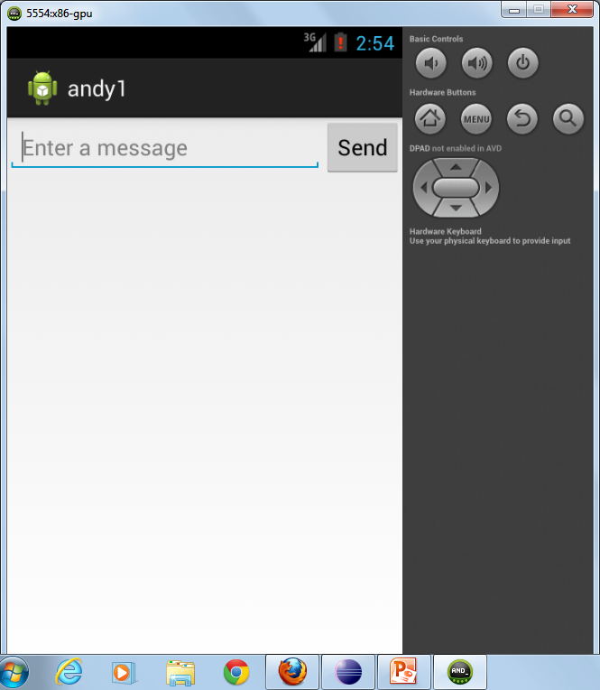

Slide 23
SETTING UP THE ANDROID DEVELOPMENT ENVIRONMENT

Slide 24
Setup on PC
Install eclipse + android (see http://developer.android.com/sdk/index.html).
  Instructions are there if eclipse is already installed.
Enable virtualization in BIOS.
  On a Lenovo T510, press F1 when you see the “ThinkVantage” message.

Slide 25
Setup on PC
Two ways to run Android apps:
  Create a virtual device.
    Note: It takes some time for the emulator to start. So don’t close it once it starts! (Use the ‘back’ button to stop you application.)
  Use a real android device.

Slide 26
Setup on PC for Galaxy
Install the Android USB driver for Samsung.
  First, install Samsung Kies software.
    This will take some time (~1 hour).
    Then it will update itself again.
  Then plug in the Galaxy; your laptop will install a number of drivers.
  If all is well, when you run adb devices on your laptop, you will see your device listed.

Slide 27
Steps to run your Android application
Right-click on the name of your project in the Project Explorer pane.
Choose your Android device (or virtual device). (See next slide.)

Slide 28
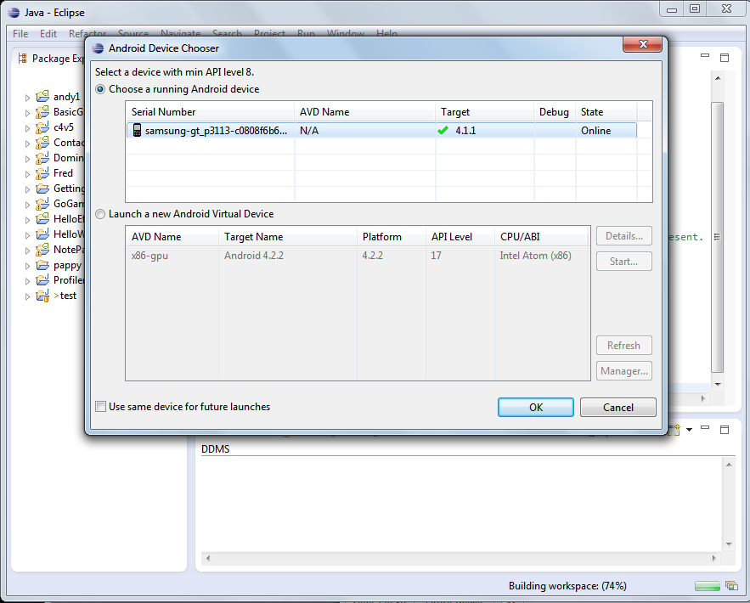
Setup

Slide 29
Setup on Android device
Setting --> Security --> Unknown source
  Make sure it’s checked.
Settings --> Developer options --> USB debugging
  Make sure it’s checked.

Slide 30

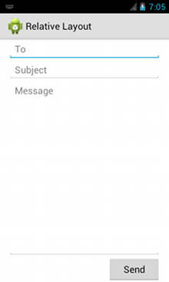
LinearLayout
<?xml version="1.0" encoding="utf-8"?>
<LinearLayout xmlns:android="http://schemas.android.com/apk/res/android"
android:layout_width="fill_parent"
android:layout_height="fill_parent"
android:paddingLeft="16dp"
android:paddingRight="16dp"
android:orientation="vertical" >
<EditText
android:layout_width="fill_parent"
android:layout_height="wrap_content"
android:hint="@string/to" />
<EditText
android:layout_width="fill_parent"
android:layout_height="wrap_content"
android:hint="@string/subject" />
<EditText
android:layout_width="fill_parent"
android:layout_height="0dp"
android:layout_weight="1"
android:gravity="top"
android:hint="@string/message" />
<Button
android:layout_width="100dp"
android:layout_height="wrap_content"
android:layout_gravity="right"
android:text="@string/send" />
</LinearLayout>
Relative Layout?
Typo?
Should be LinearLayout.

Slide 31

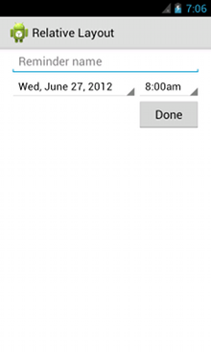
RelativeLayout
<?xml version="1.0" encoding="utf-8"?>
<RelativeLayout xmlns:android="http://schemas.android.com/apk/res/android"
android:layout_width="fill_parent"
android:layout_height="fill_parent"
android:paddingLeft="16dp"
android:paddingRight="16dp" >
<EditText
android:id="@+id/name"
android:layout_width="fill_parent"
android:layout_height="wrap_content"
android:hint="@string/reminder" />
<Spinner
android:id="@+id/dates"
android:layout_width="0dp"
android:layout_height="wrap_content"
android:layout_below="@id/name"
android:layout_alignParentLeft="true"
android:layout_toLeftOf="@+id/times" />
<Spinner
android:id="@id/times"
android:layout_width="96dp"
android:layout_height="wrap_content"
android:layout_below="@id/name"
android:layout_alignParentRight="true" />
<Button
android:layout_width="96dp"
android:layout_height="wrap_content"
android:layout_below="@id/times"
android:layout_alignParentRight="true"
android:text="@string/done" />
</RelativeLayout>

Slide 32
Comments about layouts
Layouts may be nested/hierarchical.
See http://www.learn-android.com/2010/01/05/android-layout-tutorial/ for a layout tutorial.

Slide 33
HOW TO LOG MESSAGES FOR DEBUGGING

Slide 34
Writing to the log
import android.util.Log;
…
Log.v( "andy1", "MainActivity.sendMessage: hello" );
d – debug
e – error
i – information
v – verbose
w – warning

Slide 35
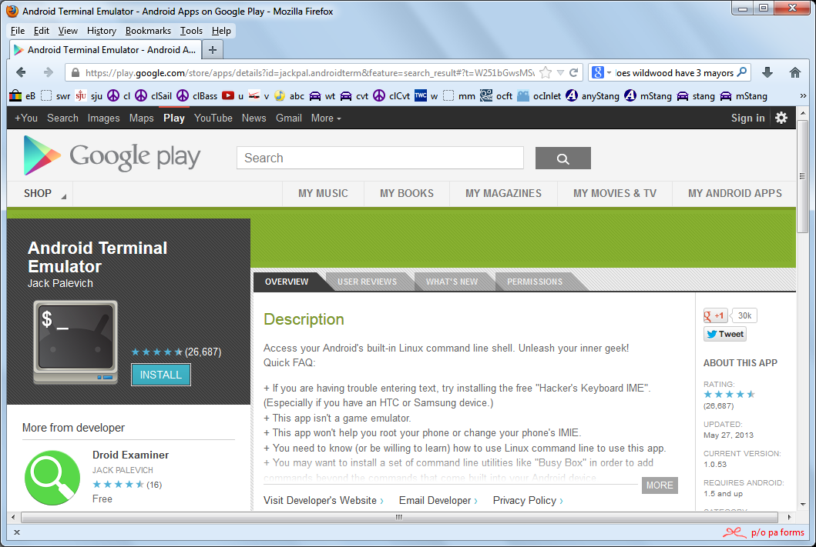
Accessing the log file on an Android device
Install an Android terminal emulator app.

Slide 36
Accessing the log file on an Android device
Install an Android terminal emulator app.
Run the terminal emulator and enter:
  adb logcat (show & wait for new messages)
  adb logcat –v (clear log file & exit)
  adb logcat ActivityManager:I
  (only show log messages from ActivityManager at level I (info) or above)

Slide 37
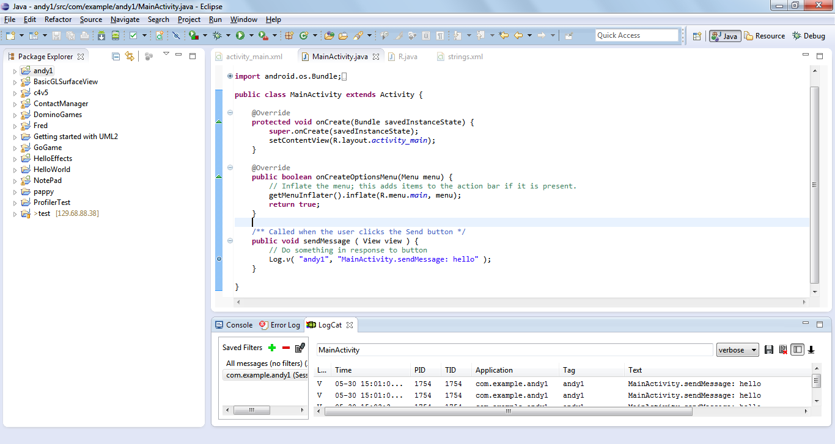
Accessing the log file on the emulator

Slide 38
BACK TO OUR BUTTON

Slide 39
Responding to a Send button press
Specify the function to be called when the button is pressed.
  Edit activity_main.xml.
  Add the following to Button:
    android:onClick="sendMessage"

Slide 40
Responding to the Send button press
Add the following to MainActivity.java:
  import android.util.Log;
  import android.view.View;
  …
  /** Called when the user clicks the Send button */
  public void sendMessage ( View view ) {
  // Do something in response to button
  Log.v( "andy1", "MainActivity.sendMessage: hello" );
  }

Slide 41
DOING SOMETHING MORE THAN LOGGING A MESSAGE

Slide 42
in·tent [in-tent]
  noun
  something that is intended; purpose; design; intention: The original intent of the committee was to raise funds.
  the act or fact of intending, as to do something: criminal intent.
  Law. the state of a person's mind that directs his or her actions toward a specific object.
  meaning or significance.
    from http://dictionary.reference.com/browse/intent

Slide 43
Definition: Intent
Intent
  “An Intent is an object that provides runtime binding between separate components (such as two activities).
  The Intent represents an app’s "intent to do something.“
  You can use intents for a wide variety of tasks, but most often they’re used to start another activity.”
    http://developer.android.com/training/basics/firstapp/starting-activity.html

Slide 44
Let’s modify sendMessage to send an Intent to a new Activity.
But first, let’s create the new Activity.
  File --> New --> Other…
  Android --> Android Activity
  Next
  Blank Activity
  Next
  Use the Activity Name: DisplayMessageActivity
  Use the Hierarchical Parent: com.example.andy1.MainActivity

Slide 45
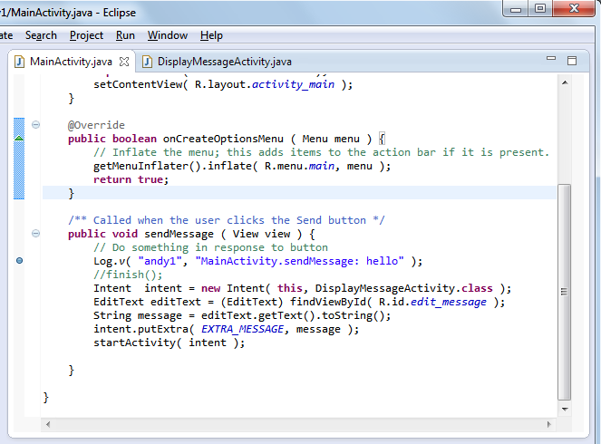
The intent that we create and pass to the new activity contains information (in this case, the text that was input by the user before the button was pressed).
It also specifies the new activity to receive the intent.

Slide 46
Note:
Define EXTRA_MESSAGE in MainActivity as follows:
  public final static String EXTRA_MESSAGE = "com.example.andy1.extra_message";

Slide 47
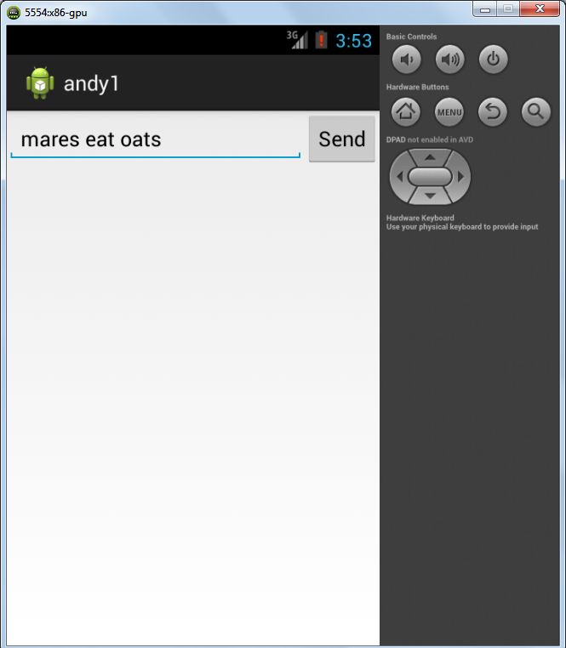

Slide 48
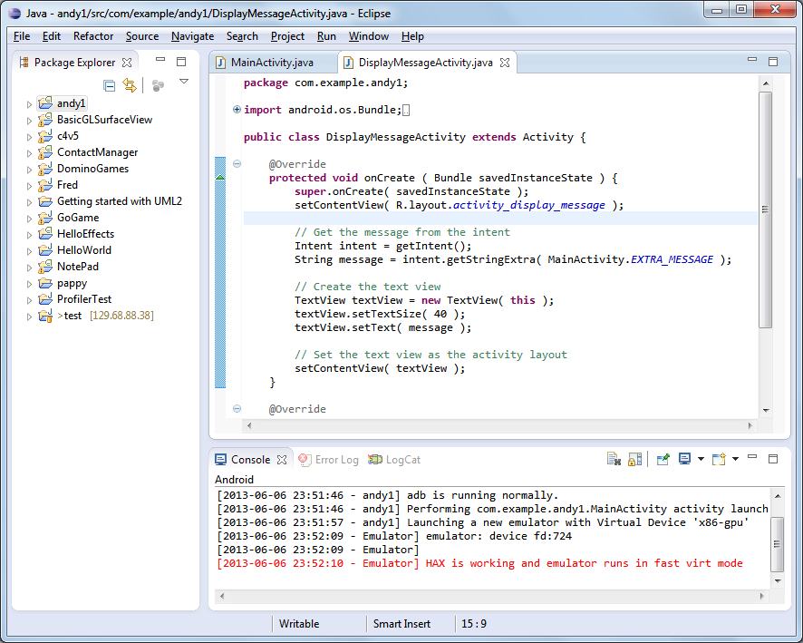
The new activity retrieves the information from the intent.

Slide 49
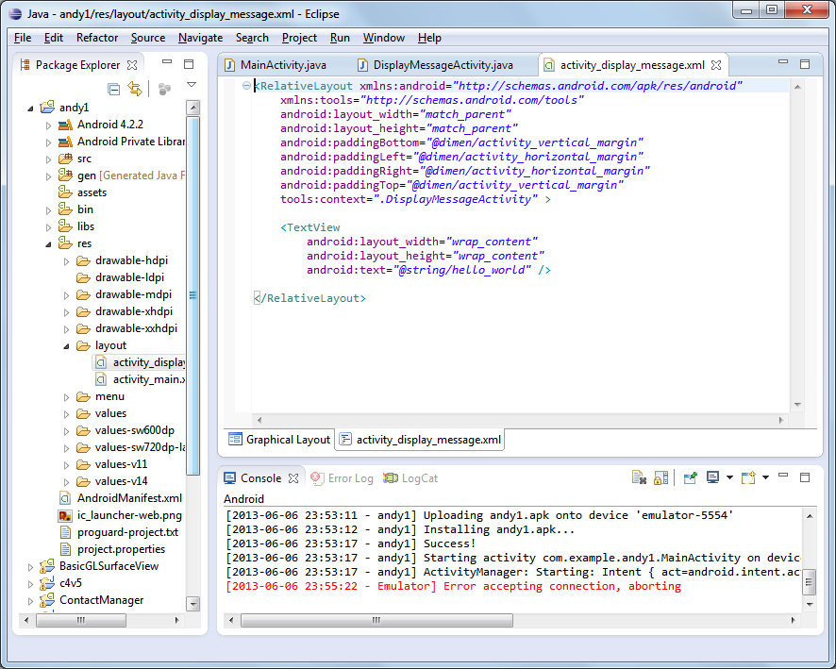
This is the new layout for the new activity.

Slide 50
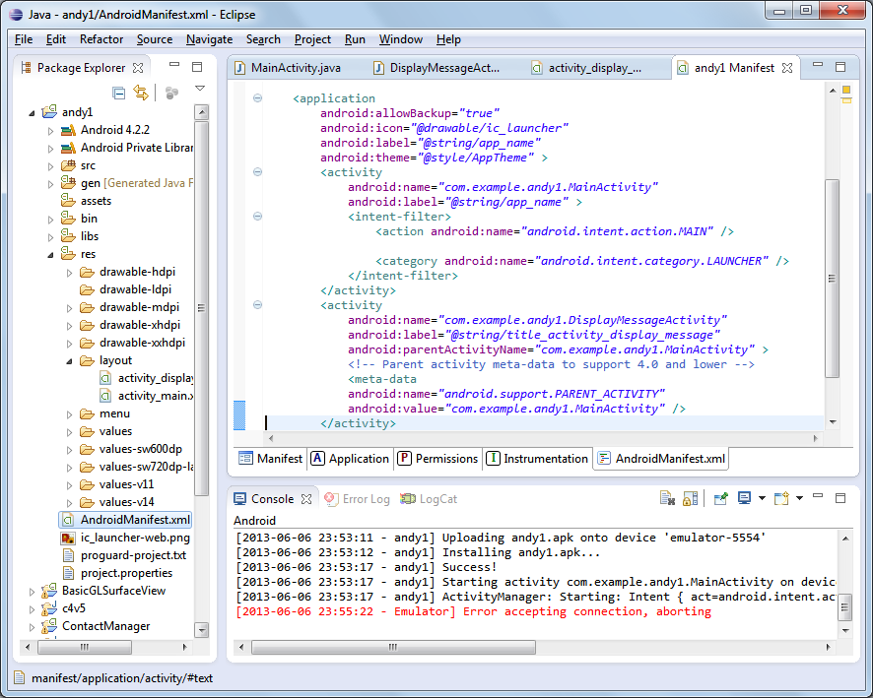
The manifest lists and contains information about all of the activities in the application.

Slide 51
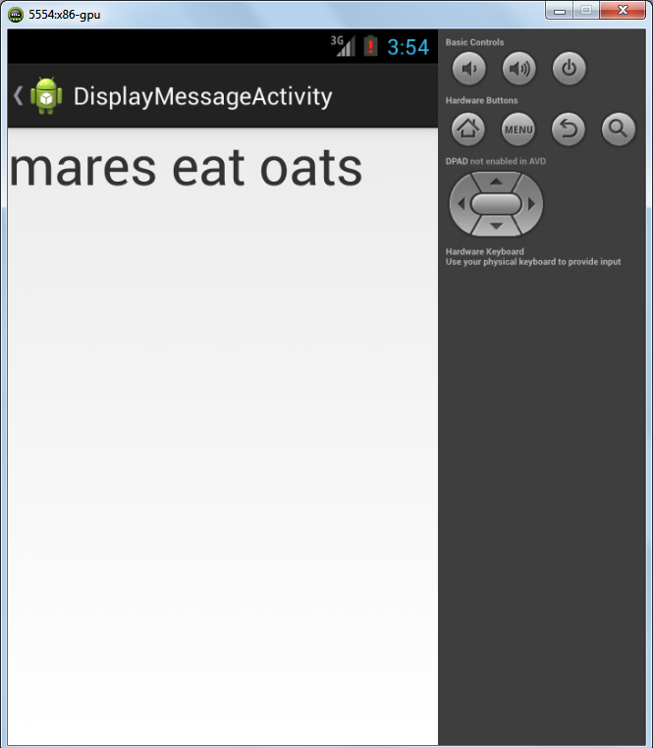
The new activity retrieves and displays the message that was sent to it in the intent.

Slide 52
ANDROID WIDGETS

Slide 53
Android widget classes
More than 100!
  See http://developer.android.com/reference/android/widget/package-summary.html.
Button
EditText
ImageButton
ImageView
NumberPicker
PopupMenu
RadioButton, RadioGroup
Toast
ToggleButton

Slide 54
LAYOUT EDITOR

Slide 55
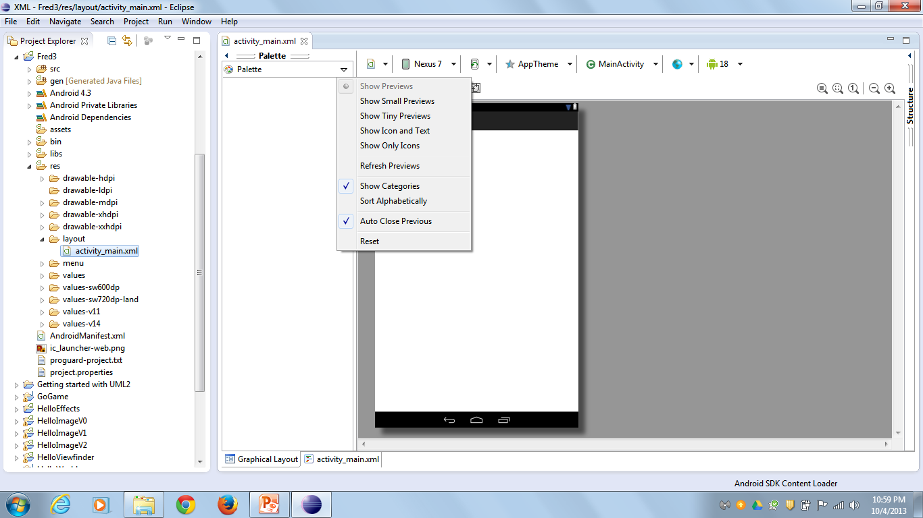
Palette contents disappear when Show Previews is selected (default)

Slide 56
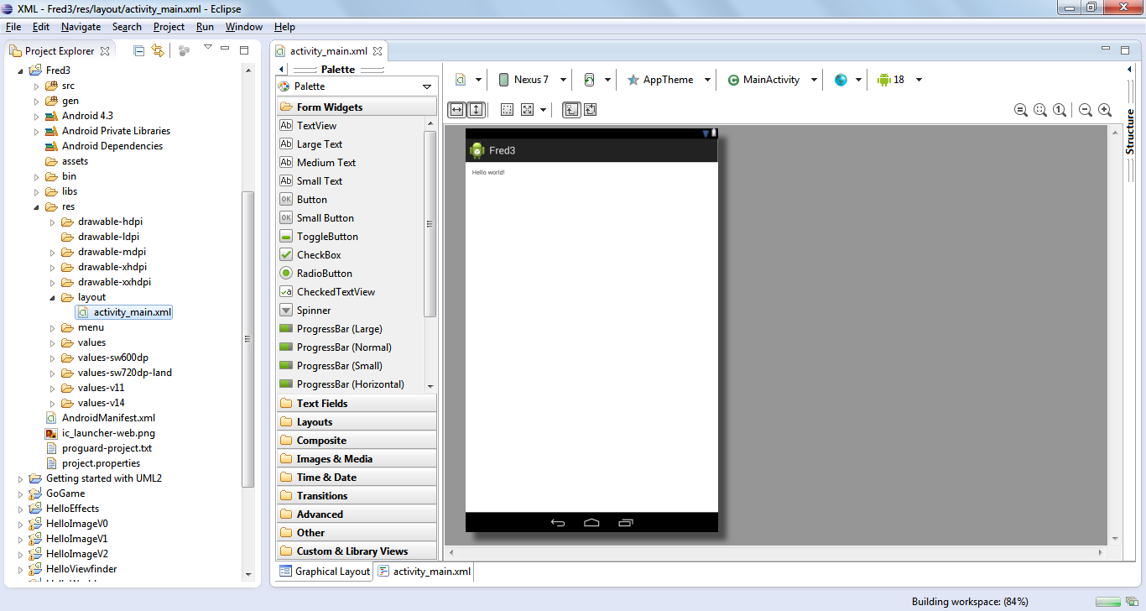

Slide 57
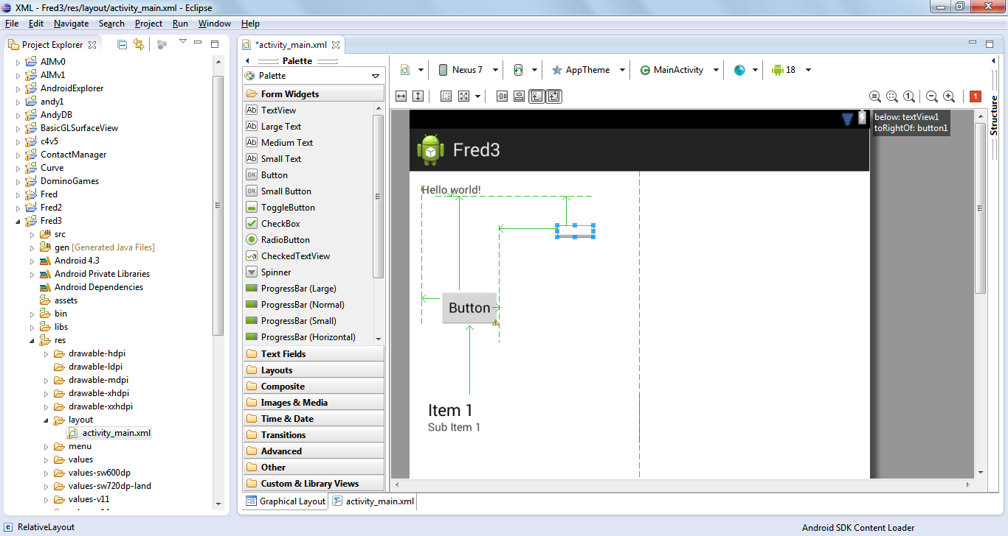

Slide 58
Summary
Activity
  http://developer.android.com/reference/android/app/Activity.html
Intent
  http://developer.android.com/reference/android/content/Intent.html

Slide 59


Slide 60
References
developer.android.com/guide/topics/ui/declaring-layout.html
developer.android.com/guide/topics/ui/layout/linear.html; developer.android.com/reference/android/widget/LinearLayout.html
developer.android.com/guide/topics/ui/layout/relative.html; developer.android.com/reference/android/widget/RelativeLayout.html
developer.android.com/guide/webapps/webview.html; developer.android.com/reference/android/webkit/WebView.html
developer.android.com/guide/topics/ui/layout/listview.html; http://developer.android.com/reference/android/widget/ListView.html
developer.android.com/guide/topics/ui/layout/gridview.html; http://developer.android.com/reference/android/widget/GridView.html
http://developer.android.com/tools/debugging/debugging-log.html
http://developer.android.com/reference/android/widget/package-summary.html
http://www.learn-android.com/2010/01/05/android-layout-tutorial/

