Slide 1
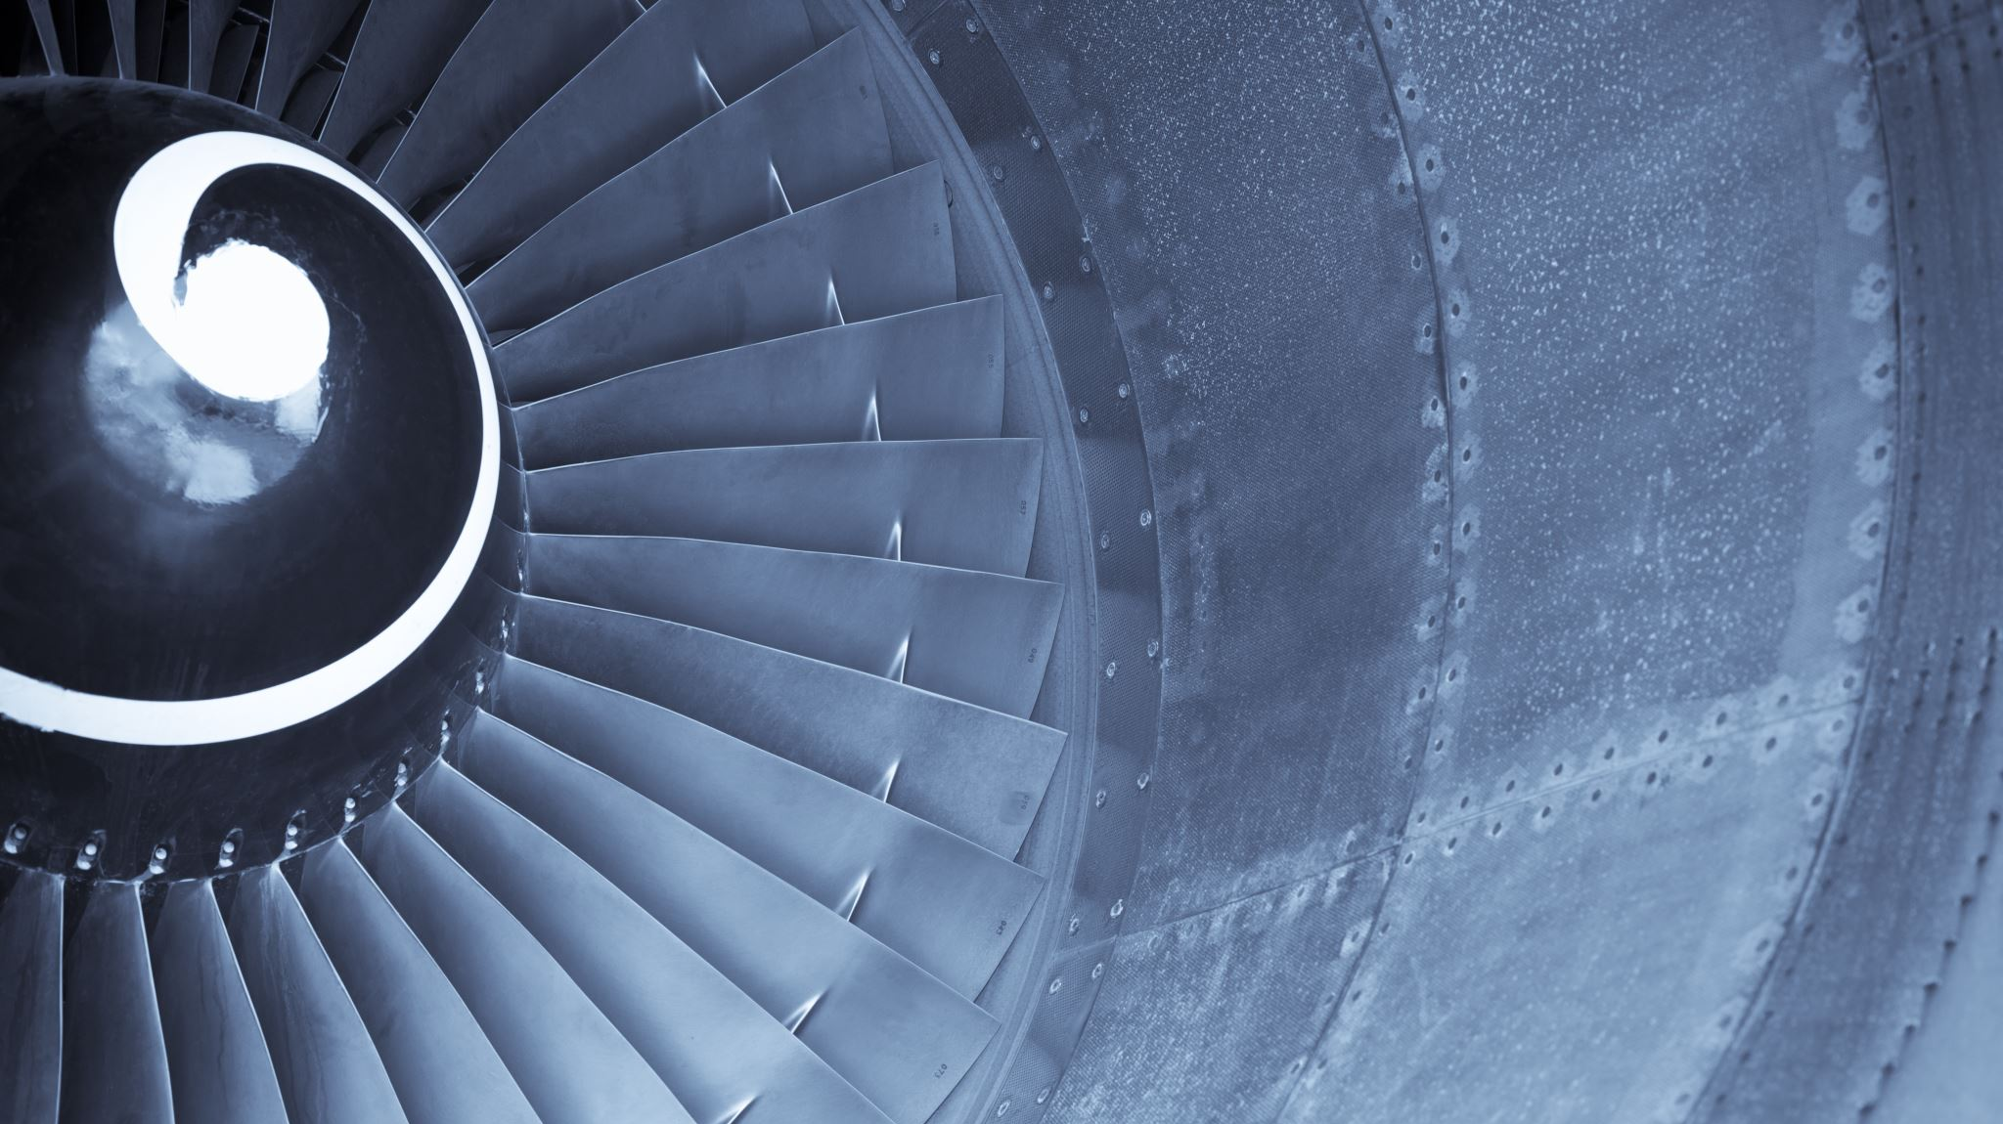


FYP INITIAL DEFENSE
Project Supervisor
Engr. Muhammad Nauman.
Group Members
M. Junaid Maqsood (01-132202-015)
M. Hassan Khan (01-132202-022)
M.Zain-ul-Abeedin (01-132202-035)

Slide 2
Predictive & Preventive Maintenance System

Slide 3

Contents
Background
Problem Statement
Objectives
Proposed Solution
Methodology
Timeline
Scope

Slide 4


Background
The turbofan jet engines are an important part of aircrafts, and their reliable performance is crucial for air travel.
Traditional maintenance approaches, such as scheduled or reactive maintenance, often result in suboptimal resource allocation, increased downtime, and higher maintenance costs.
However, there can be unexpected failures or malfunctions in engines which can cause many problems such as
Increased maintenance costs.
Compromised passenger safety.
Flight cancellations.
Substantial financial losses for airlines.

Slide 5
Problem Statement
In view of above given problems, There is a need for a system that calculates the remaining useful life (RUL) of turbofan jet engines and alert the maintenance officers to provide maintenance to required aircraft before any failure or malfunctions occur. Early maintenance can reduce maintenance costs and manufacturing costs as well as not compromise passenger safety.

Slide 6
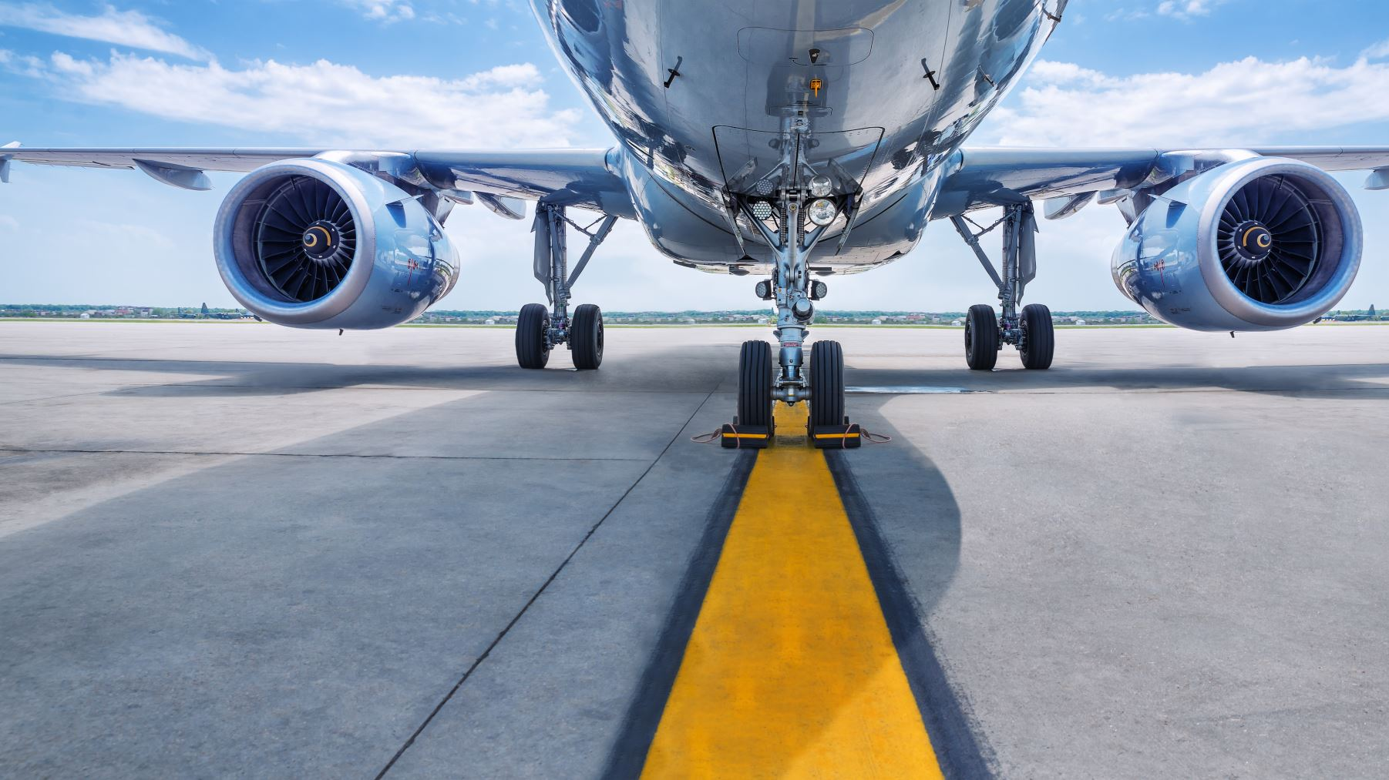
Objectives
Predict the remaining useful life (RUL) of turbofan engines.
Predict when an aircraft needs maintenance.
To achieve high accuracy.
Reduce maintenance costs.
Improve passenger safety.

Slide 7

Methodology
We use the following techniques:
Supervised and unsupervised learning.
Python IDE.
Using HTML, CSS and JavaScript or REACT to develop front end.

Slide 8

Timeline
Stage 1
June 2023 – July 2023): Project problem view, proposal preparation and defence.
Stage 2
July 2023 – September 2023): Literature Review, learning required concepts and installation of required tools.
Stage 3
September 2023 – November 2023): Performing pre-processing, feature engineering etc. on the dataset.
Stage 4
December 2023 – January 2024): Implementation and training of Deep Learning model used to predict RUL and maintenance time.
Stage 5
January 2024 – March 2024): Create front end for operator to check the statistics and when the maintenance is required.
Stage 6
March 2024 – May 2024): Final Research Document, Submission of Project, and Final Defence.

Slide 9

Scope
Can be used for maintaining different machines such as:
Aircraft for passenger safety.
Commercial Machines used in different Industries.
Hospital Equipment.
In networking fields for maintaining servers in warehouses.

Slide 10

Thank You!

