Slide 1

Background! Mistford is a mid-size city to the southwest of the Boonsong Lekagul Wildlife Preserve. The city has a small industrial area with four light-manufacturing endeavors. Mistford and the wildlife preserve are struggling with the possible endangerment of the RoseCrested Blue Pipit, a locally loved bird. The birdʼs nesting pairs seem to have decreased alarmingly

Slide 2
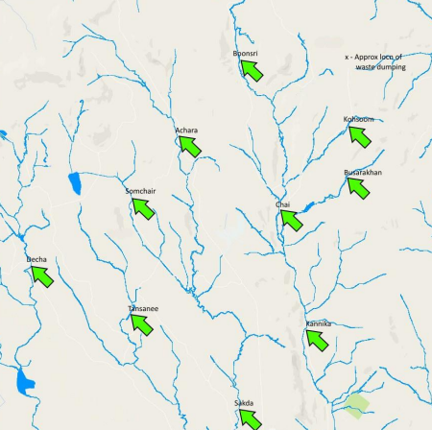
An investigation last year (VAST challenge 2017) indicated that the Kasios Office Furniture, a Mistford manufacturing firm, may be linked to this Though there is no firm evidence. Now the company insists that they have done nothing wrong. It is time for more visual analytics investigation
Goal- to find proof that either supports or refutes the company's claim that the RCBP is prospering across the preserve. Our technique entails the use of several visual studies to find spatiotemporal patterns.

Slide 3
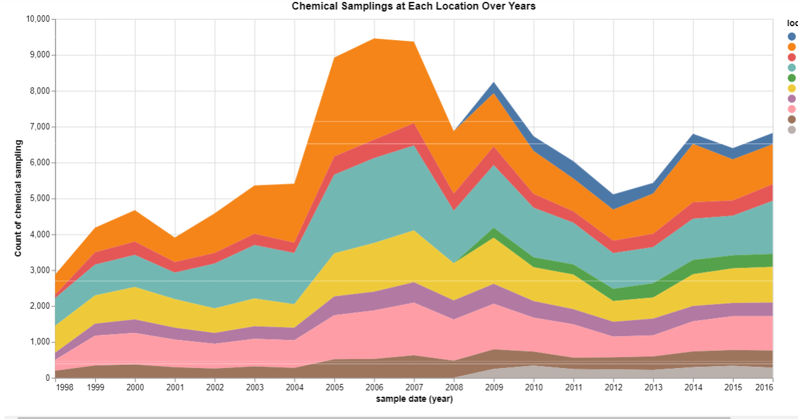
Uncertain issues finding 1.1
Discovery to find out the missing data for various locations over the years.

Slide 4
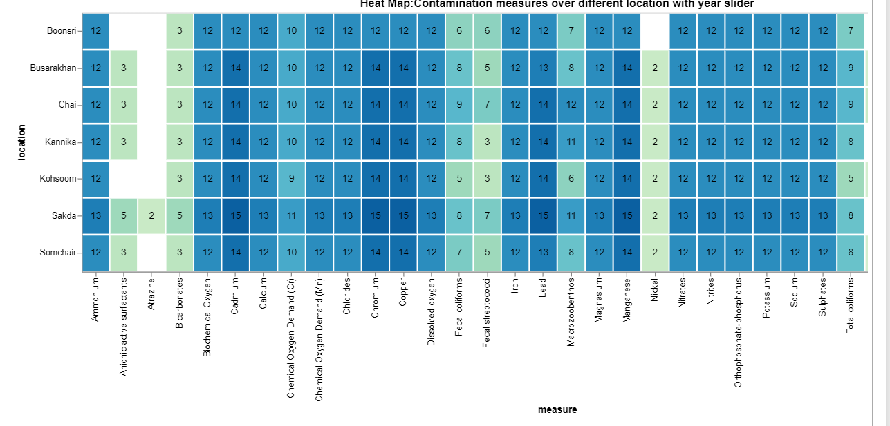
Discovered a trend in some locations whereby chemical counts increased and decreased in certain years resulting in identifying the trend and the missing values.
1998-2003

Slide 5
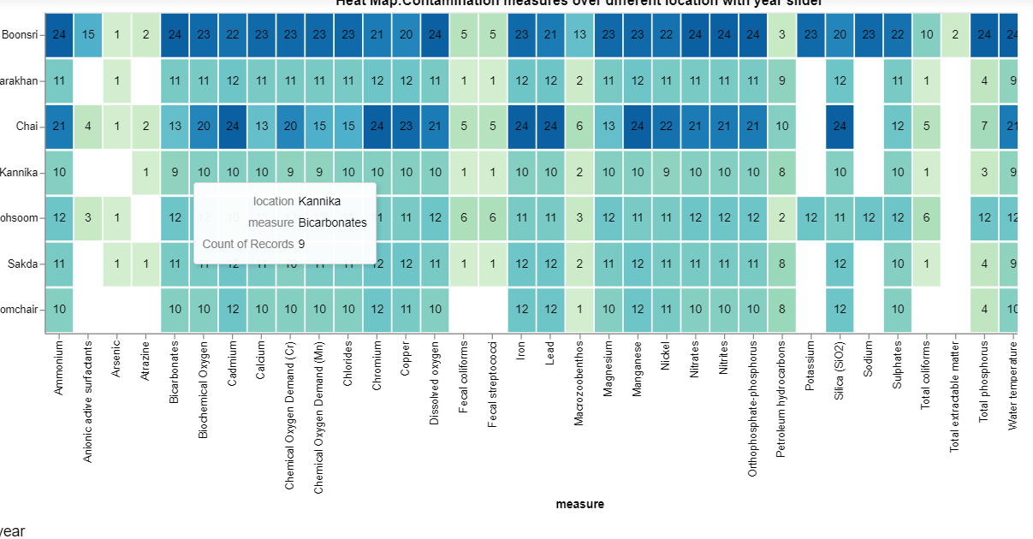
Year: 2004- 2007
Trend that from the year 2004 & 2005 the change in chemical count was rising drastically for a period of time

Slide 6
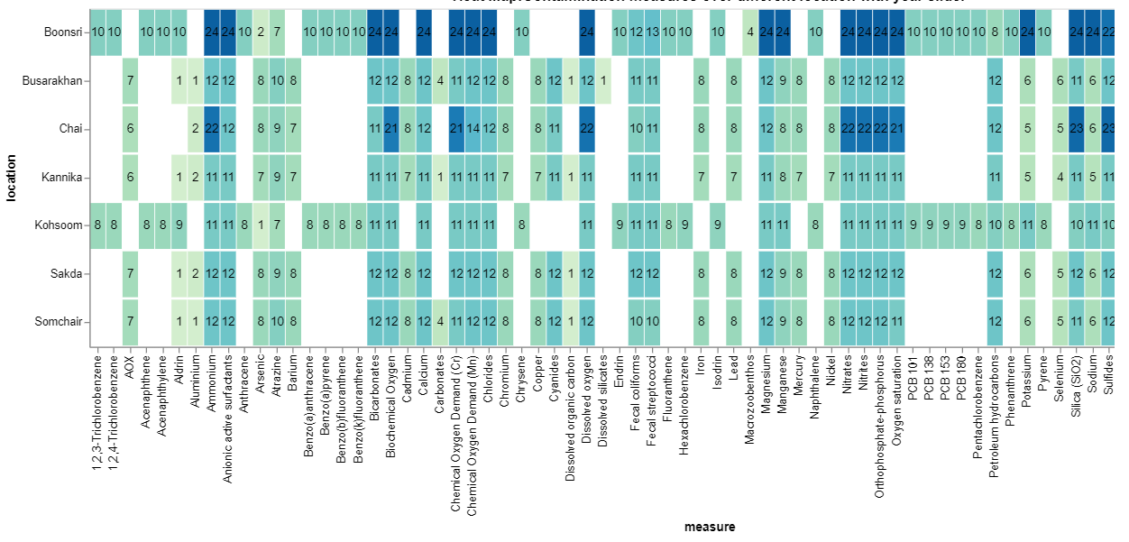
2008-2016
New chemicals being introduced and sampled.

Slide 7
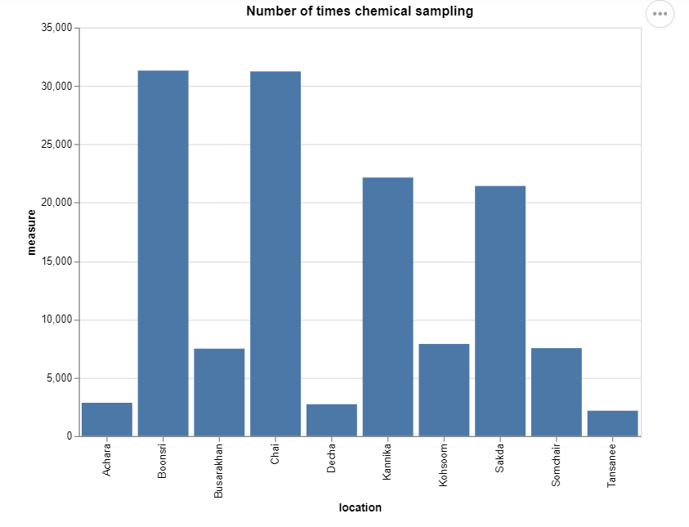
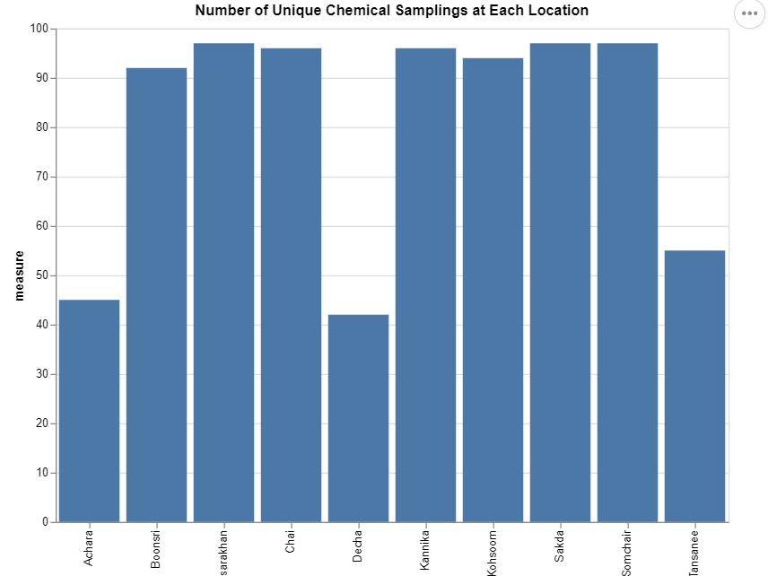
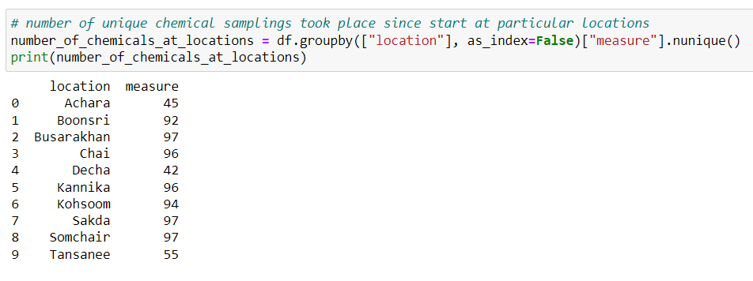
Change In collection Frequency
discover the number of times chemicals were counted at each location
discovered a trend in some locations whereby chemical counts are more in number while in some locations they are in less number resulting in identifying the trend.

Slide 8
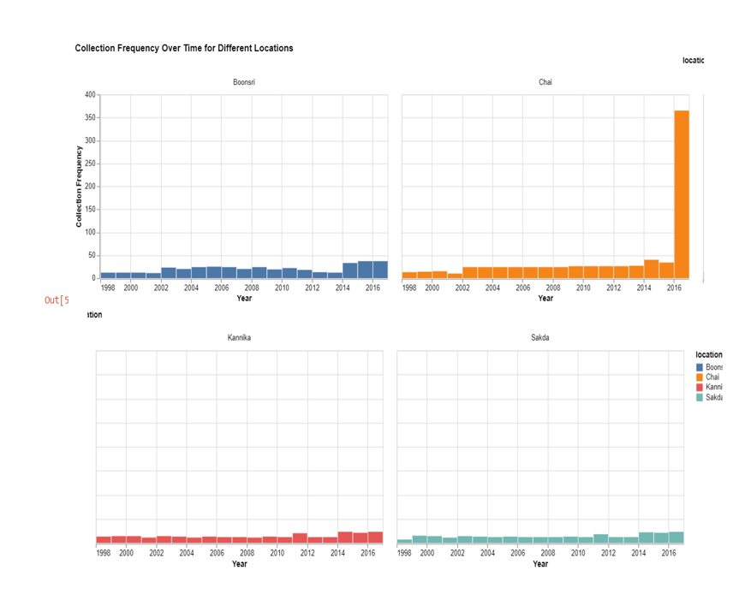
Distribution of the chemical/ sampling in different locations.
Analyse and visualise the change in collection frequency in different locations with the help of the bar chart.

Slide 9
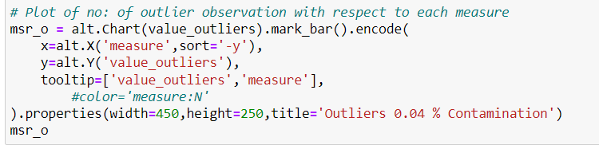
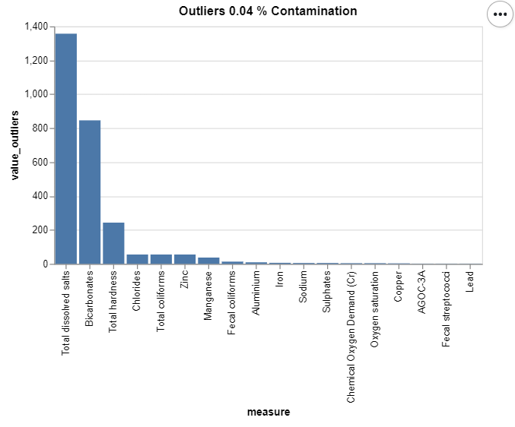
Unrealistic Values
which chemical was actually having the unexpected sudden difference in its count/values??

Slide 10
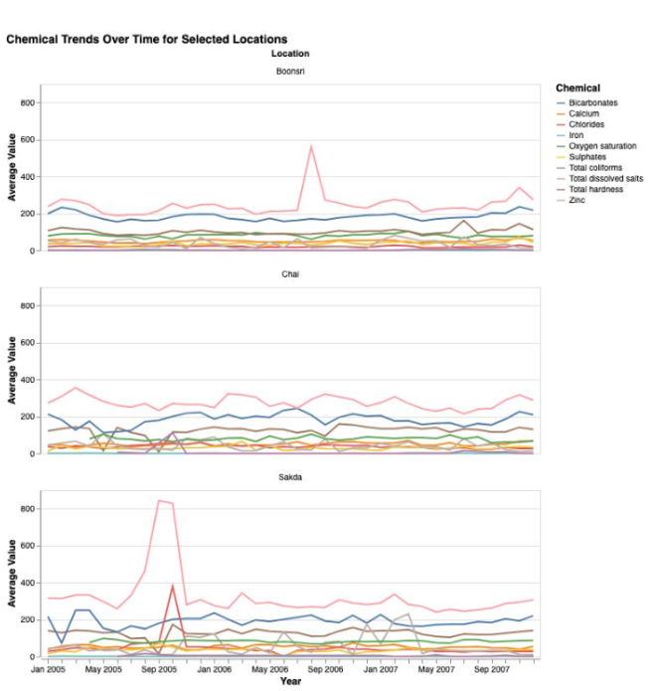
Finding 2.1- Trends
Trend w.r.t selected locations with the top impactful chemicals.

Slide 11
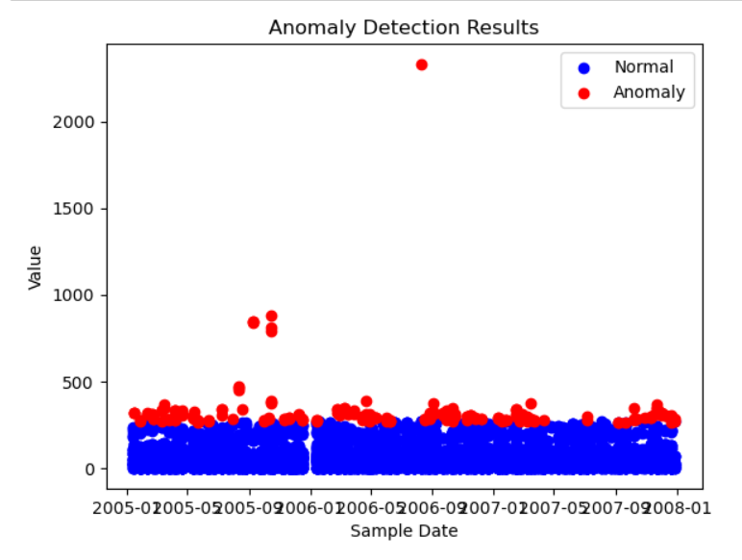
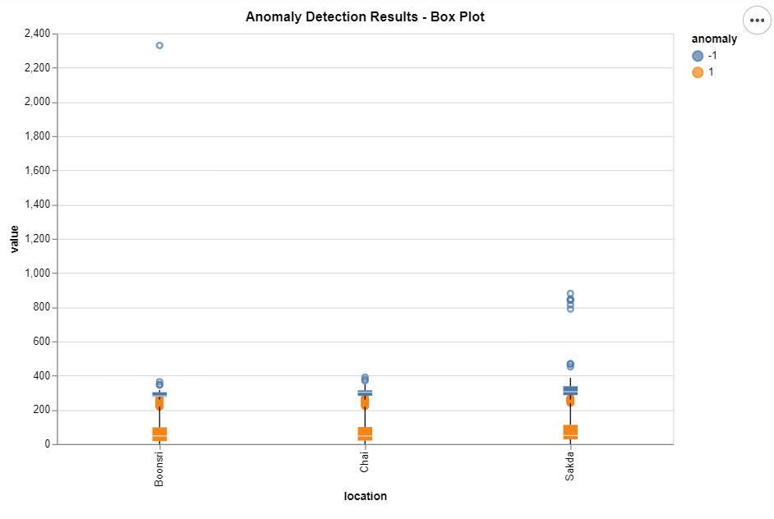
Finding 2.2- Detecting Anomalies
anomalies present in the dataset over a period of time, & location with respect to the chemical pollution.
Total dissolved salts, bicarbonate & total hardness falls as anomalies in the selected locations (Boonsri, Chai & Sakda) in huge counts.

Slide 12
Thank You

