Slide 1
Modeling of Electromagnetic Wave Propagation in NIM using FDTD Technique
Supervisor:
Attique Dawood
Group Member:
Muhammad Junaid Nasir (10-0361)

Slide 2
Problem Statement
To simulate and observe the behavior of Electromagnetic Waves specifically phenomenon of refraction when they pass through negative index materials
To use FDTD algorithm and modify it for negative index material simulations
Comparison of algorithm performance on different platforms

Slide 3
Introduction to NIM
Negative Index Materials (NIM) or Left Handed Material (LHM) is a material which has negative permeability and permittivity.
when a light enters from one medium to another with different refractive indices, it alters its path depending upon the difference between the refractive indices. (Refraction)
Naturally value of refractive index is always positive

Slide 4
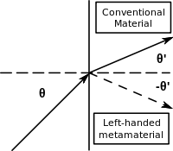
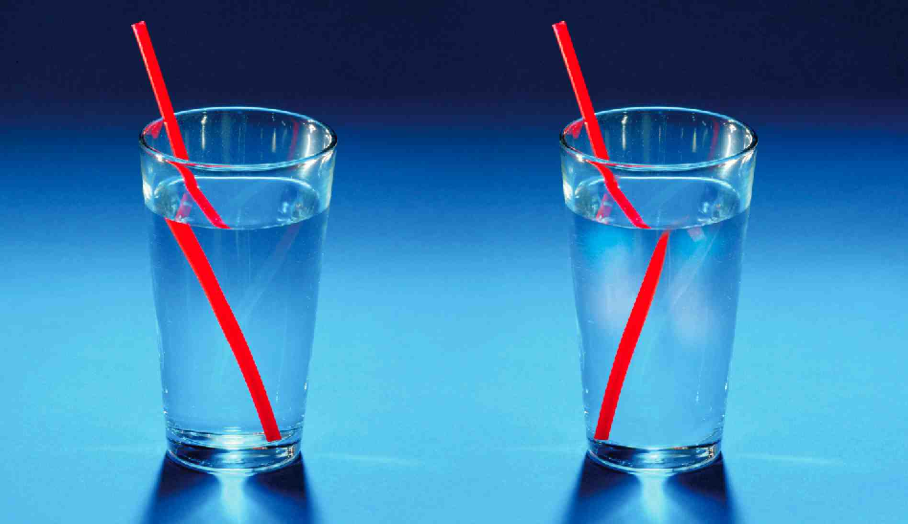

Slide 5
Deliverables
FYP 1
Learning FDTD technique
Implementation of FDTD algorithm in Matlab
Frequency domain analysis of medium
FYP 2
Analysis of EM wave in NIM
GPU implementation
Performance Analysis

Slide 6
TASK 1: FDTD Implementation on MATlab

Slide 7
Questions ?

Slide 8
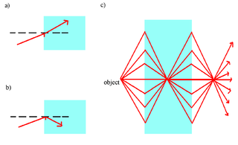
Applications of NIM
Superlense
Notes:
is a lens which uses metamaterials to go beyond the diffraction limit

