Slide 1
Modeling of Electromagnetic Wave Propagation in NIM using FDTD Technique
Supervisor:
Attique Dawood
Group Member:
Muhammad Junaid Nasir (10-0361)

Slide 2
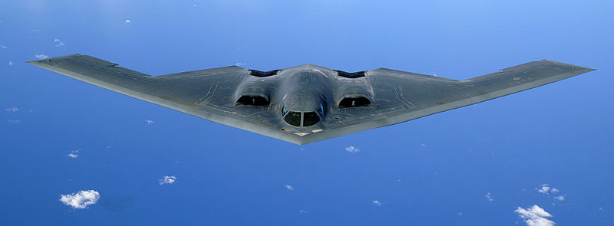
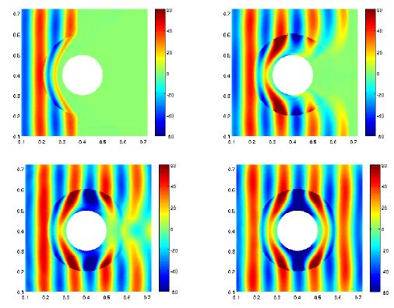
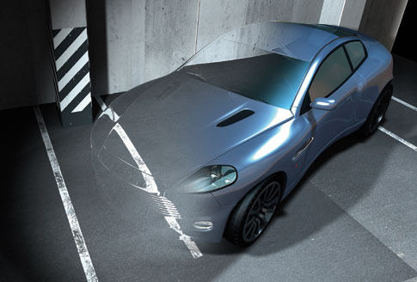
Introduction & motivation
Invisibility cloaking
Northrop Grumman B-2 Spirit
Image courtesy:
http://www.conservativerefocus.com/blog5.php/2012/01/05/scientists-say-event-cloaking-now-possible-materials-designed-to-adjust-speed-of-light-could-obscure-events
http://www.airforce-technology.com/projects/b2/
http://spectrum.ieee.org/semiconductors/metamaterials/
Notes:
Many earlier cloaking systems turned objects "invisible" only under wavelengths of light that the human eye can't see
40,000 lb (18 Tons) 150 tons total weight
1997. Undetectable in radar
Radar-absorbent material (RAM)

Slide 3
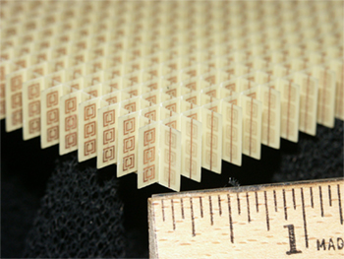
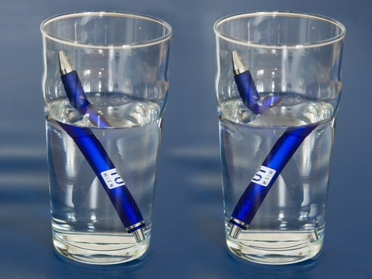
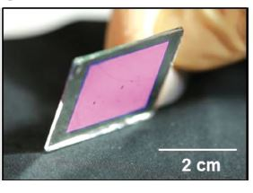
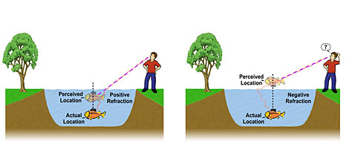
Negative Index Materials (NIM)
Negative Index Materials (NIM) or Left Handed Material (LHM) is a material which has negative permeability and permittivity.
when a light enters from one medium to another with different refractive indices, it alters its path depending upon the difference between the refractive indices. (Refraction)
Engineered materials
split-ring resonator array
Nanotransfer Printing
Image courtesy:
1) http://randommization.com/2011/08/19/making-light-bend-the-wrong-way-with-science/
2) UC Berkeley
3) NASA Glenn Research Center

Slide 4
Project Objectives
To simulate and observe the behavior of Electromagnetic Waves when they pass through negative index materials
To use FDTD algorithm and modify it for negative index material simulations
Reducing computational time by using the parallel processing power of Graphics Processing Units (GPU)
Comparison of algorithm performance on different platforms (MATLAB, C++, GPU)

Slide 5
Deliverables
S. No | Task | Status
1 | Learning FDTD technique | Complete
2 | Implementation of FDTD algorithm in MATLAB | Complete
3 | Frequency domain analysis of medium | Complete
S. No | Task | Status
1 | Modeling of NIM | Complete
2 | Code conversion in C++ | Complete
3 | Performance analysis | Complete
4 | GPU programming | Complete

Slide 6
Task 1: FDTD
Finite-Difference Time-Domain (FDTD) is one of the most efficient techniques of differential time domain numerical modeling methods
It solves the Maxwell’s differential equations in leap-frog manner (At a given time instant, first electric field and then magnetic field is solved)
It is readily parallelizable on hardware like GPU

Slide 7
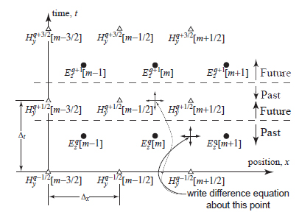
Task 1: FDTD
Notes:
Update equations
Recursive

Slide 8
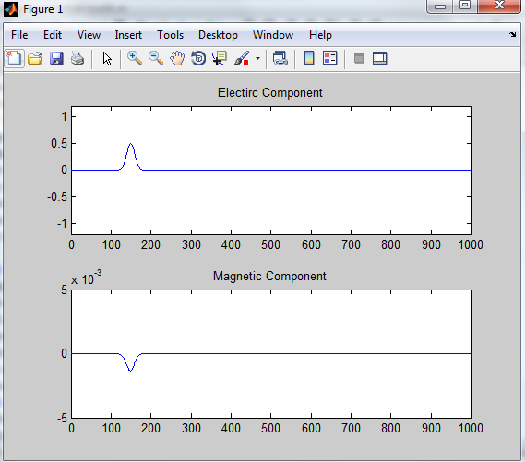
Results
Stable Simulation with correct output
Sources
Guassian
3GHz Sine

Slide 9
Limitations of FDTD Algorithm
cannot cater for negative values of permittivity or permeability (unstable results)
This is because of the Courant stability criterion
Solution: Drudes Model

Slide 10
Drude Dispersive Model
It relates the net force on charges moving under the influence of an electric field and facing n impeding force due to collisions with material
Not only depends on pervious spatial value of a parameter but also on pervious time-step value
2 main update equations for By & Dz, 2 auxiliary equations for Hy & Ez

Slide 11
Flow graph of algorithm

Slide 12
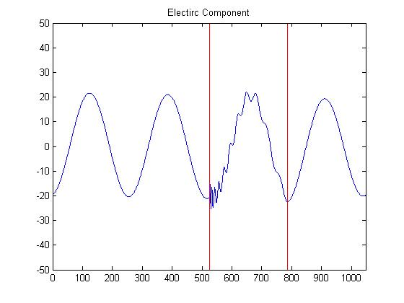
Results
A slab of left handed material is placed in free space
Mu = -1* mu_nought
Epsilon= -1 * epsilon_nought
A sine wave of 3 Ghz is passed through it

Slide 13
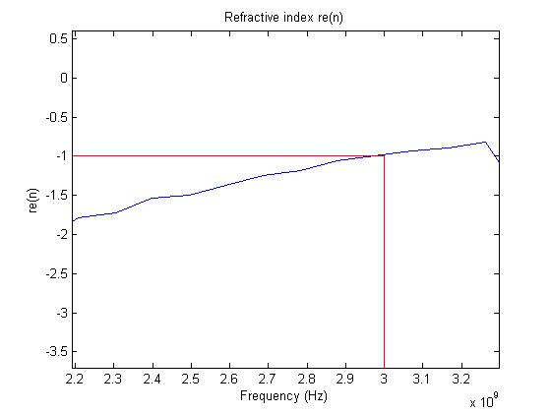
Results

Slide 14
Problems
Grid truncation
Boundary condition

Slide 15
Code conversion in C++
Problems:
File handling
Solution:
Changed development environment to Linux

Slide 16
GPU Programming
ATI Readeon 6770M
256 cores
1GB memory
OpenCL

Slide 17
Problems
Read Delay
Kernel Synchronization

Slide 18
Performance Analysis

