Slide 1
Modeling of Electromagnetic Wave Propagation in NIM using FDTD Technique
Supervisor:
Attique Dawood
Group Member:
Muhammad Junaid Nasir (10-0361)

Slide 2
Problem Statement
To simulate and observe the behavior of Electromagnetic Waves specifically phenomenon of refraction when they pass through negative index materials
To use FDTD algorithm and modify it for negative index material simulations

Slide 3
Introduction to FDTD
Finite-Difference Time-Domain (FDTD) is one of the most efficient techniques of differential time domain numerical modeling methods.
Treats nonlinear material properties in a natural way.
It solves the Maxwell’s differential equations in leap-frog manner (At a given time instant, first electric field and then magnetic field is solved).
It is readily parallelizable on hardware like GPU.
The response of the system over a wide range of frequencies can be obtained with a single simulation

Slide 4
Introduction to NIM
Negative Index Materials (NIM) or Left Handed Material (LHM) is a material which has negative permeability and permittivity.
when a light enters from one medium to another with different refractive indices, it alters its path depending upon the difference between the refractive indices. (Refraction)
Naturally value of refractive index is always positive

Slide 5
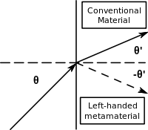
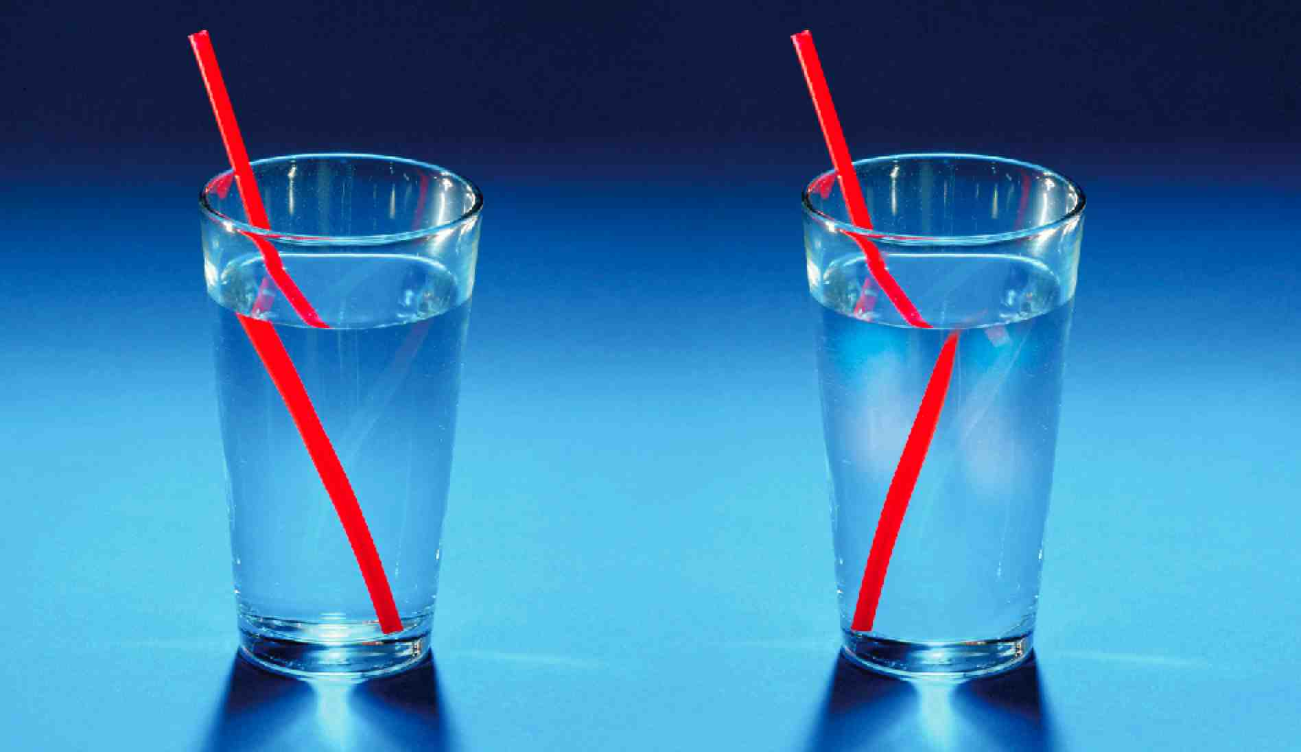

Slide 6
Application & Scope
The negative index materials are under research to alter and improve the properties of devices related to or using the electromagnetic signals
Cloaking
Superlens
Absorber
Beam broadband / Data
High-speed fiber-optic
Efficient solar cells

Slide 7
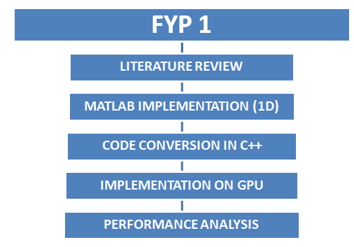
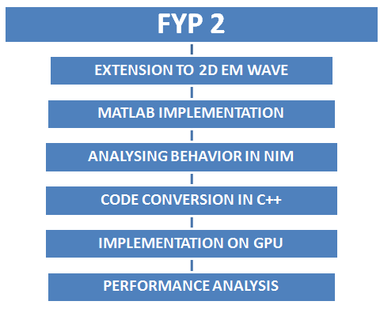
Block Diagram of Main Modules

Slide 8
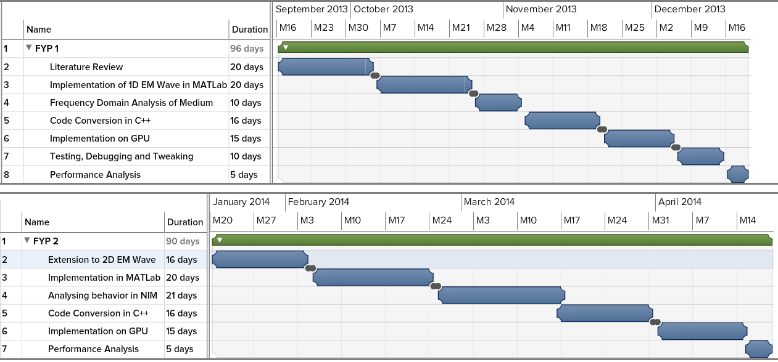
Project Plan

Slide 9
Budget
Component | Price(Rs)
ATI Radeon HD 6670M | Available
ATI HD770 | Available
PC with PCI Express Slot | Available
MATLab (R 2010 a) | Available
Visual Studio (2012) | Available
SubVersion | Available
Latex | Available
XFDTD | Available

Slide 10
Deliverables
FYP 1
Learning FDTD technique
Implementation of FDTD algorithm in Matlab
Frequency domain analysis of medium
FYP 2
Matlab Simulation of 1D EM Wave
Analysis of EM wave in NIM
GPU implementation
Performance Analysis

Slide 11
References
John B. Schneider "Understanding the Finite-Difference Time-Domain Method” www.eecs.wsu.edu/~schneidj/ufdtd, 2010.
Aso Rawandi, Hamed Sheikh Abdul Kareem, Sohrab Rajdai sani, Yelva Olmebrand, “Negative Index Materials (NIMs)”, Royal Institue of Technology KTH
D. M. Sullivan, "Electromagnetic Simulation using the FDTD Method ,Piscataway, NY: IEEE Press, 2000.
A. Taflove and S. C. Hagness, “Computational Electrodynamics: The Finite- Difference Time-Domain Method”. Artech House Publishers, 2nd ed., jun 2000.
http://www.remcom.com/examples
http://gpgpu.org/

Slide 12
Questions ?

Slide 13


How FDTD Works?
Write Ampere's and Faraday's laws in the form of finite differences. Writing them in the form of electric and magnetic field as the derivative of time and space.
Solve equation so that we can get future values from past values
Notes:
change in the E-field in time (the time derivative) is dependent on the change in the H-field across space (the curl)
ε permittivity (extent to which it concentrates electrostatic lines offlux. In technical terms, it is the ratio of the amount of electrical energy stored in a material by an applied voltage, relative to that stored in a vacuum )
µ permeability ( the ability of a material to support the formation of a magnetic field within itself. In other words, it is the degree of magnetization that a material obtains in response to an applied magnetic field.)

Slide 14
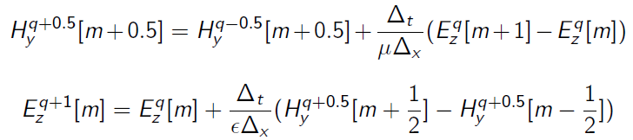
How FDTD works
We can find magnetic field using past values of electric field also find electric field values using past magnetic field values.
Repeat the above step to get all values

Slide 15
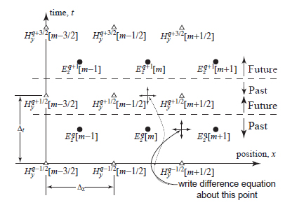
How FDTD works

Slide 16

Refractive index
where c is the speed of light in vacuum and v is the speed of light in the substance
Snell's law of refraction, n₁sinθ₁= n₂sinθ₂, where θ₁ and θ₂ are the angles of incidence of a ray crossing the interface between two media with refractive indices n₁ and n₂.

Slide 17
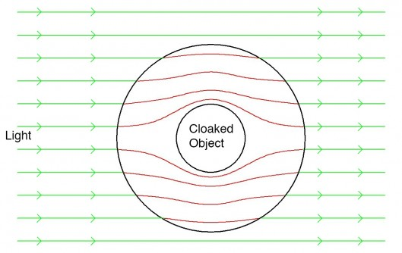
Applications of NIM
Cloaking
Notes:
This is accomplished by manipulating the paths traversed by light through a novel optical material. Metamaterials direct and control the propagation and transmission of specified parts of the light spectrum and demonstrate the potential to render an object seemingly invisible

Slide 18
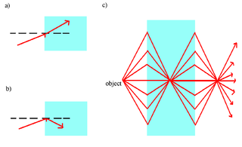
Applications of NIM
Superlense
Notes:
is a lens which uses metamaterials to go beyond the diffraction limit

Slide 19
Applications of NIM
Absorber
An electromagnetic absorber neither reflects nor transmits the incident radiation. Therefore, the power of the impinging wave is mostly absorbed in the absorber materials

