Slide 1
Modeling of Electromagnetic Wave Propagation in NIM using FDTD Technique
Supervisor:
Attique Dawood
Group Member:
Muhammad Junaid Nasir (10-0361)

Slide 2
Project Objectives
To simulate and observe the behavior of Electromagnetic Waves specifically phenomenon of refraction when they pass through negative index materials
To use FDTD algorithm and modify it for negative index material simulations
Comparison of algorithm performance on different platforms

Slide 3
Literature Review
Richard W. Ziolkowski and Ehud Heyman , “Wave propagation in media having negative permittivity and permeability”, 2001
Pavel Kolinko and David R. Smith, “Numerical study of electromagnetic waves interacting with negative index materials”, 2003

Slide 4
Introduction to NIM
Negative Index Materials (NIM) or Left Handed Material (LHM) is a material which has negative permeability and permittivity.
when a light enters from one medium to another with different refractive indices, it alters its path depending upon the difference between the refractive indices. (Refraction)
Naturally value of refractive index is always positive

Slide 5
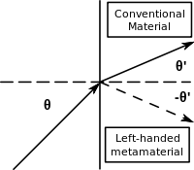


Slide 6
Deliverables
FYP 1
Learning FDTD technique
Implementation of FDTD algorithm in Matlab
Frequency domain analysis of medium
FYP 2
Analysis of EM wave in NIM
GPU implementation
Application Specific analysis (Super lens)
Performance Analysis

Slide 7
Task 1: FDTD Technique
Finite-Difference Time-Domain (FDTD) is one of the most efficient techniques of differential time domain numerical modeling methods.
Treats nonlinear material properties in a natural way.
It solves the Maxwell’s differential equations in leap-frog manner (At a given time instant, first electric field and then magnetic field is solved).
It is readily parallelizable on hardware like GPU.

Slide 8


Task 1: FDTD Technique
Write Ampere's and Faraday's laws in the form of finite differences. Writing them in the form of electric and magnetic field as the derivative of time and space.
Solve equation so that we can get future values from past values
Notes:
change in the E-field in time (the time derivative) is dependent on the change in the H-field across space (the curl)
ε permittivity (extent to which it concentrates electrostatic lines of flux. In technical terms, it is the ratio of the amount of electrical energy stored in a material by an applied voltage, relative to that stored in a vacuum )
µ permeability ( the ability of a material to support the formation of a magnetic field within itself. In other words, it is the degree of magnetization that a material obtains in response to an applied magnetic field.)

Slide 9
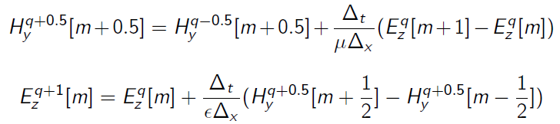
Task 1: FDTD Technique
We can find magnetic field using past values of electric field also find electric field values using past magnetic field values.
Repeat the above step to get all values

Slide 10
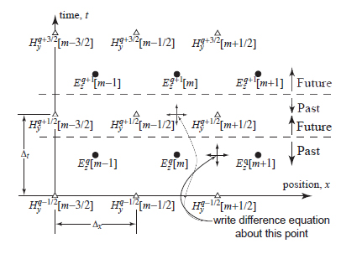
Task 1: FDTD Technique

Slide 11
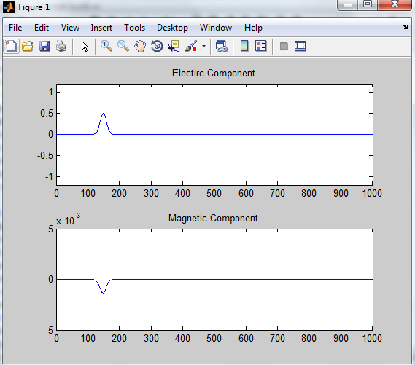
Task 2: Implementation On MATlab
Both sinusoidal and Gaussian waves
F = 3 GHz (sinusoidal)

Slide 12

Task 3: Frequency Domain Analysis
Medium under observation is shown
ε permittivity = 2 ε_{o}
Reflection coefficient Γ = 0.1716
Fourier Analysis of incident and Transmitted waves
Refractive Index = 1.4141
Notes:
reflection coefficient is the ratio of the amplitude of the reflected wave to the amplitude of the incident wave

Slide 13
Additional Task: Implementation in C++

Slide 14
Problems
Source Node
Grid Truncation
Boundary condition
Unstable Simulation results
Frequency Analysis results
File Handling in C++
Variables precision

Slide 15
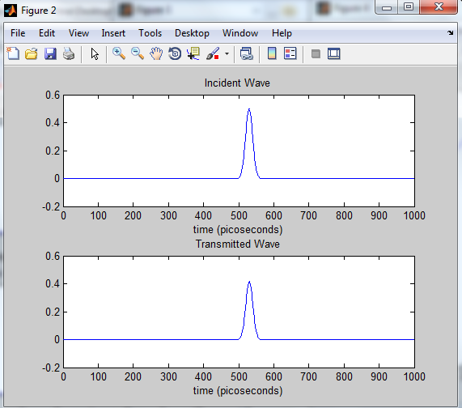
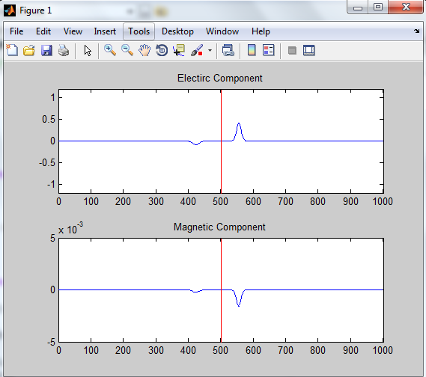
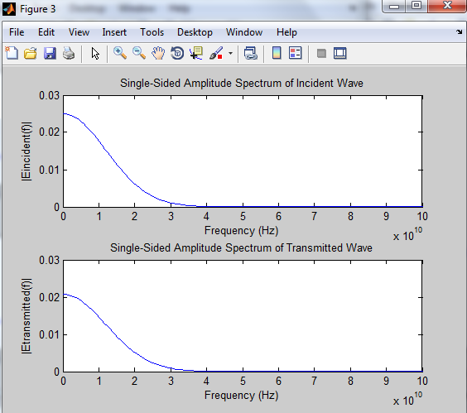
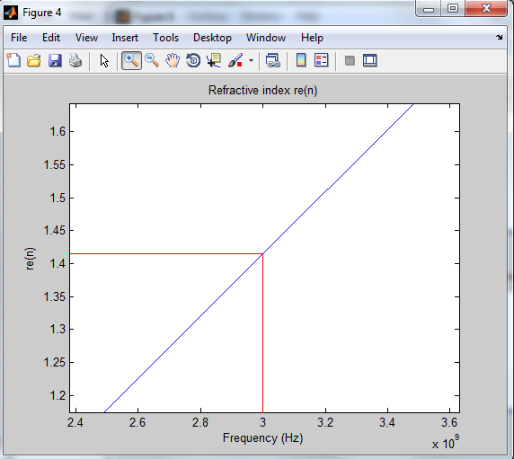
Results

Slide 16
References
John B. Schneider, “Understanding the Finite-Difference Time-Domain Method”, 2010
Dennis M. Sullivan, “Electromagnetic Simulation using the FDTD method”, Publisher: Wiley, 2013
S Anantha Ramakrishna, “Physics of negative refractive index materials”, 2005

Slide 17
Thank you

Slide 18
Questions ?

Slide 19
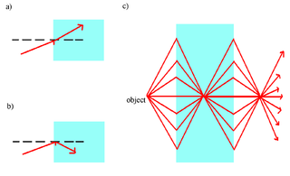
Applications of NIM
Super lense
Notes:
is a lens which uses metamaterials to go beyond the diffraction limit

