Slide 1
Modeling of Electromagnetic Wave Propagation in NIM using FDTD Technique
Supervisor:
Attique Dawood
Group Member:
Muhammad Junaid Nasir (10-0361)

Slide 2
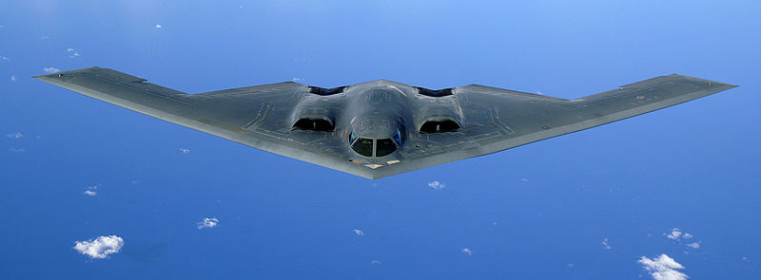
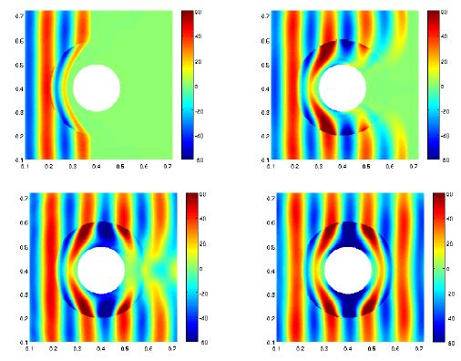

Introduction & motivation
Invisibility cloaking
Northrop Grumman B-2 Spirit
Image courtesy:
http://www.conservativerefocus.com/blog5.php/2012/01/05/scientists-say-event-cloaking-now-possible-materials-designed-to-adjust-speed-of-light-could-obscure-events
http://www.airforce-technology.com/projects/b2/
http://spectrum.ieee.org/semiconductors/metamaterials/
Notes:
Many earlier cloaking systems turned objects "invisible" only under wavelengths of light that the human eye can't see
40,000 lb (18 Tons) 150 tons total weight
1997. Undetectable in radar
Radar-absorbent material (RAM)

Slide 3
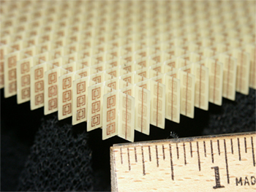
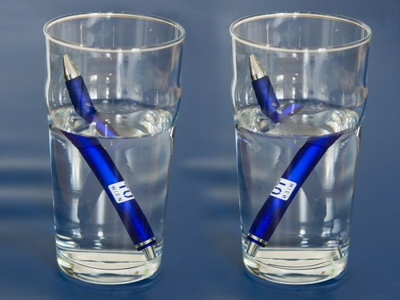
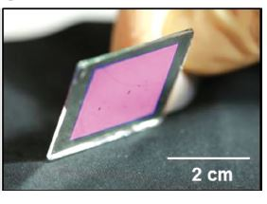
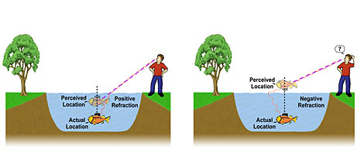
Negative Index Materials (NIM)
Negative Index Materials (NIM) or Left Handed Material (LHM) is a material which has negative permeability and permittivity.
When a light enters from one medium to another with different refractive indices, it alters its path depending upon the difference between the refractive indices. (Refraction)
Engineered materials
Split-ring resonator array
Nanotransfer Printing
Image courtesy:
1) http://randommization.com/2011/08/19/making-light-bend-the-wrong-way-with-science/
2) UC Berkeley
3) NASA Glenn Research Center

Slide 4
Project Objectives
To simulate and observe the behavior of Electromagnetic Waves when they pass through negative index materials
To use FDTD algorithm and modify it for negative index material simulations
Reducing computational time by using the parallel processing power of Graphics Processing Units (GPU)
Comparison of algorithm performance on different platforms (MATLAB, C++, GPU)

Slide 5
Problem Statement
model an NIM (slab) using (frequency dependent dispersive) drude model that will effectively have refractive index of -1 (choosing µ_{r} and є_{r} = -1) at 3 GHz

Slide 6
Deliverables
S. No | Task | Status
1 | Learning FDTD technique | Complete
2 | Implementation of FDTD algorithm in MATLAB | Complete
3 | Frequency domain analysis of medium | Complete
S. No | Task | Status
1 | Modeling of NIM | Complete
2 | Code conversion in C++ | Complete
3 | GPU programming | Complete
4 | Performance analysis | Complete

Slide 7
FDTD
Finite-Difference Time-Domain (FDTD) is one of the most efficient techniques of differential time domain numerical modeling methods
It solves the Maxwell’s differential equations in leap-frog manner (At a given time instant, first electric field and then magnetic field is solved)
It is readily parallelizable on hardware like GPU

Slide 8
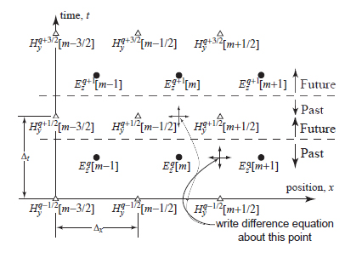
FDTD
Notes:
Update equations
Recursive

Slide 9
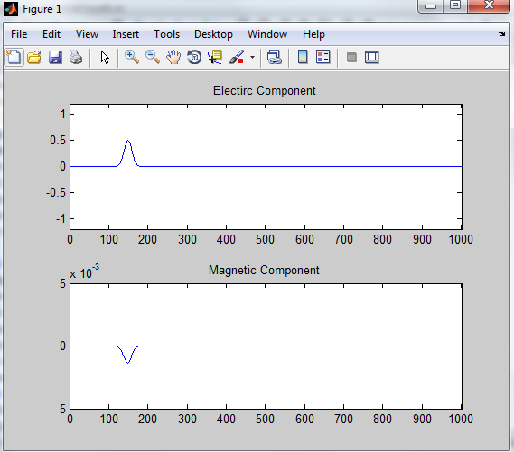
Results
Stable Simulation with correct output
Sources
Guassian
3GHz Sine

Slide 10
Limitations of FDTD Algorithm
Cannot cater for negative values of permittivity or permeability (unstable results)
This is because of the Courant stability criterion
Solution: Drudes Model

Slide 11
Drude Dispersive Model
It relates the net force on charges moving under the influence of an electric field and facing an impeding force due to collisions with material
Not only depends on pervious spatial value of a parameter but also on pervious time-step value
2 main update equations for By & Dz, 2 auxiliary equations for Hy & Ez

Slide 12
Flow graph of algorithm
Initialization
Simulation
Initialize simulation parameters
Compute B_{y} & H_{y}
Allocate data arrays
Compute D_{z} & E_{z}
Initialize simulation parameter arrays
Update source node
T= maxTime ?
Post-Processing
No
Compute transmission & reflection coefficient
Yes
Compute refractive index of slab

Slide 13
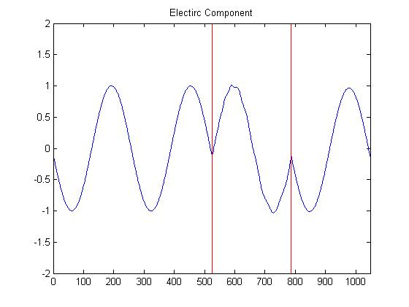
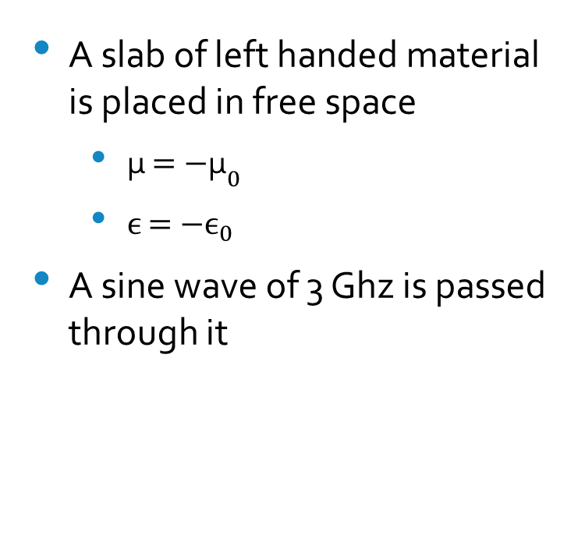
Results
A slab of left handed material is placed in free space
${\text{µ }\text{= −}\text{µ}}_{0}$
${ϵ \text{= −}ϵ}_{0}$
A sine wave of 3 Ghz is passed through it

Slide 14
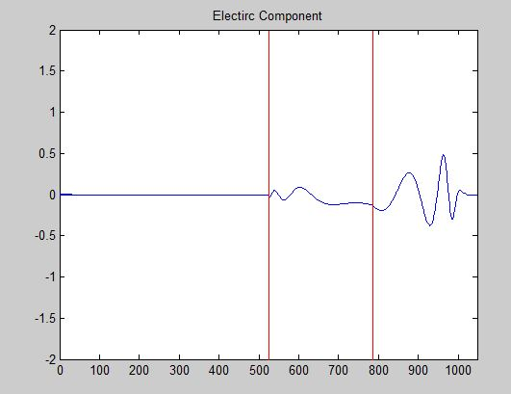
Observations
Sinusoidal wave
Phase velocity is negative
Group velocity is still positive
Gaussian pulse
Different velocities for different frequencies
Notes:
The phase velocity of a wave is the rate at which the phase of the wave propagates in space.
The group velocity of a wave is the velocity with which the overall shape of the waves' amplitudes — envelope of the wave — propagates through space
Gaussian pulse since there are a number of frequency components present, they will be split up in time-domain owing to different velocities for different frequencies in the slab
A material is dispersive if its permittivity or permeability is dependent on frequency

Slide 15
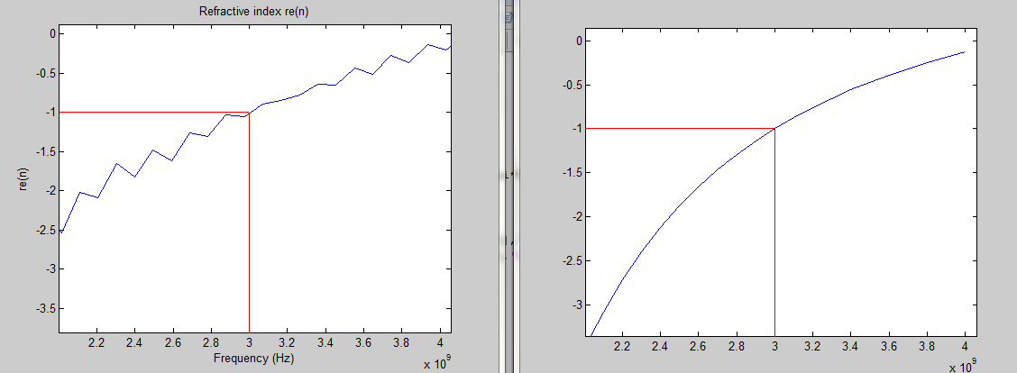
Results
Simulation Results
Calculated Refractive Index

Slide 16
Problems
Grid truncation
Boundary condition

Slide 17
Code conversion in C++
Problems:
File handling
Solution:
Change development environment to Linux

Slide 18
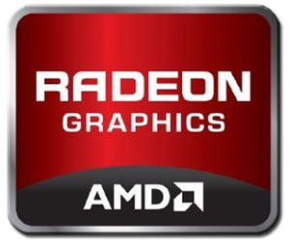
GPU Programming
AMD Radeon HD 6770M
Fast middle class graphics card
256 cores
1GB memory
625 Mhz
716 Million transistors
128 bit memory bus width
Does not support Double data type
Source: http://www.notebookcheck.net/AMD-Radeon-HD-6770M.43955.0.html
Notes:
Double 64 bit with 15 digit precession
Float is 32 bit with 7 digit precession

Slide 19

GPU Programming
OpenCL (Open Computing Language)
Open source
Framework for writing programs that execute across heterogeneous platforms (CPUs, GPUs, FPGAs, DSPs)
Provides parallel computing using task-based and data-based parallelism
Give an application access to a graphics processing unit for non-graphical computing
Source: https://www.khronos.org/opencl/

Slide 20
Problems
Read Delay
Kernel Synchronization
Solutions:
Increased snapshot intervals
Boundary conditions also moved into kernel
Balancing the work load between kernels

Slide 21
Performance Analysis
Notes:
2^24 max

Slide 22
Performance Analysis
Notes:
2^15 max
2^14 c++ win better then gpu

Slide 23
Performance Analysis
Notes:
2^15 max
2^18 c++ better then gpu

Slide 24
Performance Analysis

Slide 25
Platform Comparison
For big simulation size GPU is faster
Than MATLAB by the factor of 20 (times)
Than C++ (Windows) by the factor of 3 (times)
Than C++ (Linux) by the factor of 2 (times)
For simulation size of 2^14 or less c++ is a better option than GPU

Slide 26
References
[1] S. G. et al, “Metamaterials and fdtd based numerical modeling studies," ELECO, Sep 2007.
[2] J. B. Schneider, Understanding the Finite Dierence Time-Domain Method. www.eecs.wsu.edu/~schneidj/ufdtd, 2010.
[3] Y. H. Argyropoulos C., Yan Zhao, “A radially-dependent dispersive finite-dierence time-domain method for the evaluation of electromagnetic cloaks," IEEE Transactions on Antennas and Propagation, vol. 57, pp. 1432{1441, May 2009.
[4] R. W. Ziolkowski and E. Heyman, “Wave propagation in media having negative permittivity and permeability," Physical Review, vol. 64, October 2001.
[5] Ryoji Tsuchiyama, Takashi Nakamura, Takuro Iizuka, Akihiro Asahara, Jeongdo Son, Satoshi Miki, The OpenCL Programming Book, 1st ed. , Fixstars, March 2010.

Slide 27
Thank You

Slide 28
Phase & Group velocity
The phase velocity of a wave is the rate at which the
phase of the wave propagates in space. any given phase of the wave (for example, the crest) will appear to travel at the phase velocity
The group velocity of a wave is the velocity with which the overall shape of the waves' amplitudes — known as the modulation or envelope of the wave — propagates through space
Credits: Kraaiennest, Geek3

