Slide 1
Modeling of Electromagnetic Wave Propagation in NIM using FDTD Technique
Supervisor:
Attique Dawood
Group Member:
Muhammad Junaid Nasir (10-0361)

Slide 2
Project Objectives
To simulate and observe the behavior of Electromagnetic Waves specifically phenomenon of refraction when they pass through negative index materials
To use FDTD algorithm and modify it for negative index material simulations
Comparison of algorithm performance on different platforms

Slide 3
Introduction to NIM
Negative Index Materials (NIM) or Left Handed Material (LHM) is a material which has negative permeability and permittivity.
when a light enters from one medium to another with different refractive indices, it alters its path depending upon the difference between the refractive indices. (Refraction)
Naturally value of refractive index is always positive

Slide 4
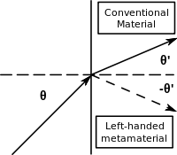


Slide 5
Deliverables
FYP 1
Learning FDTD technique
Implementation of FDTD algorithm in Matlab
Frequency domain analysis of medium
FYP 2
Analysis of EM wave in NIM
GPU implementation
Application Specific analysis (Super lense)
Performance Analysis

Slide 6
Task 1: FDTD Technique
Why FDTD ?
Problems

Slide 7


How FDTD works
Write Ampere's and Faraday's laws in the form of finite differences. Writing them in the form of electric and magnetic field as the derivative of time and space.
Solve equation so that we can get future values from past values
Notes:
change in the E-field in time (the time derivative) is dependent on the change in the H-field across space (the curl)
ε permittivity (extent to which it concentrates electrostatic lines of flux. In technical terms, it is the ratio of the amount of electrical energy stored in a material by an applied voltage, relative to that stored in a vacuum )
µ permeability ( the ability of a material to support the formation of a magnetic field within itself. In other words, it is the degree of magnetization that a material obtains in response to an applied magnetic field.)

Slide 8
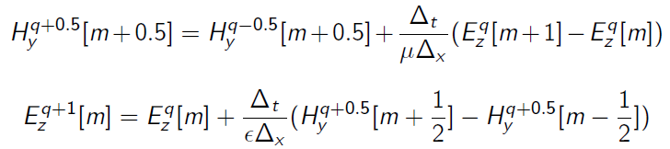
How FDTD works
We can find magnetic field using past values of electric field also find electric field values using past magnetic field values.
Repeat the above step to get all values

Slide 9
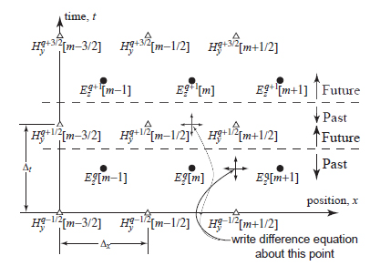
How FDTD works

Slide 10
Task 2: Implementation On MATlab
Both sinusoidal and Gaussian waves
F = 3 Ghz

Slide 11
Task 3: Frequency Domain Analysis
Medium under observation is shown
ε permittivity = 2 ε_{o}

Slide 12
Additional Task: Implementation in C++
Problems
File handling
Data Types

Slide 13
Questions ?

Slide 14
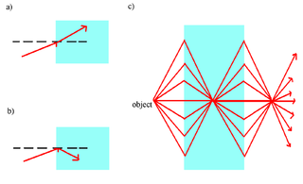
Applications of NIM
Super lense
Notes:
is a lens which uses metamaterials to go beyond the diffraction limit

