Slide 1
Steganography
The art of hiding secrets

Slide 2

So what is steganography???
Steganography (‘stego’ for short) is essentially concealing things.
Things include:
Messages
Files
Your assignment

Slide 3
Audio Steganography

Slide 4


Recommended tools
Audacity https://www.audacityteam.org/
Sonic Visualiser https://sonicvisualiser.org/

Slide 5
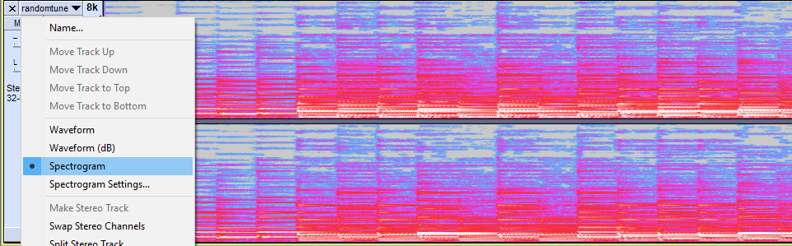
Spectrogram
Visually shows the spectrum of frequencies
Can be used to visually hide messages

Slide 6
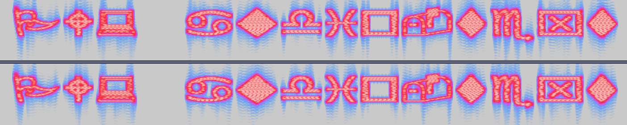
Example of spectrogram hiding messages

Slide 7
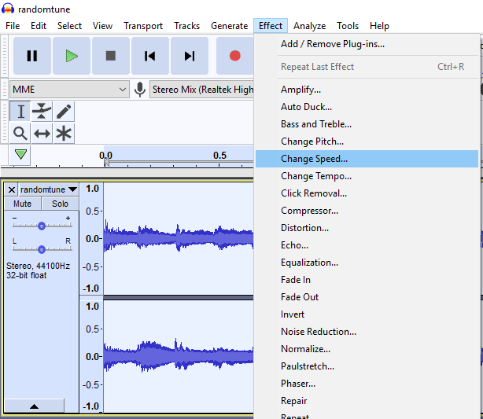
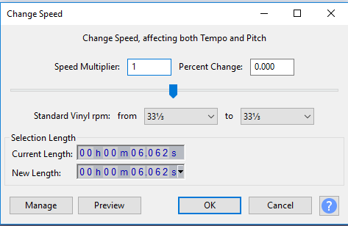
Speed Altering
Sometimes audio may need a tad bit of speed adjustments (faster or slower)

Slide 8
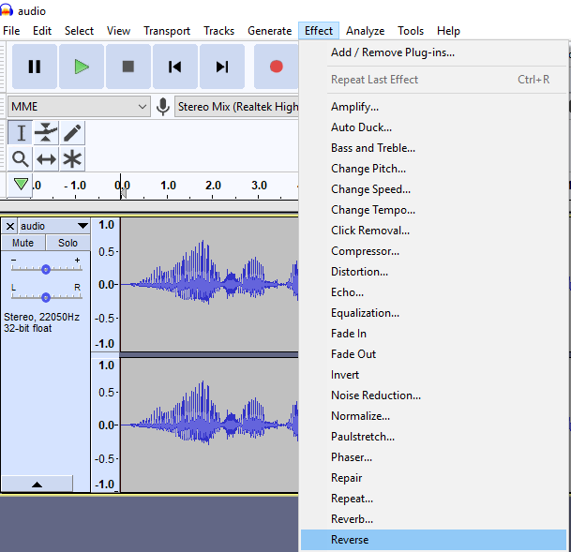
Reversing
Perhaps the gibberish is just reversed audio

Slide 9
Visual Steganography

Slide 10
Recommended tools
Photoshop
GIMP https://www.gimp.org/
Photopea (Online tool) https://www.photopea.com/
Media Player Classic (Windows only) https://mpc-hc.org/
VLC https://www.videolan.org/vlc/

Slide 11
Frame by frame
Some things appear and disappear faster than you can say “Misc Cat”
For videos:
In VLC use ‘e’ to go to the next frame. Other programs may use arrow keys
For YouTube videos, use , and . to go back and forth between frames
For gifs:
Opening in an image editor actually reveals each frame as layers (except ms paint, or anything that doesn’t deal with layers)

Slide 12
Gifs frame by frame example

Slide 13
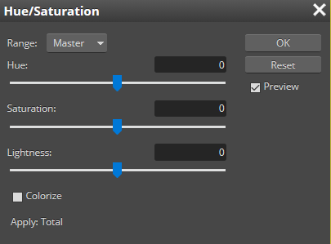
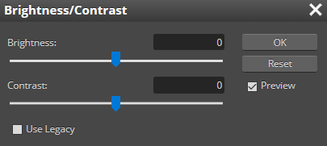
Image adjustments
Brightness / Contrast / Hue / Saturation / Zooming
Just slide the sliders till you see stuff (sometimes using paint bucket tool works)
Some things though, need you to look really really closely

Slide 14
Hidden in plain sight
In a giant wall of text
Invisible (ink)
Italics/Bold
Capitals (maybe even punctuation)
Acrostic
Font changes
Challenge: http://bit.ly/PlainSightFun (hint: this slide is your key)

Slide 15
Other Steganography

Slide 16
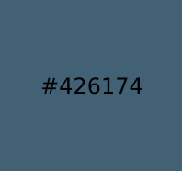
Colour codes
An innocent set of pixels can hide a secret message that can change the whole world
Images are made up of tiny pixels. Essentially small dots that make up a large image. Each of those pixels are set to a certain colour, represented using colour codes.

Slide 17
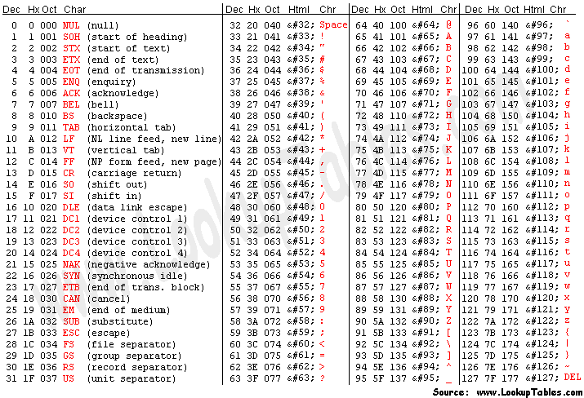
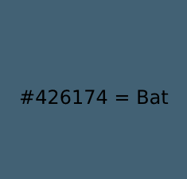
From colours to ASCII
All english characters are encoded into a system called “ASCII” - which is essentially a way for computers to represent text.

Slide 18

Binary everywhere
Sometimes, an image with seemingly random image with black and white dots may turn out to be a binary string (or vice versa, where a random binary string may turn out to be a meaningful image).
E.g. Where black = 0, and white = 1:
= 01100001 = ASCII code for ‘a’
Binary (and even morse) can appear anywhere when there are only two states / options (e.g. Left/Right, Up/Down, Upper/Lower case, and other creative scenarios)

Slide 19
Least Significant Bit
Each pixel of an image can be represented with binary (RGB has 3 bytes, grey scale only has one byte)
E.g. in a black and white image, a set of pixels could have the value:
00110100 10101011 01001001 00010010 01101101 01010100 00111011 010110111
By taking the ‘least significant bit’ (right most bit), you get the binary: ‘01101011’ - the ascii value for ‘k’
For RGB, it’s the same logic, just done with each of the colour channels.

Slide 20
File signatures
Every file has a signature that lets the computer know what kind of file it is
https://en.wikipedia.org/wiki/List_of_file_signatures
https://www.garykessler.net/library/file_sigs.html
Recommended tool: HxD (love it - windows only)
Mac: 0xED
Linux: okteta / hexedit

Slide 21

Common file types:
PNG:
JPG:
Zip:

Slide 22
Exif and metadata
Exif data stores information about the image (generally found in jpg / jpeg files)
Metadata shows information about the file, however, someone can edit this data to hide information (audio files, video files, images)
Sometimes, meaningful data can be appended somewhere in the file. Most of the time it’s at the very end of the file, though at times, it can be somewhere in the middle.

Slide 23
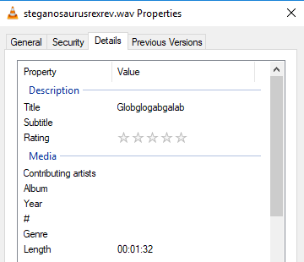
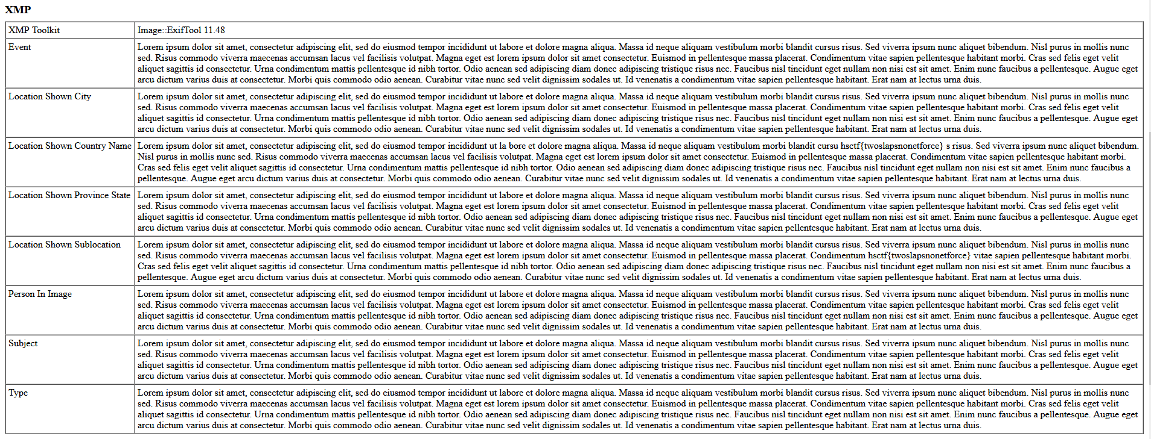
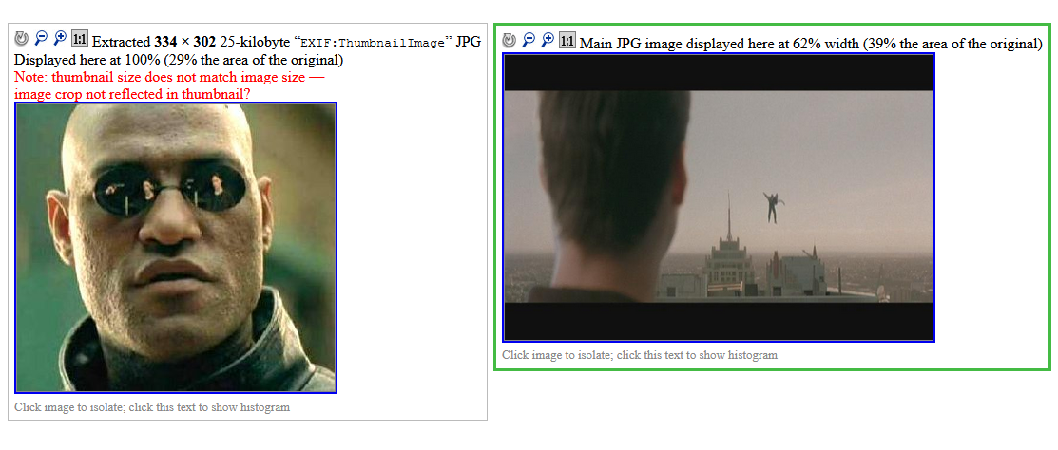

Places where metadata can hide

Slide 24
Other Stego Tools
Zsteg (https://github.com/zed-0xff/zsteg) - detects stego in PNG/BMP files
stegsolve (http://www.caesum.com/handbook/Stegsolve.jar) allows you to see different colour channels separately
Steghide, StegoSuite, StegSnow, s-tools and thousands of other stego programs: Allows you to hide (and in some cases detect/unhide, but only if it’s been hidden with its tool) data in files
Binwalk (https://github.com/ReFirmLabs/binwalk) - Useful for things other than stego as well. Has (file) signature scanning, easily identifying hidden files.

Slide 25
Challenges!!!
Check out MISCCTF Bot on the discord for challenges
In DMs, type $challs, and check out the stego challenges, and give them a crack
Finished them all? I’m working on some challenges soon, and I’m sure a few others are too. Stay tuned for them!

