Slide 1



SoFi Q1 2026 Growth Quality Assessment
Business Analysis Portfolio Project
Core Research Question
Scope & Methodology
Is SoFi's rapid Q1 2026 growth also high-quality and sustainable?
This case study evaluates SoFi's Q1 2026 growth quality across eight business dimensions using publicly available financial, regulatory, and customer-friction data.
Data source: Public Q1 2026 earnings disclosure, regulatory filings, and selected public datasets
Analytical framework: Eight business dimensions assessing growth quality and sustainability
Growth Quality Index (GQI): Independent weighted scoring framework applied to the defined performance dimensions
CFPB complaint data: Used solely as an external public proxy for customer friction
Data boundary: No internal SoFi data, employment, or consulting relationship implied
Investment boundary: No valuation, stock recommendation, or investment view presented
PUBLIC-DATA CASE STUDY
Q1 2026
BUSINESS ANALYST PORTFOLIO
Prepared by Junaid Shaik

Slide 2








ANALYTICAL FRAMEWORK
Revenue growth alone does not establish sustainable business performance
The analysis evaluates eight business dimensions to assess the quality and sustainability of Q1 2026 growth. The Growth Quality Index then applies defined signal scores and weights to the corresponding performance dimensions.
Financial Performance
Customer Depth
Lending & Credit
Funding Quality
Revenue, profitability, margins
Member & product growth, cross-buy rate
Originations, portfolio quality, NCO rates
Deposit growth, deposit-to-loan ratio
Cash Efficiency
Segment Diversification
Customer Friction
Technology Platform Performance
Operating cash flow vs. net income
Revenue mix across lending, financial services, technology
Public complaint signals and trends
Revenue and contribution-margin trajectory

Slide 3

HEADLINE METRICS
Q1 growth was broad, measurable, and profitable
Headline scale and profitability metrics strengthened materially in Q1 2026
$1.10B
$166.7M
Total Revenue
GAAP Net Income
+43% YoY — accelerating top-line at scale
+134% YoY — profitability deepening faster than revenue
$339.9M
14.7M
Adjusted EBITDA
Total Members
31.3% margin — operationally efficient at current scale
+35% YoY — customer base expanding broadly
22.2M
$12.18B
Total Products
Loan Originations
+39% YoY — outpacing member growth (ecosystem depth signal)
Record loan originations, reflecting strong lending activity
Net income growth materially outpaced revenue growth, indicating a significant improvement in reported profitability during Q1 2026.

Slide 4

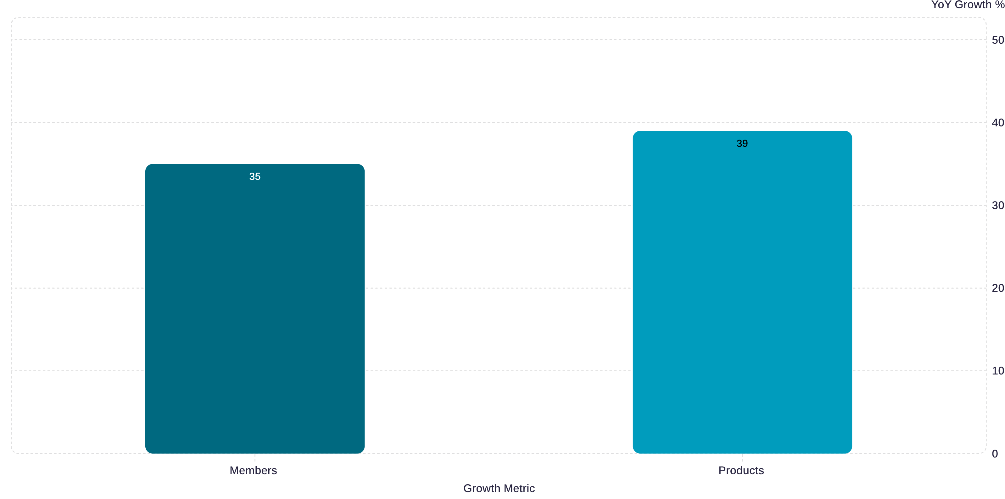
CUSTOMER DEPTH
Customer growth is translating into deeper ecosystem engagement
Key Engagement Metrics — Q1 2026
Analytical Interpretation
Products per Member: 1.51
Up from 1.46 in Q1 2025 — consistent improvement in ecosystem penetration
Cross-Buy Rate: 43%
43% of new products purchased by existing members — a signal of existing-member product adoption and ecosystem depth
Products Growth vs. Member Growth:
Products +39% YoY vs. Members +35% YoY — a 4-point spread indicating stronger ecosystem depth per member cohort
Products grew 39% YoY versus 35% member growth, lifting products per member from 1.46 to 1.51. This indicates that product adoption is growing faster than the member base and supports the assessment of improving customer depth.
A cross-buy rate of 43% means that nearly half of all new product adoption is driven by the existing member base.
Products per member increased from 1.46 to 1.51, indicating deeper product engagement across the member base.
Member vs Product Growth — Q1 2026

Slide 5

LENDING, CREDIT & FUNDING
The lending engine remains strong, while funding and credit require monitoring
Lending & Funding Snapshot
Credit Quality Analysis
1
2.04% — Total NCO Rate
Overall portfolio NCO rate; remains a key credit-quality monitoring metric.
$42.17B — Total Loans
$40.24B — Total Deposits
95.4% — Deposit-to-Loan Ratio
$12.18B — Loan Originations
2
~6.68% — Credit Card NCO Rate
Q1 2026 loan balance
Deposit growth did not keep pace with loan growth in Q1 2026
Highest displayed category — warrants continued monitoring.
Deposits did not fully cover reported loans, making the funding mix an important monitoring consideration.
Record loan originations, reflecting strong lending activity.
Loans expanded faster than deposits in Q1 2026, and the deposit-to-loan ratio declined to 95.4%. This makes funding mix and credit performance important areas for continued monitoring.

Slide 6
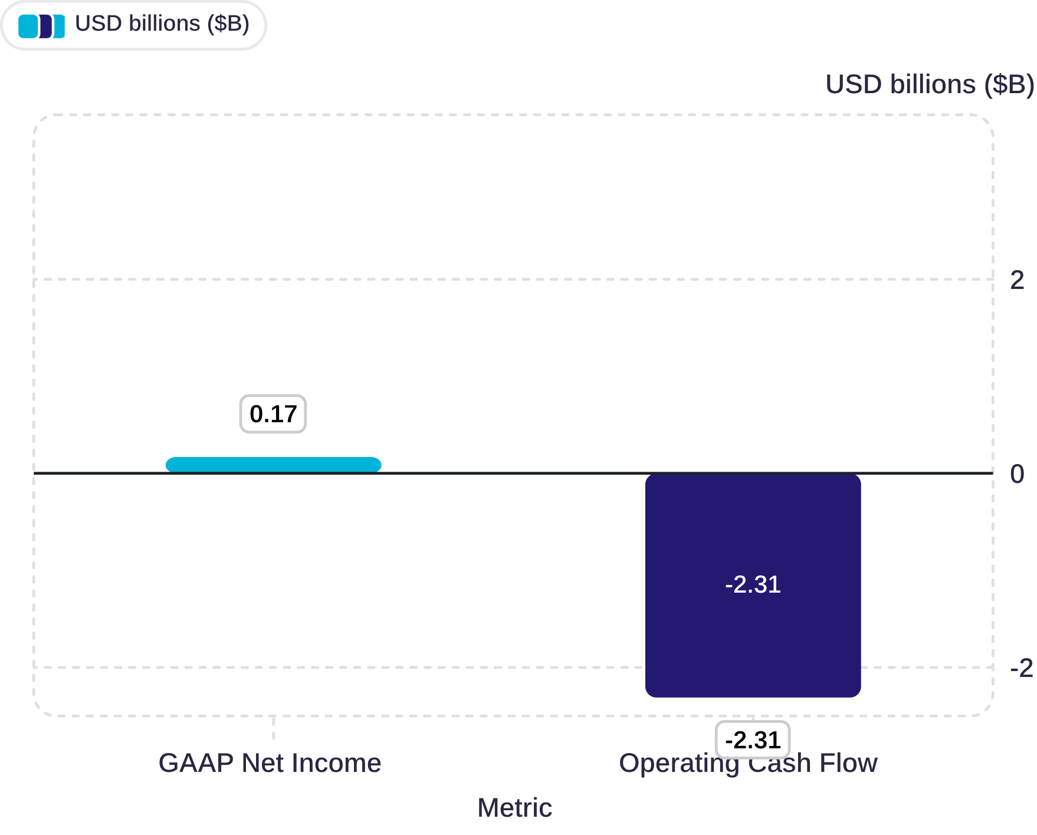
CASH EFFICIENCY
Profitability improved sharply, but cash conversion remains the key tension
Operating Cash Flow vs GAAP Net Income
Analytical Interpretation
Negative operating cash flow does not automatically indicate poor business quality. Q1 originations of $12.18B provide context for the scale of lending activity, while the $2.48B profit-to-cash divergence remains a material monitoring signal.
However, the magnitude of divergence — a -13.88× OCF-to-net-income ratio — is a material monitoring signal. Operating cash flow was -$2.31B despite $166.7M of positive GAAP net income, creating a $2.48B divergence.
Q1 originations at record $12.18B pressure near-term OCF
Cash-conversion trajectory is the key monitoring question
Monitoring signal: not automatic negative, but requires explanation
$2.48B divergence: the gap between accounting profit and operating cash generation is immediately visible.

Slide 7
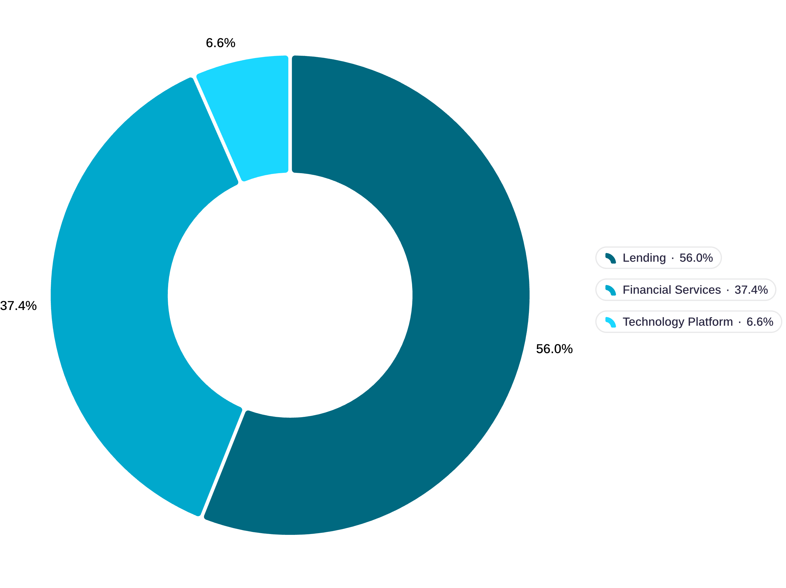

SEGMENT DIVERSIFICATION
Diversification is improving, but it is not yet proven
Segment-Level Commentary
1
Lending — 56.1%
Core business; strong performance. Lending remains the largest revenue contributor, so concentration remains an important diversification consideration.
2
Financial Services — 37.4%
Becoming increasingly meaningful. Financial Services is the strongest positive diversification signal in Q1 2026.
3
Technology Platform — 6.6% (~$75.1M)
-27% YoY. Contribution margin: 16%. Technology Platform should currently be treated as a recovery lever rather than evidence of completed diversification.
Financial Services strengthens the diversification case, while Technology Platform weakness limits the strength of that conclusion.
Q1 2026 Share of Reported Segment Net Revenue

Slide 8
CUSTOMER FRICTION
Public customer-friction signals are concentrated, but normalized intensity has not materially worsened
CFPB Complaint Data Q1
Two-Part Analytical Reading
Total Complaints: 940
Normalized Intensity: 63.92 per million members
Checking/Savings Concentration: 62.45% of all complaints
Methodology Note: CFPB complaint data is an external public proxy for customer friction, not internal SoFi support data or a complete measure of customer experience quality.
Raw Volume Rose with Scale — Normalized Intensity Did Not Materially Worsen
Absolute complaint volume increased in Q1 2026, consistent with the 35% YoY growth in member base. However, normalizing complaints per million members reveals that intensity did not materially deteriorate from Q1 2025 to Q1 2026. This is the more analytically rigorous comparison.
Product Concentration Risk: 62.45% in Checking & Savings
Nearly two-thirds of all public complaints are concentrated in a single product category. This concentration warrants monitoring — checking/savings represents the dominant observed complaint concentration in the CFPB dataset and therefore warrants monitoring. Friction here has outsized ecosystem impact.

Slide 9
GROWTH QUALITY INDEX
Growth quality is uneven across business dimensions
The Growth Quality Index assigns a weighted score to each dimension. Scores and decision flags are the analyst's independent framework — not an official SoFi metric. Weighted Score = Signal Score × Dimension Weight.
Dimension
Signal Score
Weight
Weighted Score
Decision Flag
Customer Depth
4
1.20
4.80
SCALE
Funding Quality
4
1.20
4.80
SCALE / MONITOR
Profitability
4
1.10
4.40
SCALE
Credit Risk
3
1.30
3.90
MONITOR
Segment Diversification
3
1.10
3.30
IMPROVE
Operational / Customer Friction
3
1.00
3.00
MONITOR
Cash Efficiency
2
1.40
2.80
MONITOR
Technology Platform Performance
2
1.00
2.00
FIX / MONITOR
Action Framework: Scale what is working. Monitor credit risk, customer friction, and cash efficiency. Improve diversification and Technology Platform performance.

Slide 10
EXECUTIVE ASSESSMENT
Growth is real — sustainability is conditional
SoFi's Q1 2026 growth is strong and increasingly diversified at the customer and product level. Sustainability depends on improving cash conversion, maintaining credit and funding discipline, and recovering Technology Platform performance.
SCALE ✓
MONITOR ⚠
IMPROVE / FIX ✗
Dimensions showing stronger performance signals and supporting the growth-quality thesis.
Dimensions with material signals that require ongoing scrutiny and trajectory tracking.
Dimensions requiring improvement or recovery to strengthen the growth-quality thesis.
Credit Risk (3.90)
Customer Friction (3.00)
Cash Efficiency (2.80)
Customer Depth (4.80)
Funding Quality (4.80)
Profitability (4.40)
Segment Diversification (3.30)
Technology Platform Performance (2.00)
The conditional thesis: Q1 2026 growth is supported by strong public-data evidence, but growth quality remains uneven across dimensions. The primary areas requiring continued attention are cash conversion, credit risk, customer friction, segment diversification, and Technology Platform performance.
Independent Business Analysis case study based on public data only. Q1 2026. No internal SoFi data, investment view, or valuation implied.
Prepared by Junaid Shaik

