Slide 1
Community detection methodologies for signed graphs – a survey
Maria Tomasso
CS 7300 – Fall 2020

Slide 2
Graph theory – the basics
A graph G consists of two disjoints sets, V and E, whose objects are called vertices and edges, respectively.
Graphs can be directed or undirected
In a signed graph, edges are assigned +1 or -1 sentiments
In a complete graph, every pair of vertices is connected by an edge
A graph is said to be dense if the total number of edges is close to the maximum number of edges
If a graph has very few edges, it is sparse

Slide 3
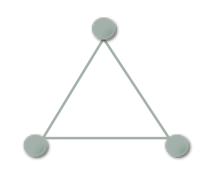
Graph theory – balance
Introduced by Fritz Heider in 1946, structural balance theory arose from studies in attitude and perception
Provides a framework for determining when a social network is stable
“The enemy of my enemy is my friend”
+
+
+
+
-
-
+
-
+
(+++)
balanced
(++-)
unbalanced
(--+)
balanced

Slide 4
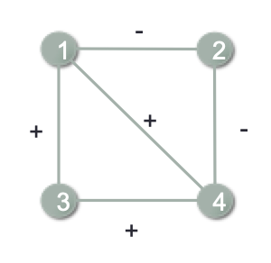
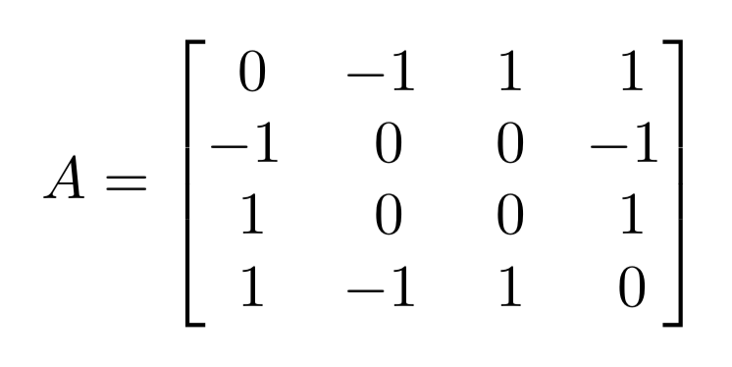
Graph representations
The adjacency matrix is a square matrix whose row and column numbers represent vertices. Entries in the adjacency matrix indicate the edges.

Slide 5
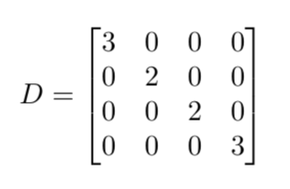
Graph representations
The degree matrix is a square matrix whose row and column numbers represent vertices. Entries along the diagonal represent the degrees of the vertices; all other entries are zero.

Slide 6
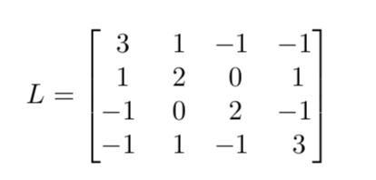
Graph representations
The Laplacian matrix is equal to the degree matrix minus the adjacency matrix

Slide 7
History of signed graphs
Year | Event
1946 | Heider publishes landmark paper ‘Attitudes and cognitive organization’, introducing the idea of structural balance theory
1956 | Cartwright and Harary built on Heider’s work and formalized the idea of a balanced signed graph
1978/ 1979 | Moore applied structural balance theory to diplomatic relations in South Asia
1993 | Axelrod and Bennet applied structural balance theory to international relations during WWII
2005 | Massa and Avesani applied signed graph theory to the Slashdot Zoo network
2005+ | Signed graph mining exploded in popularity with the rise of social media

Slide 8
Signed graph mining
Node-based tasks: community detection, node ranking, node classification, node embedding
Link-oriented tasks: Link prediction, sign prediction, tie strength prediction, negative link prediction
Application oriented tasks: Information diffusion, recommendation, data classification, data clustering

Slide 9
Community detection - the basics
Goal: Discover community structure(s) within signed networks
Why can we not just apply unsigned clustering methods to signed graphs?
The most popular clustering method for unsigned graphs is spectral clustering
Spectral clustering requires that all of the eigenvalues of the Laplacian be real and non-negative, i.e. the Laplacian must be positive semi-definite
This cannot be assumed for signed graphs, and in many cases is untrue, so we must either adapt unsigned clustering methods or use novel methods on signed graphs

Slide 10
Community detection - the basics
Early work:
Brieger, 1975 (CONCOR)
Repeatedly partitions nodes into two sets based on convergence of an iterative correlation matrix
Doreian and Mrvar, 1996
Introduced a partitioning algorithm to minimize negative ties within clusters and positive ties between clusters
Tested on small datasets for k=2 and k=3
Contemporary methodologies
Spectral based methods
Modularity based methods
Random walk models

Slide 11
Community detection – spectral clustering methods
By far the most popular, most signed graph methods involve adapting the original methodology proposed by Shi and Malik in 2000
Yang 2007 (FEC)
Designed for densely connected networks
Treats sign and density of edges as clustering attributes
Designed for signed graphs but applicable to unsigned graphs
Kunegis 2009 (Signed Laplacian)
Positive definite iff the network is unbalanced
Seperates negative-linked nodes rather than grouping positive-linked nodes
Chiang 2012 (Balanced normalized cut)
Minimizes positive links between communities
Hseih 2012 (Clustering with matrix completion)
Relies heavily on sign inference
Complete the graph with any matrix completion algorithm, then perform spectral clustering

Slide 12
Community detection – spectral clustering methods
Zheng 2015 (Balanced normalized signed Laplacian)
Addresses shortcomings of the signed Laplacian
Mercado 2016 (Geometric Laplacian means)
Uses the geometric mean of the positive and negative Laplacians
This approach works well for networks with little to no noise in either the positive or negative structure
Effective, but computationally expensive
Cucuringu 2019 (SPONGE)
Solves for the k smallest eigenvalues using a generalized eigenproblem
Mercado 2019 (Matrix power means)
Uses the matrix power mean of the normalized and signless positive and negative Laplacians

Slide 13
Community detection – modularity based methods
Main idea: Seek densely connected clusters using optimization techniques
Newman 2004
Introduced an hierarchical agglomeration algorithm based on modularity for community detection
Notable for running in near linear time – a significant improvement over state-of-the-art techniques at the time
Gomez 2009
Extended existing methods to networks that are signed, directed, weighted, and/or contain loops
Anchuri 2012
Uses a spectral approach to minimize frustration and maximize modularity
Traag 2013
Uses subgraph analysis to determine appropriate resolution parameters

Slide 14
Community detection – random walk models
Main idea: Trace a random path from node to node on a graph, with edge weights affecting the probability of a node being included in the walk
Harel 2001
Introduced random walk clustering for weighted graphs
Hua 2020
Proposes the random walk gap (RWG) heuristic for clustering on signed graphs
Uses two types of random walks: one on positive edges, and one on negative edges, to make inferences about community structure
First study to use walks on negative edges

Slide 15
Conclusion
Community detection in signed graphs is a rapidly evolving discipline with many different underlying methodologies
Understanding the underlying assumptions and methodologies is critical when choosing the correct algorithm for your data
While spectral methods remain as the “gold-standard”, emerging methodologies provide promise in community detection as well as other areas of signed graph mining
See https://datalab12.github.io/work/attitudinal-network-science.html for more information on a new methodology being developed here at Texas State!

Slide 16
Citations
Fritz Heider. 1946. Attitudes and cognitive organization. The Journal of psychology 21, 1 (1946), 107–112.
Dorwin Cartwright and Frank Harary. 1956. Structural balance: a generalization of Heider’s theory. Psychological review 63, 5 (1956), 277.
Michael Moore. 1978. An international application of Heider’s balance theory. European Journal of Social Psychology 8, 3 (1978), 401–405.
Michael Moore. 1979. Structural balance and international relations. European Journal of Social Psychology 9, 3 (1979), 323–326.
Robert Axelrod and D Scott Bennett. 1993. A landscape theory of aggregation. British journal of political science 23, 02 (1993), 211–233.
Paolo Massa and Paolo Avesani. 2005. Controversial users demand local trust metrics: An experimental study on epinions. com community. In Proceedings of the National Conference on artificial Intelligence, Vol. 20. Menlo Park, CA; Cambridge, MA; London; AAAI Press; MIT Press; 1999, 121.
Breiger, R.L., Boorman, S. A., & Arabie, P. (1975). An algorithm for clustering relational data with applications to social network analysis and comparison with multidimensional scaling. Journal of Mathematical Psychology, 12(3), 328-383.
Patrick Doreian and Andrej Mrvar. 1996. A partitioning approach to structural balance. Social networks 18, 2 (1996), 149–168.
Bo Yang, William K Cheung, and Jiming Liu. 2007. Community mining from signed social networks. Knowledge and Data Engineering, IEEE Transactions on 19, 10 (2007), 1333–1348.
Kai-Yang Chiang, Joyce Jiyoung Whang, and Inderjit S Dhillon. 2012. Scalable clustering of signed networks using balance normalized cut. In Proceedings of the 21st ACM international conference on Information and knowledge management. ACM, 615–624.
Cho-Jui Hsieh, Kai-Yang Chiang, and Inderjit S Dhillon. 2012. Low rank modeling of signed networks. In Proceedings of the 18th ACM SIGKDD international conference on Knowledge discovery and data mining. ACM, 507–515.
Q Zheng and DB Skillicorn. 2015. Spectral Embedding of Signed Networks. In SDM. SIAM.
Mark EJ Newman and Michelle Girvan. 2004. Finding and evaluating community structure in networks. Physical review E 69, 2 (2004), 026113.
Sergio Go ́mez, Pablo Jensen, and Alex Arenas. 2009. Analysis of community structure in networks of correlated data. Physical Review E 80, 1 (2009), 016114.
Pranay Anchuri and Malik Magdon-Ismail. 2012. Communities and balance in signed networks: A spectral approach. In Advances in Social Networks Analysis and Mining (ASONAM), 2012 IEEE/ACM Interna- tional Conference on. IEEE, 235–242.
Jérôme Kunegis, Stephan Schmidt, Andreas Lommatzsch, Jürgen Lerner, Ernesto William De Luca, and Sahin Albayrak. Spectral analysis of signed graphs for clustering, prediction and visualization. SDM, 10:559–570, 2010.
Pedro Mercado, Francesco Tudisco, and Matthias Hein. Clustering signed networks with the geo- metric mean of Laplacians. In NIPS. 2016.
M Cucuringi, P Davies, A Glielmo, H Tyagi (2019). SPONGE: A generalized eigenproblem for clustering signed networks. arXiv preprint arXiv:1904.08575
Mercado, Pedro, Tudisco, Francesco and Hein, Matthias (2019). Spectral clustering of signed graphs via matrix power means. ICML, 2019.
Hua, Jialin, Yu, Jian, and Yang, Miin-Shen (2020). Fast clustering for signed graphs based on random walk gap. Social Networks. 60: 113-128.
Harel D., Koren Y. (2001) On Clustering Using Random Walks. In: Hariharan R., Vinay V., Mukund M. (eds) FST TCS 2001: Foundations of Software Technology and Theoretical Computer Science. FSTTCS 2001. Lecture Notes in Computer Science, vol 2245. Springer, Berlin, Heidelberg.
Tang, Jiliang, Yi, Chang, and Huan, Liu (2016). A Survey of Signed Network Mining in Social Media. arXiv preprint arXiv1511.07569

