Slide 1

Let’s add Fedora multiarch containers to your CI
Jun Aruga
Flock Budapest
August 2019

Slide 2


Fedora and Upstream
Past and Present
Contribute
x86_64
x86_64
aarch64
?
How?
ppc64le
s390x
Image source: GitHub, Travis CI Wikipedia

Slide 3
CPU Architecture Kinds
Host architecture "uname -m" | RPM Package architecture "rpm -q rpm --qf "%{arch}\n" | Description
x86_64 | x86_64 | Intel, 64-bit, Little-endian
x86_64, i686 | i686 | Intel, 32-bit, Little-endian
aarch64 | aarch64 | ARM 64-bit, Little-endian
aarch64, armv7l, armv8l | armv7hl | ARM 32-bit, Little-endian
ppc64le | ppc64le | IBM PowerPC, 64-bit, Little-endian
s390x | s390x | IBM Z/Linux ONE 64-bit, Big-endian
Notes:
See /etc/mock/fedora-rawhide-$arch.cfg

Slide 4
Tools for multiarch
Today's topics
qemu-user-static [✔]
mock
Koji
Packit
multiarch/qemu-user-static image [✔]
{podman,docker,docker buildx} build --platform (extra) [✔]

Slide 5
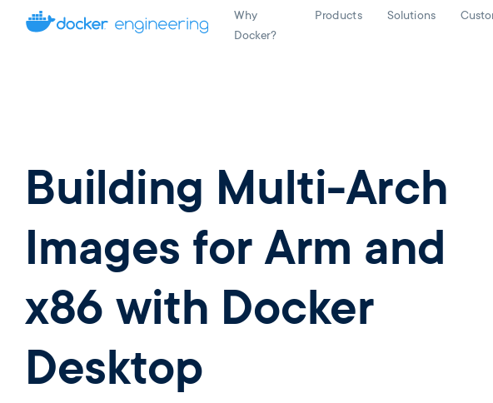

QEMU and binfmt_misc
on News
April, 30, 2019 Docker engineering
Image source: https://engineering.docker.com/2019/04/multi-arch-images/

Slide 6
5 steps
to add Fedora multiarch to upstream CI
qemu-$arch-static
binfmt_misc
qemu-user-static RPM
qemu-user-static RPM and container
multiarch/qemu-user-static container to add Fedora multiarch cases to CI

Slide 7
1. qemu-$arch-static
An interpreter
$ uname -m
x86_64
$ file /path/to/bin/hello-aarch64
bin/hello-aarch64: ELF 64-bit LSB executable, ARM aarch64, …
$ /path/to/bin/hello-aarch64
bash: bin/hello-aarch64: cannot execute binary file: Exec format error
$ qemu-aarch64-static /path/to/bin/hello-aarch64
Hello World!

Slide 8
2. binfmt_misc (1)
A kernel feature for binary format
How to add
$ ls /proc/sys/fs/binfmt_misc
register status
# echo ":my-qemu-aarch64:M::\x7fELF\x02\ …\xff:/path/to/qemu-aarch64-static:F" \
> /proc/sys/fs/binfmt_misc/register
$ ls /proc/sys/fs/binfmt_misc
my-qemu-aarch64 register status
Notes:
How to add binfmt_misc file.

Slide 9
2. binfmt_misc (2)
The usefulness
$ cat /proc/sys/fs/binfmt_misc/my-qemu-aarch64
enabled
interpreter /path/to/qemu-aarch64-static
flags: F
offset 0
magic 7f454c460201010000000000000000000200b700
mask ffffffffffffff00fffffffffffffffffeffffff
$ /path/to/bin/hello-aarch64
Hello World!
Notes:
binfmt_misc is to run an architecture binary file withtout specifying the interpreter qemu-$arch-static.
flags: F is a persistent. After the file is created, the interpreter does not need to be existed.

Slide 10
2. binfmt_misc (3)
flags: F to work without the existance of interpreter
$ /path/to/bin/hello-aarch64
Hello World!
$ rm /path/to/qemu-aarch64-static
$ /path/to/bin/hello-aarch64
Hello World!
Notes:
binfmt_misc is to run an architecture binary file withtout specifying the interpreter qemu-$arch-static.
flags: F is a persistent. After the file is created, the interpreter does not need to be existed.

Slide 11
2. binfmt_misc (4)
How to remove
$ ls /proc/sys/fs/binfmt_misc
my-qemu-aarch64 register status
# echo -1 > /proc/sys/fs/binfmt_misc/my-qemu-aarch64
$ ls /proc/sys/fs/binfmt_misc
register status
Notes:
How to remove binfmt_misc file.

Slide 12
3. qemu-user-static RPM (1)
installs binfmt_misc/qemu-$arch files
$ ls /proc/sys/fs/binfmt_misc
register status
# dnf install qemu-user-static
$ ls /proc/sys/fs/binfmt_misc
qemu-aarch64 qemu-aarch64_be … qemu-xtensaeb register status

Slide 13
3. qemu-user-static RPM (2)
How to reset binfmt_misc/qemu-$arch files (1/2)
$ ls /proc/sys/fs/binfmt_misc
qemu-aarch64 qemu-aarch64_be … qemu-xtensaeb register status
# echo -1 > /proc/sys/fs/binfmt_misc/qemu-aarch64
# echo ":qemu-aarch64:M:: … :/usr/local/bin/my-qemu-aarch64-static:" > /proc/sys/fs/binfmt_misc/register
# echo ":my-qemu:M:: … :/path/to/qemu-aarch64-static:" > /proc/sys/fs/binfmt_misc/register
Just edit and add the binfmt_misc files
for an experiment of reset.

Slide 14
3. qemu-user-static RPM (3)
How to reset binfmt_misc/qemu-$arch files (2/2)
$ ls /proc/sys/fs/binfmt_misc
my-qemu qemu-aarch64 qemu-aarch64_be ... register status
# systemctl restart systemd-binfmt
$ ls /proc/sys/fs/binfmt_misc
qemu-aarch64 qemu-aarch64_be … qemu-xtensaeb register status

Slide 15

3. qemu-user-static RPM (4)
systemd-binfmt service
(systemd)
restart
qemu-user-static RPM
dnf install !
read
add / remove
dnf remove !
/usr/lib/binfmt.d/qemu-$arch-static.conf files
recreate
/proc/sys/fs/binfmt_misc/qemu-$arch files

Slide 16
4. qemu-user-static RPM and container (1)
$ podman run --rm -t arm64v8/fedora uname -m
standard_init_linux.go:211: exec user process caused "exec format error"
# dnf install qemu-user-static
$ cat /proc/sys/fs/binfmt_misc/qemu-aarch64
…
flags: F
...
$ podman run --rm -t arm64v8/fedora uname -m
aarch64
Notes:
By flags: F, the interpreter does not exist inside container.

Slide 17
4. qemu-user-static RPM and container (2)
aarch64 container
(arm64v8/fedora)
/path/to/bin/something
($arch specific binary)
podman run arm64v8/fedora
uname -m
/usr/bin/uname
(aarch64 specific binary)
Ref: A case
without container
Emulate
Emulate
Kernel: /proc/sys/fs/binfmt_misc/qemu-$arch files
commonly used between host and inside container
Already loaded with "flags: F"
x86_64 host

Slide 18
5. multiarch/qemu-user-static and CI (1)
$ sudo podman run --rm --privileged multiarch/qemu-user-static --reset -p yes
$ cat /proc/sys/fs/binfmt_misc/qemu-aarch64
…
flags: F
…
$ podman run --rm -t arm64v8/fedora uname -m
aarch64
Notes:
By flags: F, the interpreter does not exist inside container.

Slide 19
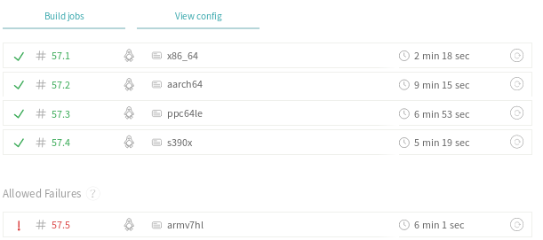
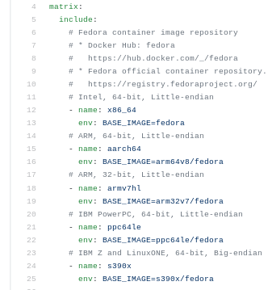
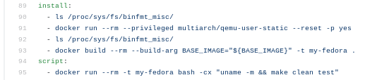
5. multiarch/qemu-user-static and CI (2)
$ cat Dockerfile
ARG BASE_IMAGE=fedora
FROM ${BASE_IMAGE}
...
Go https://github.com/junaruga/fedora-workshop-multiarch/blob/master/.travis.yml !

Slide 20
5. multiarch/qemu-user-static and CI (3)
docker (or sudo podman) run --privileged multiarch/qemu-user-static --reset -p yes
multiarch/qemu-user-static
container
arm64v8/fedora
container
$arch specific binary
make test
$arch specific binary
register script
Ref: A case
without container
Register (add)
Emulate
Emulate
Kernel: /proc/sys/fs/binfmt_misc/qemu-$arch files
commonly used between host and inside container
Already loaded with "flags: F"
x86_64 host

Slide 21
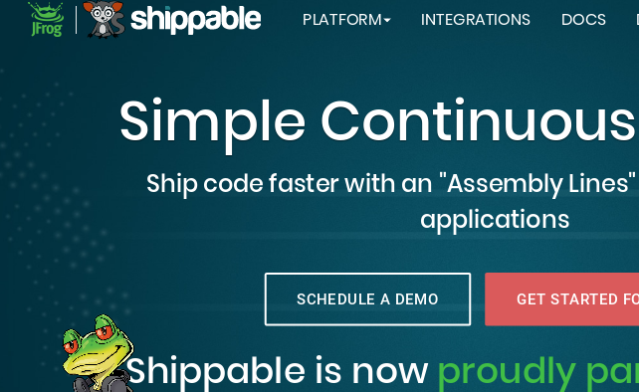


Note A: ARM supported CI services
Image source: https://www.shippable.com/ , https://drone.io/ , https://www.worksonarm.com/cluster/

Slide 22
Note B: A Dockerfile to multi-arch images (1)
podman build --platform
$ cat Dockerfile
FROM fedora
RUN uname -m
$ podman build --rm -t my-fedora:aarch64 --platform linux/aarch64 .
$ podman run --rm -t my-fedora:aarch64 uname -m
aarch64
buildah, podman:
developing in progress.
https://github.com/containers/buildah/issues/1590

Slide 23
Note B: A Dockerfile to multi-arch images (2)
docker build --platform or docker buildx build --platform
$ DOCKER_BUILDKIT=1 \
docker build --rm -t my-fedora:aarch64 --platform linux/aarch64 .
or
$ docker buildx build --rm -t my-fedora:aarch64 --platform linux/aarch64 .
then
Run on installed qemu-user-static RPM.
$ docker run --rm -t my-fedora:aarch64 uname -m
aarch64

Slide 24
Note B: A Dockerfile to multi-arch images (3)
docker/podman build
--platform <platform>
multiarch/qemu-user-static
(qemu-user-static)
x86_64
image
run
build
aarch64
image
Common
Dockerfile
Emulate to run
ppc64le
image
s390x
image

Slide 25
5 steps
to add Fedora multiarch to upstream CI
qemu-$arch-static
binfmt_misc
qemu-user-static RPM
qemu-user-static RPM and container
multiarch/qemu-user-static container and CI

Slide 26
Special Thanks!
multiarch/qemu-user-static project
dbhi/qus project (sister project)
containers/libpod project
containers/buildah project
docker/buildx project

Slide 27
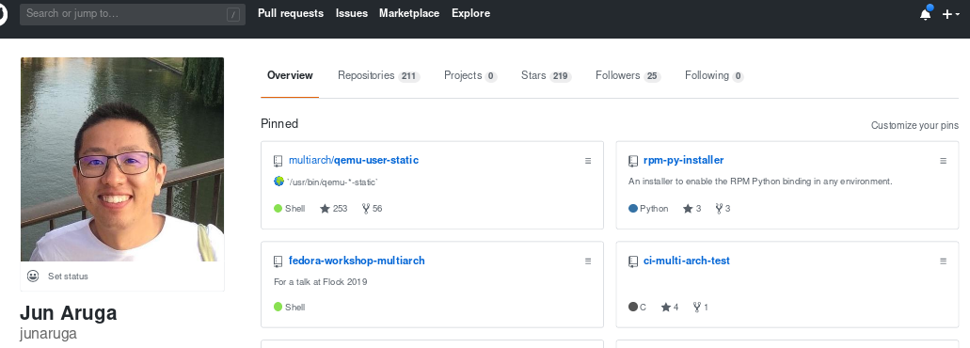
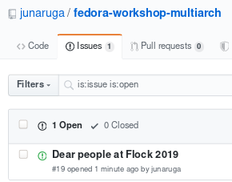
Questions & Answers
Slide URL: https://github.com/junaruga/fedora-workshop-multiarch/slides
Open ticket to ask your questions! 🙆🙋

