Slide 1
Hobby Web Application
Junathan Abraham-Odukale

Slide 2
Shoe-Gle
For this task I created a graphical user interface to keep track of my shoe collection portfolio.
As well as keeping track of shoes that I do not own but want
I created tables where the data would be stored in mysql
The front end was developed using HTML and Java
The program was also tested using Mockito and Selenium
I'm able to add, update and remove elements from both tables
I can also query both tables to find specific shoes

Slide 3
SQL code for portfolio and grail tables
create table Portfolio(shoeID(Or grailID) integer not null auto_increment primary key,
Brand varchar(40),
Sillouhette varchar(40),
Colourway varchar(100),
Size integer,
Collab boolean,
RetailPrice integer,
AftermarketPrice integer
)

Slide 4
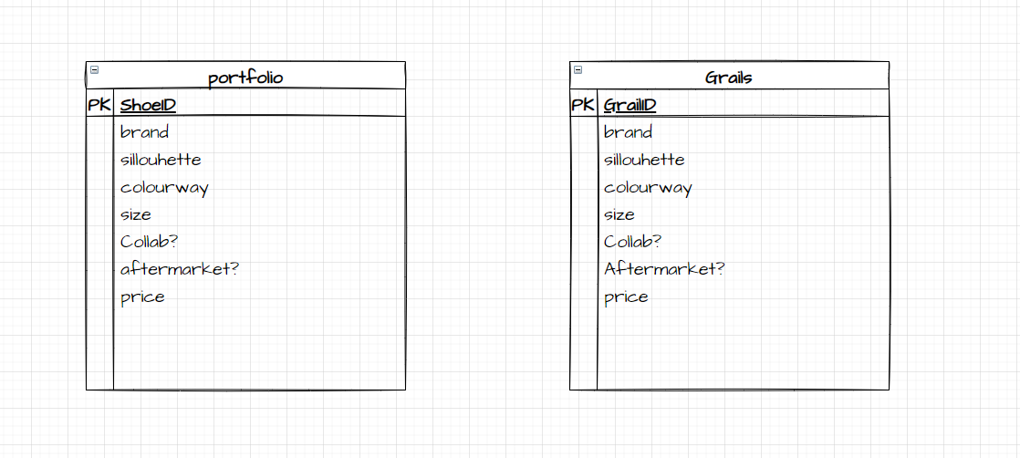
Entity Relationship diagram

Slide 5
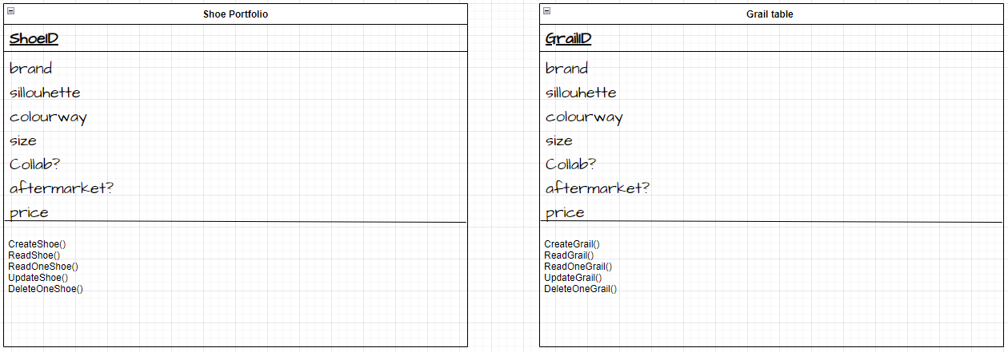
UML Diagram

Slide 6
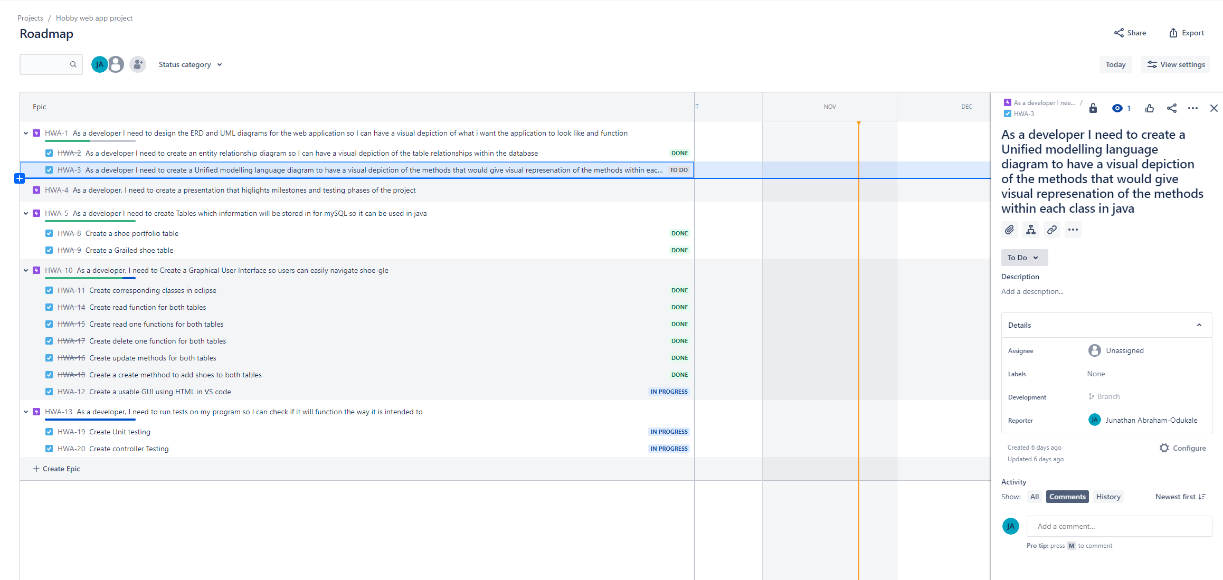
Current Jira board
This Screenshot reflects my Current progress with the web applications developments

Slide 7
Limitations
Due to time constraints and limited knowledge, I was unable to complete the task within the allotted time
No complete instances of testing currently available
I spent majority of the time looking into the backend testing and how to get it working and trying to get it working that I had less time to focus on the front-end HTML form design

Slide 8
What to improve
Better management of time
Extended research on testing using Junit
Understanding in more detail, the difference between unit and Integration testing
Focusing more on creating a minimal viable product instead of getting one section of the code to work

