Slide 1



The New Procurement Catalogue (IPSAS)
February 22 2011
Mr. Dominic Grace
Director, Procurement Support Office
…..is coming 01 January 2012! Click here for updates on progress, training activities and news.

Slide 2
Welcome to the new Procurement Catalogue
Challenges with the current Catalogue
Purpose of the new, revised Catalogue
Benefits to using the Catalogue
Changes impacted by IPSAS
Procurement Cycle
Training Tools
Upcoming Webinars
Additional Resources
…..is coming 01 January 2012! Click here for updates on progress, training activities and news.

Slide 3


Financial Report
Expenses
Leases
Donor Report
Employee Benefits
Fixed Assets
Revenue
Road to IPSAS
Notes:
Key is to highlight that IPSAS is a road, and there are multiple decision points along the way and that this catalogue is one piece of it
KEY – the actual new Catalogue will be implemented May 1st 2011

Slide 4
The Road to IPSAS
  UNSAS
United Nations System Accounting Standards
Internally developed
Inconsistently applied
Transactions and other events when cash is received or paid or a PO dispatched.
  IPSAS
International Public Sector Accounting Standards
Independent
Best practice
Detail orientated, transparent, accurate
“Go Live” January 2012
Transactions and other events are recognized when they occur not just when cash is received or paid or the PO dispatched. This is known as “accrual accounting”
Note
Having accessible accurate and timely global information will be key to UNDP’s adoption of IPSAS
…..is coming 01 January 2012! Click here for updates on progress, training activities and news.
Notes:
- Be reminded that this was presented in the first Webinar by Helen Hall – this shows the difference between how we currently perform accounting practices and what we will do come January 1st 2012

Slide 5
Challenges with Current Setup
  Current UNCCS code set incomplete - Item/Category codes to record correctly
  Incorrect/Inappropriate Category Recording (e.g. – classifying Travel as equipment, DSA as asset, office supplies as Furniture etc.)
  Inconsistent Data Entry (Items, Account etc.)
  Lack of User Friendliness
  No Meaningful Spend Analysis
…..is coming 01 January 2012! Click here for updates on progress, training activities and news.
Notes:
- This is to highlight why we had to introduce a revised/new catalogue – and that while it worked well, the new catalogue ensures we are following policies and procedures and allows for better recording

Slide 6
Purpose of the New Catalogue
  Ease of Use (user selects from the catalogue)
  Item Selection automatically derives the Category, Account, and Asset information
  Improved Data quality and consistency across Atlas
  Complies with UNSPSC codes
  Improved Spend Analysis
…..is coming 01 January 2012! Click here for updates on progress, training activities and news.
Notes:
- May 1 2011 is implementation

Slide 7
Benefits of Procurement Catalogue
Navigation menu makes it easy for requisitioner to select the right item.
A clear way of listing/tracking items which are used within UNDP and items which are delivered to governments and third parties
Provides UNSPSC-reports on goods & services.
Facilitates IPSAS reporting:
    Transparency - clear, consistent and accessible information
    Simplicity - easy to understand information that demonstrates what is going on.
…..is coming 01 January 2012! Click here for updates on progress, training activities and news.
Notes:
- Highlight- Prevents people entering the same data multiple times in different modules.

Slide 8
Impact of changes for Procurement Catalogue Users:
Users of Catalogue:
Requisitioner
Buyer
Operations Manager
Project Manager
External Access User
Decision to be made at beginning of procurement process -- is it a UNDP Asset or a Non UNDP Asset?:
  You will record the asset as “UNDP asset” if you “use and control” it
  This is, GENERALLY, (but not always) determined by the location of the asset.
…..is coming 01 January 2012! Click here for updates on progress, training activities and news.
Notes:
Be sure to highlight and reinforce that a NON UNDP ASSET may be procured by UNDP on behalf of the actual user, but it is instantly given over to third party and is therefore not owned, controled or used by UNDP

Slide 9
Impact of changes for Procurement Catalogue Users: (cont’d)
Examples of “UNDP assets”:
  Furniture purchased for UNDP HQ
  Vehicles purchased for use by UNDP staff to oversee DIM project
Examples of “non UNDP assets”:
  Equipment purchased for use by Govt staff
  Any assets purchased solely for delivery to the Govt.
Additional guidance will be provided. This is a key decision and not an easy one.
…..is coming 01 January 2012! Click here for updates on progress, training activities and news.
Notes:
- Highlight that this decision is made with support of Project manager or senior staff member, and not just by person entering into Atlas

Slide 10
Impact of changes for Procurement Catalogue Users (cont’d)
The Item ID is a mandatory field.
The use of e-Requisition is mandatory for Goods & Services >$2,500.
E-Requisition is Mandatory for all Travel activities (Tickets, DSA & Terminals) irrespective of the value of the transaction.
E-Requisition is Mandatory for all Asset Items.
No Access to Special Request Page
New Process in place to add additional items
…..is coming 01 January 2012! Click here for updates on progress, training activities and news.
Notes:
- Must highlight the threshold

Slide 11
Procurement Cycle:
The Procurement cycle in any organization can be divided into 6 steps as follows:
Step 1: Requisition Creation and Approval
Step 2: Purchase Order creation, Approval and sending to Vendor
Step 3: Receive and inspect the items
Step 4: Invoice Creation
Step 5: Verification of invoice with Purchase Order and Receipt
Step 6: Payment
…..is coming 01 January 2012! Click here for updates on progress, training activities and news.

Slide 12
Training tools
* Training on the new Catalogue to be offered to all staff starting in April, and will include the following:
  Webinars
  OnDemand
  Teamworks/Share point
Multiple Training sessions will be scheduled to accommodate user needs
Finalized schedule to be shared with all countries by mid March – training will be mandatory
…..is coming 01 January 2012! Click here for updates on progress, training activities and news.

Slide 13
Schedule of Webinars
These webinars are intended to introduce you to the topic, and to allow you to familiarize yourself with how IPSAS will impact your work.
An Introduction to IPSAS – 26 January 2011 – 7am, 1pm, 10pm - COMPLETED
IPSAS Ready Procurement Catalogue – 22 February 2011 – 7am, 1pm, 10pm - COMPLETED
Employee Benefits – 29 March 2011 – 7am, 1pm, 10pm
Revenue – 26 April 2011 – 7am, 1pm, 10pm
Asset Management – 31 May 2011 - 7am, 1pm, 10pm
Expense – 28 June 2011 – 7am, 1pm, 10pm
Reporting – 26 July 2011 – 7am, 1pm, 10pm
…..is coming 01 January 2012! Click here for updates on progress, training activities and news.

Slide 14

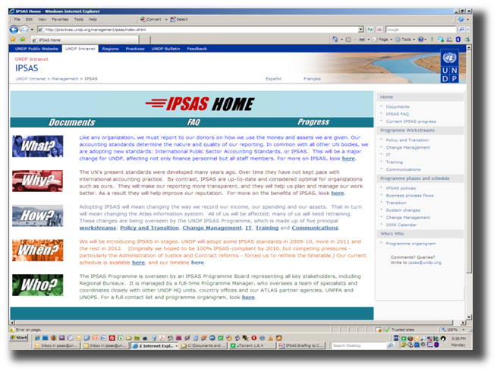
Additional Resources
Consult the IPSAS intranet website
http://practices.undp.org/management/ipsas/index.shtml
Learn more at LMS UN IPSAS courses
https://gm1.geolearning.com/geonext/learning_un/coursesummary.CourseCatalog.geo?id=22505494843
Ask your questions and get them answered on Teamworks
https://undp.unteamworks.org/node/18074
…..is coming 01 January 2012! Click here for updates on progress, training activities and news.

