Slide 1
Modeling and Generation of Soft Data in Kinematic Scenarios for Surveillance Applications
Scenarios for Surveillance Applications
S. Rostamiª, R. Tharmarasaª, Mike McDonald^{b}, Mihai Florea^{c} and T. Kirubarajanª
ªMcMaster University, Hamilton, ON, Canada
^{b}Defence Research and Development Canada, Ottawa, ON, Canada
^{c}Thales Research and Technology, Québec, QC, Canada

Slide 2
Motivation
Why we need soft data:
Increasing the accuracy of estimates from hard data
Locations where hard sensors do not exist
Source of soft data:
Social Media
Phone Call
Text Message
Why simulated soft data:
Companies do not like to share their clients data
Real soft data is expensive
Complex algorithm should be applies on real data (NLP)
In contrast to hard data, lack of software for generating soft measurements.
Hard to find hard and soft data for the same time duration
With ground truth

Slide 3
Soft Data Simulator
Simulator supports:
Different type of events
First hand Information
Second Hand Information
Information from other sources
Scenario specifications:
Event
Location
Time
Sensors
Trajectories
Characteristics
Measurements
Specific for the event

Slide 4
Data Types
Data
String
Integer
Fuzzy
Integer
Enumerate
Time

Slide 5
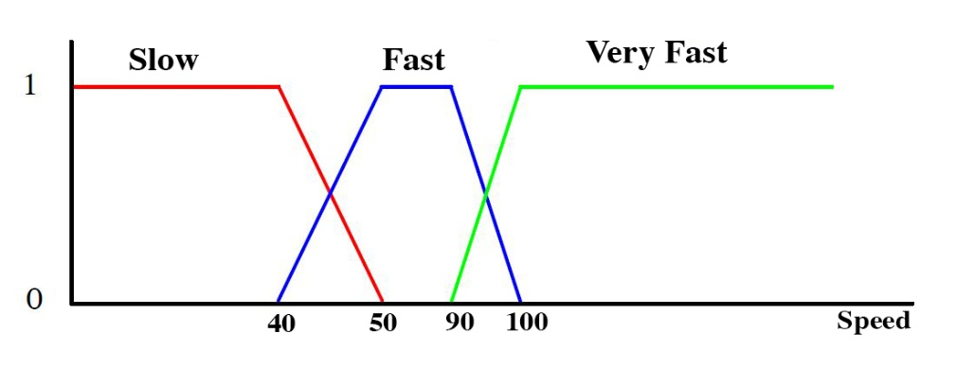

Fuzzy Data
Fuzzy type data:
Let U be a universe of discourse and F be a fuzzy set in U. A membership function is defined for F as follows:
$$μ_{F}:U →[0,1]$$
And the Fuzzy set F can be defined as;
$$F=\{\left(u_{1},μ_{F}\left(u_{1}\right)\right),\left(u_{2},μ_{F}\left(u_{2}\right)\right),…,(u_{n},μ_{F}(u_{n}))\}$$

Slide 6
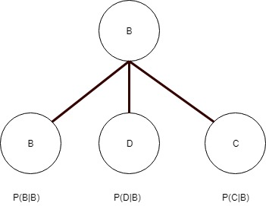
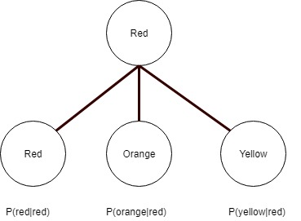
Confusion Matrix
String - Integer & Enumerate type data:
Letter | B | D | C
B | 0.5 | 0.3 | 0.2
D | 0.1 | 0.6 | 0.3
C | 0.2 | 0.4 | 0.4
Color | Red | Orange | Yellow
Red | 0.4 | 0.3 | 0.3
Orange | 0.3 | 0.5 | 0.2
Yellow | 0.1 | 0.2 | 0.7

Slide 7
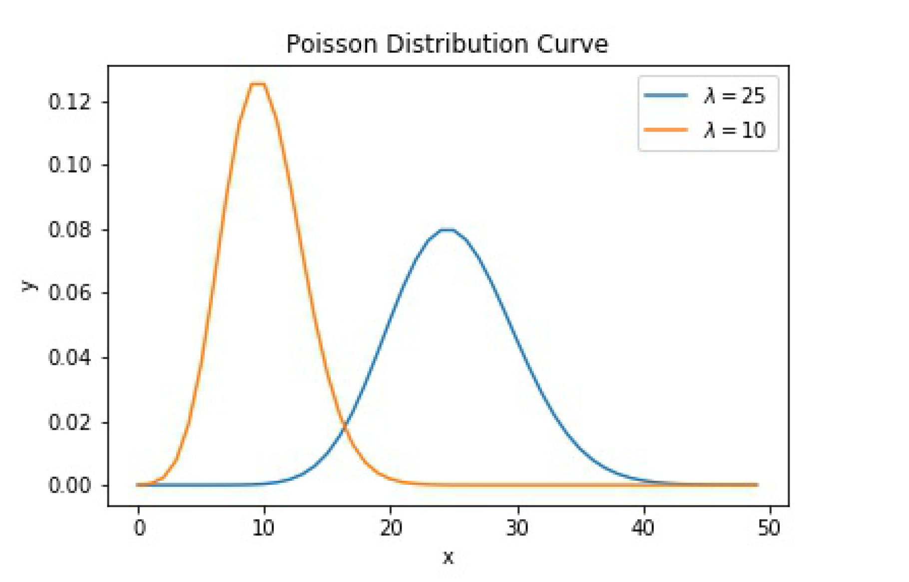
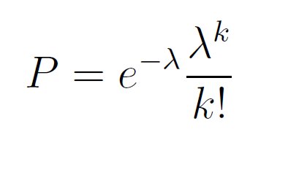
Integer Type Data
Integer type data:
Number of death people
Number of cars in accident
Number of passengers
Generated data should be around ground truth
Poisson distribution

Slide 8
Soft Data Simulator Diagram
Event
Generator
Details of accident
Simulator
Traffic
Simulator
Sensor
Trajectories
Output
Reference Time
Active Sensors Probabilities
Respond Type
Measurements
Sensor
Config.

Slide 9
Event Generator
Event Generator Input File(.xml)
Event Severity
Event ID
Event time : simulation duration, start time
Event Location : latitude, longitude / place name, street etc.
Event Details:
accident
number of cars
possible car types
number of passengers

Slide 10
Event Generator (2)
Event Properties
Real Accident
False Alarm
Any Type
of Accident
Dynamic
Severity

Slide 11
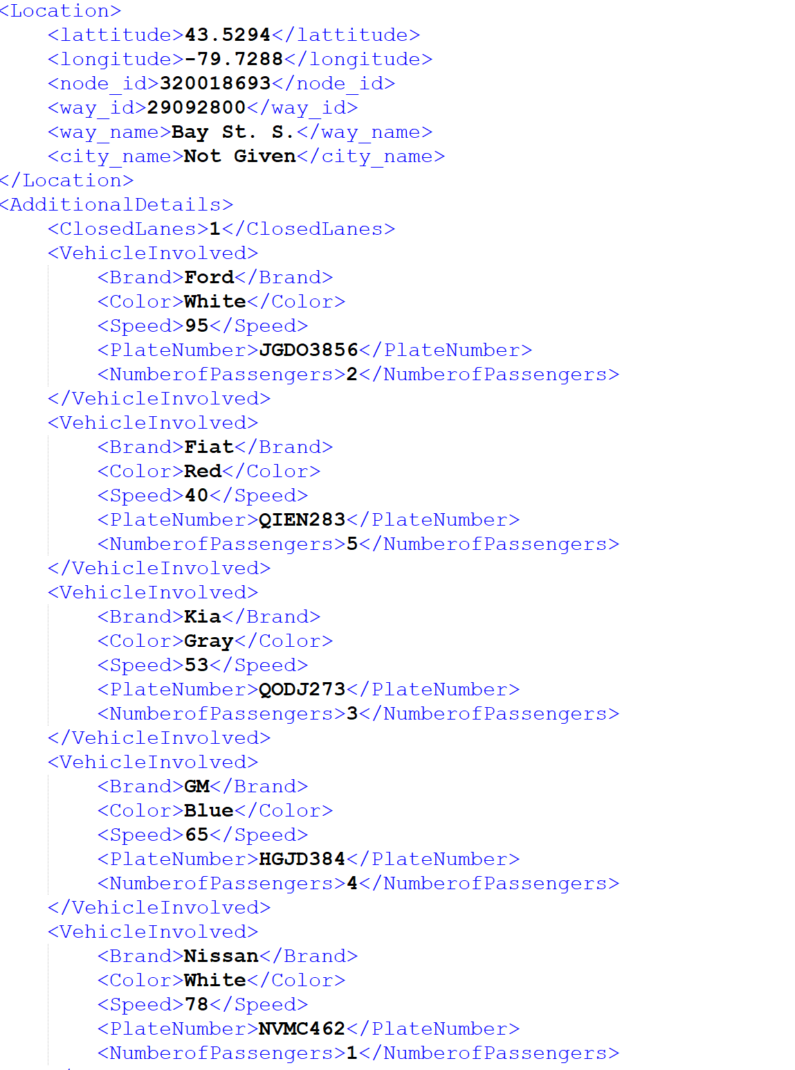
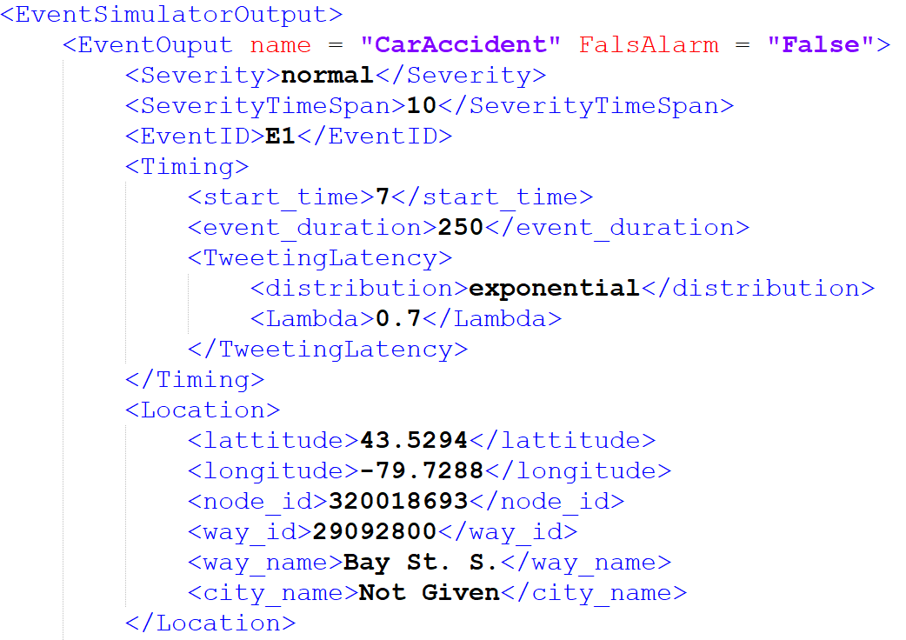
Event Generator (3)

Slide 12
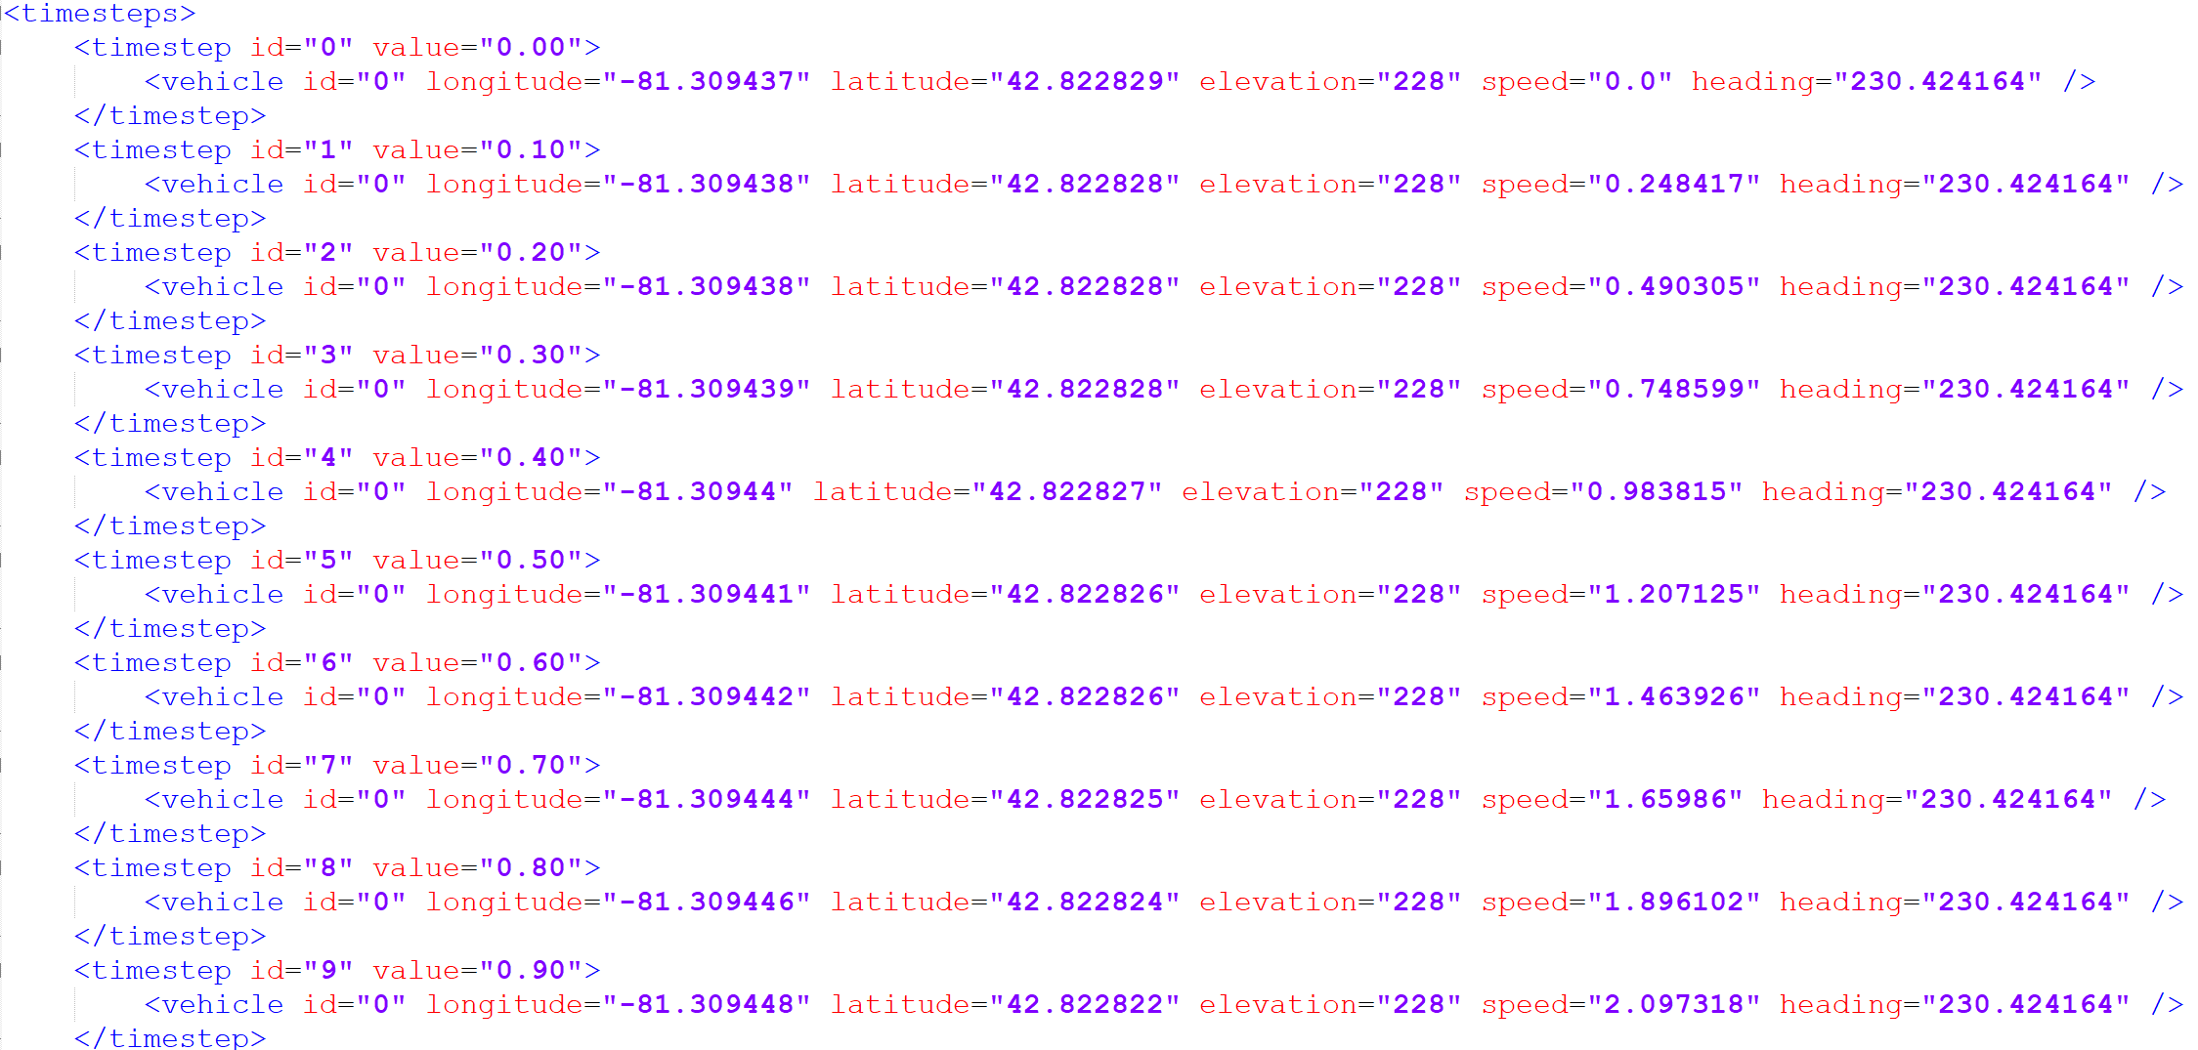
Sensor Trajectory
Traffic Simulator
Latitude
Longitude
Time
Speed
Car
Car ID
Vehicle Type
Number of the People in the car
People ID
People in the cars are our sensors in this simulation

Slide 13
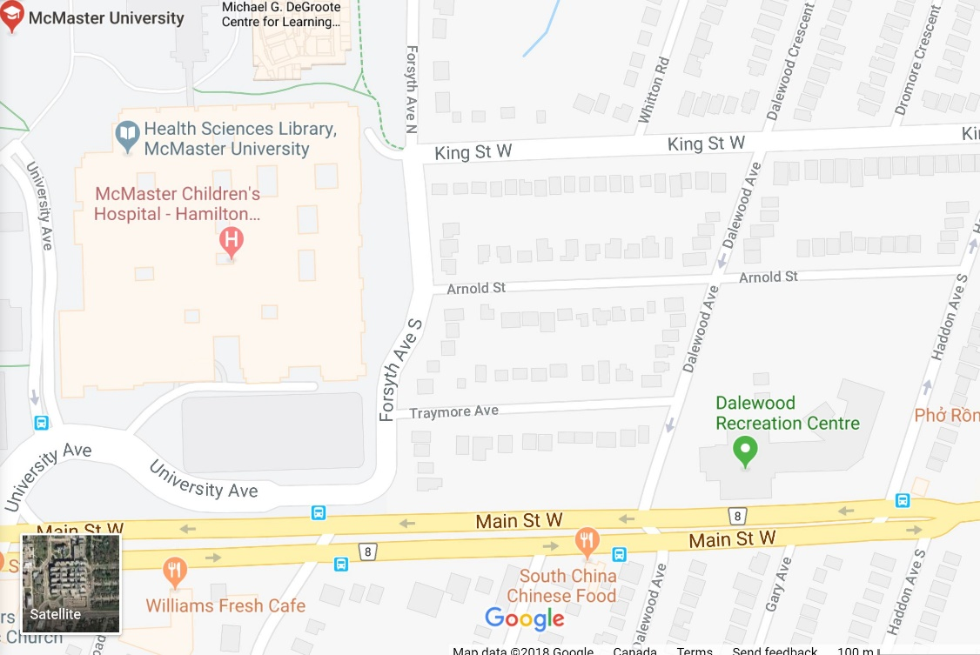
Gating & Timing
Gating:
Event File
Latitude and Longitude of Accident
Traffic Simulator
Latitude and Longitude of Accident
Timing
Accident Time
Closest Distance to Accident Time
Report Time

Slide 14
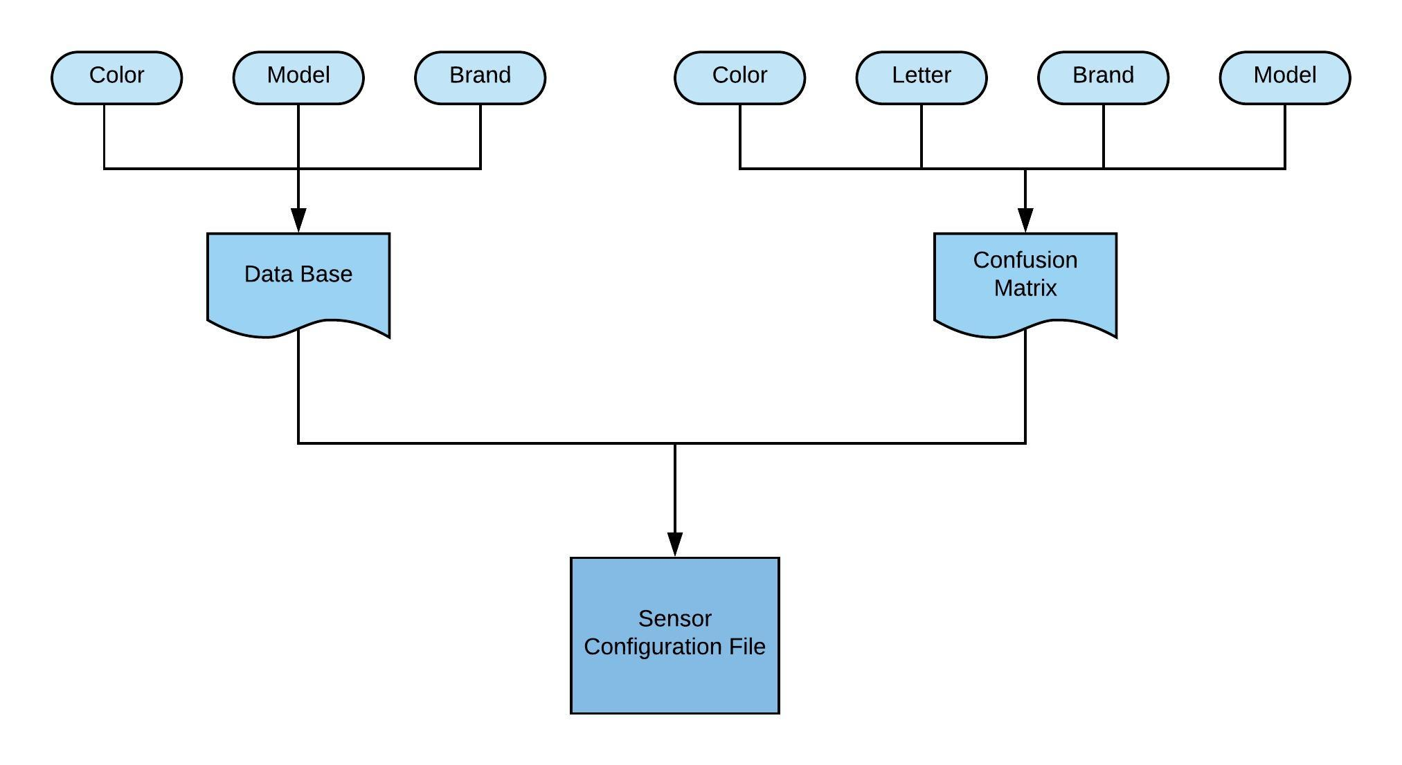
Sensor Configuration
Sensor Configuration File :
Reference Time
Data Base Address
Event
Gating Distance
Active Sensors
Type of Respond
Tweet
Text Message
Phone Call
etc.
Measurements
Brand
Color
Speed
Number of injured or death people
etc.

Slide 15
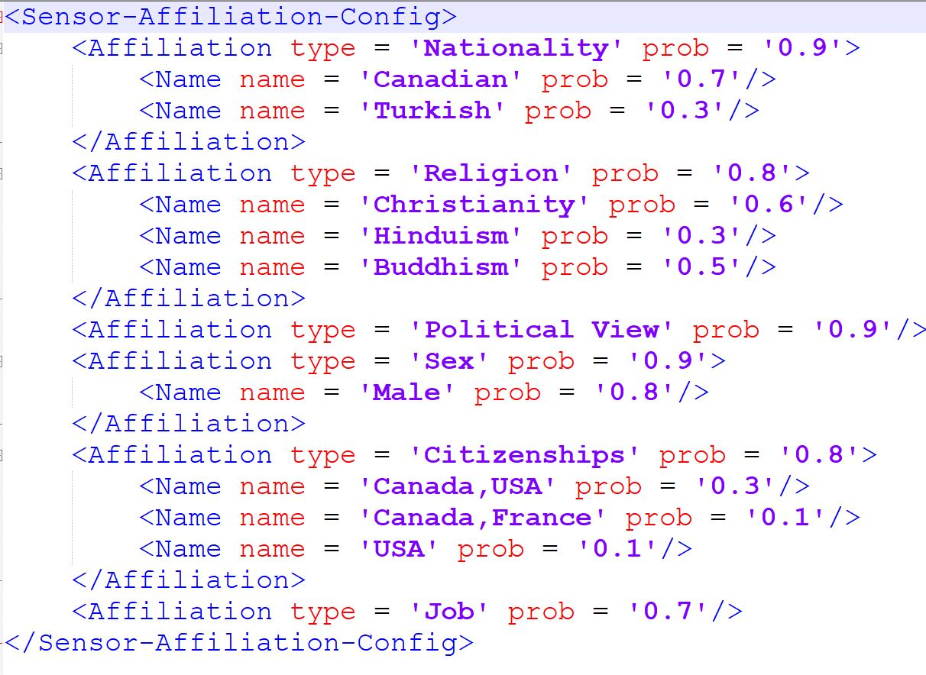
Sensor Characteristics
Sensor Characteristics Configuration File:
Nationality
Religion
Political View
Sex
Citizenships
Job
etc.

Slide 16
Second Hand Information
Challenge:
How to decide which one is true
Secondary Sensors
Confusion
Matrix
Majority
Accuracy
Characteristics

Slide 17
Second Hand Information (2)
Majority
Accuracy
S5
S5
S1
S2
S3
S4
S1
S2
S3
S4
Red
Red
Blue
Red
0.2
0.5
0.7
0.3

Slide 18
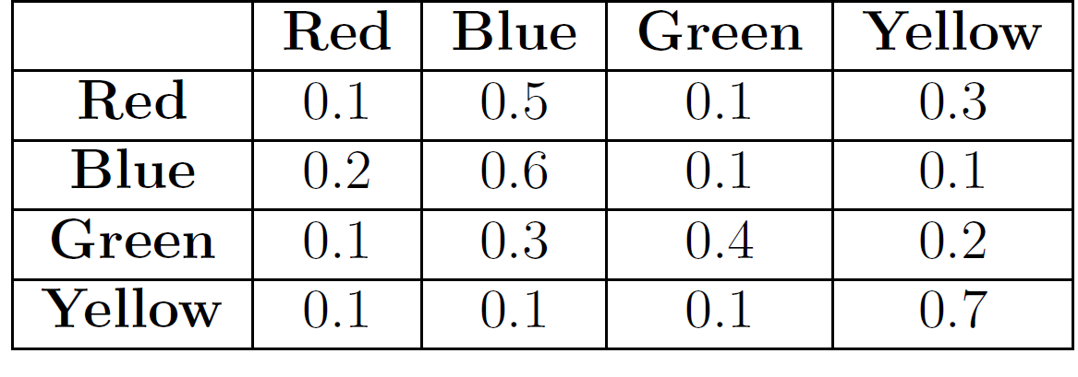
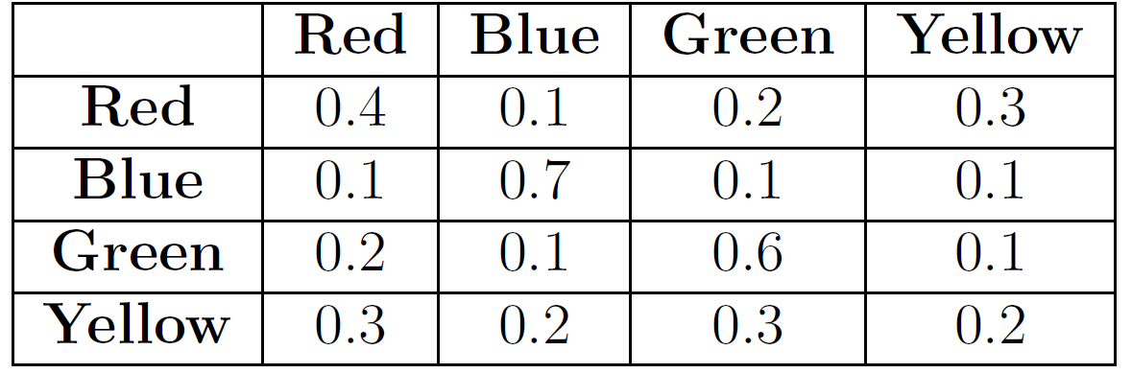
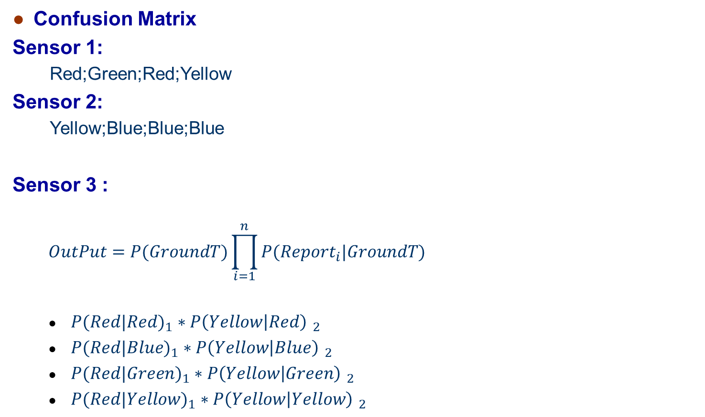
Second Hand Information (3)
Confusion Matrix
Sensor 1:
Red;Green;Red;Yellow
Sensor 2:
Yellow;Blue;Blue;Blue
Sensor 3 :
$$OutPut=P(GroundT)\prod_{i=1}^{n}{P({Report}_{i}|GroundT)}$$
${P(Red|Red)}_{1}∗{P\left(Yellow | Red\right) }_{2}$
${P(Red|Blue)}_{1}∗{P\left(Yellow | Blue\right) }_{2}$
${P(Red|Green)}_{1}∗{P\left(Yellow | Green\right) }_{2}$
${P(Red|Yellow)}_{1}∗{P\left(Yellow | Yellow\right) }_{2}$

Slide 19
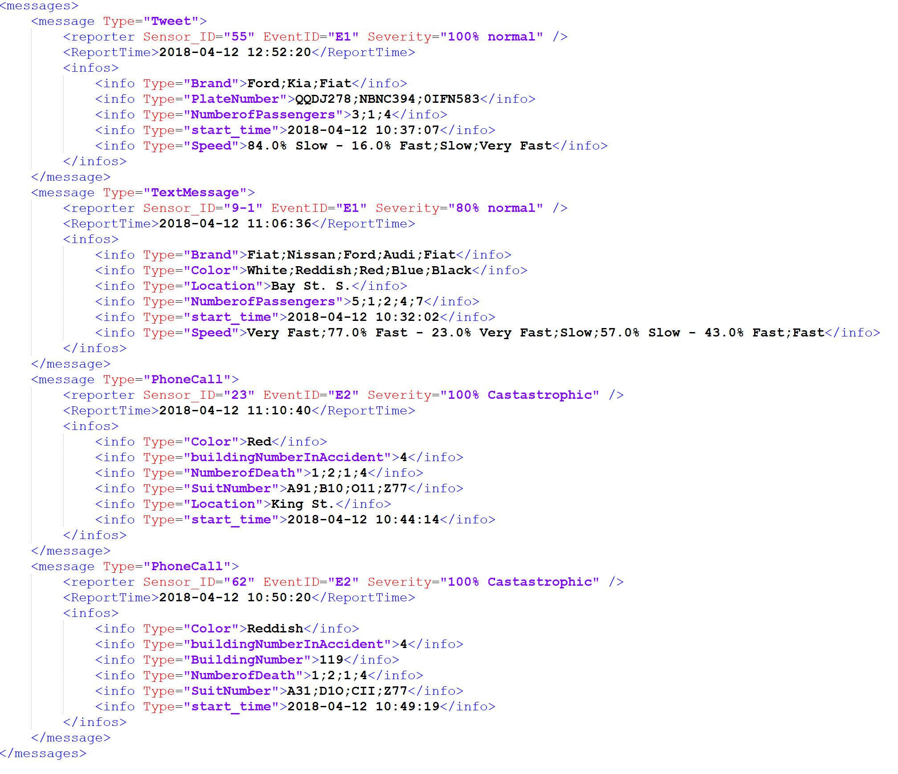
Results

Slide 20
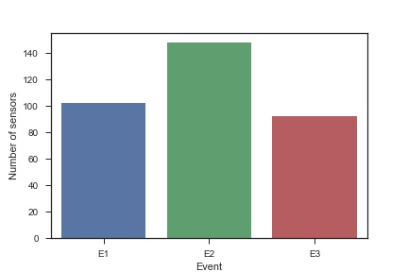
Results (2)
 | E1 | E2 | E3
Inside Gate Sensors | 170 | 165 | 157
Probability | 0.6 | 0.9 | 0.6
Active Sensors | 102 | 148 | 94

Slide 21
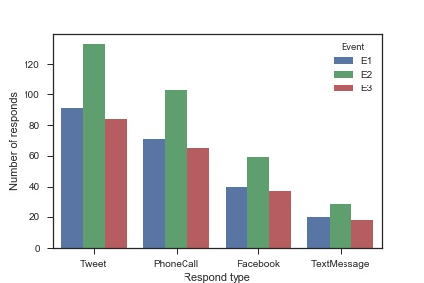
Results (3)
 | E1 | E2 | E3
Active sensors | 102 | 148 | 94
Tweet , 90% | 92 | 133 | 84
Phone call, 70% | 71 | 104 | 66
Text message, 20% | 20 | 30 | 19
Facebook, 40% | 41 | 59 | 38

Slide 22
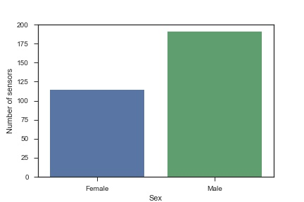
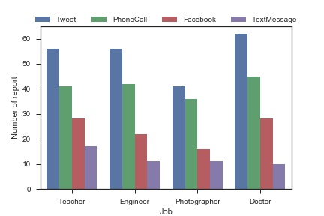
Results (4)

Slide 23
THANK YOU！

