Slide 1
NORTHWESTERN MLDS · NLP · SPRING 2026 · OPTION 2
Multi-LexSum
Hierarchical summarization and civil-rights lawsuit classification
TEAM
Junbo Lian
Yujun Sun
Data · Integration
Summarization
Feng Xiong
Jianong Xu
Classification
App · Evaluation
Final Project
Notes:
Hi everyone. I'm Jacob. With me are Yujun, Feng, and Jianong. Our project is called Multi-LexSum. We work with civil rights lawsuits. We summarize them and classify them. Let me start with the data.

Slide 2
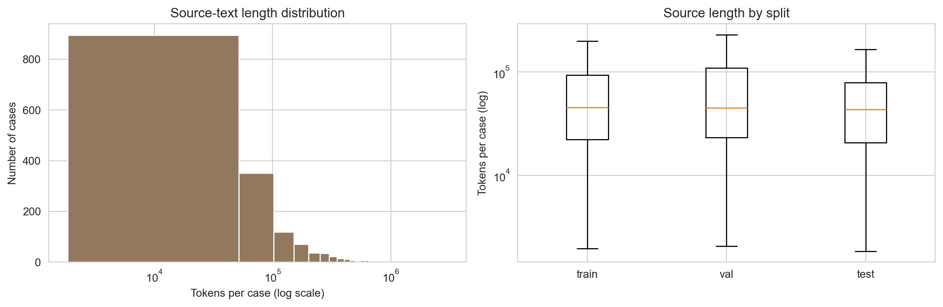
THE DATA
02
Long documents, expert summaries
Multi-LexSum: 4,539 federal civil-rights cases, 1,602 with all three reference summaries and complete metadata.
MEDIAN CASE
44.8K
tokens per case
= 87× BERT's 512-token context limit.
Source-text token distribution (log scale). Long tail to 3M; train · val · test identical.
Longest case: 3,002,324 tokens.
Direct transformer feed impossible — motivates §2.
1,602 cases 24 raw labels 3 granularities
Notes:
Multi-LexSum is a dataset of federal civil rights lawsuits. It comes from the Civil Rights Litigation Clearinghouse. Every case has three expert-written summaries. We call them long, short, and tiny.
We start with 4,539 cases. We keep only the ones with all three summaries and full metadata. That gives us 1,602 cases.
Now look at the size. The median case has 44,800 tokens. That is 87 times more than BERT can handle. The longest case has 3 million tokens.
This is the main challenge. We cannot feed a full case into BERT or any transformer. So we need a hierarchical pipeline. Yujun will explain that in section two.

Slide 3
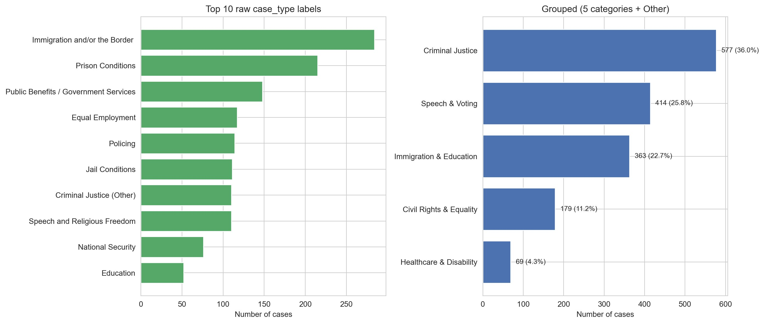
PREPROCESSING
03
Cleaning, then collapsing 24 labels into 5
Seven regex passes catch 614 citations per case (mean) in 74 ms. Mostly reporter cites and U.S.C. references.
CASE_TYPE GROUPING
24 → 5
labels collapsed. 0% in 'Other'.
Criminal Justice
577
36%
Speech & Voting
414
26%
Immigration & Education
363
23%
Civil Rights & Equality
179
11%
Healthcare & Disability
69
4%
— Class-action rate varies 15.5% (Speech & Voting) to 57.7% (Criminal Justice).
Notes:
First, cleaning. The raw text has a lot of legal noise. Things like page numbers, court citations, and footnotes. We wrote seven regex patterns to remove them. On average, each case has 614 citations. We process each case in 74 milliseconds.
Next, the case type. The original data has 24 different labels. That is too many. Some labels have only four cases. We collapse them into five groups based on legal theme. After two rounds of fixing the mapping, every case fits in one of the five. Zero percent goes to "Other".
Here are the group sizes. Criminal Justice is the biggest with 577 cases. Healthcare and Disability is the smallest with 69.
One finding to highlight. The class-action rate is very different across groups. In Speech and Voting, only 15.5 percent of cases are class actions. In Criminal Justice, it is 57.7 percent. That is a strong signal we will use later.

Slide 4

SUMMARIZATION
04
Why extraction comes first
The data is long; the design question is how to ground generation without blowing up context or cost.
DESIGN CONSTRAINT
WHAT WE DO INSTEAD
A median case is already 44.8K tokens, but BART-style generation sees roughly 1K tokens at once.
Full case tens of thousands of tokens
LexRank evidence packet 3,500 selected tokens
If we feed only the lead pages, the model misses filings, remedies, and procedural posture. If we use long-context models everywhere, runtime and memory dominate the project.
BART/T5 generation long, short, tiny
Key idea: extractive reduction is not the final summary; it is the grounding layer that makes abstractive summarization feasible.

Slide 5
PIPELINE
5
Extract -> abstract -> compress
LexRank creates a 3,500-token evidence packet, then BART and T5 produce the three required granularities.
STAGE DESIGN
FULL CASE -> 3 OUTPUTS
Clean case 1.8K-3.0M tokens
LexRank TF-IDF graph + PageRank
BART long + short
T5-small tiny sentence
One pipeline returns {long, short, tiny}. 92.0% median reduction on test.
Candidate cap
650
sent.
LexRank edge
0.10
cos
Shared evidence base reduces hallucination surface before abstractive generation.
Evidence packet
3.5K
tok.
BART decode
4
beams
T5 tiny lr
5e-5
rate
Key finding: extract first, generate second keeps local inference tractable for legal-length sources.

Slide 6
RESULTS
6
Summarization smoke results
End-to-end path verified on 2 test cases; run full test split before final claims.
Output | ROUGE-1 | ROUGE-2 | ROUGE-L | BERTScore | Scope
long | 0.214 | 0.068 | 0.124 | 0.740 | n=2 smoke
short | 0.278 | 0.084 | 0.187 | 0.749 | n=2 smoke
tiny | 0.245 | 0.118 | 0.151 | 0.735 | n=2 smoke
Stage A | 92.0% |  | median | reduction | n=312 test
Good case: CJ-AL-0020 preserves plaintiff, fines, jail term, and inability-to-pay facts. Failure risk: CJ-AL-0007/T5 tiny repeats source wording and keeps OCR noise such as "impowrished".

Slide 7
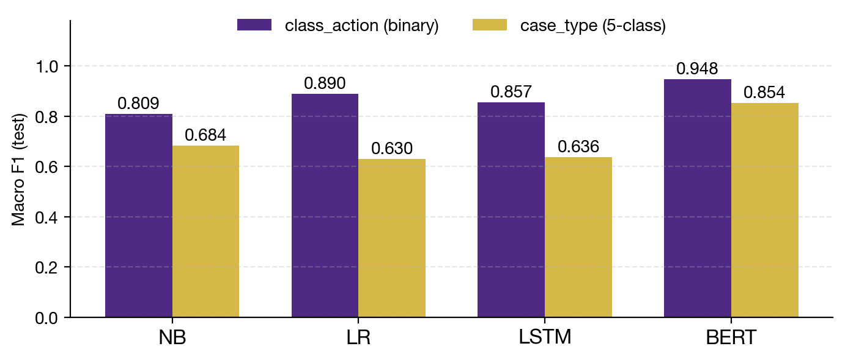
CLASSIFICATION
07
Two tasks, four models
From TF-IDF baselines to a Legal-BERT fine-tune, all on the same 1,602-case split.
MACRO-F1 LIFT
+17
pts · Legal-BERT vs best classical on case_type
Legal-BERT wins both tasks. The 5-class gap is the bigger story.
Macro F1 (test) for all 4 models × 2 tasks. Both Legal-BERT bars > 0.85.
Input: long_ref (median ≈ 250 tokens). 1,129 train / 161 val / 312 test.
4 models 2 tasks 8 runs
Notes:
LAYOUT A — Hero stat + figure (single dominant number) BEST FOR: Slide 4 (Yujun: motivation for hierarchical — hero could be 'long-tail token count') Slide 7 (Feng: classification approach with key model count) RECIPE: - LEFT: small label → big hero number → italic unit caption → punchline → muted sub-text - RIGHT: figure (h=2.05) → caption → thin rule → 3 inline secondary stats - Replace the rectangle placeholder with addImage()

Slide 8
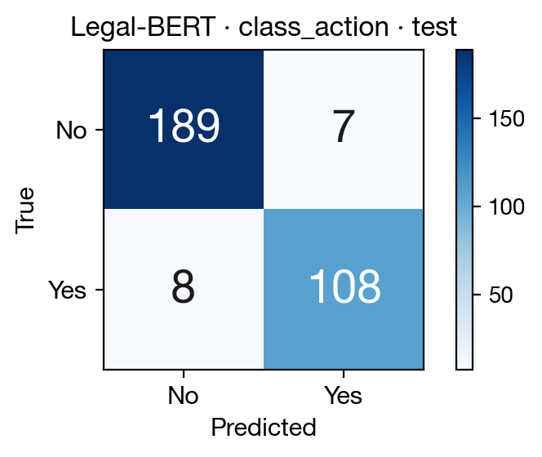
RESULTS
08
class_action — Legal-BERT lifts F1 by +5.8 pts
Binary task, 312 test cases. AUC ≥ 0.92 for every model; macro F1 separates them.
CONFUSION MATRIX · LEGAL-BERT
0.948
Legal-BERT macro-F1 (test). +5.8 pts over LR, +13.9 pts over NB.
Legal-BERT
0.948
0.971
LR (TF-IDF)
0.890
0.968
Bi-LSTM
0.857
0.929
Naive Bayes
0.809
0.920
— Legal-BERT recovers 108 / 116 'Yes' cases (93 % recall) with only 8 false negatives.
Notes:
LAYOUT B — Figure-prominent + hero + list BEST FOR: Slide 5 (Yujun: pipeline diagram on left, model selection table on right) Slide 8/9 (Feng: confusion matrix on left, per-class metrics on right) Slide 11 (Jianong: SHAP/attention viz on left, error cases on right) RECIPE: - Title + optional intro sentence - Thin rule - LEFT 60%: figure (w=5.7, h=2.55) - RIGHT 40%: HERO (e.g. 'A → B'), short caption, list of 5 rows - Bottom: italic pull-quote with gold em-dash

Slide 9
RESULTS
09
case_type — only Legal-BERT handles the tail
5-class task, 312 test cases. Headline: macro-F1 = 0.854 for Legal-BERT; +17 pts over the best classical baseline.
Model | Features | Accuracy | Macro-F1 | AUC | F1 on smallest class
Naive Bayes | TF-IDF (Complement) | 0.776 | 0.684 | 0.944 | 0.222
LR (TF-IDF) | L2 · class-balanced | 0.760 | 0.630 | 0.971 | 0.000
Bi-LSTM | Word2Vec 300d | 0.744 | 0.636 | 0.914 | 0.154
Legal-BERT | Fine-tune, 3 epochs | 0.897 | 0.854 | 0.972 | 0.645
Finding: on the rarest class 'Healthcare & Disability' (n = 16), LR scores F1 = 0.000 — zero recall. Legal-BERT scores 0.645, the only model that preserves long-tail performance.
Notes:
LAYOUT C — Results comparison table BEST FOR: Slide 6 (Yujun: summarization ROUGE / BERTScore by granularity) Slide 8 (Feng: class_action results — 4 models compared) Slide 9 (Feng: case_type results — 4 models, macro-F1) RECIPE: - Title + 1-line italic lede stating the headline finding - Wide table, purple header row - Purple-wash callout below with the 'so what' - Don't pack > 6 columns. If you need more comparisons, split into 2 slides.

Slide 10
Interactive tool demo
10
One end-to-end app now connects summarization, classification, and explainability
Input case text
1. LexRank trims long case records into a manageable evidence packet
2. BART generates long and short summaries from the reduced text
3. T5 compresses the short summary into a tiny one-line version
4. Legal-BERT predicts class action + grouped case type
5. The Explainability tab shows LR SHAP plots and a BERT attention heatmap
Tabs: Summaries | Predictions | Explainability
Local demo: python -m app.gradio_app | Spaces entrypoint: app.py
Notes:
LAYOUT D — Full-bleed visual BEST FOR: Slide 10 (Jianong: Gradio demo screenshot or live screencast) Slide 11 (Jianong: large SHAP plot or BERT attention heatmap) RECIPE: - Title gives the demo name - One large image, no other visuals competing - Small caption below — URL, version, or what to focus on TIP for slide 10: pre-record a backup screencast. Live demos fail.

Slide 11
Explainability & error analysis
11
The app now has real evidence-backed cases, not placeholders
01
What the app explains
LR SHAP token plots render live for both tasks on the generated long summary. The BERT attention panel is included for qualitative inspection only; it is not treated as causal proof.
02
Five concrete cases
Notebook 06 and results/error_cases.md now freeze five categories: model disagreement, summary divergence, high-confidence wrong, low-confidence correct, and rare-class recovery.
03
What the errors show
Boundary cases like IM-CA-0025 split the model families, prison-heavy wording pulls multiple models toward Criminal Justice, and Legal-BERT is the only model that reliably recovers the rare Healthcare & Disability class.
Artifacts: results/predictions/*.csv + results/app/explanations/*.png
Notes:
LAYOUT E — Numbered takeaway list (conclusion) BEST FOR: Slide 12 (Jianong: lessons & future work — the closer) RECIPE: - Three takeaway cards, each with a big numeral (01/02/03) - One line for the heading, one line for the body - Italic pull-quote at the bottom: future work VOICE: Be specific. Avoid 'we learned a lot'. State what surprised you.

Slide 12
Lessons & future work
12
What the project taught us and what remains open
01
Summarization takeaway
Long legal cases need aggressive extractive compression before standard encoder-decoder models can summarize them reliably. The hierarchical pipeline is what makes the project feasible on commodity hardware.
02
Classification takeaway
Legal-BERT is the strongest classifier, especially on rarer case-type groups. The biggest gains over LR and Bi-LSTM show up on Healthcare & Disability, where classical models collapse.
03
Tool / integration takeaway
The biggest engineering lesson was ownership-friendly integration: one app contract can reuse the team's summarization and classification artifacts without rewriting upstream code.
Future work: strengthen tiny-summary training, improve long-summary factual consistency, and optionally retrain classifiers on generated summaries later.

