Slide 1

Experiments and Investigations for the TinyBERT Distillation Method
Xinyi Yang, Haoyun Xu and Junchao Wu
2022 - CISC7021 Applied Natural Language Processing
Professor：Derek, Fai Wong

Slide 2

CONTENTS
Introduction
Preliminaries
Methodology
Experiment
Relative Work
Conclusion

Slide 3

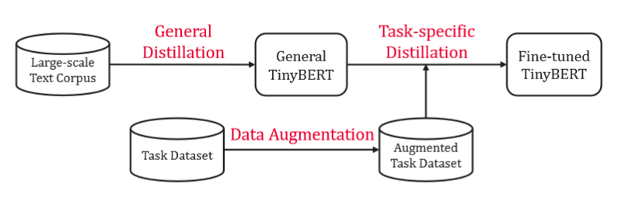
INTRODUCTION
Xinyi Yang
BACKGROUND
Neural network models show a progressive trend in size, numerous parameters, huge volume and other objective factors, leading to many limitations and difficulties in their use and deployment.
Figure 1: The illustration of TinyBERT learning.
(Jiao et al., 2020)

Slide 4
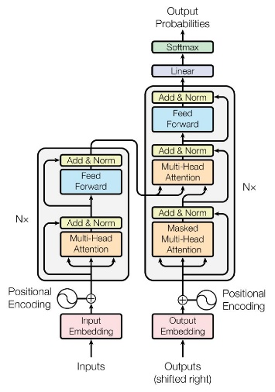
PRELIMINARIES
TRANSFORMER
Xinyi Yang
Transformer is a deep learning model based entirely on Self-Attention, which has a simple structural model and excellent parallelization of computation, and therefore outperforms the popular recurrent neural network in terms of accuracy and performance.
Figure 2: The Transformer - model architecture.
(Vaswani et al., 2017)

Slide 5
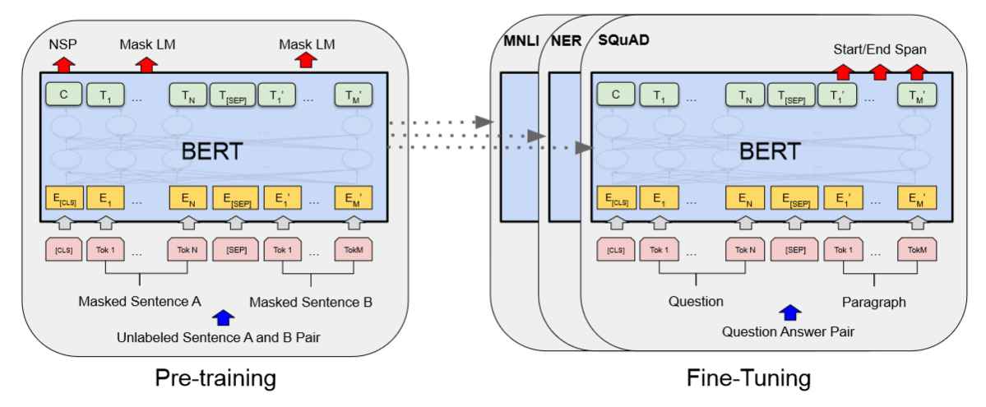
PRELIMINARIES
Xinyi Yang
BERT
(Bidirectional Encoder Representations From Transformers)
The pre-trained BERT model can be fine-tuned with an additional output layer to create state-of-the-art models for a wide range of tasks without extensive modifications to the task-specific architecture.
Figure 3: Overall pre-training and fine-tuning procedures for BERT. (Devlin et al., 2019)

Slide 6
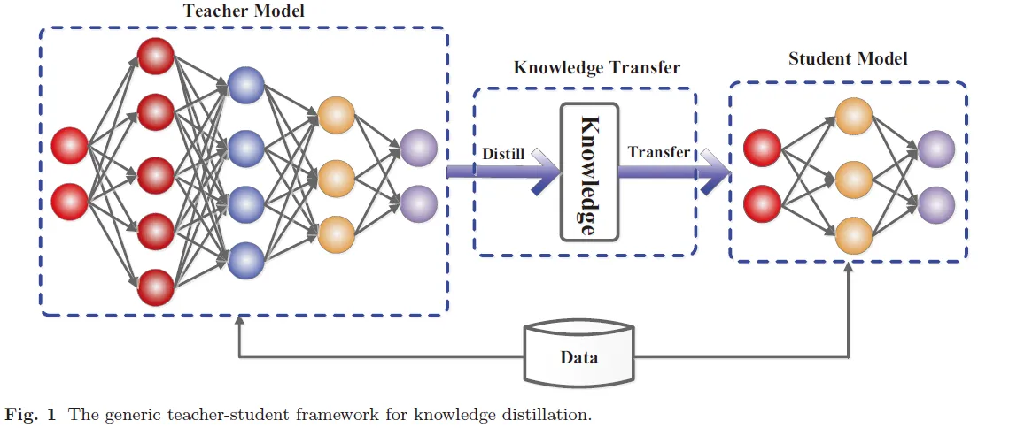
PRELIMINARIES
Xinyi Yang
KNOWLEDGE DISTILLATION (DK)
Knowledge distillation is one of the main model compression techniques, by constructing a small lightweight model and using supervised information from a larger model with better performance to train this small model with the aim of achieving better performance and accuracy.
Figure 4: The Generic Teacher-Student Framework for Knowledge Distillation.
(https://blog.csdn.net/u012347027/article/details/111415197)

Slide 7
METHODOLOGY
Haoyun Xu
TINYBERT TRAINING PIPLINE
STEP | SPECIFIC OPERATION
1 | Using Bert base as teacher model for general distillaton on a large-scale text corpus to acquire a general student model
2 | Using task-related dataset to finetune a Bert base model as the teacher model for task-specific distillaton
3 | Using the teacher model in step 2 to further distill student model on an augmented task-specific dataset. In this step, student model is initialized with the model in step 1. (embedding loss + hidden state loss + attention loss)
4 | Repeat step 3, in this step, student model is initialized with the model in step 3. (pred loss)

Slide 8
METHODOLOGY
Embedding Distillation &Hidden State Distillation
Haoyun Xu
0
…
Because embedding and hidden state have the same shape(text length * hidden size), in the code they are sent into the same array for processing distillation.
0
3
1
…
2
6
3
The first layer of the mapping(0) is the embedding and the rest of the layers are hidden state.
…
4
9
…
12
Figure 5: Layer Mapping in Embedding and Hidden State Distillation

Slide 9


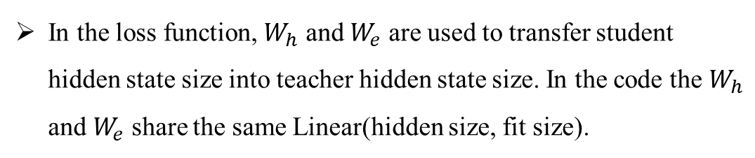
METHODOLOGY
Embedding Distillation &Hidden State Distillation
Haoyun Xu
In the loss function, $W_{h}$ and $W_{e}$ are used to transfer student hidden state size into teacher hidden state size. In the code the $W_{h}$ and $W_{e}$ share the same Linear(hidden size, fit size).

Slide 10
METHODOLOGY
Attention Distillation
Haoyun Xu
…
new_teacher_atts=[teacher_atts[i * layers_per_block + ayers_per_block - 1] for i inrange(student_layer_num)]
2
0
…
1
6
2
…
3
8
…
11
Figure 6: Layer Mapping in Attention Distillation

Slide 11
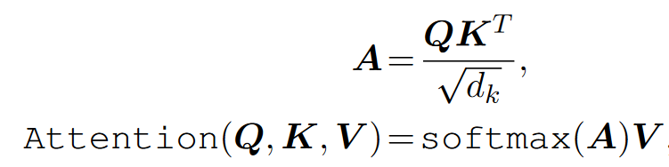
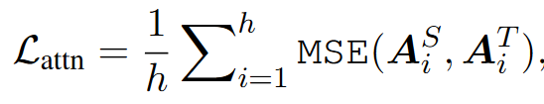
METHODOLOGY
Attention Distillation
Haoyun Xu
The attention distillation uses the unnormalized attention matrix A instead of its softmax output, since experiments in the original paper show that the former setting has a faster convergence rate and better performances.
Because the shape of unnormalized attention matrix A is (head num * text length * text length), so there is no need to add a Linear to convert dimension.

Slide 12
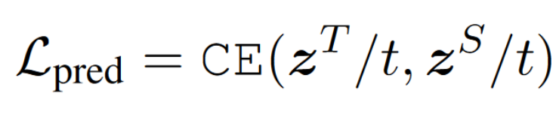

METHODOLOGY
Prediction Distillation
Haoyun Xu
In addition to imitating the behaviors of intermediate layers, distillation is also used to fit the predictions of teacher model.
In the loss function, $z^{S}$ and $z^{T}$ are the logits vectors predicted by the student and teacher respectively, the CE means the cross entropy loss and t means the temperature value. In the paper, t = 1 performs well.

Slide 13
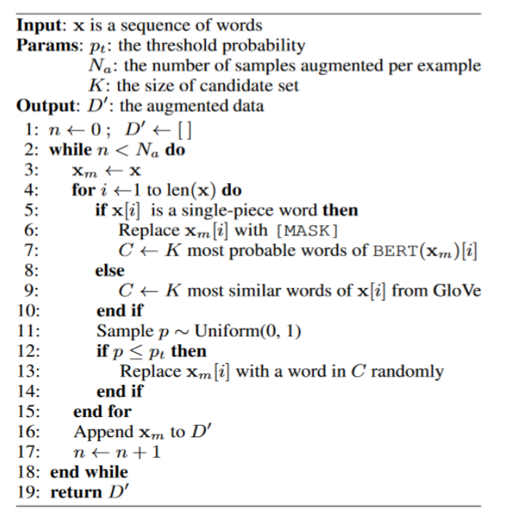
METHODOLOGY
Data Augmentation
Haoyun Xu
Table 7: Data Augmentation Procedure for Task-specific Distillation.(Jiao et al., 2020)

Slide 14
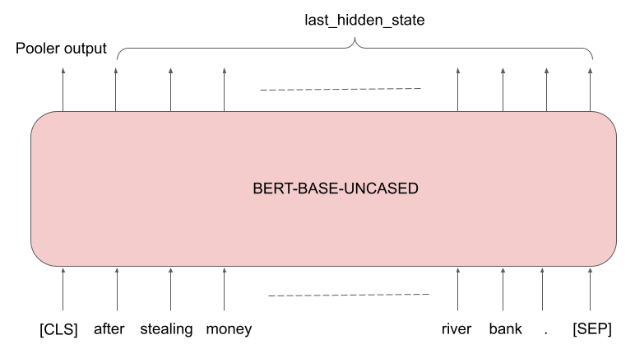
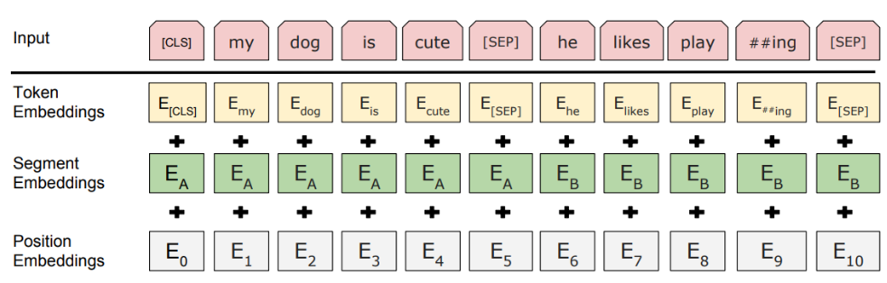
EXPERIMENT SETTING
Haoyun Xu
Inspired by DistilBERT, Token Type Embedding and Bert Pooler are justified to be deleted in the following experiments.
Since we are going to do experiment on the CoLA dataset which is a classification task, so the reason for cutting Token Type Embedding and Bert Pooler is that they are mainly useful in the sentence-pair task (exp: NSP) and not important in the single sentence task.
Table 8: Schematic Diagram of Pooler (Upper) and Embedding (Lower) Modules in BERT. (Devlin et al., 2019)

Slide 15
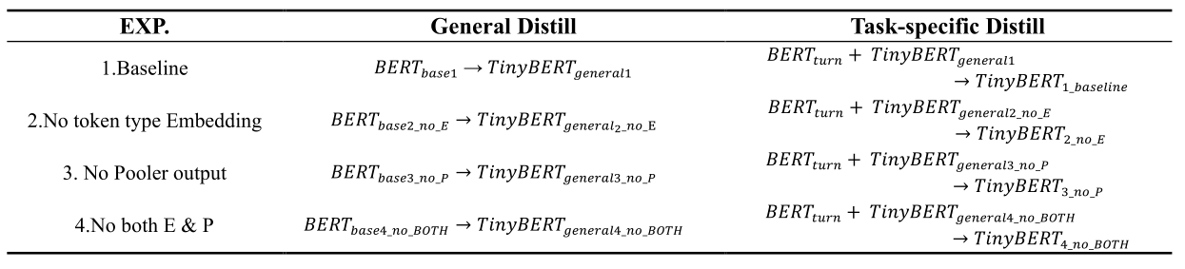
EXPERIMENT SETTING
Haoyun Xu
Table 9: Specific experimental setup.

Slide 16
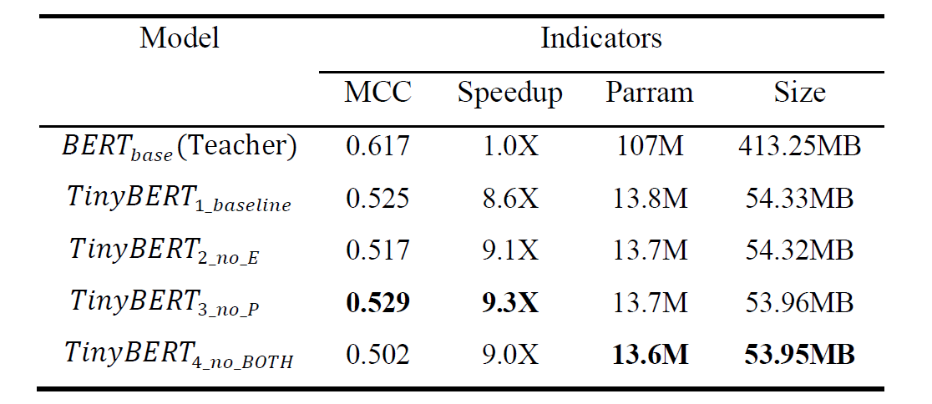
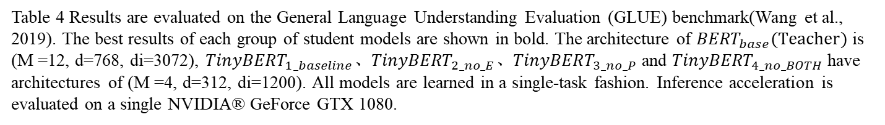
EXPERIMENT RESULTS
Junchao Wu
Table 4 Results are evaluated on the General Language Understanding Evaluation (GLUE) benchmark(Wang et al., 2019). The best results of each group of student models are shown in bold. The architecture of ${BERT}_{base}(Teacher)$ is (M =12, d=768, di=3072), ${TinyBERT}_{1_baseline}$、${TinyBERT}_{2_no_E}$、${TinyBERT}_{3_no_P}$ and ${TinyBERT}_{4_no_BOTH}$ have architectures of (M =4, d=312, di=1200). All models are learned in a single-task fashion. Inference acceleration is evaluated on a single NVIDIA® GeForce GTX 1080.

Slide 17
EXPERIMENT RESULTS
Junchao Wu
Due to the dramatic reduction in model size, there is a large performance gap between the distilled student model and 𝐵𝐸𝑅𝑇𝐵𝐴𝑆𝐸(Teacher).

Slide 18
EXPERIMENT RESULTS
Junchao Wu
We successfully verified the original results reported by TinyBERT(Jiao et al., 2020) that 𝑇𝑖𝑛𝑦𝐵𝐸𝑅𝑇1_𝑏𝑎𝑠𝑒𝑙𝑖𝑛𝑒 preserves nearly 85% of competitive performance in the CoLA task with less than 1/7 of the size of Teacher Model, while inference is accelerated by 8.6 times.

Slide 19
EXPERIMENT RESULTS
Junchao Wu
Surprisingly, 𝑇𝑖𝑛𝑦𝐵𝐸𝑅𝑇3_𝑛𝑜_𝑃 has better performance than 𝑇𝑖𝑛𝑦𝐵𝐸𝑅𝑇1_𝑏𝑎𝑠𝑒𝑙𝑖𝑛𝑒 , and its model overhead and inference speed are better than 𝑇𝑖𝑛𝑦𝐵𝐸𝑅𝑇1_𝑏𝑎𝑠𝑒𝑙𝑖𝑛𝑒 , especially the inference speed is further improved by 0.7 times compared with the Teacher Model. It is obvious that removing the Bert Pooler output in BERT is beneficial to further improve the model based on the TinyBERT architecture.

Slide 20
EXPERIMENT RESULTS
Junchao Wu
The removal of the token type embedding layer will cause some damage to the model.
Removing both token type embedding and Bert Pooler output hurts the model the most (𝑇𝑖𝑛𝑦𝐵𝐸𝑅𝑇4_𝑛𝑜_𝐵𝑂𝑇𝐻 ), and further removing Bert Pooler output while removing token type embedding does not improve either in MCC score or inference speed.

Slide 21
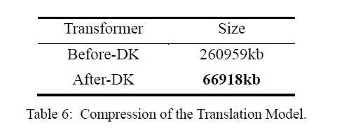
RELATIVE WORK
Junchao Wu
TRANSLATION: TRANSFORMER
The compression of the model is good. However, in fact, the translation effect of this English-Chinese translation model is far from the expectation. (not sufficiently trained, was not learn well from Teacher Model)

Slide 22
CONCLUSION & FUTURE WORK
Junchao Wu
CONCLUSION
Our experiments validate the effectiveness of the TinyBERT distillation method, which not only achieves competitive performance, but also significantly reduces model size and inference time.
We explore the possibility of further improvements on TinyBERT, and our experiments demonstrate that removing the Bert Pooler output from BERT can further improve TinyBERT performance. Specifically, our trained 𝑇𝑖𝑛𝑦𝐵𝐸𝑅𝑇3_𝑛𝑜_𝑃 obtains an MCC score of 0.529, obtaining 85% of the performance and 9.3 times the inference speed of the original model with only 1/7 of the overhead of the Bert model.

Slide 23
CONCLUSION & FUTURE WORK
Junchao Wu
CONCLUSION
We also explored the possible application of TinyBERT's distillation method in the field of machine translation, performed distillation of Transformer, and even though the achieved model performance was average, the model size optimization made a substantial breakthrough, compressing nearly 4 times on the Teacher Model.

Slide 24
CONCLUSION & FUTURE WORK
Junchao Wu
FUTURE WORK
In our future work, we will study the application of TinyBERT distillation method on different models, such as applying TinyBERT to AlBERT, to further explore effective solutions for deploying BERT-based NLP models on edge devices.

Slide 25
REFERENCE
AIChallenger. (2022). AIChallenger/AI_Challenger_2017 [Python].https://github.com/AIChallenger/AI_Challenger_2017 (Original work published 2017)
Clark, K., Khandelwal, U., Levy, O., & Manning, C. D. (2019). What Does BERT Look At? An Analysis of BERT’s Attention (arXiv:1906.04341).
Devlin, J., Chang, M.-W., Lee, K., & Toutanova, K. (2019). BERT: Pre-training of Deep Bidirectional Transformers for Language Understanding (arXiv:1810.04805).
Gong, Y., Liu, L., Yang, M., & Bourdev, L. (2014). Compressing Deep Convolutional Networks using Vector Quantization (arXiv:1412.6115).
Han, S., Pool, J., Tran, J., & Dally, W. (2015). Learning both Weights and Connections for Efficient Neural Network. Advances in Neural Information Processing Systems, 28.
Hinton, G., Vinyals, O., & Dean, J. (2015). Distilling the Knowledge in a Neural Network (arXiv:1503.02531).
Jiao, X., Yin, Y., Shang, L., Jiang, X., Chen, X., Li, L., Wang, F., & Liu, Q. (2020). TinyBERT: Distilling BERT for Natural Language Understanding (arXiv:1909.10351).
Kovaleva, O., Romanov, A., Rogers, A., & Rumshisky, A. (2019). Revealing the Dark Secrets of BERT (arXiv:1908.08593).
Pennington, J., Socher, R., & Manning, C. (2014). GloVe: Global Vectors for Word Representation. Proceedings of the 2014 Conference on Empirical Methods in Natural Language Processing (EMNLP), 1532–1543.
Romero, A., Ballas, N., Kahou, S. E., Chassang, A., Gatta, C., & Bengio, Y. (2015). FitNets: Hints for Thin Deep Nets (arXiv:1412.6550).
Sanh, V., Debut, L., Chaumond, J., & Wolf, T. (2020). DistilBERT, a distilled version of BERT: Smaller, faster, cheaper and lighter (arXiv:1910.01108).
Vaswani, A., Shazeer, N., Parmar, N., Uszkoreit, J., Jones, L., Gomez, A. N., Kaiser, Ł., & Polosukhin, I. (2017). Attention is All you Need. Advances in Neural Information Processing Systems, 30.
Wang, A., Singh, A., Michael, J., Hill, F., Levy, O., & Bowman, S. R. (2019). GLUE: A Multi-Task Benchmark and Analysis Platform for Natural Language Understanding (arXiv:1804.07461).
Warstadt, A., Singh, A., & Bowman, S. R. (2019). Neural Network Acceptability Judgments. Transactions of the Association for Computational Linguistics, 7, 625–641.

Slide 26
THANK YOU
QUESTIONS

