Slide 1

IAQ Keeper – Indoor Air Quality Monitoring and Control System
Features
Real-time Device Status and Alerts
IAQ data
Electrostatic Precipitator(ESP) and ESP Cleaner Status
Air Handle Unit(AHU) Fan Status
ESP Fault Alarms
Rules Engine & Schedules
Automatically runs at optimal settings based on predefined rules and actions
Automatically turn on/off ESP and ESP Cleaner after desired amount of time
Schedule by weekly, daily and/or hourly
Reports
Purification Time
Energy Usage
Difference between Outdoor AQI and Indoor AQI
Device Alarms
Forcing Control
Historical Trend
Collect public Outdoor AQI data
Pure Web UI

Slide 2


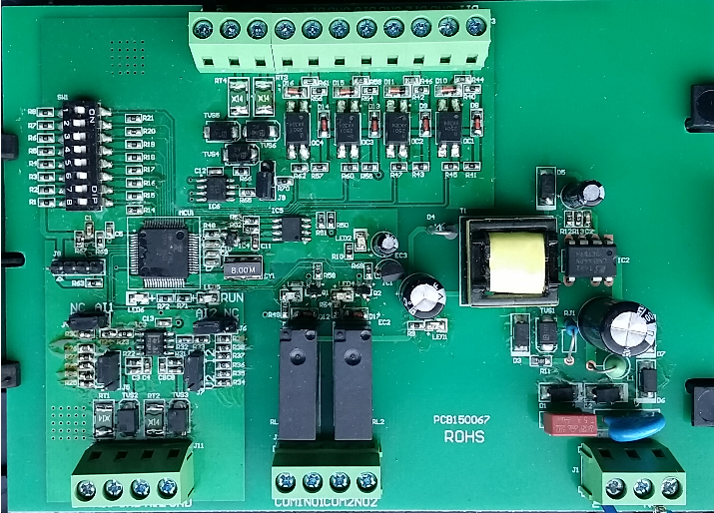
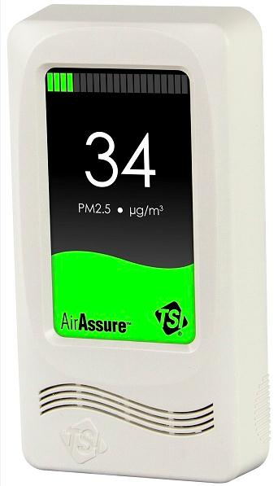
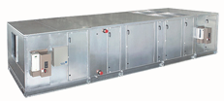
System Architecture
LAN/WLAN
Supervisory Controller
Public Outdoor AQI
RS485 Bus #6
RS485 Bus #2
RS485 Bus #1
Field Controller
Field Controller
Field Controller
PM2.5 Sensor
PM2.5 Sensor
...
PM2.5 Sensor
AHU#1
AHU#2
AHU#31
Zone #1
Zone #2
Zone #31

Slide 3
Field Controller
Provides direct, closed loop control over mechanical refrigeration equipment
Either as a standalone device or as a part of a larger networked control system.
Protocol: Modbus/RTU
Built-in Logics (Non-Programmable)
Desired PM2.5 Value: Should set expected value via Modbus which is in range 5~100ug/m³; Should persistent the value either Modbus is off line or power is off.
Actual PM2.5 Value: Should be set to the value of PM2.5 sensor If the PM2.5 sensor is connected to A!1, else if the controller is connected to Modbus the value should be set to other sensor’s value via Modbus, else the value should be the latest value persisted. The actual value’s range is 5~300ug/m³.
ESP Status（DO1）: When ESP Forcing Control Mode is OFF, If the actual PM2.5 value is higher than the sum of the desired value and the dead band value then ESP should ON, otherwise OFF. When ESP Forcing Control Mode is ON, ESP can be set ON/OFF via Modbus directly.
ESP Cleaner Status（DO2）: When ESP Cleaner Forcing Control Mode is OFF, if AHU Fan is ON and ESP Cleaner is set to ON via Modbus, the ESP Cleaner is ON, otherwise OFF. When ESP Cleaner Forcing Control Mode is ON, ESP Cleaner can be set ON/OFF via Modbus directly.
AHU
ESP
Modbus/RTU
DI(1-4)
Masks
RS485 BUS
AI(1-2)
DO(1-2)
PWR
DC12V
PM2.5 Sensor

Slide 4
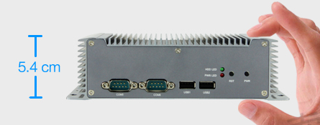
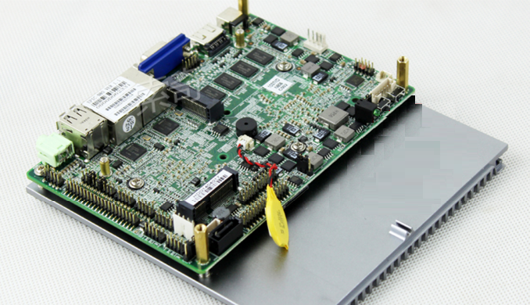
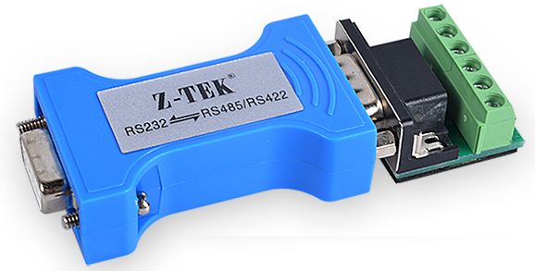
Supervisory Controller Hardware
Provides integrated control, supervision and network management services to one or more field controllers.
Also provides system-wide coordination to automate operations, improve occupant comfort, reduce energy usage, and optimize operating efficiencies.
Specifications
IPC-S2221 Non-Fan Industry Computer
CPU: Intel® 1037U Dual-core 22nm Processor 1.8GHz TDP 17W
Memory: Integrated DDR3 4GB Memory inboard
Storage: 32G SSD
LAN: 2* Intel 82583V 10/100/1000Mbps Ethernet,
Dimension: 193 × 157 × 54mm
Operating Temp.：0℃～55℃
WLAN: WIFI or 3G
I/O: 4 × USB2.0, 6 × COM, COM2 supports RS485, others support RS232
6xCOM

Slide 5
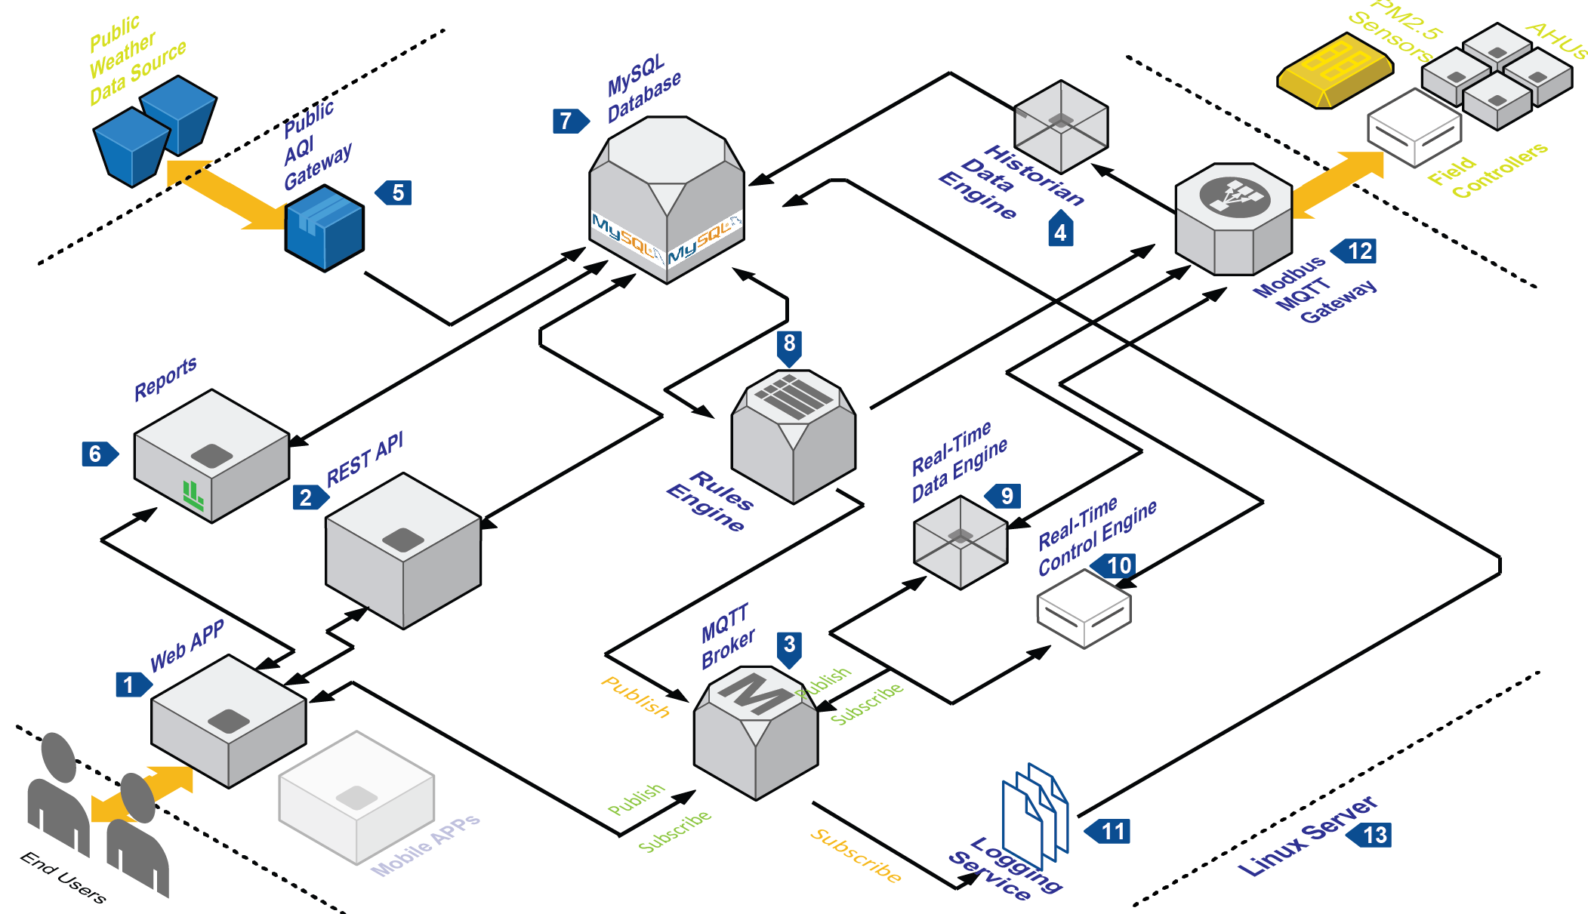
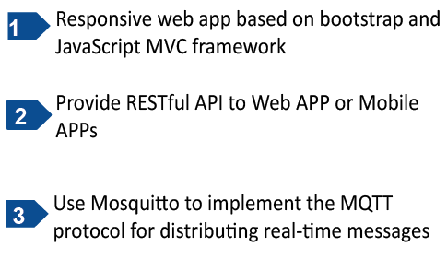
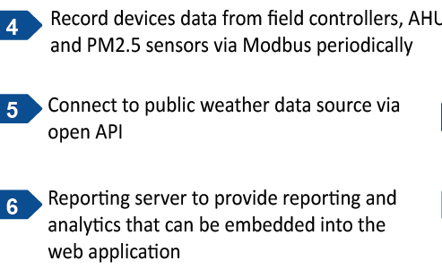
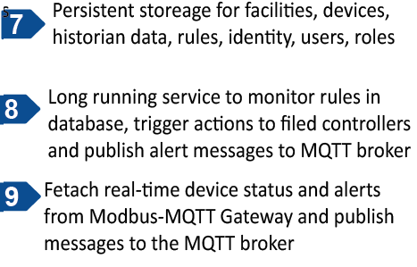



Supervisory Controller Software

Slide 6
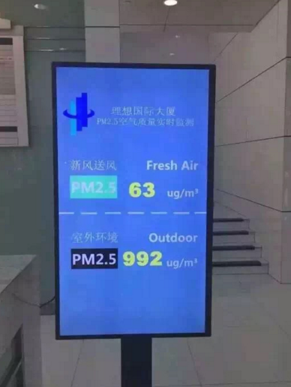
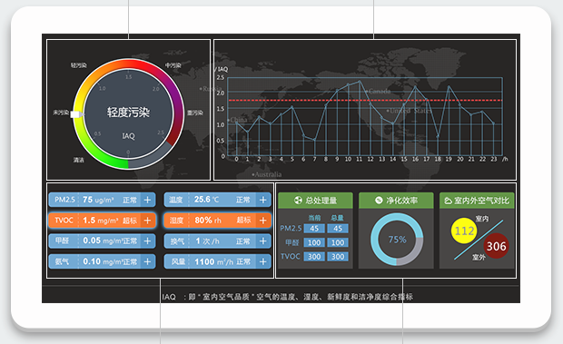
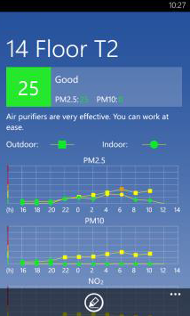
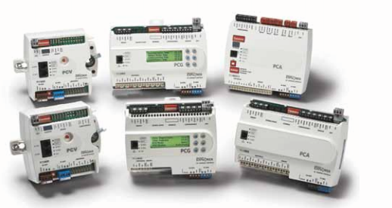
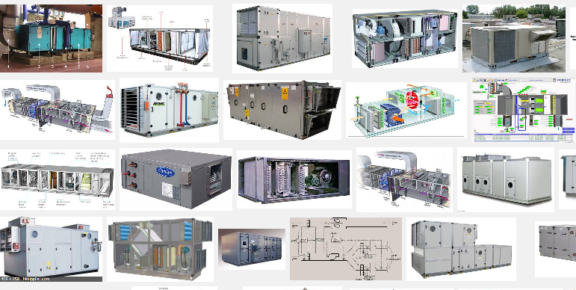
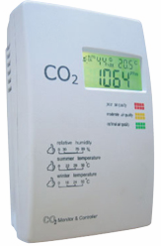
Road Map
Protocols:
BACnet MQTT Gateway
BACnet Server (as data provider to 3rd party)
APPs:
Kiosk in Lobby
Wall Mount Tablet
Android APP
iOS APP
Hardware:
Programmable Field Controllers
Third Party AHUs
Sensors: CO2, VOC, Formaldehyde, Temperature, Humidity, Pressure and Wind Speed

