Slide 1
SEED Architecture Design
Guangyu Zhang
Centre of engineering china
Johnson controls
Last Update: May 24, 2013

Slide 2
Structure Energy Efficiency Dashboard
SEED Architecture
Web Based Components
Back End
Front End
Windows Based Components
Windows Services
Windows Desktop Applications
IDEs
Application Lifecycle Management Tools
Graphic Design Tools

Slide 3
SEED Architecture
Web Based Components
Back End
Front End
Windows Based Components
Windows Services
Windows Desktop Applications

Slide 4
SEED Architecture
User
Web App
Bootstrap,
Backbone.js, Require.js,
jQuery, HTML5,CSS3
Desktop Apps
Mobile Apps
3rd Party APPs
Metasys
Front End
Windows Services
Slave,
Spider,
Hoe,
Beacon,
Watch Dog
Windows GUI APPs
SEED Manager,
SEED Register
SEED Installer
REST API (JSON)
CodeIgniter
PHP
Apache Server
Back End
.NET Framework
Database Server
PostgreSQL, MySQL

Slide 5
Web Based Components
Back End
Front End

Slide 6
Back End
JSON
REST API Server
Apache Server
on Windows
SEED Business Layer
CodeIgniter PHP Framework
Database Server(PostgreSQL/MySQL)
on Windows

Slide 7
CodeIgniter
A PHP framework
Based on the Model-View-Controller development pattern
Free
http://ellislab.com/codeigniter/

Slide 8
RESTful API
Representational State Transfer (REST)
A RESTful web API is a web API implemented using HTTP and the principles of REST
CodeIgniter REST Server
JavaScript Object Notation (JSON)

Slide 9
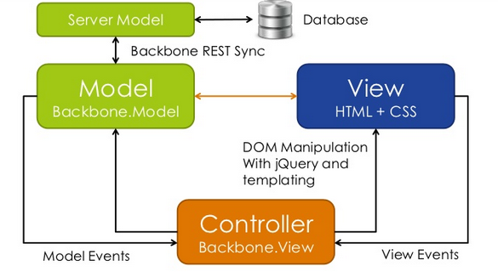
Front End

Slide 10
JQuery
A JavaScript library
DOM Traversal and Manipulation
Event Handling
Ajax
Plugins
Open Source
http://jquery.com/

Slide 11
Backbone.js
Backbone.js gives structure to web applications by providing
Models with key-value binding and custom events,
Collections with a rich API of enumerable functions,
Views with declarative event handling,
and connects it all to RESTful API.
Open Source
http://backbonejs.org/

Slide 12
RequireJS
RequireJS is a JavaScript file and module loader
Open Source: new BSD or MIT licensed
http://requirejs.org/

Slide 13
Responsive Web Design
Providing an optimal viewing experience—easy reading and navigation with a minimum of resizing, panning, and scrolling—across a wide range of devices (from desktop computer monitors to mobile phones)
Desktop browsers
Chrome, Firefox, Internet Explorer, Opera, Safari
Tablets & Mobiles
iOS Safari, Opera Mini, Android Browser, Blackberry Browser, Opera Mobile, Chrome for Android, Firefox for android
Bootstrap: http://twitter.github.io/bootstrap/

Slide 14
Windows Based Components
Windows Services
SEED Slave Service
SEED Spider Service
SEED Hoe Service
SEED Beacon Service
SEED Watch Dog Service
Windows Desktop Applications
SEED Manager
SEED Register

Slide 15
SEED Slave Service
Transfers historian data from Metasys System to SEED.
To be written in C#.NET
To run as Windows Service

Slide 16
SEED Spider Service
Aggregates energy data from bottom to top in asset tree.
To be written in C#.NET
To run as Windows Service

Slide 17
SEED Hoe Service
Removes or repairs exceptional data.
To be written in C#.NET
To run as Windows Service

Slide 18
SEED Beacon Service
Sends alarm and warning messages via SMS and/or Email.
To be written in C#.NET
To run as Windows Service

Slide 19
SEED Watch Dog Service
Monitors all SEED Windows services.
Slave
Spider
Hoe
Beacon
and Watch Dog Itself

Slide 20
SEED Manager
A Windows desktop application :
To be written in WPF & C#.NET
To control all SEED windows services
To copy historian data from Metasys System manually
To configure SEED options

Slide 21
SEED Register
A Windows desktop application :
To be written in WPF & C#.NET
To generate SEED licensing files
To verify SEED licensing files

Slide 22
Integrated Development Environment (IDE)
Zend Studio 10
Aptana Studio 3
Visual Studio 2012

Slide 23
Zend Studio 10
PHP Editor and File Management
PHP Debugging
PHP Unit Testing
$149.00
http://www.zend.com/en/products/studio/

Slide 24
Aptana Studio 3
HTML, CSS, and JavaScript Code Editor
JavaScript Debugger
Free
http://www.aptana.com/

Slide 25
Visual Studio 2012
An IDE from Microsoft.
To develop Windows services and Windows desktop applications.
Available with MSDN Subscription.
http://www.microsoft.com/visualstudio/eng

Slide 26
Application Lifecycle Management
Git
Mantis, bugs tracking
Todoyu, tasks and time tracking

Slide 27
Git
A distributed revision control and source code management (SCM) system
Free Git Hosting:
Bitbucket
https://bitbucket.org/jcisoft
Free host plan for 5 users.
Free Desktop Client:
SourceTree
http://sourcetreeapp.com/

Slide 28
Todoyu
A web-based system for task management, time tracking
Open source
http://jcisoft.com/todoyu/
Note: All tasks should be assigned on Todoyu, otherwise may be delayed!

Slide 29
Mantis
A web-based bug tracking system
Free
http://jcisoft.com/mantis/
Note: All bugs MUST be reported on Mantis, otherwise will be completely ignored

Slide 30
Graphic Design Tools
Adobe Photoshop CS6
Adobe Dreamweaver CS6
Adobe InDesign CS6
Adobe Flash Builder 4.6 Premium Edition
$599.88/Year
Available at https://creative.adobe.com/plans

