Slide 1
Controller
Network Core
Endpoint

Slide 2

Controller
Endpoint
Network Core

Slide 3
Data
Real-time QoE of clients
DDN Controller
1
Multi-session view
2
Real-time control

Slide 4
Data
Real-time QoE of clients
DDN Controller
1
Actionable insight
2
Real-time control

Slide 5
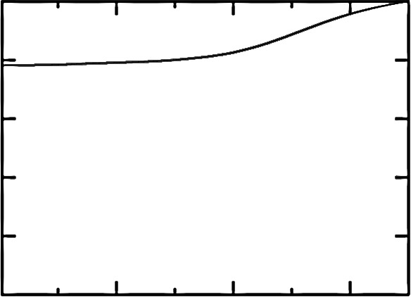
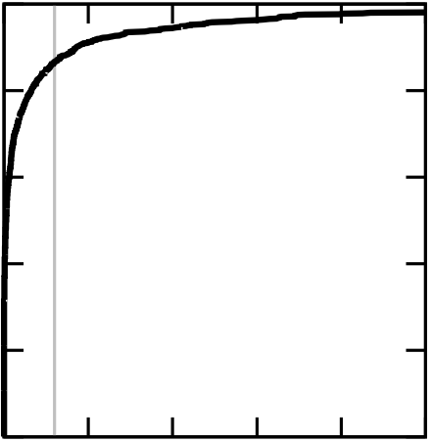
1
0.8
0.6
0.4
0.2
0
1
0.8
0.6
0.4
0.2
0
CDF
CDF
0.001 | 0.1 | 10
0 | 2 | 4 | 6 | 8 | 10
Buffering ratio (%)
Packet loss rate (%)

Slide 6
1
0.8
0.6
0.4
0.2
0
1
0.8
0.6
0.4
0.2
0
CDF
CDF
0.001 | 0.1 | 10
0 | 2 | 4 | 6 | 8 | 10
Buffering ratio (%)
Packet loss rate (%)

Slide 7
Challenge #1
Expressive prediction models
Challenge #2
Scalable control platforms
Key insight
Persistent Structures in QoE-determining factors
CFA & DDA
(Ch. 5, 6)
Accurate QoE/throughput predictions by critical features
Pytheas
(Ch. 7)
Scalable exploration-exploitation by group-based control
VIA
(Ch. 8)
Tackling large decision spaces by guided exploration

Slide 8
Challenge #1
Expressive prediction models
Challenge #2
Scalable control platforms
Key Insight (Ch. 4)
Persistent Critical Structures in QoE-determining factors
CFA & DDA
(Ch. 5, 6)
Accurate QoE/throughput predictions by critical features
Pytheas
(Ch. 7)
Scalable exploration-exploitation by group-based control
VIA
(Ch. 8)
Tackling large decision spaces by guided exploration

Slide 9
Expressive prediction models
Scalable control platforms
CFA
[NSDI 2016]
VIA
[SIGCOMM 2016a]
CS2P
[SIGCOMM 2016b]
Pytheas
[NSDI 2017]
C3
[NSDI 2015]
VDN
[SIGCOMM 2015]

Slide 10
CDN1
…
0.8Mbps
Managed Overlay
…
2.4Mbps
…
5.2Mbps
Internet
CDN2
…
Internet
…
CDN3

Slide 11
CDN1
…
0.8Mbps
Managed Overlay
…
2.4Mbps
…
5.2Mbps
Internet
CDN2
…
Internet
…
CDN3

Slide 12
 | IP | Transport | Application
In-network | QoS | Router-assist CC | ADN
Endpoint | RON | TCP | DASH
More direct QoE feedback
Less visibility to network conditions
 | Lower Level | Application
In-network | XCP, QoS | ADN
Endpoint | TCP, RON | DASH
More deployable
Less visibility to network conditions

Slide 13
More direct QoE feedback
Easier to deploy
Application
Which level in the protocol stack?
Lower levels
More insight to network conditions
In-network
Endpoint
Where in the network?

Slide 14
Handcrafted logic
Data-driven logic
Measurement
data
Adaptation actions
Measurement
data
Adaptation actions
Underlying system
Underlying system
Machine-generated logic
Measurement
data
Adaptation actions
Underlying system

Slide 15
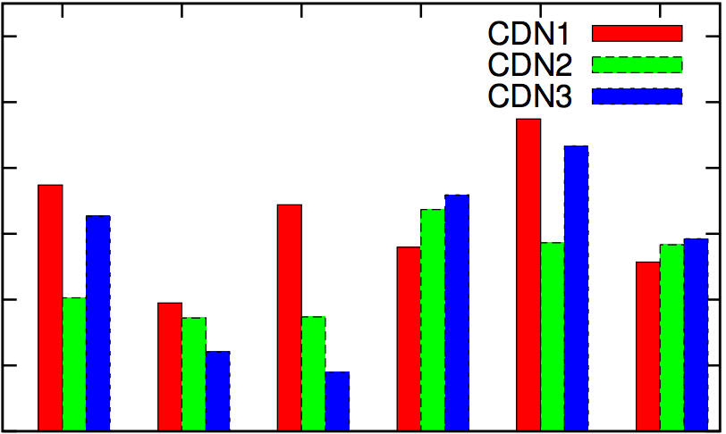
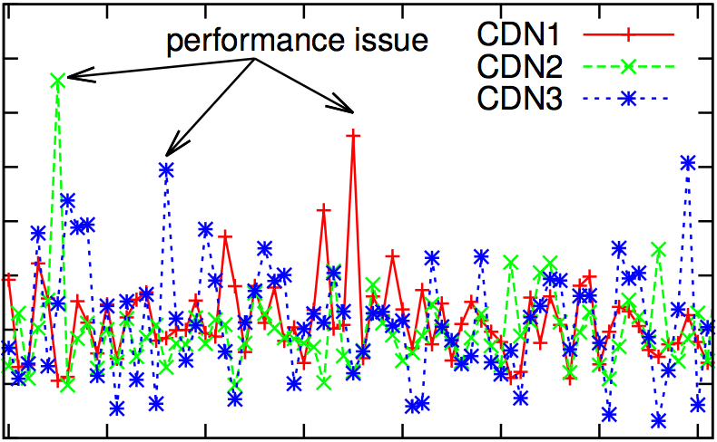
6
5
4
3
2
1
0
16
14
12
10
8
6
4
2
0
Avg. buffering ratio (%)
Avg. buffering ratio (%)
1 | 2 | 3 | 4 | 5 | 6
0 | 10 | 20 | 30 | 40 | 50 | 60 | 70
Top cities
Hour

Slide 16
Complex QoE-determining factors
Idea #1 (Ch. 5, 6)
Critical feature analysis
Challenge #1
Expressive prediction models
Large decision spaces
Idea #2 (Ch. 7)
Group-based control
Key insight
Persistent Structures
Geo-distributed analytics with a fresh global view
Challenge #2
Scalable control platforms
Idea #3 (Ch. 8)
Guided exploration
Near real-time predictive control

Slide 17
Complex QoE-determining factors
Idea #1 (Ch. 5, 6)
Critical feature analysis
Challenge #1
Expressive prediction models
Large decision spaces
Idea #2 (Ch. 7)
Group-based control
Key insight
Persistent Critical Structures
Geo-distributed analytics with a fresh global view
Challenge #2
Scalable control platforms
Idea #3 (Ch. 8)
Guided exploration
Near real-time predictive control

Slide 18
Challenge #1 (§3.2.1)
Expressive prediction models
Challenge #2 (§3.2.2)
Scalable control platforms
Complex QoE-determining factors
Large decision spaces
Near real-time predictive control
Geo-distributed analytics with a fresh global view
Idea #1 (§3.4.1, Ch. 5, 6)
Critical feature analysis
Idea #2 (§3.4.2, Ch. 7)
Group-based control
Idea #3 (§3.4.3, Ch. 8)
Guided exploration
Key insight (§3.3)
Persistent Critical Structures

Slide 19
Notes:
At a high-level, the goal of data-driven QoE optimization is to map each session in the session-level feature space (on the left) onto the optimal decision in the decision space (on the right).
For example, you can imagine each circle on the left is a video session characterized by features like client-side AS, location, connection type, and the video content genre.
And each box on the right is a potential decision of CDN and bitrate.
We’ll see more examples later.
Now, let’s assume we have some history sessions whose QoE has been observed.
Let’s say we have a new session coming in, and we need to find the best decision for it based on the QoE observed from other sessions.
The first question is which sessions’ measurement data are relevant to the decision of the new session?
It’s not scalable to use all history sessions to make the decision in real time, neither is it ideal to just look at the most similar ones (coz the data will be too sparse).
TO solve this problem, our first idea is that each session's QoE only depends on by a few critical features, so we can find many similar sessions by matching along the most relevant features.

Slide 20
Sessions
Decisions
Sessions
Decisions
Backend
Frontend
Sessions
Notes:
At a high-level, the goal of data-driven QoE optimization is to map each session in the session-level feature space (on the left) onto the optimal decision in the decision space (on the right).
For example, you can imagine each circle on the left is a video session characterized by features like client-side AS, location, connection type, and the video content genre.
And each box on the right is a potential decision of CDN and bitrate.
We’ll see more examples later.
Now, let’s assume we have some history sessions whose QoE has been observed.
Let’s say we have a new session coming in, and we need to find the best decision for it based on the QoE observed from other sessions.
The first question is which sessions’ measurement data are relevant to the decision of the new session?
It’s not scalable to use all history sessions to make the decision in real time, neither is it ideal to just look at the most similar ones (coz the data will be too sparse).
TO solve this problem, our first idea is that each session's QoE only depends on by a few critical features, so we can find many similar sessions by matching along the most relevant features.

Slide 22
VIA
Tackling large decision spaces by guided exploration
Session-Level Feature Space
Video: AS, Location, Connection type, Content genre, …
VoIP: Caller-callee IP prefix
Decision Space
Video: CDN, Bitrate
VoIP: Relay paths
Notes:
Now, let’s say we’ve found some similar sessions, but what if there are too many decision for these sessions to explore and identify the best decision?
To solve this problem, our second idea is to focus on a small fraction of most promising decisions which are very likely to include a close-to-optimal decision.
Now, it seems these two ideas have solved the problem, right?
But they only solve the problem mathematically! Remember there will be millions of sessions (circles) and they are geo-distributed, so the question is how to build a system to run such decision-making process at scale?

Slide 23
Controller servers
Pytheas
Scalable exploration-exploitation by group-based control
Notes:
Well, it turned out these similar sessions who share critical features, also share network locality.
This allows us to divide sessions into groups, and each group can be independently controlled by a frontend cloud server.
Such group-based control mechanism can easily scale up to many geo-distributed sessions.
So far, we have always assumed that we know these structures such as critical features and subspace of promising decisions.
But how do we get structures in the first place?

Slide 24
Key techniques (4): Persistence of Structures
Structures of QoE-determining factors are persistent
➔ Can be Learned from long-term history data by an offline process
Notes:
The key insight here is that these structures tend to persist on relatively long timescales of tens of minutes.
So they can be learned from long-term history data by an offline process.
In the remaining of the talk, I will discuss these ideas in more details.

