Slide 1
Controller
Network Core
Endpoint

Slide 2

Controller
Endpoint
Network Core

Slide 3
Data
Real-time QoE of clients
DDN Controller
1
Multi-session view
2
Real-time control

Slide 4
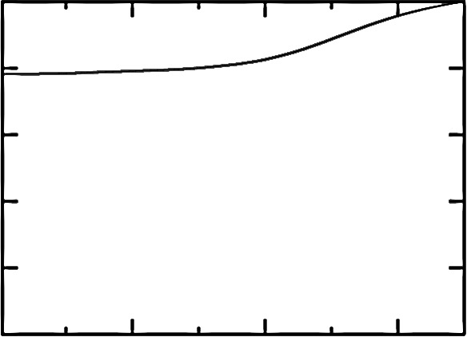
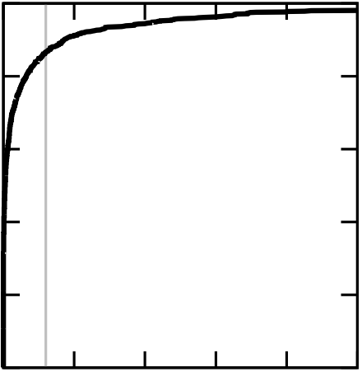
1
0.8
0.6
0.4
0.2
0
1
0.8
0.6
0.4
0.2
0
CDF
CDF
0.001 | 0.1 | 10
0 | 2 | 4 | 6 | 8 | 10
Buffering ratio (%)
Packet loss rate (%)

Slide 5
1
0.8
0.6
0.4
0.2
0
1
0.8
0.6
0.4
0.2
0
CDF
CDF
0.001 | 0.1 | 10
0 | 2 | 4 | 6 | 8 | 10
Buffering ratio (%)
Packet loss rate (%)

Slide 6
Challenge #1
Expressive prediction models
Challenge #2
Scalable control platforms
Key insight
Persistent Structures in QoE-determining factors
CFA & DDA
(Ch. 5, 6)
Accurate QoE/throughput predictions by critical features
Pytheas
(Ch. 7)
Scalable exploration-exploitation by group-based control
VIA
(Ch. 8)
Tackling large decision spaces by guided exploration

Slide 7
Expressive prediction models
Scalable control platforms
CFA
[NSDI 2016]
VIA
[SIGCOMM 2016a]
CS2P
[SIGCOMM 2016b]
Pytheas
[NSDI 2017]
C3
[NSDI 2015]
VDN
[SIGCOMM 2015]

Slide 8
CDN1
…
0.8Mbps
Managed Overlay
…
2.4Mbps
…
5.2Mbps
Internet
CDN2
…
Internet
…
CDN3

Slide 9
CDN1
…
0.8Mbps
Managed Overlay
…
2.4Mbps
…
5.2Mbps
Internet
CDN2
…
Internet
…
CDN3

Slide 10
 | IP | Transport | Application
In-network | QoS | Router-assist CC | ADN
Endpoint | RON | TCP | DASH
More direct QoE feedback
Less visibility to network conditions
 | Lower Level | Application
In-network | XCP, QoS | ADN
Endpoint | TCP, RON | DASH
More deployable
Less visibility to network conditions

Slide 11
More direct QoE feedback
Easier to deploy
Application
Which level in the protocol stack?
Lower levels
More insight to network conditions
In-network
Endpoint
Where in the network?

Slide 12
Handcrafted logic
Data-driven logic
Measurement
data
Adaptation actions
Measurement
data
Adaptation actions
Underlying system
Underlying system
Machine-generated logic
Measurement
data
Adaptation actions
Underlying system

Slide 13
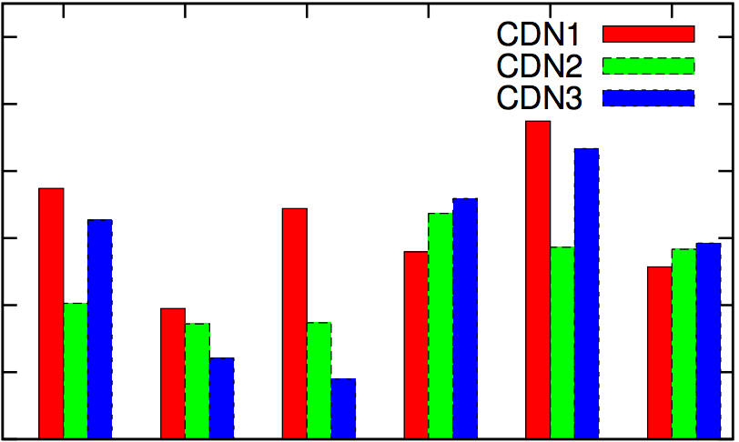
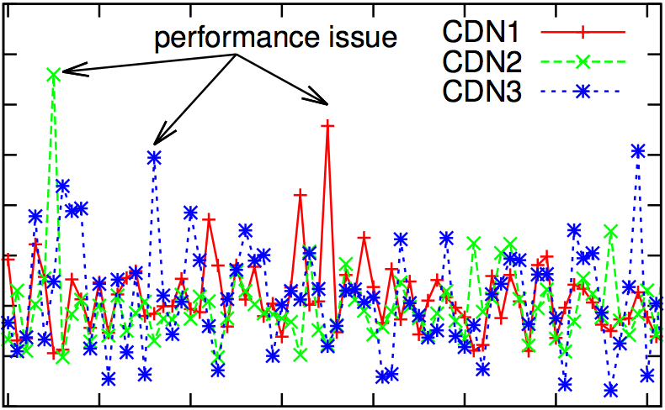
6
5
4
3
2
1
0
16
14
12
10
8
6
4
2
0
Avg. buffering ratio (%)
Avg. buffering ratio (%)
1 | 2 | 3 | 4 | 5 | 6
0 | 10 | 20 | 30 | 40 | 50 | 60 | 70
Top cities
Hour

Slide 14
Complex QoE-determining factors
Idea #1 (Ch. 5, 6)
Critical feature analysis
Challenge #1
Expressive prediction models
Large decision spaces
Idea #2 (Ch. 7)
Group-based control
Key insight
Persistent Structures
Geo-distributed analytics with a fresh global view
Challenge #2
Scalable control platforms
Idea #3 (Ch. 8)
Guided exploration
Near real-time predictive control

