Slide 1

STATISTICAL INVESTIGATION OF CHRONIC KIDNEY DISEASE RISK FACTORS AND PREDICTION
Complex Engineering Project (CEP) — STA281 Spring 2026
Team: Tehreek-e-Muhandis

Slide 2

01 — Objective: Identify CKD Risk Factors & Predictive Insights
02 — Dataset: 400 Patients, 26 Variables (Kaggle)
03 — Methodology: Descriptive Stats, Probability, Hypothesis Testing, Regression
04 — Target: Binary CKD Classification
CKD
STA281 CEP

Slide 3
03 - DATASET OVERVIEW
400 patient records across 26 clinical and laboratory variables
Target Variable: CKD status (binary: 1 = CKD, 0 = No CKD)
Variables include clinical measurements such as serum creatinine, blood urea, hemoglobin, and blood pressure, alongside demographic and lab indicators.
Preprocessing Steps: Variable renaming for clarity, missing value imputation, numeric type conversions, and target label standardization to prepare data for statistical analysis.
400 Records
26 Variables

Slide 4

Key Clinical Variables — CKD Patient Dataset (n=400)
Serum Creatinine: Mean 3.07 | Median 1.80 | Std Dev 3.31 | Range: 0.5–15.2
Blood Urea: Mean 57.4 | Median 44.0 | Std Dev 40.6 | Range: 10–391
Hemoglobin: Mean 12.5 | Median 13.9 | Std Dev 2.91 | Range: 3.1–17.8
Blood Pressure: Mean 76.5 | Median 80.0 | Std Dev 13.9 | Range: 50–180
Elevated creatinine & urea indicate impaired filtration; low hemoglobin signals anemia risk in CKD patients.
04 — DESCRIPTIVE STATISTICS SUMMARY

Slide 5
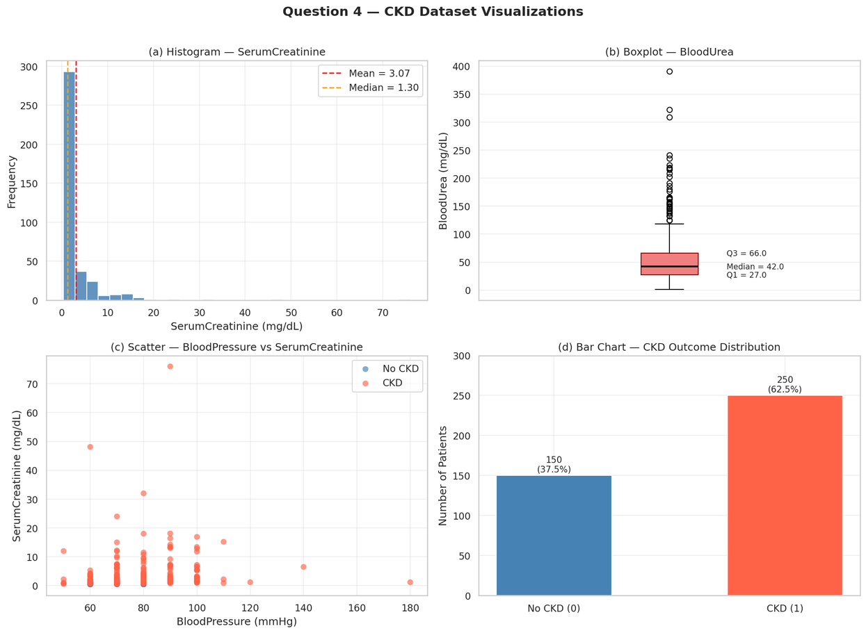
05 - VISUALIZATION FINDINGS
CKD prevalence: 62.5% vs 37.5% non-CKD in the dataset
(a) SerumCreatinine histogram shows right-skew — some patients with severe kidney dysfunction.
(b) BloodUrea boxplot reveals wide spread and outliers indicating abnormal urea accumulation.
(c) BP vs Creatinine scatter: CKD patients cluster at higher values.
(d) CKD outcome bar chart confirms 62.5% CKD prevalence.

Slide 6
06 - CKD VS NON-CKD COMPARISON
CKD PATIENTS SHOW ELEVATED KIDNEY MARKERS AND LOWER HEMOGLOBIN
Key differences between CKD and Non-CKD groups:
• SerumCreatinine: Significantly higher in CKD patients
• BloodUrea: Elevated, indicating impaired filtration
• BloodPressure: Higher in CKD — hypertension link
• Hemoglobin: Lower in CKD — anemia indicator
CKD
Clinical differentiation supports early CKD screening and diagnosis
Non-CKD

Slide 7
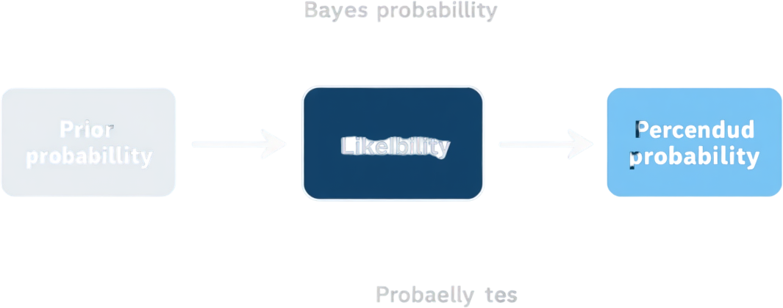
07 - PROBABILITY & BAYES ANALYSIS
Conditional Probability:
P(CKD | SerumCreatinine > 1.5) = 100%
Bayes Theorem Result:
Posterior probability = 100% for threshold > 1.8 mg/dL
Clinical Implication:
Elevated SerumCreatinine is a near-perfect predictor of CKD status, confirming its role as a primary screening biomarker.
Likeability
Elevated SerumCreatinine strongly predicts CKD with 100% posterior probability
Bayes
P(CKD) = 100%

Slide 8
08 - PROBABILITY DISTRIBUTIONS & CLT
Binomial & Normal distributions capture CKD prevalence and biomarker spread across patient populations
Five distributions model CKD data patterns:
• Binomial PMF: CKD counts in sample (n=12, p=0.55)
• Normal: SerumCreatinine risk categories
• Uniform: Patient age probabilities
• Exponential: CKD admission intervals
• CLT: Sampling distribution of BloodUrea mean converges to normality
Binomial
CLT Applied
CLT confirms BloodUrea sample means follow normal distribution, enabling robust statistical inference

Slide 9
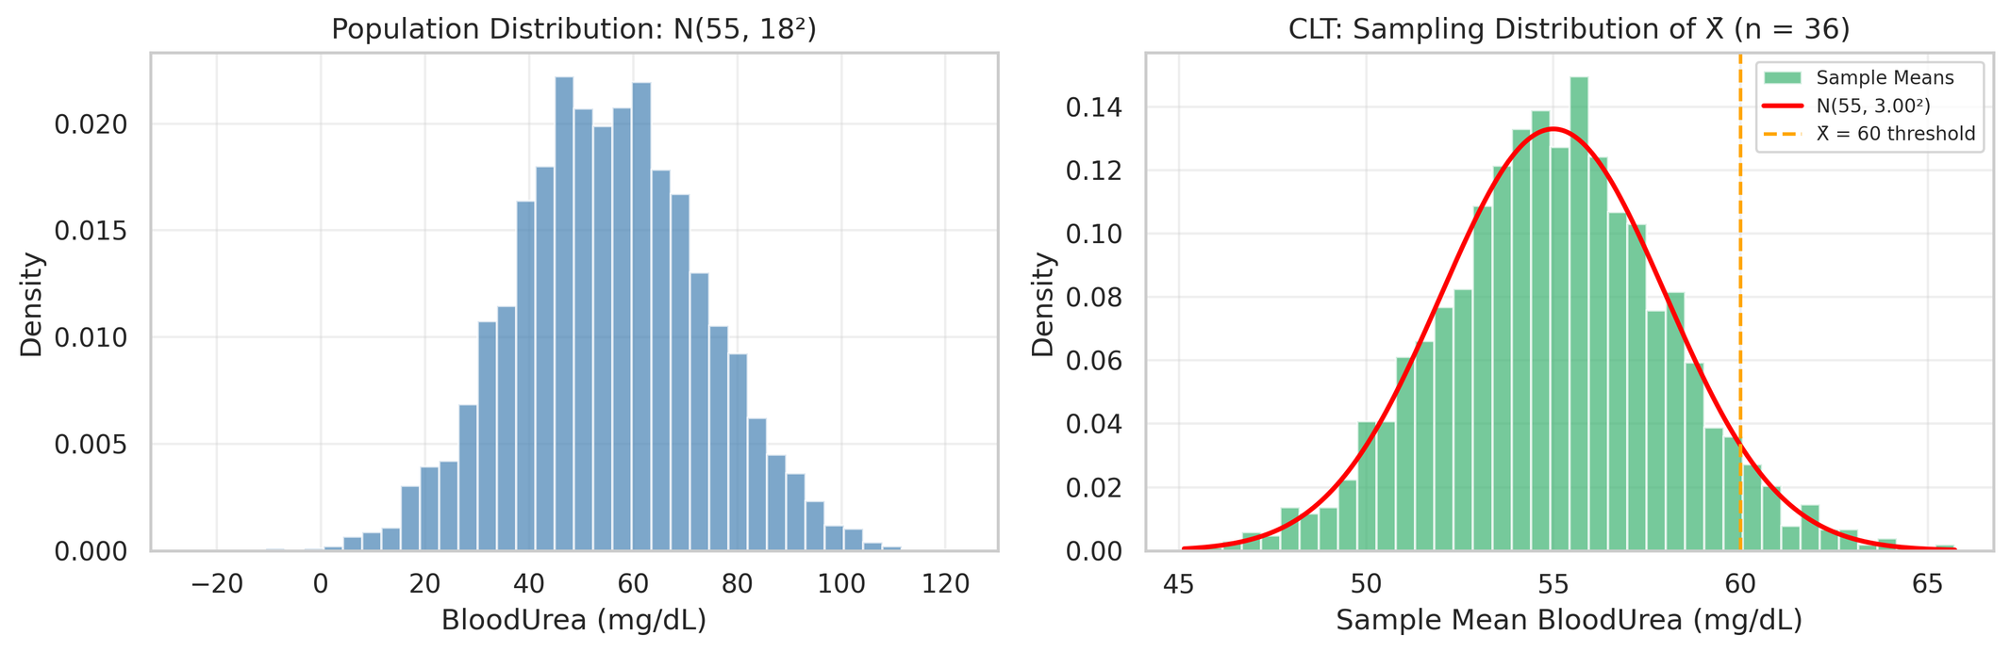
09 - DISTRIBUTIONS & CLT
Exponential distribution models CKD admission intervals; CLT confirms sample mean convergence for robust inference
Exponential Distribution: Models time between CKD patient admissions, revealing clustering patterns in high-risk periods.
Central Limit Theorem: Sampling distribution of BloodUrea mean converges to normal as sample size increases, validating parametric inference methods used throughout this study.

Slide 10
10 - CONFIDENCE INTERVAL & HYPOTHESIS TESTING
Statistical evidence confirms impaired kidney function in CKD patients
95% CI for SerumCreatinine: Mean above normal range — indicates impaired kidney filtration.
Z-Test (Right-tailed): BloodUrea significantly > 50 mg/dL — confirms abnormal urea accumulation.
T-Test (Left-tailed): Hemoglobin significantly < 12.5 g/dL — confirms anemia in CKD patients.
CI
All three tests support data-driven diagnosis of chronic kidney dysfunction
Hypothesis

Slide 11
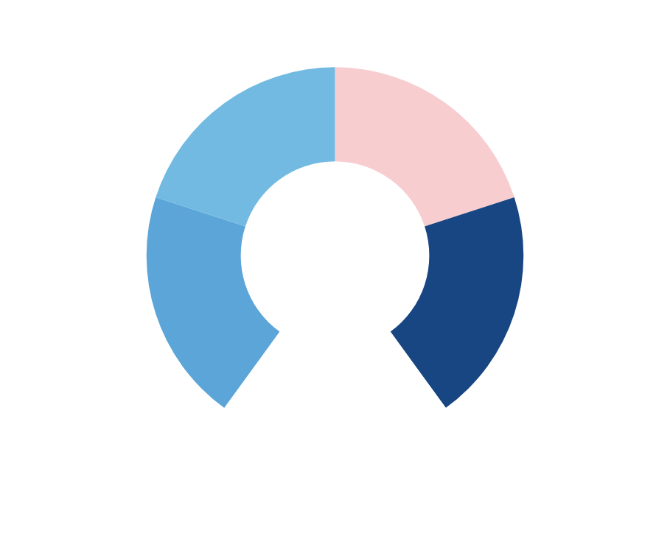
10 - CORRELATION ANALYSIS
Key Correlations:
• SerumCreatinine & BloodUrea: r = +0.78 (Strong Positive)
Elevated creatinine and urea rise together, confirming impaired kidney filtration.
• Hemoglobin & CKD: r = −0.81 (Strong Negative)
Lower hemoglobin strongly associated with CKD presence, indicating anemia.
• BloodPressure & CKD: Moderate positive correlation
Hypertension linked to progressive kidney damage.
Clinical Insight:
Correlation analysis confirms expected clinical relationships between kidney function markers and CKD status, supporting their use as diagnostic indicators.

Slide 12
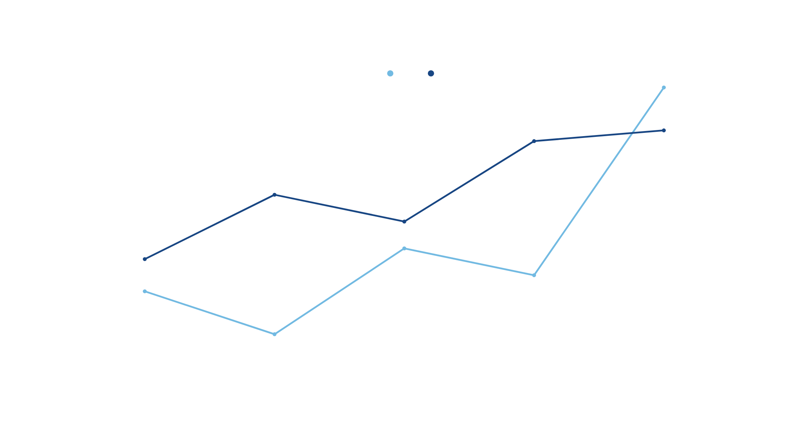
11 - Regression & Predictive Insights

Slide 13

01 — SerumCreatinine & BloodUrea
02 — Hemoglobin & BloodPressure
03 — Hypertension, Diabetes, Electrolyte Imbalance
04 — Elevated Creatinine & Low Hemoglobin
Biomarkers
Risk Factors

Slide 14

• CKD patients show significantly altered clinical markers across all key biomarkers
• Probability & Bayes analysis confirm SerumCreatinine as a near-perfect CKD predictor
• Distribution modeling & CLT support robust statistical inference on patient data
• Hypothesis testing confirms abnormal BloodUrea and Hemoglobin in CKD patients
• Correlation analysis reveals strong links between kidney markers and CKD status
• Comprehensive statistical analysis supports reliable, data-driven CKD prediction
Statistical evidence strongly supports data-driven prediction of CKD risk factors.
14 - EVIDENCE-BASED CONCLUSION

Slide 15

15 - RECOMMENDATIONS
✔ Regularly monitor SerumCreatinine, BloodUrea, BloodPressure, and Hemoglobin in at-risk patients.
✔ Initiate early screening for hypertensive and diabetic patients before symptom onset.
✔ Control blood pressure and manage diabetes to reduce CKD progression risk.
✔ Monitor anemia indicators and electrolyte levels for timely early intervention.
✔ Promote lifestyle modifications including diet, hydration, and exercise.
✔ Schedule regular follow-up testing to track biomarker trends over time.
Screen
Early detection and evidence-based management can slow CKD progression
Prevention

Slide 16

THANK YOU
Questions & Discussion
Tehreek-e-Muhandis | STA281 Spring 2026

