Slide 1

Don’t Get Kicked
Predict whether Car Purchase at Auction is a ‘Lemon’
BIOS 635: Final Project Report
Junead Khan

Slide 2


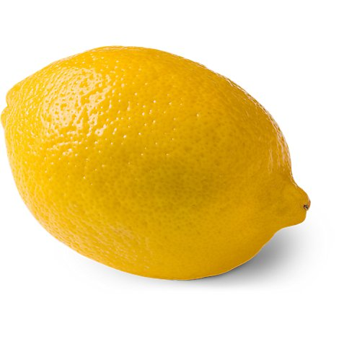



What is a ‘Lemon Car’

Slide 3
Aim:
Can we predict whether a car bought at an auction is a Lemon Car?

Slide 4
The Dataset
Training Dataset:
Test Dataset:
72,893
47,707
records
records
32 Unique Features
PurchDate, Auction, VehYear, VehicleAge, Make, Model, Trim, SubModel, Color, Transmission, WheelTypeID, WheelType, VehOdo, Nationality, Size, TopThreeAmericanName, MMRAcquisitionAveragePrice, MMRAcquisitionCleanPrice, MMRAcquisitionRetailAveragePrice, MMRAcquisitionRetailCleanPrice, MMRCurrentAuctionAveragePrice, MMRCurrentAuctionCleanPrice, MMRCurrentRetailAveragePrice, MMRCurrentRetailCleanPrice, PRIMEUNIT, AcquisitionType, AUCGUART, KickDate, BYRNO, VNZIP, VNST, VehBCost, IsOnlineSale, WarrantyCost

Slide 5
Holding Out Data
Split Training Dataset:
Training Dataset:
2/3
72,893
records
Hold Out Dataset:
1/3

Slide 6
1. Data Cleaning
Variables with high number of NULL removed (>90%)
Variables deemed to be not relevant were removed
Transmission Variable
One-to-one mapping between WheelType and WheelTypeID
Changed String ‘NULL’s to NA in R
Converted MMR variables to numeric
Converted other character variables to Factors.
NULL WheelType = ’Steel’ Wheels

Slide 7
2. Data Exploration

Slide 8
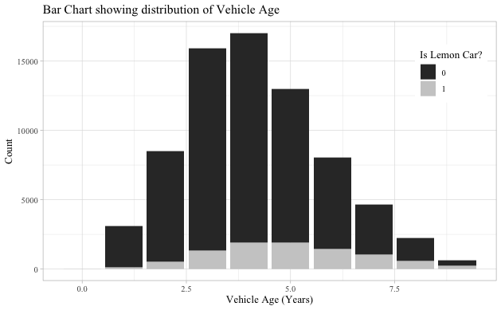
2.1 Vehicle Age
Mean Age: 4.18
Median Age: 4.00
Newest Car: 0 Years
Oldest Car: 9 Years

Slide 9
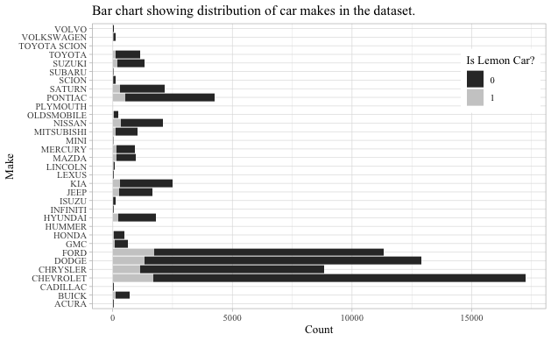
2.2 Vehicle Make
American Manufacturers overrepresented
e.g. Chevrolet, Ford, Chrysler, Dodge, Cadillac
Asian Manufacturers underrepresented
e.g. Toyota, Honda, Nissan, Subaru

Slide 10
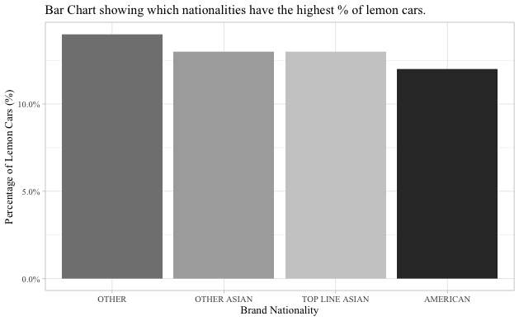
2.3 Vehicle Nationality

Slide 11
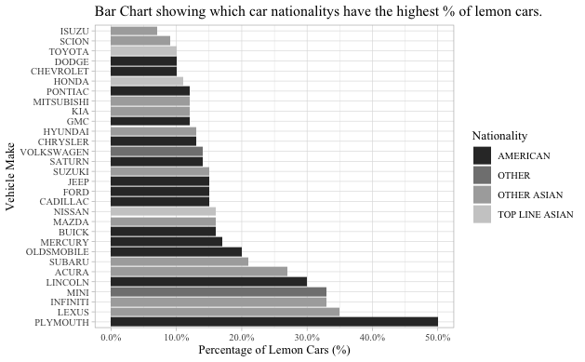
2.4 Vehicle Make Relative to Proportion

Slide 12
3. Feature Engineering

Slide 13
Using Model to create 2 new features
V6
Displacement
Model
via RegEx
Matching
RAV4 V6 4WD
4WD
Powertrain

Slide 14
Price Difference
MMRAcquisitionAveragePrice
$12,000
price_difference
Difference
$5000
Model
$7,000

Slide 15
Miles Travelled Per Year
VehOdo
Vehicle Age
miles_per_year
Ratio
34,000
5
6,800
Ratio
36,000
2
18,000

Slide 16
4. Feature Selection
Random Forest 500 Trees Variable Importance

Slide 17
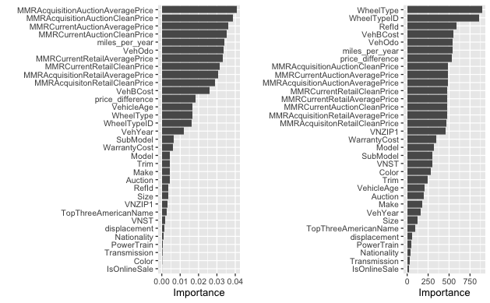
Variable Importance
Permutation Imprtance
Gini Impurity

Slide 18
5. Modelling & Evaluation
Accuracy Sensitivity AUC

Slide 19
5.2 Baseline Performance
Accuracy
0.8870

Slide 20
5.3 Logistic Regression
Features Included:
Model Performance Metrics for Logistic Regression Model
Accuracy | Sensitivity | AUC
.8968 | .2458 | .7398
MMR features, miles_per_year, VehOdo, VehBCost, VehOdo, WheelType, WheelTypeID, and VNZIP1

Slide 21
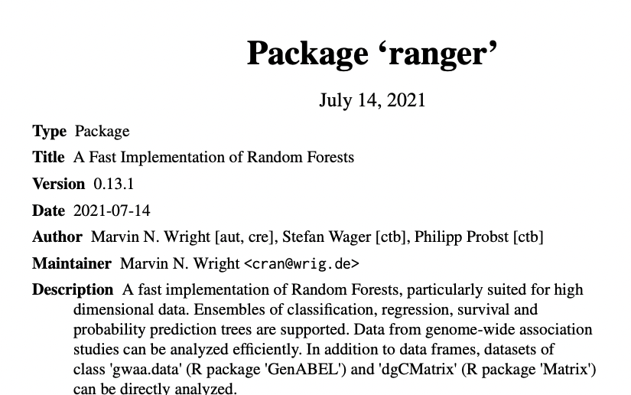
5.4 Random Forest
Model Performance Metrics for Random Forest Model
Accuracy | Sensitivity | AUC
.9000 | .2425 | .7242

Slide 22
5.4 Gradient Boosting
Model Performance Metrics for Gradient Boosting Model
Accuracy | Sensitivity | AUC
.9012 | .2475 | .7417
500 Trees
Shrinkage: 0.01
Interaction Depth: 5
5-Fold Cross Validation to Reduce Overfitting and aid in Parameter Tuning

Slide 23
Comparison of Results
Model Performance Metrics for All Models. Darker shade represents better performance. | Model Performance Metrics for All Models. Darker shade represents better performance.
Model | Accuracy | Sensitivity | AUC
Logistic Regression | .8968 | .2458 | .7398
Random Forest | .9000 | .2425 | .7242
Gradient Boosting | .9012 | .2475 | .7417

Slide 24
6. Kaggle Submission Result
My Public Score:
Best Submission on Kaggle:
0.1375
0.2672
Top 500 Entries
1st Place Entry

Slide 25
7. Areas of Improvement
Top Kaggle Submissions used Ensemble Methods
One-Hot Encoding
Dataset was heavily class-imbalanced
f
- Under sampling or Class Weighting

Slide 26
Thank you for listening
BIOS 635: Final Project Report
Junead Khan

