Slide 1
A HANDS-ON WORKSHOP
Beyond
AI Slop
Building better interfaces
with design systems
Junead Khan · Founder, Treasury
TREASURY / HACKNC 2026
01
Notes:
0:00–1:00. Welcome. I'm Junead, the founder of Treasury. Money interfaces make you care about which number matters, the date attached to it, and the next action. Today we give AI those choices explicitly. This workshop uses fictional data and a prepared starter. It is not a product demo or a model benchmark.
Promise: leave with your own design system and a working redesign.

Slide 2
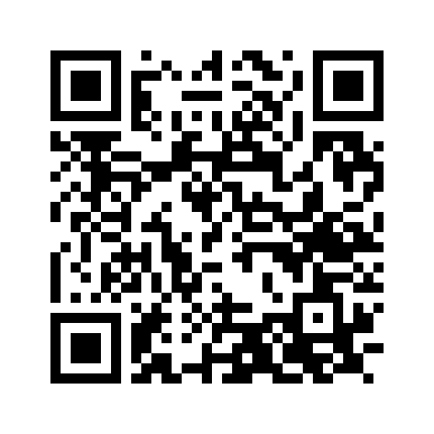
START HERE
Join the studio. Pair up if needed.
juneadkhan.github.io/
hacknc-beyond-ai-slop/
No setup for the studio
Browser + your AI chat. Nothing to install.
No AI access? Use a reference
and change its tokens.
TREASURY / HACKNC 2026
02
Notes:
1:00–3:00. Keep this up as students arrive. QR opens the workshop studio. Laptop browser recommended. Studio needs no account/install/API/subscription. Use an existing AI chat; those services have their own limits and eligibility. No purchase required. Pair up or use prepared reference CSS if access fails. Mention starter ZIP for students who prefer their own editor.
Tool sources, checked Oct 9, 2026: https://support.google.com/gemini/answer/13275745 ; https://support.google.com/gemini/answer/16275805 ; workshop TOOLS.md.

Slide 3
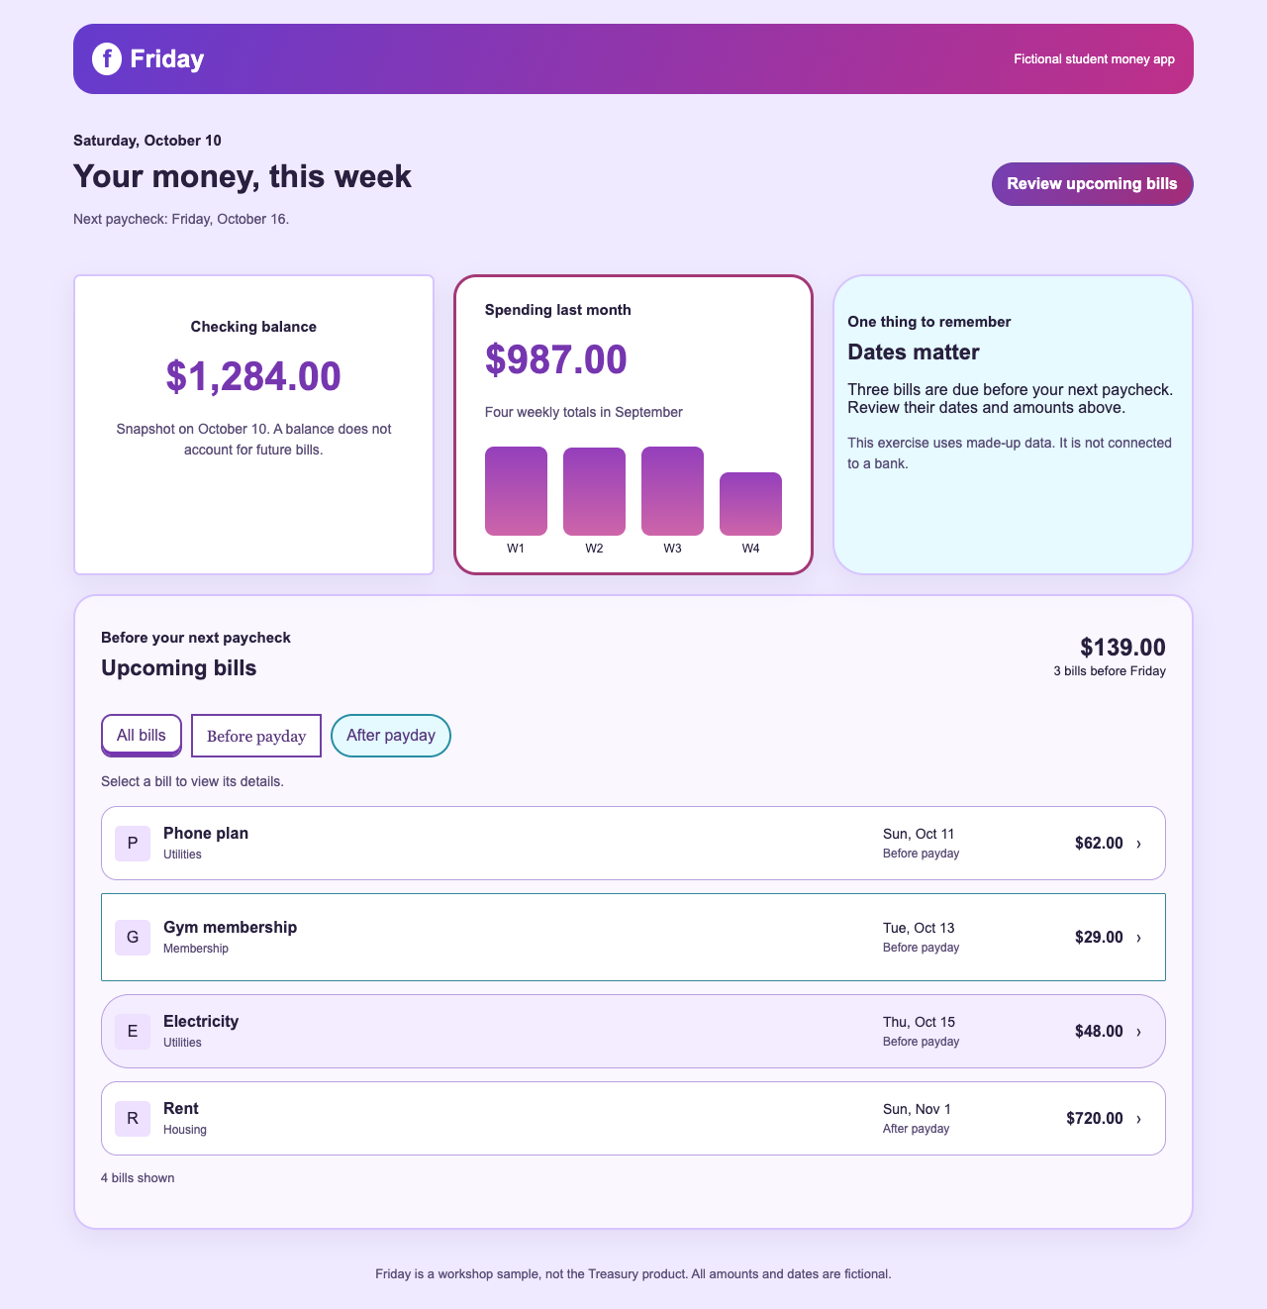
30-SECOND TASK
First, try the user’s task.
Which bills are due
before Friday?
Find the dates
and amounts.
Same task for every style.
TREASURY / HACKNC 2026
03
Notes:
3:00–5:00. Show original app in studio, or use screenshot. Give 30 seconds: Which bills are due before Friday's paycheck? Ask what students noticed first. Do not coach them. This is a task test, not controlled research. Answer: Phone $62 Oct 11, gym $29 Oct 13, electricity $48 Oct 15; 3 bills total $139. Rent $720 Nov 1 is after payday.
Image: actual prepared Friday starter; authored for workshop, not output attributed to a model.

Slide 4
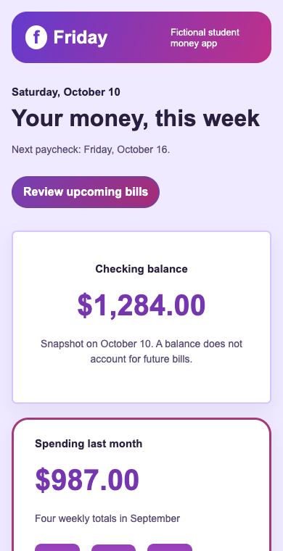
CRITIQUE THE INTERFACE
Name the failure you can observe.
Hierarchy
The secondary metrics get attention before bill dates.
Component rules
Three filters look like three unrelated controls.
Small screens
The important list moves below secondary content.
TREASURY / HACKNC 2026
04
Notes:
5:00–7:00. Ask the room for observations. Show original at 390px. Bills are fourth after balance/spending/note. Filters share a task but differ in typography, radii and borders; rows have unrelated styles. Explain that gradients can fit a coherent direction, including HackNC Aero. Removing gradients alone does not repair hierarchy.
Image: actual original app at 390px, top viewport; bill content is below this viewport.

Slide 5
THE SYSTEM
Give AI decisions it can reuse.
01
02
03
04
Purpose
Tokens
Components
Rules
Find bills before payday.
Name roles, then assign values.
Reuse rows, filters and panels.
Define priority, states and mobile.
A shared system still leaves room for your own taste.
TREASURY / HACKNC 2026
05
Notes:
7:00–9:00. A design system is shared decisions, not just a palette. Purpose establishes task; semantic tokens name roles; reusable components enforce consistent use; rules describe when/how components work, including exceptions and states. Explain this is a small system designed for one exercise. Larger systems add foundations, documentation, governance and tooling.
Sources: https://carbondesignsystem.com/ ; https://help.figma.com/hc/en-us/articles/43602393097239-Write-design-system-guidelines-for-Make-kits

Slide 6
SEMANTIC TOKENS
Name the role. Reuse the value.
:root {
--surface: #ffffff;
--text: #1c303c;
--accent: #214e63;
--on-accent: #ffffff;
--space-4: 16px;
}
.button-primary {
background: var(--accent);
color: var(--on-accent);
padding: var(--space-4);
}
One shared decision can update several components.
TREASURY / HACKNC 2026
06
Notes:
9:00–10:30. Explain :root and CSS variables for beginners. Semantic accent is an action/identity role, not a description of one hex color. Components consume role tokens. A new accent/on-accent pair updates brand, primary button, chart bars and selected filter border in the prepared references. Changes to colors must preserve readable contrast.
Code is a shortened teaching example; complete CSS is in reference downloads.

Slide 7
COMPONENT RULES
Specify the states and the exceptions.
Bill rows
Same date, amount and spacing rules for every bill.
Buttons and filters
Default, hover, selected and visible keyboard focus.
Responsive hierarchy
Bills remain first; amounts stay beside their own bill.
TREASURY / HACKNC 2026
07
Notes:
10:30–12:00. Repeated items should reuse rules. Hierarchy is a deliberate difference: primary action differs from filter. Selected state uses aria-pressed, keyboard uses focus-visible. Show live Ledger filter and bill dialog if time. CSS does not replace markup/interaction/accessibility testing. The fixture preserves native dialog and buttons.
Source: https://www.radix-ui.com/primitives/docs/overview/introduction

Slide 8
EXISTING SYSTEMS
Start with foundations that fit your project.
Carbon
Fluent 2
Radix Primitives
IBM’s product system
Microsoft’s design system
Unstyled behaviors
Foundations, components
and usage guidance.
Resources and components
for several platforms.
Accessible building blocks;
you supply visual rules.
TREASURY / HACKNC 2026
08
Notes:
12:00–13:00. A quick survey, not a library install. Carbon is IBM's open-source product system. Fluent 2 is Microsoft's cross-platform design system. Radix Primitives provides accessible, unstyled component behaviors: it is not a complete visual identity. Do not imply all are interchangeable or all work in every framework. Our CSS exercise imports none.
Sources accessed Oct 9, 2026: https://carbondesignsystem.com/ ; https://fluent2.microsoft.design/ ; https://www.radix-ui.com/primitives/docs/overview/introduction

Slide 9
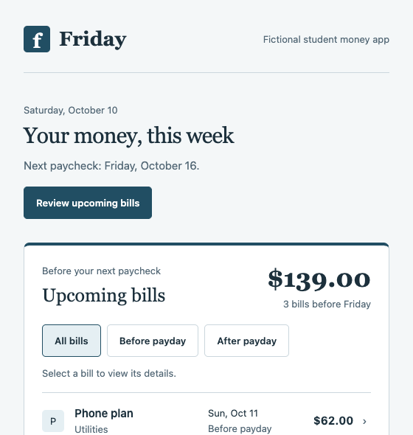
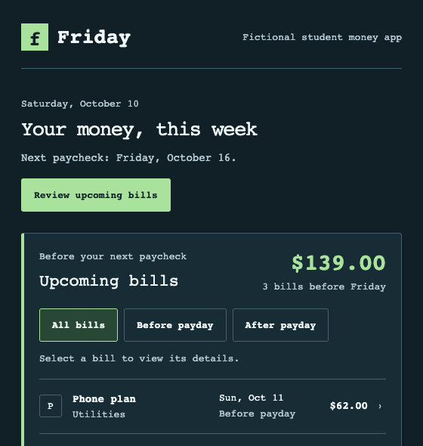
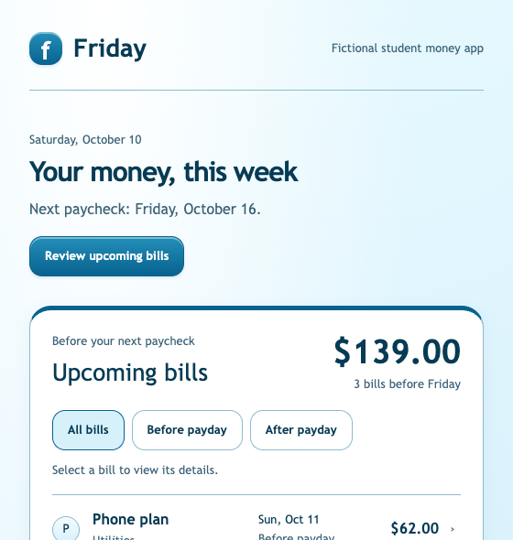
CHOOSE A DIRECTION
Different personalities. Shared discipline.
Ledger
Signal
Aero
Quiet reading
Technical clarity
Optimistic gloss
TREASURY / HACKNC 2026
09
Notes:
13:00–15:00. Prepared examples on exactly the same app, not AI benchmark outputs. Ledger: quiet reading; serif display and restrained blue; bills first. Signal: technical clarity; dark panels, monospace, mint accents. Aero: optimistic gloss; blue surfaces, tactile controls, readable dates. Students may invent another direction. Ask for audience/mood/type/density/priority, not just an adjective like pretty.
Images: actual workshop reference app screenshots.

Slide 10
LIVE REDESIGN · 6 MINUTES
Guide first. Implementation second.
1 Create and review the guide
Purpose, tokens, component rules, states and mobile.
2 Apply one complete stylesheet
Use the fixed DOM and facts. Inspect the rendered app.
3 Revise a specific observed failure
“At 390px, the date wraps away from its amount.”
TREASURY / HACKNC 2026
10
Notes:
15:00–21:00. Move to studio. Direction: optimistic campus planner with Aero gloss; dates first. Copy system prompt and send to chosen chat. Review guide instead of blindly accepting. Paste guide, copy implementation prompt, send, paste full CSS, Apply. Check390px, before-payday filter, open bill and Escape. One actual observation should lead revision. If response exceeds ~45 seconds use prepared CSS; state honestly that it is prepared. If model produces HTML despite constraints, ask for CSS only.
Context guidance: https://help.figma.com/hc/en-us/articles/38978644498199-AI-workflows-collection-Refine-your-components-and-variables-for-the-Figma-agent ; https://help.figma.com/hc/en-us/articles/43602393097239-Write-design-system-guidelines-for-Make-kits

Slide 11
BUILD · 12 MINUTES
Your style. The same working app.
Choose a point of view
Audience + mood + typography + density + priority.
12
minutes
Generate → review → apply
A design guide, then a complete CSS stylesheet.
Check mobile and keyboard
No AI access?
Use a reference
and change tokens.
Keep every amount, date, filter and detail dialog.
TREASURY / HACKNC 2026
11
Notes:
21:00–33:00. Start browser timer with Start12min. At3min ask for a guide; at6min a visible preview; at10min mobile and keyboard checks. Circulate. Students can pair. Reference CSS is valid fallback. No purchases. The studio supports prompt copy, CSS paste/apply, undo, import, local autosave and downloads. Have beginners change tokens before fine layout. Advanced students may use starter in their editor.
Pedagogy: https://workshops.hackclub.com/sprig/ ; https://carpentries.github.io/instructor-training/17-live.html

Slide 12
PEER TEST · 6 MINUTES
Swap laptops. Let the screen explain.
Give your partner the task
“Find every bill due before Friday. Open one.”
Look for evidence
Dates and amounts, shared rules, 390px, keyboard.
Share one rule and one remaining issue
What improved? What still gets in the user’s way?
TREASURY / HACKNC 2026
12
Notes:
33:00–39:00. Pairs test without explanation: find the3bills and dates before payday, open a bill, use keyboard, mobile preview. Answer three $139 phone62 gym29 electricity48. Invite two volunteers representing different styles. Each shares one reusable rule and one remaining problem. Do not select only polished aesthetics. Time/score is informal feedback, not controlled research.
Use student rubric for task clarity/system consistency/direction/readability/interaction/integrity.

Slide 13
USE IT TONIGHT
Bring the rules into your own hack.
Write the task and save the guide
Give your coding agent rules it can keep returning to.
Reuse components; change one thing at a time
Inspect the rendered result before moving on.
Make trustworthy information easy to use
A clear date and amount matter more than decoration.
TREASURY / HACKNC 2026
13
Notes:
39:00–42:00. Transfer beyond this toy: identify user task, choose direction, reuse existing system/components before new ones, save guide beside code, ask one change at time and inspect. CSS-only is deliberately constrained for setup and fair comparison; a real product may need changes to structure, content or workflow. Treasury lesson is truthful amount/date labels, clear priority and predictable interactions. No product claims beyond these design decisions.
Source: Figma Make guidelines above; external guidance motivates this exercise, not measured gains.

Slide 14
EXPORT AND CONTINUE
Keep your work. Keep asking why.
Download your app + your design guide
Keep the working interface and the decisions behind it.
Which rule will you
use in your hack?
Junead Khan · treasury.sh
TREASURY / HACKNC 2026
14
Notes:
42:00–45:00. Download my app and my guide. Exported HTML opens independently. Browser storage is local only; downloads are the handoff. Closing question: what one rule will you carry into your hack? Mention Treasury briefly and invite conversation after. No promise of unconfigured student promo or access. The joinQR remains available. Source links and tool options live in workshop guides.

