Slide 1
Transients identification basing on PDG (permanent downhole gauge) pressure data
Lejun Chen
Supervisors: Prof. Chunming Rong
Dr. Anton Shchipanov

Slide 2
Outlines
Methods in last two decades
Algorithms, detecting steps, user input, prerequisites
Experiments results of these methods
Summarization of these methods
Baseline methods that I developed
A naive attempt need improvement
Job ahead
Explore advanced methods: e.g. feature-based machine learning, predefine pattern recognition, etc.
Web-application for testing real field data

Slide 3
Methodology for analysis of PDG data (proposed by Athichanagorn 1999)
Outlier removal and denoising
Data reduction
Transient identification main task
Flow history reconstruction
Behavioural filtering
Data interpretation

Slide 4
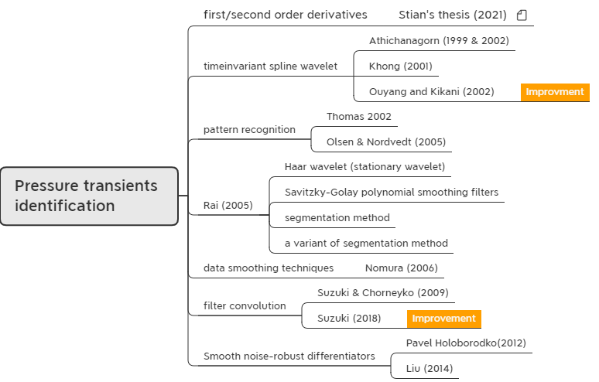
Methods investigated

Slide 5
Time invariant spline wavelet
Athichanagorn (1999 & 2002)
Use wavelet multilevel signal decomposition
Detect algorithm:
The wavelet modulus maxima at different levels of decomposition
The characteristics of wavelet modulus maxima
High level: signal singularities are group as a single singularity
Low level: signal singularities and noise singularities both present
Intermediate level: only signal singularities present detect this level
Note: intermediate level may vary for different datasets

Slide 6
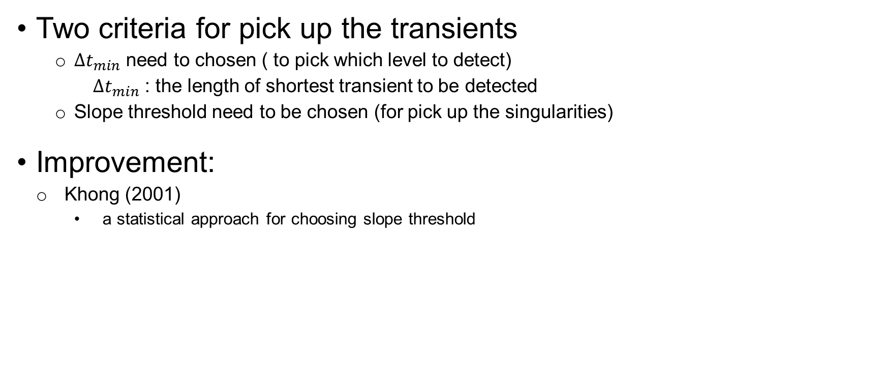
Time invariant spline wavelet
Two criteria for pick up the transients
$∆t_{min}$ need to chosen ( to pick which level to detect)
$∆t_{min}$ : the length of shortest transient to be detected
Slope threshold need to be chosen (for pick up the singularities)
Improvement:
Khong (2001)
a statistical approach for choosing slope threshold

Slide 7
Time invariant spline wavelet
Detecting steps:
Determine which level should be used in the detection algorithm based on the desired resolution of the results.
Choose a slope threshold to discriminate between singularities corresponding to new transients and noise singularities.
Determine possible locations for starting positions of new transients by choosing wavelet modulus maxima whose detail signals are higher than the threshold and map the positions back to the original resolution.
Check whether the slope extending from the singularity point forward is higher than the slope threshold and whether it deviates from the slope of data prior to the point of singularity.
Determine the exact location of the beginning of a new transient by computing the intersection between a line that passes through the first two points in the new transient and another line passing through the last two points in the previous transient.

Slide 8
Pattern-recognition approach
Thomas (2002)
Identify aberrant transients
Olsen & Nordvedt (2005)
Extend to identify normal transients

Slide 9
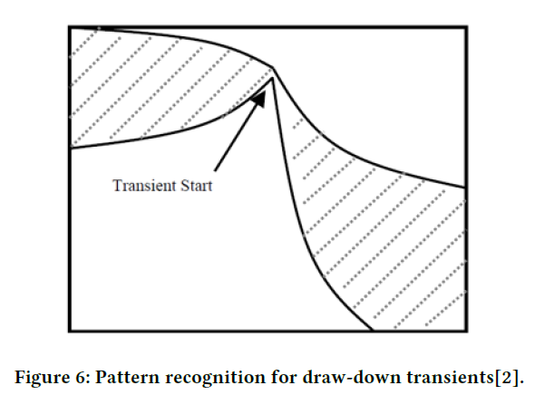
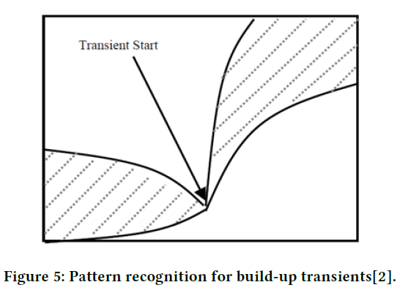
Pattern-recognition approach
Two ways to determine the pattern for break points
To predefine a pattern. ← used by Olsen & Nordvedt
To use a system learning process, like neural networks, to train the system for pattern recognition.

Slide 10
Pattern-recognition approach
Three prerequisites
Outliers must be removed.
Denoising is recommended especially when the noise level is large.
Not to use a noise filter that will seriously over smooth the transients.

Slide 11
Four methods by Rai (2005)
Four methods:
Haar wavelet (Stationary wavelet) perform similar as spline wavelet
Savitzky-Golay polynomial smoothing filters
Segmentation method significant improvements
A variant of segmentation method

Slide 12
Savitzky-Golay FIR smoothing filters
Basic idea:
Denoising the data with Savitzky-Golay filter.
Identify the breakpoints utilizing first-forth derivative.
Threshold for choosing the peak is needed.

Slide 13

Savitzky-Golay FIR smoothing filters
Algorithm for S-G filter:
A type of digital filter that replaces each data value 𝑓𝑖 by a linear combination 𝑔𝑖 of itself and some number of nearby neighbours
Similar with moving average, but not take the average
To approximate the underlying function within the moving window not by a constant (whose estimate is the average), but by a polynomial of higher order.
Note: Python has S-G filter library ready to use

Slide 14

Savitzky-Golay FIR smoothing filters
Detecting steps:
Find the peaks above a certain low threshold in the first derivative of pressure or rate data.
A backward search is carried out for identifying the corresponding peaks in the second, third and fourth derivatives of the data.
Interpolation between these locations is carried out by checking the slopes between each pair of locations to be higher than a certain value.

Slide 15
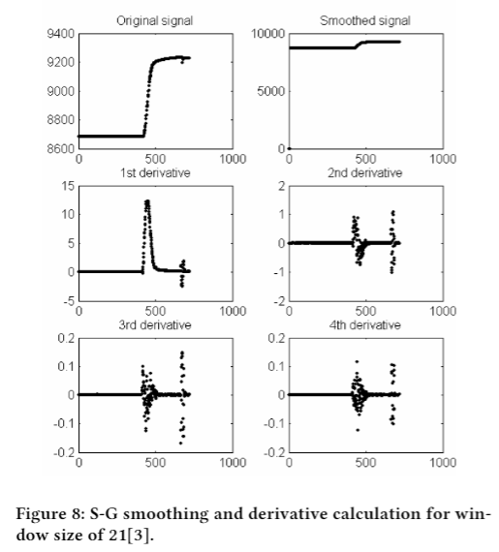
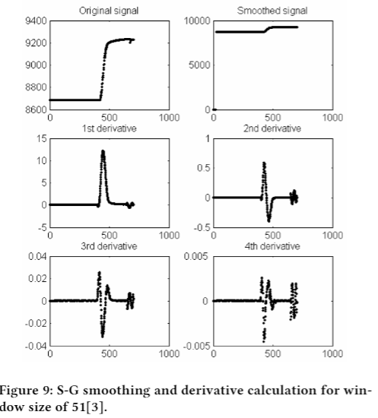
Savitzky-Golay FIR smoothing filters
Smoothing and derivative calculation for different window size:
Window size 21 window size 51
Better choice!

Slide 16
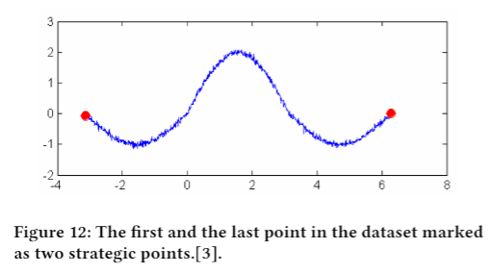
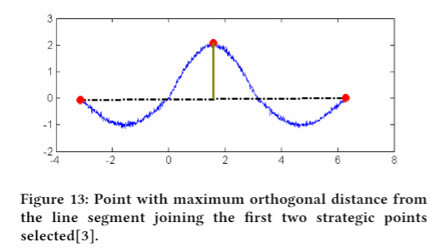
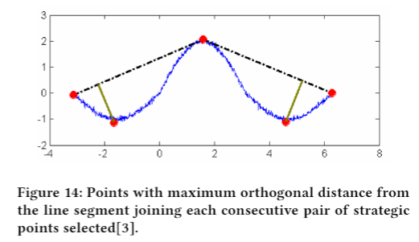
Segmentation method
Detecting algorithm
The first step is to collect a set of strategic points, by solving a sequence of maximum orthogonal (Euclidean) distance problems.

Slide 17
Segmentation method
Detecting algorithm
The second step is to calculate the area under each strategic point by considering the two other strategic points to its either side. The small or false breakpoints are then deflated using a very small area cut-off which is taken as a very small fraction of the highest area in the dataset.
The third step is to screen further by checking the forward and backward slope. As a rule of thumb, if the forward slope is less then half the backward slope, the point is discarded. The slopes were obtained by least square fitting.

Slide 18
Variation of Segmentation method
Basic idea
Identifies the zeros in the flow rate.
Between two consecutive zeros finds the peak using the segmentation approach.

Slide 19
Data smoothing techniques
Nomura (2006)
Detection algorithm
(Treat as pressure fitting problem)
Initial guess
(from wavelet processing result)
Insert break points
Delete break points

Slide 20
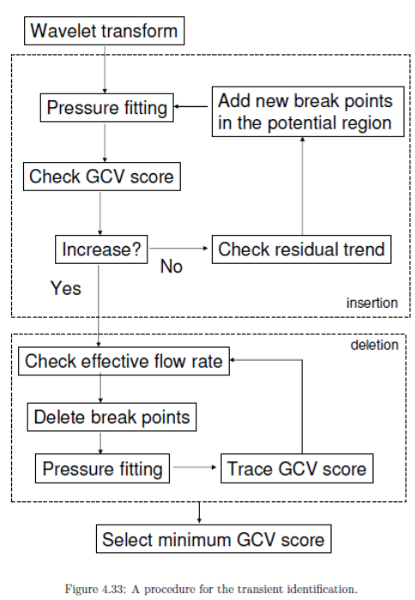
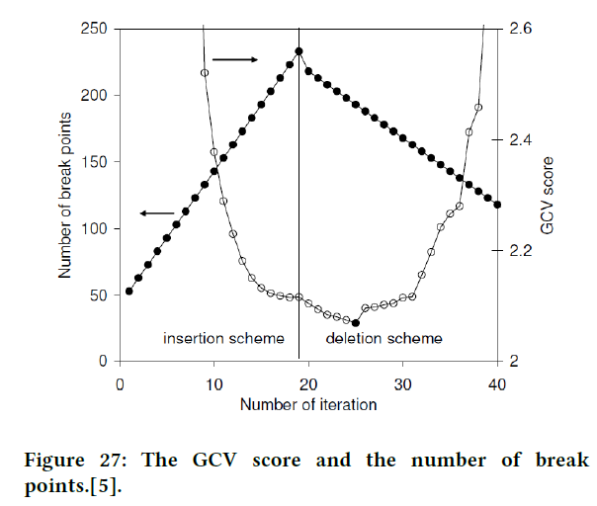
Data smoothing techniques
Applied to
Pressure data

Slide 21
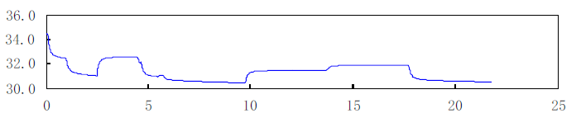
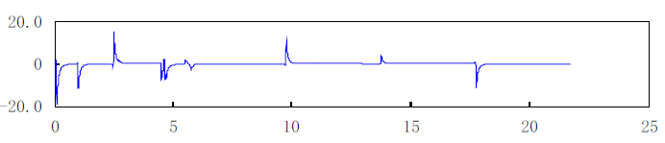
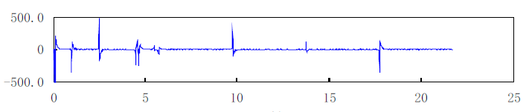
Smooth noise-robust differentiators
Pavel (2012)
Liu (2014)
Original Pressure data
First order derivative
Second order derivative

Slide 22
Filter convolution
Suzuki & Chorneyko (2009)
Suzuki (2018)
Improvement

Slide 23
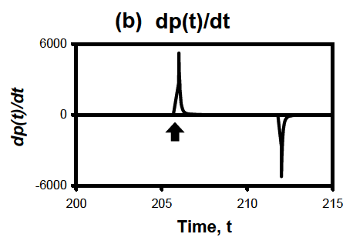
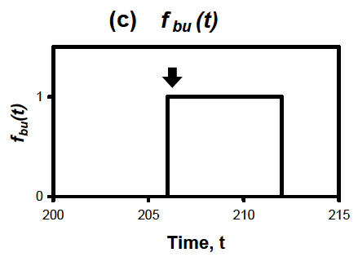
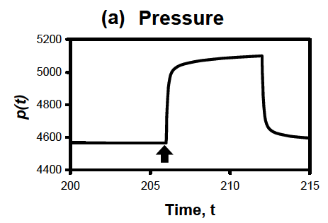
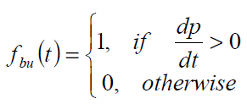
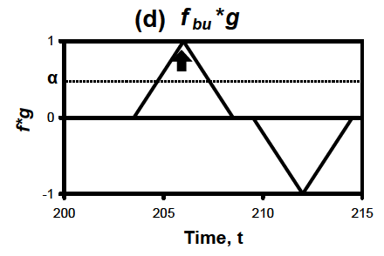
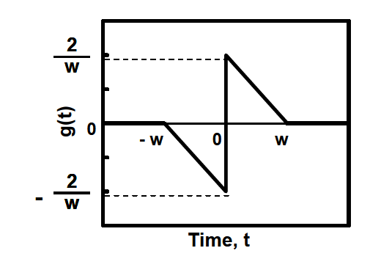

Filter convolution
Original signal Slope of pressure signal Indicator function of slope
Detecting algorithm
Convolution Filter function

Slide 24
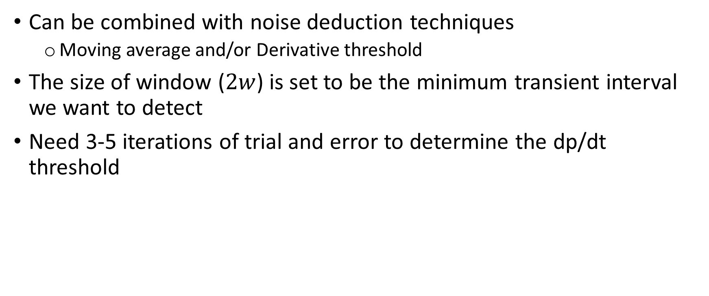
Filter convolution
Can be combined with noise deduction techniques
Moving average and/or Derivative threshold
The size of window ($2w$) is set to be the minimum transient interval we want to detect
Need 3-5 iterations of trial and error to determine the dp/dt threshold

Slide 25
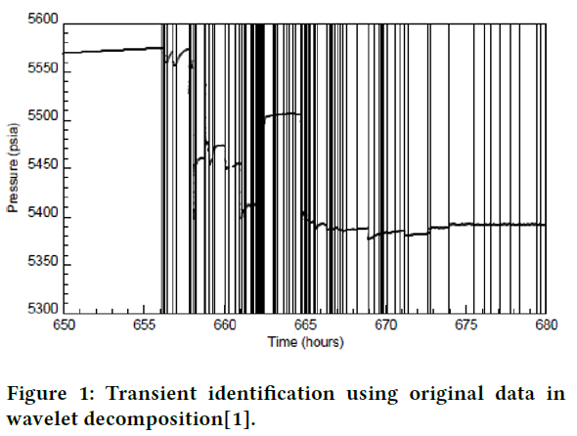
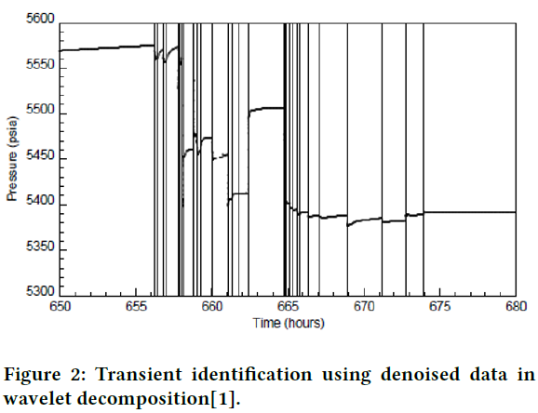
Comparison of results
Time invariant spline wavelet

Slide 26
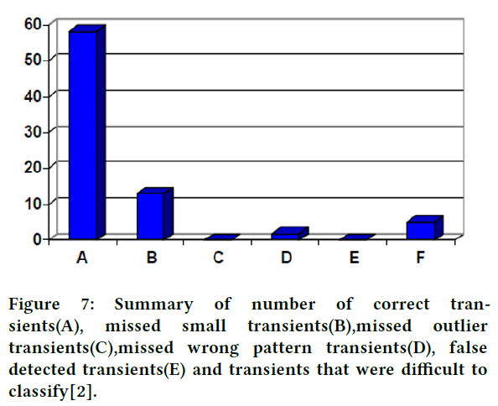
Comparison of results
Pattern-recognition

Slide 27
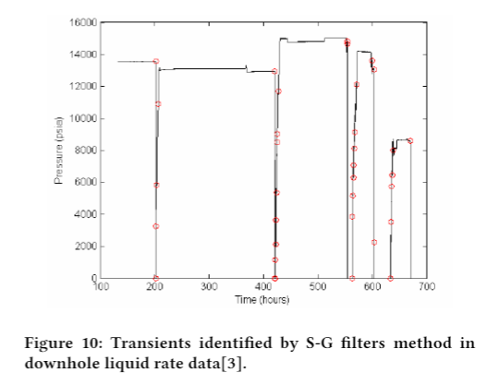
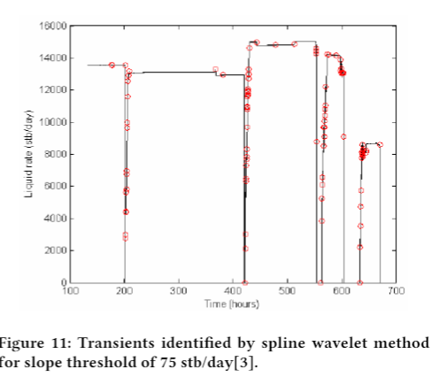
Comparison of results
Savitzky-Golay FIR smoothing filters
(compare with wavelet)

Slide 28
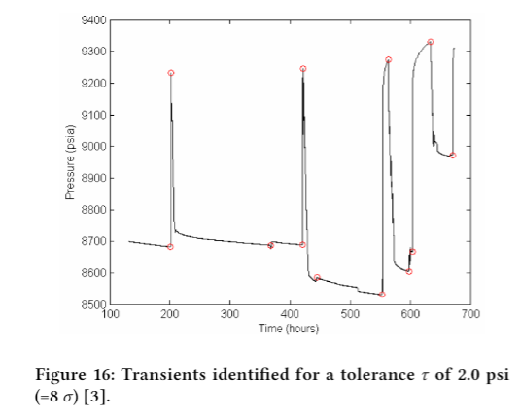
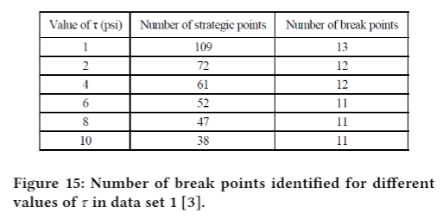
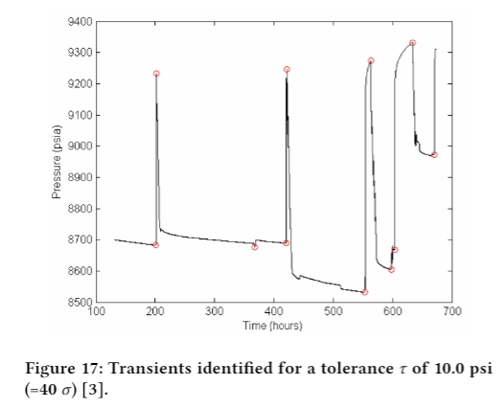
Comparison of results
Segmentation method

Slide 29
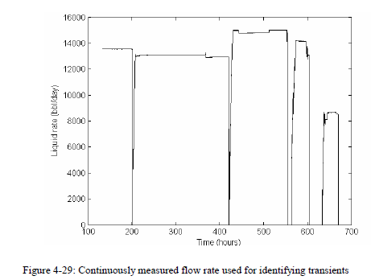
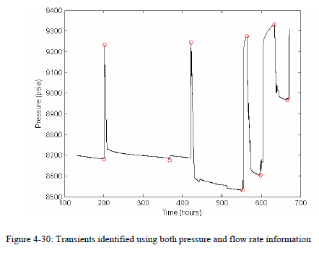
Comparison of results
Variation of Segmentation method

Slide 30
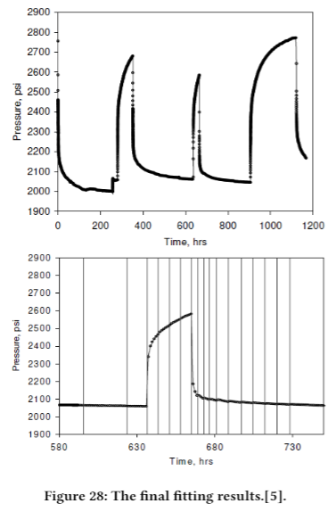
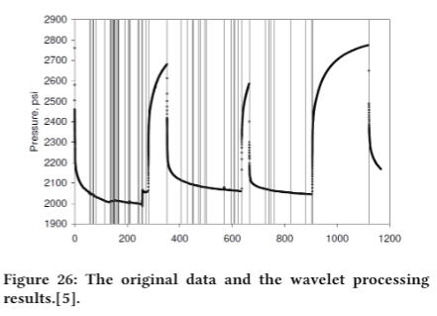
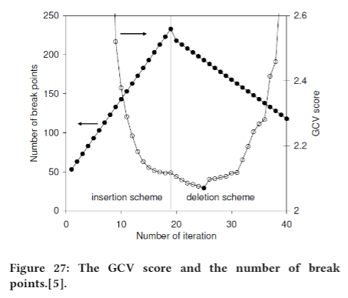
Comparison of results
Data smoothing

Slide 31
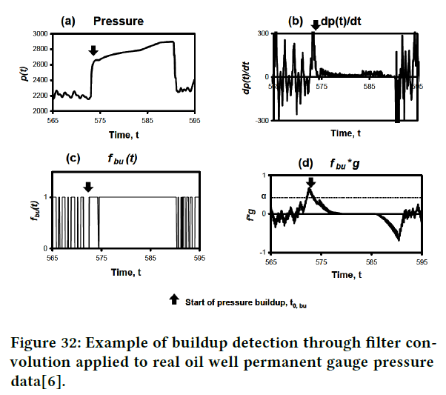
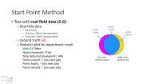
Comparison of results
Filter convolution
(real oil well)
Interesting metrics:
The time duration of slop value larger than zero or small than zero

Slide 32
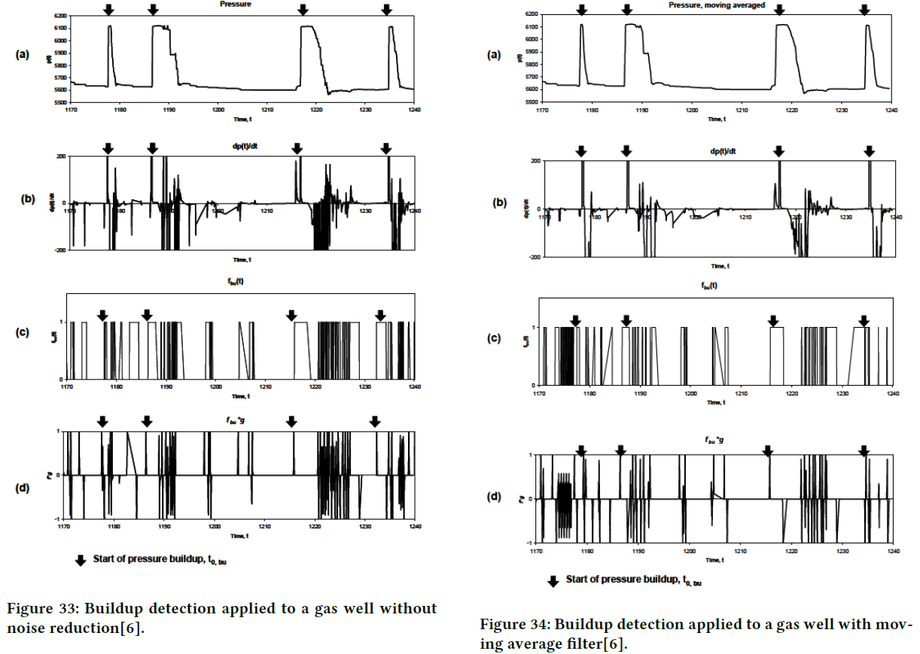
Comparison of results
Filter convolution
(real gas well)
More challenging!

Slide 33
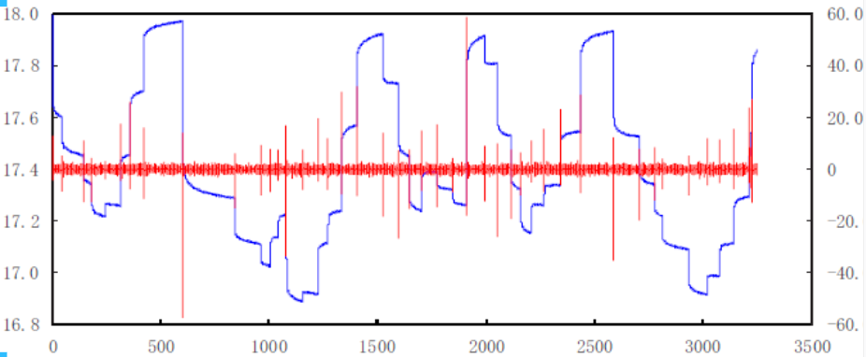
Smooth noise-robust differentiators
Pavel (2012)
Liu (2014)
Experiment result (synthetic data)

Slide 34
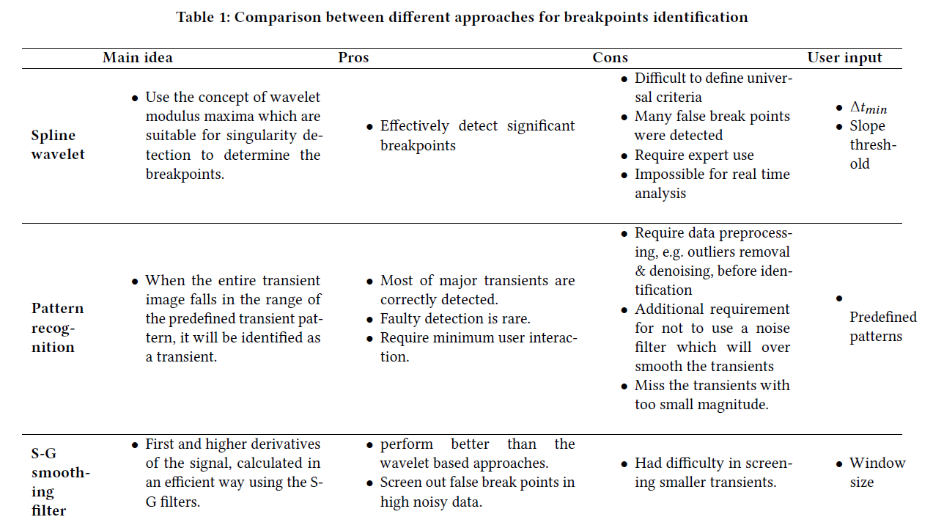
Summarization(1)

Slide 35
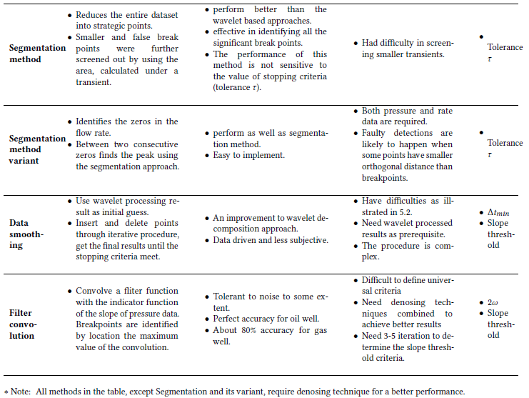
Summarization(1)

Slide 36
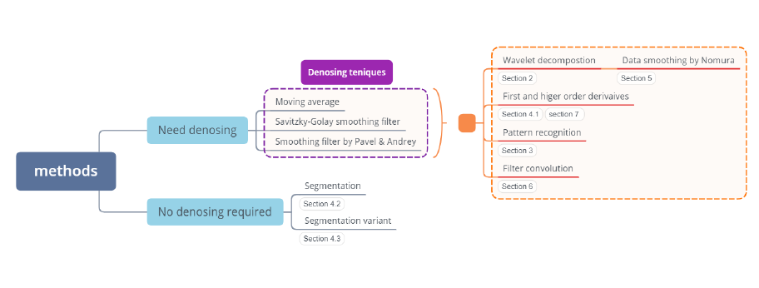
Summarization(2)

Slide 37
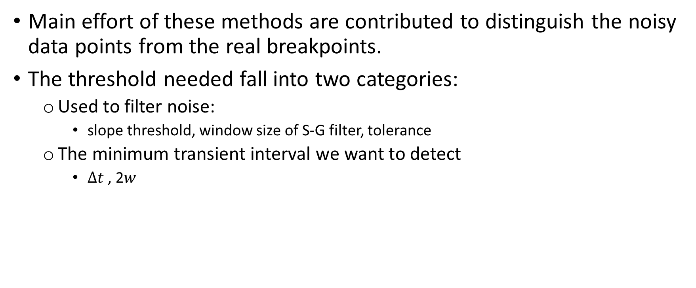
Summarization(3)
Main effort of these methods are contributed to distinguish the noisy data points from the real breakpoints.
The threshold needed fall into two categories:
Used to filter noise:
slope threshold, window size of S-G filter, tolerance
The minimum transient interval we want to detect
$∆t$ , 2$w$

Slide 38
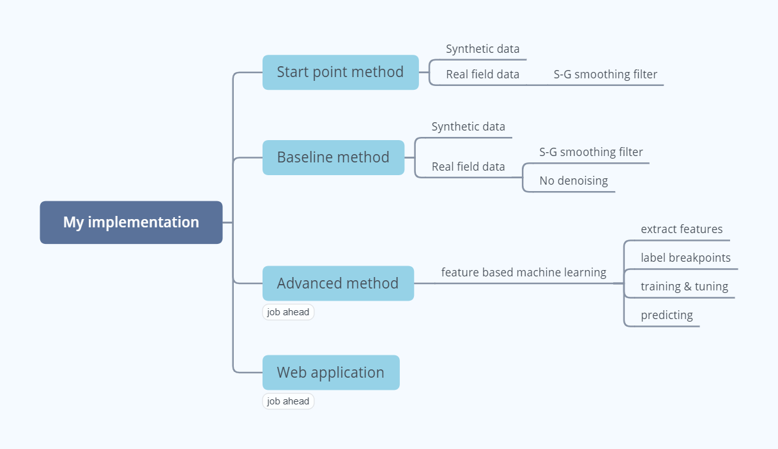

Slide 39

Start Point Method
Basic idea:
(inspired by S-G filter method proposed by Rai)
Denosing the raw data with S-G filter
Identify as the breakpoints if:
First order derivative > threshold_1
Second order derivative > threshold_2
Empirical threshold value: 2.5 * std

Slide 40
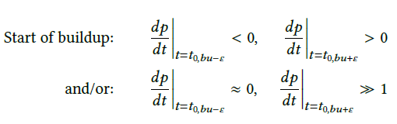
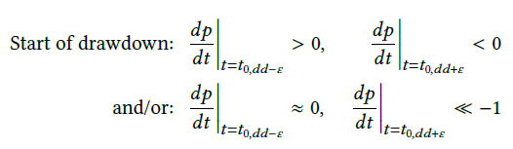
Baseline methods:
Basic idea:
(inspired by filter convolution method proposed by Suzuki & Chorneyko )

Slide 41
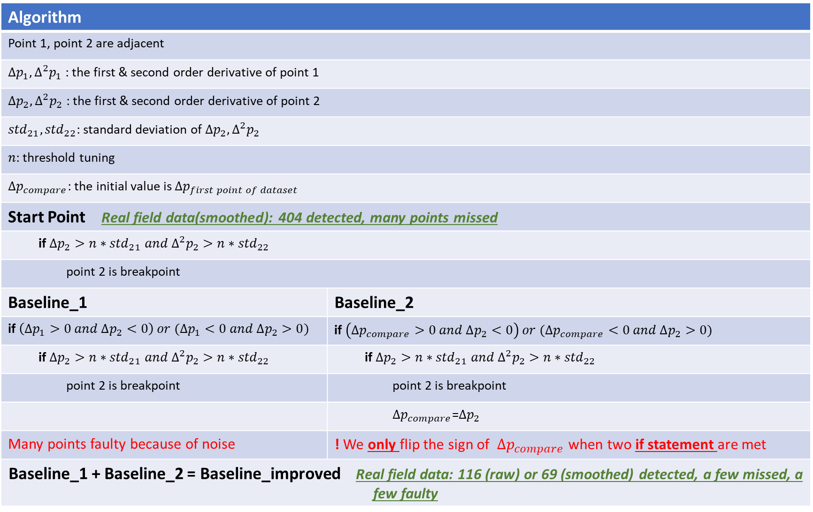
Algorithm
Point 1, point 2 are adjacent
$∆p_{1}, ∆^{2}p_{1}$ : the first & second order derivative of point 1
$∆p_{2}, ∆^{2}p_{2}$ : the first & second order derivative of point 2
${std}_{21}, {std}_{22}$: standard deviation of $∆p_{2}, ∆^{2}p_{2}$
$n$: threshold tuning
$∆p_{compare}$: the initial value is $∆p_{first point of dataset}$
Start Point Real field data(smoothed): 404 detected, many points missed
if ${∆p_{2}>n∗std}_{21} and{ ∆}^{2}p_{2}>n∗{std}_{22}$
point 2 is breakpoint
Baseline_1 | Baseline_2
if $\left(∆p_{1}>0 and ∆p_{2}<0\right) or (∆p_{1}<0 and ∆p_{2}>0)$ | if $\left(∆p_{compare}>0 and ∆p_{2}<0\right) or (∆p_{compare}<0 and ∆p_{2}>0)$
if ${∆p_{2}>n∗std}_{21} and{ ∆}^{2}p_{2}>n∗{std}_{22}$ | if ${∆p_{2}>n∗std}_{21} and{ ∆}^{2}p_{2}>n∗{std}_{22}$
point 2 is breakpoint | point 2 is breakpoint
 | $∆p_{compare}$=$∆p_{2}$
Many points faulty because of noise | ! We only flip the sign of $∆p_{compare}$ when two if statement are met
Baseline_1 + Baseline_2 = Baseline_improved Real field data: 116 (raw) or 69 (smoothed) detected, a few missed, a few faulty

Slide 42

Start Point Method
Test with synthetic data
Synthetic data
6000 hours
Pressure: 3519 measurements
Flow rate: 95 measurements
Ground truth: 45 (according to my judgement)
Statistics plot for experiment result
Noise threshold: 2.8*std points missed if threshold increase
Total detected breakpoints: 71
Points correct: 45
Points faulty: 26
Points missed: 0
detected
points
ground
truth

Slide 43
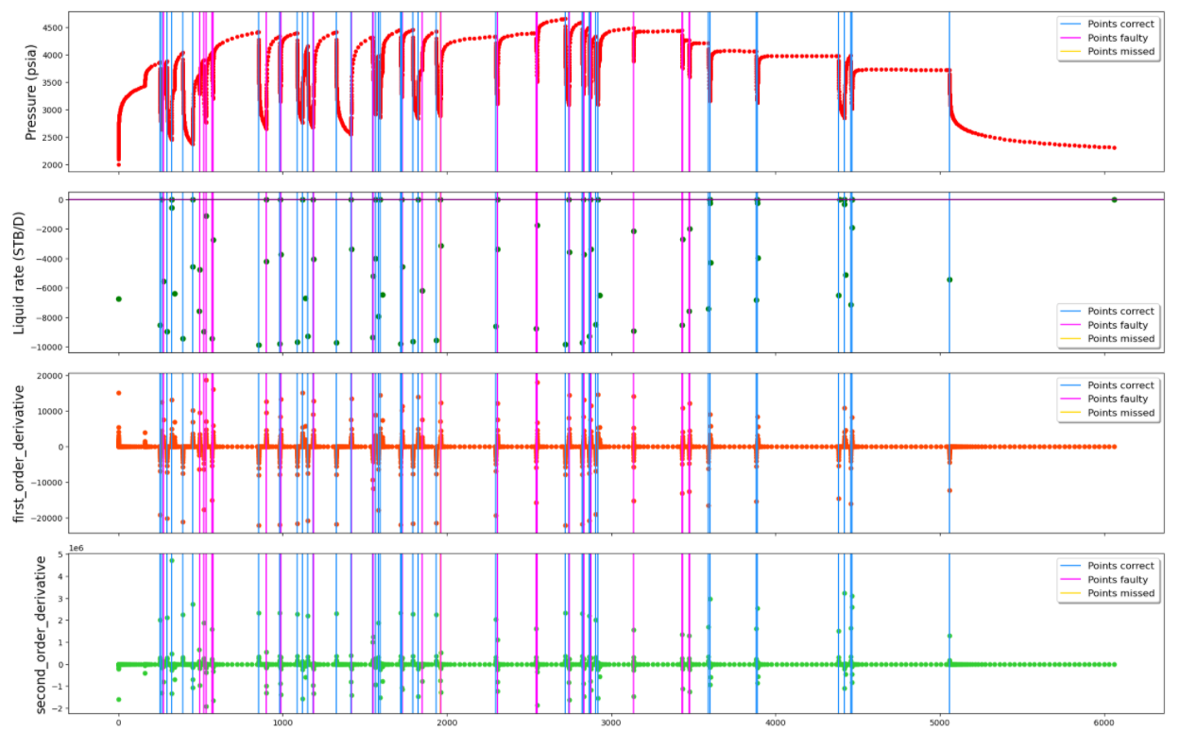
Start point
Synthetic

Slide 44
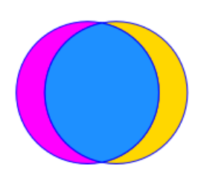

Start Point Method
Test with real field data (S-G)
Real field data
4070 hours
Pressure: 29813 measurements
Flow rate: 10191 measurements
Ground truth: 60
Statistics plot for experiment result
With S-G filter
Noise threshold: 3*std
Total detected breakpoints: 404
Points correct: ? (my next job)
Points faulty: ? (my next job)
Points missed: ? (my next job)
points
correct
points
faulty
points
missed
Left circle:
detected points
Right circle:
ground truth

Slide 45
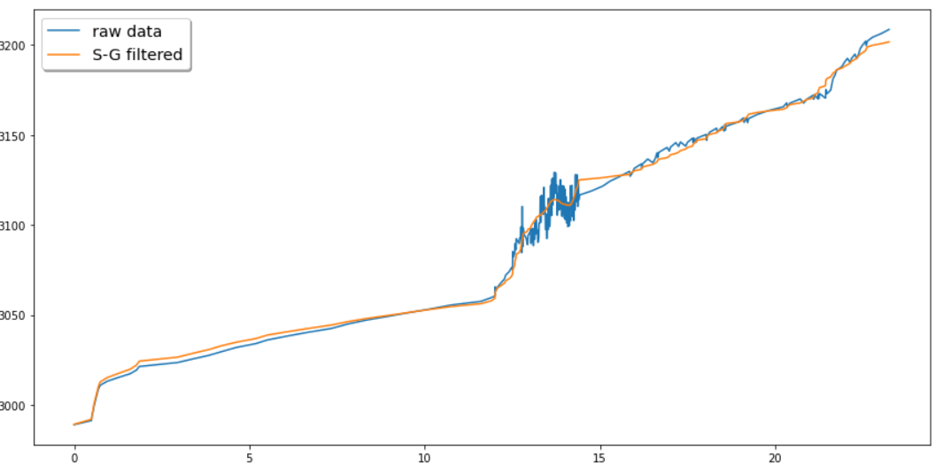
Start Point Method
Data denosing
S-G filter parameters
window_length: 199
Polyorder: 3
Very noisy !

Slide 46
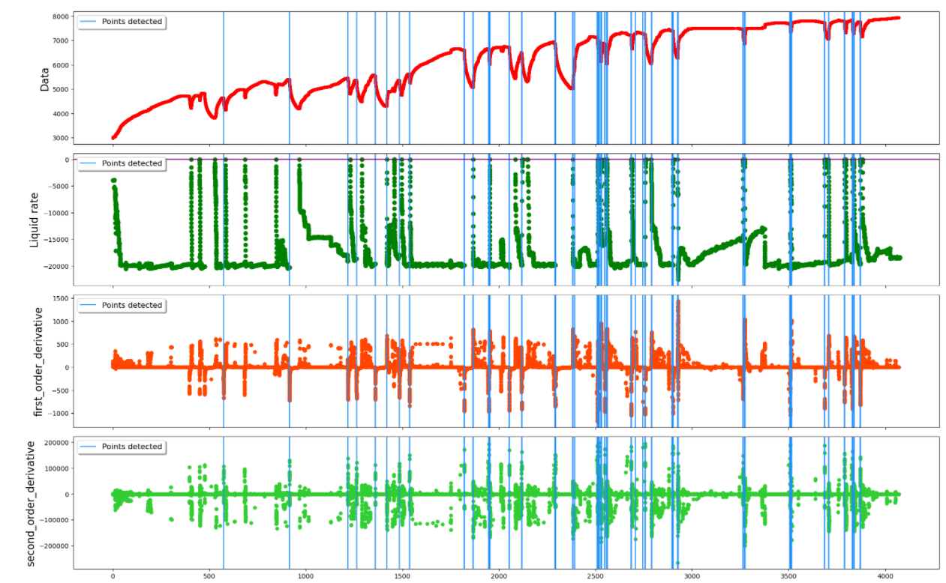
Start point
Points
missed
Points faulty
Denoised data

Slide 47
Baseline Method
Test with synthetic data
Synthetic data
6000 hours
Pressure: 3519 measurements
Flow rate: 95 measurements
Ground truth: 45 (according to my judgement)
Statistics plot for experiment result
Noise threshold: 2.4*std points missed if threshold increase
Total detected breakpoints: 57
Points correct: 45
Points faulty: 12
Points missed: 0
detected
points
ground
truth

Slide 48

Baseline
Synthetic
detected
points
ground
truth

Slide 49
Baseline methods:
Test with real field data
Real field data
4070 hours
Pressure: 29813 measurements
Flow rate: 10191 measurements
Ground truth: 60 breakpoints
Statistics plot for experiment result
points
correct
points
faulty
points
missed
Without S-G filter
Noise threshold: 2*std
Total detected breakpoints: 116
Points correct: ? (my next job)
Points faulty: ? (my next job)
Points missed: ? (my next job)
With S-G filter
Noise threshold: 0.3*std
Total detected breakpoints: 69
Points correct: ? (my next job)
Points faulty: ? (my next job)
Points missed: ? (my next job)
Left circle:
detected points
Right circle:
ground truth

Slide 50

Baseline
Raw data

Slide 51

Baseline
Denoised

Slide 52
Baseline methods
Pros:
Very good performance towards synthetic data
Do not require denosing (however denoising can help to smooth extremely noisy points)
Calculation cheap
Cons:
Have difficulty for the data which is very noisy
Difficult to filter the points where the flow rate decrease but not shut in
Need threshold
Performance is sensitive to threshold

Slide 53
Baseline methods--Conclusion
About the S-G filter
Helps with the extremely noisy data
Increase the missed points if over smoothed
The detected breakpoints are slightly different from the one without smoothing
The limitation of methods basing on derivatives
Difficult to get rid of noise threshold
The main reason for faulty detection

Slide 54
Baseline methods--Discussion
The criteria for Ground_truth?
The criteria for points_correct?
Should points closed to ground truth be classified as correct?
Should points closed to each other be grouped as 1?
Is the flow rate always available?
If so, we can use it to refine our detection basing on pressure data
Or our scope is just using the pressure data?
The criteria for dominating multi-rate transient?

Slide 55

A transient in 400-900 hours/synthetic data --My judgement for transients ?
Start point of
draw down
Start point of
build up
Start point of
Build up for next transient
Zero flow rate
Zero flow rate

Slide 56
Job ahead (advanced methods)
Machine learning --- Feature extractions
Inspired by the methods investigated
first to forth order derivatives of pressure data, estimated noise(S-G filter method)
the time duration the first derivative larger(or smaller) than zero, the first order derivative of the previous point (filter convolution method)
Backward and forward slope of two adjacent detected breakpoints, slopes were obtained by least square fitting (segmentation methods)
Feature selection criteria
Realtime
Case independent (require less or no expert use)
The one that brings minor improvement will be discarded
Computational cheap

Slide 57

Job ahead (advanced methods)
Machine learning --- label
Generate Label
Results from the baseline methods
validate with flow rate

Slide 58
Job ahead (advanced methods)
Machine learning –classical methods
Split the data to train and test set following 80/20 rule
Cross validation, K-means, etc.
Experiment with different classifiers

Slide 59
Job ahead (advanced methods)
Machine learning
Pros:
Higher accuracy
Cons:
More computation

Slide 60

Job ahead (advanced methods)
Web application[10]
Rest API
API endpoint: Python flask web framework
Front end: Javascript, CSS
User interface(picture is from Anisa[10])

Slide 61
Reference
[1] Athichanagorn, S. (1999). Development of an interpretation methodology for long-term pressure data from permanent downhole gauges.
[2] Olsen, S., Nordtvedt, J.E. (2005). Automatic Filtering and Monitoring of Real-Time Reservoir and Production Data.
[3] H. Rai. (2005). Analyzing rate data from permanent downhole gauges. MS report, Stanford University.
[4] Khong, C.K. (2001). Permanent Downhole Gauge Data Interpretation, MS report, Stanford University.
[5] Nomura, M. (2006). Processing and interpretation of pressure transient data from permanent downhole gauges.
[6] Suzuki, Satomi & Chorneyko, David. (2009). Automatic Detection of Pressure-Buildup Intervals From Permanent Downhole Pressure Data Using Filter Convolution. 10.2118/125240-MS.
[7] Pavel Holoborodko. (2009). Smooth noise-robust differentiators. http://www.holoborodko.com/pavel/numerical-methods/numericalderivative/smooth-low-noise-differentiators/deriv.
[8] Andrey Paramonov. (2015). Noise-robust smoothing filter. http://www.holoborodko.com/pavel/numerical-methods/noise-robustsmoothing-filter/.
[9] Liu Junrong, Yao Jun, Yu Weiqiang. (2016). Study of Identification Method of Transient Flow from Permanent Downhole Pressure Data. Journal of Southwest Petroleum University(Science Technology Edition)
[10] Anisa Zhurda, "Automated Well Monitoring: Machine Learning and Web Application," University of Stavanger, 2020.

Slide 62
Thanks ☺
Any comments?

Slide 63
Baseline methods:
Criteria for deciding breakpoints:
If there exists two adjacent points:
the sign of first order derivative are different
The difference of first order derivative is larger than a certain threshold
Then, the latter point is a breakpoint.
Note:
Empirical threshold value: 2.5 std
Works well with synthetic data, but not for real data because of NOISE!
Basic idea:
(inspired by filter convolution method proposed by Suzuki & Chorneyko )
to improve
(3) Set the sign of first order derivative of later point as same as the previous one, if the difference of slope between them is smaller than a threshold

