Slide 1
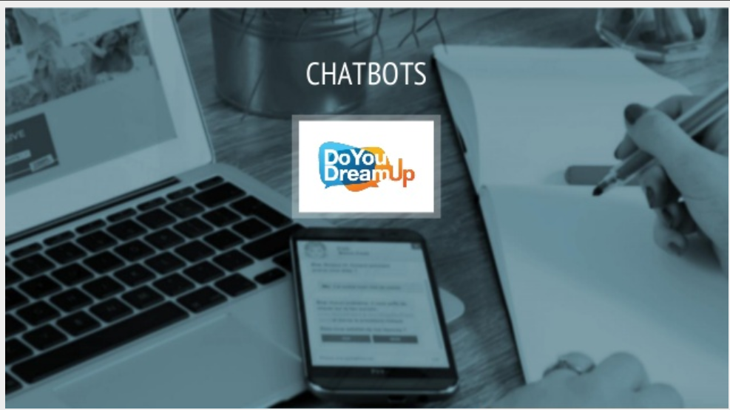

Slide 2
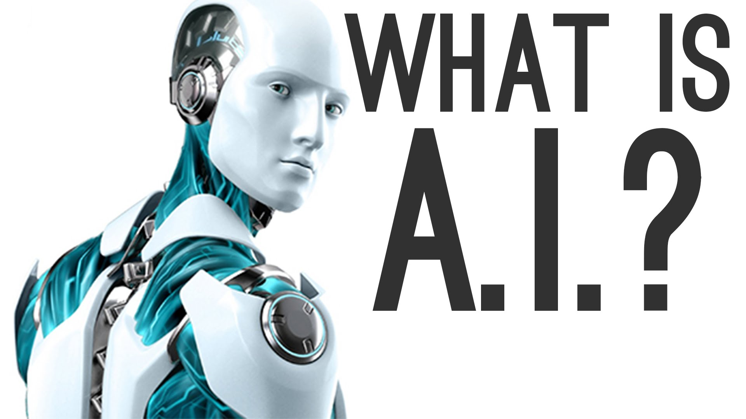
Domain name : Artificial intelligence

Slide 3
Project Members
Juned Mullani

Slide 4
What is a chatbot?
A chatbot (also chatterbot,chatterbox) is a computer program which attempts to maintain a conversation with a person

Slide 5
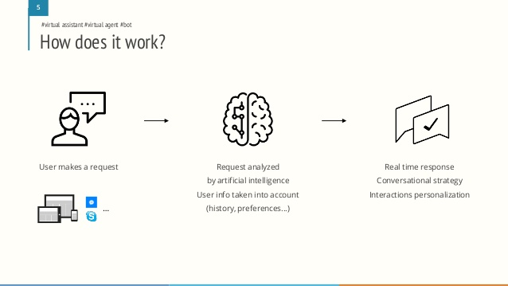

Slide 6
Important Part of The project
AIML Files.
Flask Model.

Slide 7
Applications:
Customer support
Sales and advice

Slide 8

Benefits
User satisfaction
Immediate answers
Available 24/7
90% correct answers
Personalized answers

Slide 9


Benefits
Si simplify employees life
Enhance productivity and operational effectiveness
Staff retention
Decrease calls and e-mails to support services
Resources reallocation on value added tasks

Slide 10
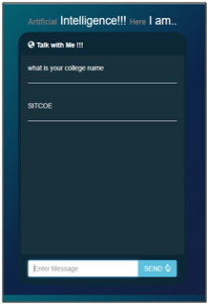
snapshot

Slide 11
THANK YOU

