Slide 1




PORTFOLIO OPTIMIZATION
Course : Financial Analytics
Sem : 4
Group : 3
Name :
Juned Saleh(0805065)

Slide 2

Agenda
Introduction
Asset classes and optimization
Risk and Return
Portfolio construction
Diversification
Optimization methods
Limitations
Practical Applications.

Slide 3

What Is Portfolio Optimization?
Portfolio optimization is the process of constructing an investment portfolio that aims to achieve the highest possible expected return for a given level of risk.
Portfolio optimization is one of the most basic skills you’ll need to acquire when actively managing your investments.

Slide 4


Main Goal
To achieve the highest possible expected return for a given level of risk or to minimize the risk for a given level of expected return.
The ultimate goal of portfolio optimization is to construct a well-diversified portfolio that maximizes returns while minimizing risk.

Slide 5

Objectives
Asset classes: Overview of different asset classes such as stocks, bonds, and alternative investments, and their role in portfolio construction.
Risk and return: Understanding the relationship between risk and return, and how to balance risk and return to optimize portfolio performance.
Diversification: Importance of diversification in portfolio optimization, how to diversify across asset classes, and how to measure portfolio diversification.

Slide 6
Portfolio construction: Steps involved in portfolio construction, including asset allocation, security selection, and rebalancing.
Optimization methods: Different methods for portfolio optimization, such as mean-variance optimization, quadratic optimization, and heuristic optimization.
Performance evaluation: How to evaluate the performance of a portfolio, including measures such as return, risk, Sharpe ratio, and alpha.
Practical applications: Real-world applications of portfolio optimization in investment management, including tactical asset allocation, strategic asset allocation, and factor investing.
Challenges and limitations: Challenges and limitations of portfolio optimization, such as data limitations, market volatility, and the assumptions underlying optimization models.

Slide 7

Asset Classes and Optimization
Any portfolio optimization strategy will apply the concept of diversification, which means investing in a wide variety of asset types and classes.
Diversification across asset classes is a risk-mitigation strategy. Financial asset classes include different types of securities, debt and equities that you can hold. Furthermore, every asset has a distinct return and risk profile.
Critically, different asset classes have different ‘systemic risk‘, which describes how they respond to the market at large. For example, when the stock market does well, commodities and bonds tend to do poorly. Conversely, commodities and bonds rise when stocks fall.
Ideally, spreading your investments across a variety of asset classes allows you to take advantage of different systematic risks.

Slide 8

Some of the popular asset classes include:
Bonds: Debt instruments issued by governments and large organizations.
Income-Generating Bonds: This is a subset of bonds that pay interest on a regular basis.
Stocks: Shares of ownership issued by private companies, which typically break out into large, mid, and small-cap categories according to the size of the issuing firm.
Commodities: Ownership of goods or products, typically raw resources, which trade based on their future prices.
Contracts: Instruments issued by private parties such as certificates of deposit and annuities.
Cash and Equivalents: Money in a bank account or other secure assets that you can liquidate immediately.

Slide 9
Most retail investors avoid direct contact with commodities and bond markets since these tend to be high-risk classes.
The alternative is buying into mutual funds or exchange-traded funds that buy into these assets.
For example, instead of taking on the considerable risk involved with trading commodities contracts in precious metals, one could purchase a mutual fund pegged to the price of gold. It’s less expensive, less risky and far more accessible.

Slide 10
Risk And Return
Portfolio optimization is a process that helps investors maximize returns and minimize risks in their investment portfolios. In this process, investors choose the assets that they want to invest in, determine the allocation of their investments, and perform a risk-return analysis to achieve the best possible outcome.
Risk and return are two key concepts that are central to portfolio optimization. Risk refers to the probability of losing money in an investment or the potential for variability in returns.
The higher the risk, the greater the chance that the investment's return will be lower than expected, or that the investor could lose money. Return, on the other hand, is the income or profit earned from an investment, typically expressed as a percentage of the investment's initial value. Investors seek higher returns, while minimizing the level of risk they are exposed to.

Slide 11

Portfolio optimization seeks to balance these two factors by constructing a diversified portfolio that minimizes risk while maximizing returns.
This is done by combining assets that have different levels of risk and return and creating a portfolio with an optimal mix of assets.
The process of portfolio optimization involves determining the expected returns for each asset, the expected risks associated with each asset, and the correlations between different assets.

Slide 12

What is investment risk?
At its most basic definition, the risk is the chance that you’ll lose money on an investment or won’t see the returns that you expected.
However, investors also measure risk through volatility, which refers to the likelihood an asset’s price will change significantly.
This is one reason risk and reward often correlate. An asset with strong volatility can deliver or lose a great deal of value.
That range of potential outcomes makes the asset hard to predict and, therefore, risky.

Slide 13
Portfolio Construction
Portfolio Construction refers to a process of selecting the optimum mix of securities for the purpose of achieving maximum returns by taking minimum risk.
A Portfolio is a combition of various securities such as stocks, bonds and money market instruments. Diversification of investments helps in spreading risk over many assets; hence one must diversify securities in the portfolio to create an optimum portfolio and ensure good returns on portfolio.

Slide 14
Two approaches
Traditional Approach
Modern Approach

Slide 15
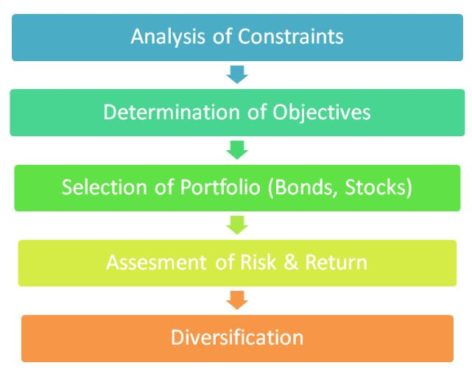
Traditional Approach of Portfolio Construction
Under traditional approach , the financial plan of an individual is evaluated with regard to an individual’s needs in terms of income and capital appreciation and appropriate securities are selected to meet those needs.
Its consists of five steps which are:

Slide 16
Analysis of constraints
The constraints decided on the basis of :
Income needs: Investor needs for current income.
Liquidity needs: Investor preference for liquid assets
Safety of principal: Saftery of principal value at the time of liquidation
Time horizon: Life Cycle stage and investment planning periods of investor
Tax Consideration: Tax benefits of investing in a particular asset
Temperament: Risk being the capacity of the investor

Slide 17

Determination of objectives
It involves formulation of objectives within the given framework of constraints.
There are some objects of investor are:
Current income
Growth income
Capital Appreciation
Preservation of Capital

Slide 18
Selection of Portfolio
The optimum asset mix for an investor depends upon his investment objectives.
Investment objective | Assets mix
Current Income | 60% debt and 40% in equity
Growth Income | 60% in equity and 40% in debt
Capital Appreciation | 90% in equity and 10% in debt
Safety of Principal | 90% in debt instruments with focus on short term debt instruments and 10% on equity

Slide 19
Assessment Risk & Return analysis
In the traditional approach, risk is typically measured using statistical measures such as standard deviation, beta, or Var and Return is measured using historical data to calculate average returns and expected returns.
Fundamental Analysis : Fundamental analysis involves evaluating the financial health of a company, including it earning,revenue,assets, and liabilities.
Technical Analysis: Technical analysis involves studying past market data, such as price and volume, to predict future market movements. Investors use charts and other tools to identify trends and pattern in the data.
Business and Economic Factors: Investors also consider broader economic factor, such as interest rate,inflation,and GDP growth, when assessing investment options.

Slide 20
Diversification
An investor can reduce portfolio risk simply by holding combinations of instruments that are not perfectly positively correlated.
Diversification works by reducing the risk of any single investment or asset class. By investing in a variety of assets that are not perfectly correlated with each other, an investor can reduce the impact of any one asset or event on the overall portfolio.
For example, if an investor only invests in one stock, the risk of losing their entire investment is much greater than if they invest in a diversified portfolio of stocks, bonds, and other assets.

Slide 21
Modern approach
Modern Approach of Portfolio Construction also known as Markowitz Approach emphasizes on selection of securities on the basis of risk and return analysis.
The financial plan of an individual is audited in terms of risks and returns and efforts are made to maximize expected returns for a given level of risk.
Unlike traditional approach which considers an investors need for income or capital appreciation as basis for selection of stocks, the modern approach takes into account the investors needs in from of market return or dividend and his tolerance for risks as basis for selection of stocks.
Returns are usually measured in terms of market return and dividend and form the basis of selection of stocks.

Slide 22
Ten to Fifteen stocks are selected after thorough analysis and expected risk and return is computed for each stock. Stocks with good return prospects are selected and funds are appropriately allocated among different stocks according to the portfolio requirements (risk & return) of the investor.
An investor may adopt an active or passive approach to manage his portfolio. Under passive approach, the investor holds the securities for a previously established holding period while an active approach involves continuous assessment of risk and return of securities and replacing low performing securities with high performing securities over time.

Slide 23
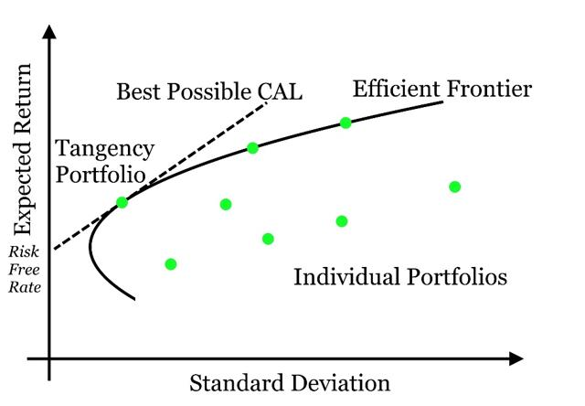
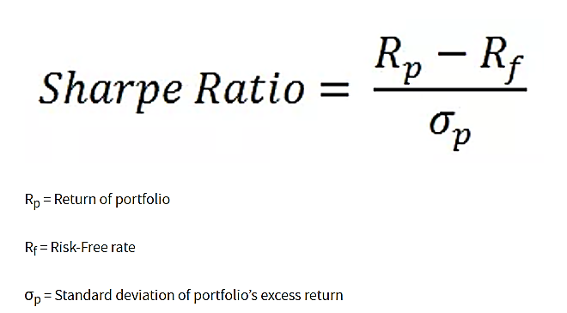
Efficient Frontier Curve & Max Sharpe Ratio
The Efficient Frontier : A cornerstone of modern portfolio theory, shows the set of portfolios that provide the highest level of return for the lowest level of risk. When a portfolio falls to the right of the efficient frontier, they possess greater risk relative to their return. Conversely, when a portfolio falls beneath the slope of the efficient frontier, they offer a lower level of return relative to risk.
Sharpe Ratio - It is the average return earned in excess of the risk-free rate per unit of volatility or total risk. Volatility is a measure of the price fluctuations of an asset or portfolio.
Owning a portfolio with the Maximum Sharpe Ratio is the dream of every investor.

Slide 24
Portfolio optimization Methods
Portfolio optimization refers to the process of selecting the best combination of assets that maximize the return on investment while minimizing risk.
There are so many methods but we mentioned few here.
1.Mean-Variance Optimization: Mean-variance optimization is a key element of data-based investing.
It is the process of measuring an asset’s risk against it’s likely return and investing based on risk/return ratio. Investor will use mean-variance optimization to create risk/reward data sets for various asstes,so they can invest based on information

Slide 25
2. ROBUST OPTIMIZATION : Robust optimization (RO) models have attracted a lot of interest in the area of portfolio selection.
The origins of robust optimization date back to the establishment of modern decision theory in the 1950s and the use of worst case analysis and Wald's MAXIMIN model as a tool for the treatment of severe uncertainty.
3. MODERN PORTFOLIO THEORY : Modern portfolio theory (MPT) is a theory on how risk-averse investors can construct portfolios to maximize expected return based on a given level of market risk.
Modern portfolio theory argues that an investment's risk and return characteristics should not be viewed alone, but should be evaluated by how the investment affects the overall portfolio's risk and return. MPT shows that an investor can construct a portfolio of multiple assets that will maximize returns for a given level of risk.
4. LSTM (Long short-term memory) : This is a special type of Recurrent Neural Networks (RNN) architecture that is mainly used in deep learning. LSTM uses a set of feedback connections to process sequences of data.
This architecture is known for its efficiency in making predictions, processing, and classifying large-scale time-series data despite the presence of some lags between events.

Slide 26
Limitations
1.Frictionless Market :
There are certain assumptions made in the Modern Portfolio Theory, which is the basis of portfolio optimization.
The assumption is that markets are frictionless, that is, there are no transaction costs, constraints, etc., in the market.
However, in reality, this is often not the case. There are frictions in the market, and this complicates the application of modern portfolio theory
2.Normal Distribution :
Another assumption under the modern portfolio theory is that the returns are normally distributed. It ignores the concepts of skewness, kurtosis, etc., when using the return data as inputs. It is often found that the returns are not normally distributed. This assumption violation under the modern portfolio theory makes it challenging to use.
3. Dynamic Coefficients :
Coefficients vary with market situations, including correlation coefficients, which are used in portfolio optimization.
It is not always true that these coefficients stay the same.

Slide 27
EXAMPLE
PREDICTIONS FOR
YAHOO FINANCE STOCKS DATA

Slide 28
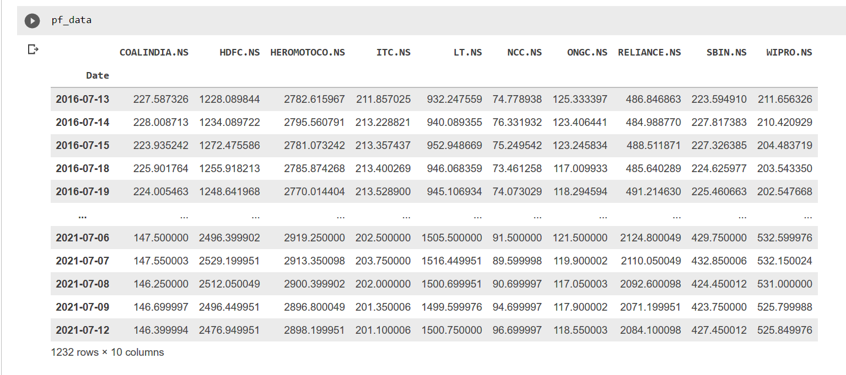
Dataset: Overview

Slide 29
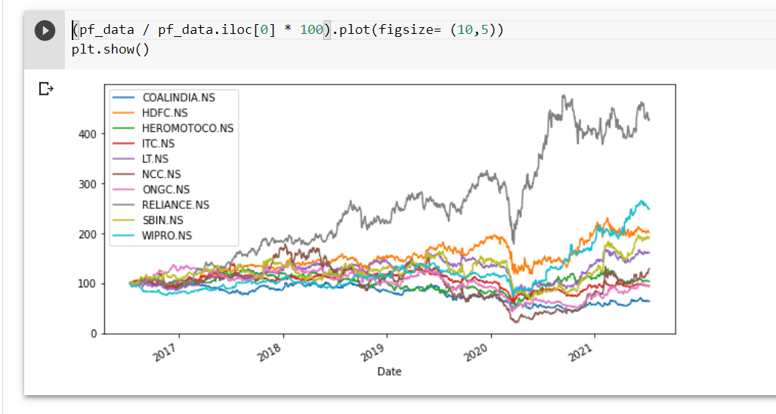

Slide 30
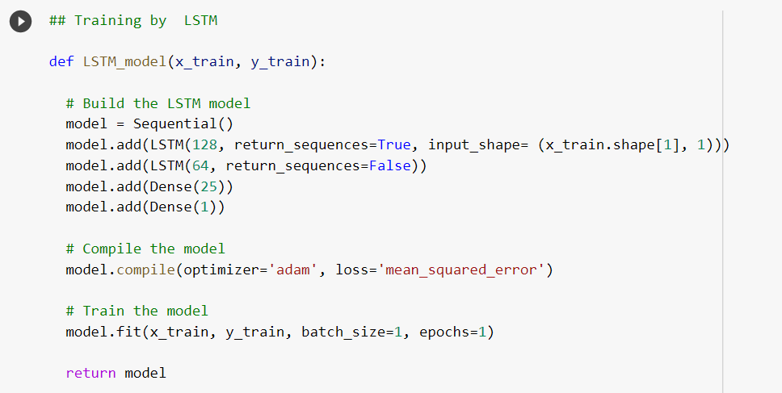
Training the LSTM

Slide 31
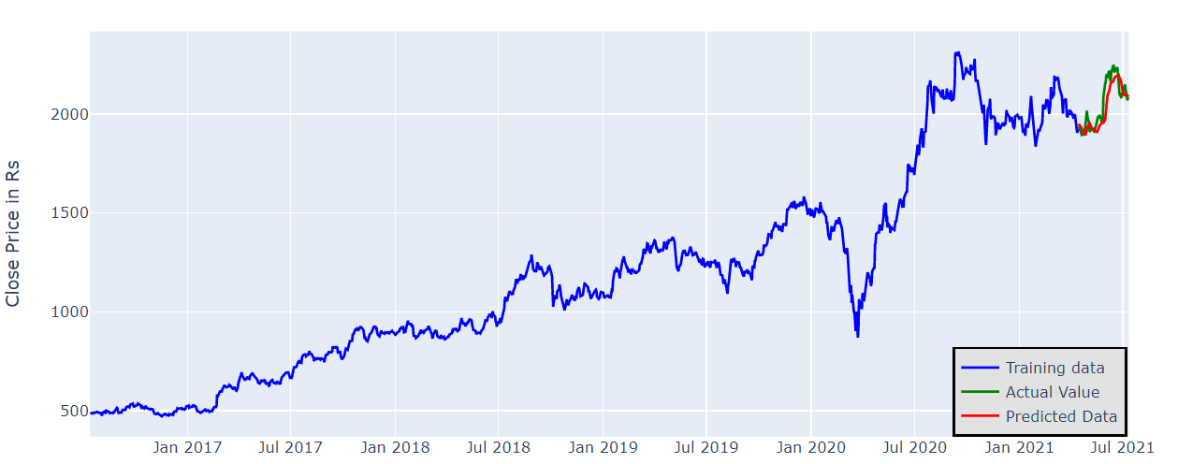

Predictions by LSTM

Slide 32
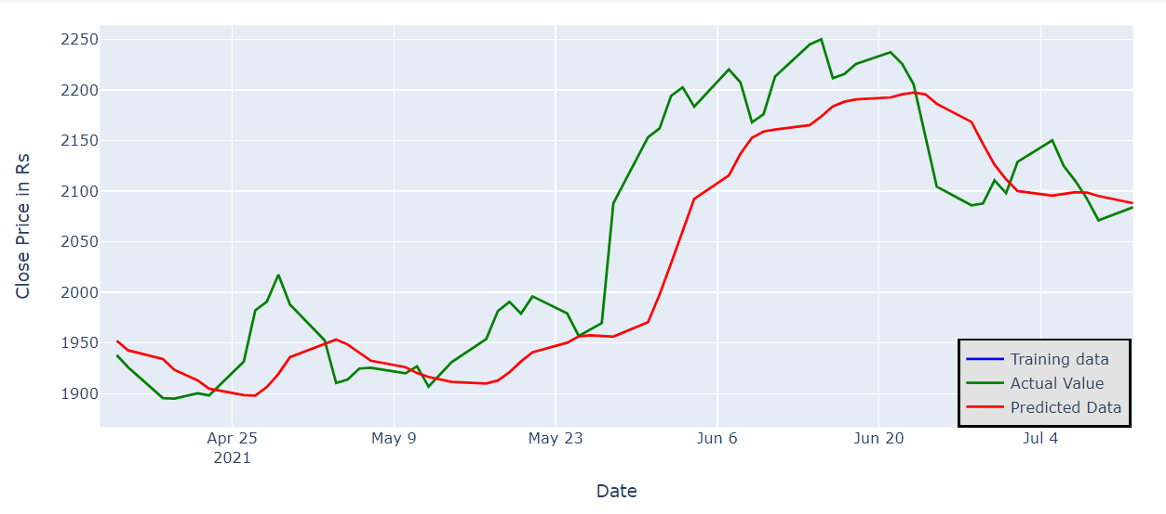

Slide 33
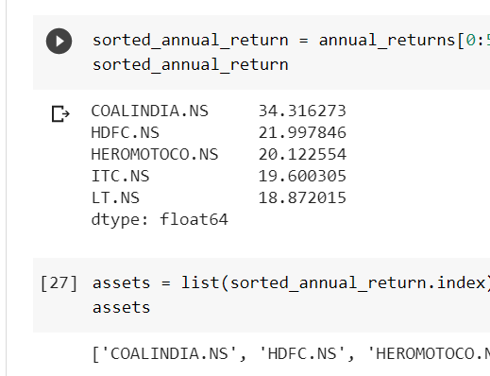
Selecting best stocks for making portfolio
Selecting the top 5 stocks out of all predicted stocks, on the basis of their moving average returns over the coming six months.

Slide 34
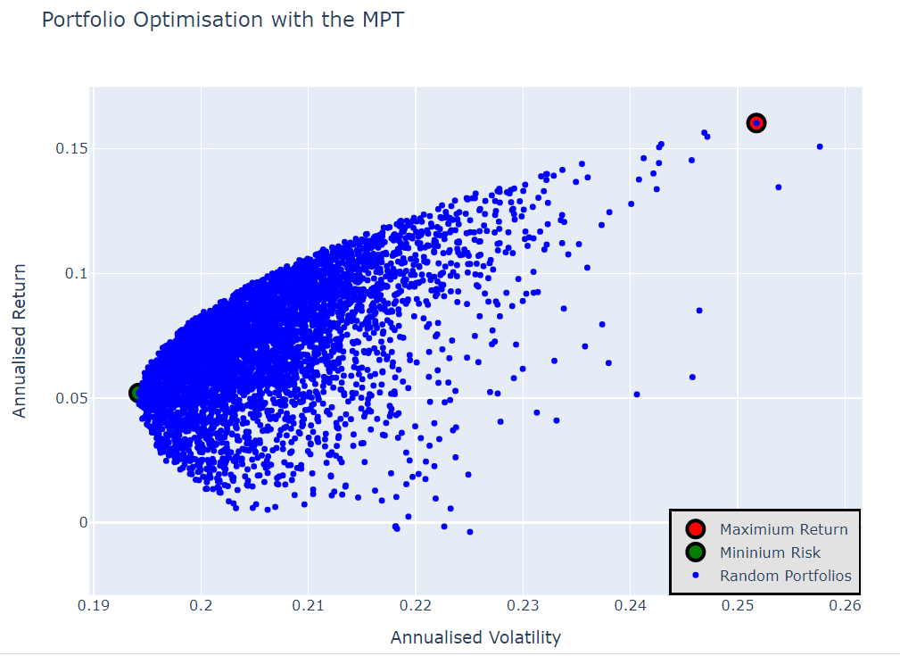
Efficient Frontier Curve

Slide 35
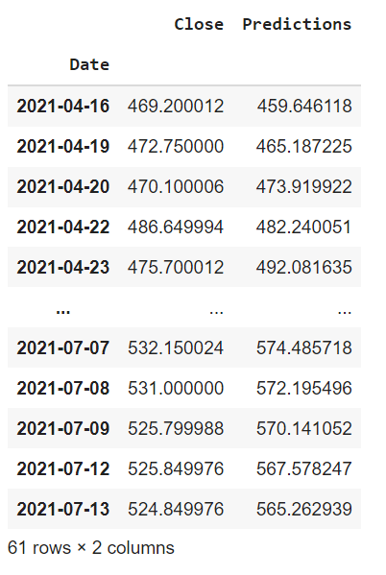
Observations
The testing RMSE values we found were as low as 2.646, 3.524 and 3.895 for ONGC, NCC and ITC stocks respectively which is pretty accurate to predict future values of stock.
Given aside are the closing actual and predicted values of Wipro Stock given by the LSTM model.
However, future values for any time period can be predicted using this model.

Slide 36
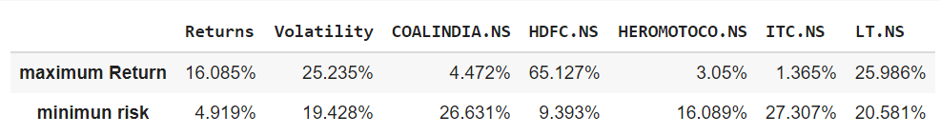
Observations
By the table below, we can get the max return of 16.085% with a volatility of 25.235% by investing the highest 65.127% in HDFC.
It also shows that we can get the return of 4.919% at the min risk possible by investing the highest 26.631% in Coal India.

Slide 37

Thank you !!
References
https://www.wallstreetmojo.com/portfolio-optimization/#h-examples-of-portfolio-optimization
https://www.stat.berkeley.edu/~aldous/24/Posted/Ali_Setayesh.pdf
https://smartasset.com/investing/guide-portfolio-optimization-strategies
https://github.com/sahilgupta2210/Stock-Portfolio-Optimization-using-MPT-and-LSTM

