Slide 1
Project Title
Periodic Table Elements Details
Purpose
The main goal of the project is to get the details of each element in the periodic table by just one click. This program is easy to run & display details of periodic table elements for each periodic number or symbol entered by user.

Slide 2
Overview
This program will help students to get the details regarding each element which are available within the periodic table. Users will need to input the atomic numbers or symbol. The system will then show the detail of periodic element name, properties (such as atomic number & atomic mass) & their location in the periodic table.

Slide 3
FUNCTIONAL REQUIREMENTS
Structure has been used as there is two types of variable in one element.
Switch Case has been used to take input (atomic number or symbol) from users.
Taken information has been passed to a Function.
Input data is compared using 'if-else' statement.
To read files , 'fopen' function has been used.
While loop has been used to read files until the end of the file & print it to console.

Slide 4
SOURCE COCE
Structure Declaration
#include<stdio.h>
#include<string.h>
struct elements
{
char symbol[3];
int AtomicNumber;
};

Slide 5
Function Declaration
void printfile(struct elements E)
{
FILE *fp;
if (E.AtomicNumber == 1 || strcmp(E.symbol,"H") == 0) {
fp = fopen("1.txt", "r");
char c;
while((c = getc(fp))!= EOF){
putchar(c);
}
fclose(fp);
}
.
.
.
else printf("Wrong Input!!");
return ;
}

Slide 6
Main Body Function
int main(void)
{
struct elements E;
int x;
printf("Search by:\n1.Atomic Number\n2.Symbol\n");
scanf("%d", &x);
switch (x) {
case 1 :
printf("Please enter the Atomic Number : ");
scanf("%d", &E.AtomicNumber);
break;
case 2 :
printf("Please enter the Symbol : ");
scanf("%s", E.symbol);
break;
default :
printf("Wrong Input!");
break;
}
printfile(E);
return 0;
}

Slide 7
BUGS
If I put '2' to compare the condition of 'if' for Helium , then the program prints the details of 'He' ( Helium ) for any symbol entered by the users.
Tools & Resources
C programming language
& Code :: Blocks
References
Wikipedia

Slide 8
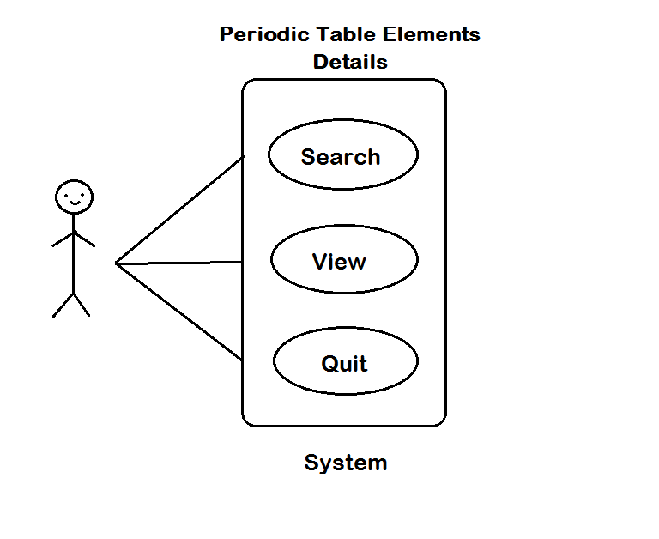
System Use Case Diagram

