Slide 1
Meta Dynamic Programming
Paul O'Neil
Juneki Hong

Slide 2
Dynamic Programming across Dynamic Programming problems
Local Alignment problems are frequently queried in large batches.
Individual Local Alignment problems can be efficiently solved with Dynamic Programming.
Many Local Alignment problems may be similar in nature. Share similar structure, or even have identical regions where the genes are the same.

Slide 3
Existing Approaches
SIMD (Tyler and Jen)
Static Work Allocation, MPI-type parallelism

Slide 4
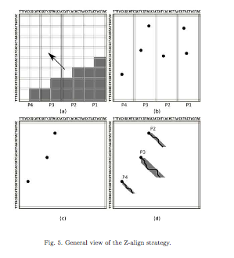
Existing Approaches
BOUKERCHE, et al.
EXACT PARALLEL ALIGNMENT OF MEGABASE GENOMIC SEQUENCES WITH TUNABLE WORK DISTRIBUTION
2012, International Journal of Foundations of Computer Science

Slide 5
Our Goals
We want operate a server for Local Alignment problems.
… that will solve many problems over time.
We want to reuse solutions to previous problems to help solve current ones.
We want to run many of these problems concurrently.

Slide 6
Our Approach - Architecture
Client
Leader
  Allocates work and puts together solutions.
Worker
  Computes the matrix.
Storage
  Stores answers and problems.

Slide 7
Here is a System Diagram
Leader
Worker
Storage

Slide 8
What's a Problem?
A | C | G | T | A | C | G
1
2 | 3 | 4 | 5 | 6 | 7 | 8
A
C
G
T
A
C
G
2
3
4
5
6
7
8
Answer is O(n^2) in the size of the problem

Slide 9
What's a Problem?
A | C | G | T | G | C | G
1
2 | 3 | 4 | 5 | 6 | 7 | 8
A
C
G
T
A
C
G
2
3
4
5
6
7
8

Slide 10
Leader
Advertises a list of problems to the workers
Workers attempt to claim problems
  Leader rules on the claim
Upon completion, worker sends a “certificate” to the leader
Leader informs the client of the solution

Slide 11
Worker

Slide 12
Storage
Persists solutions to problems
Searches for

Slide 13
Issues with our Approach
We have to be faster than naively computing the whole matrix (on average).
Message cost overhead. The cache hits have to be worth it.
  Network latency
Computing cache hits themselves have to be worth it.
Total data size.

Slide 14
Features yet to Come
Partial matching
Subdivision
  Intelligent subdivision
  Genome metadata
Distributed storage
  Local RAM cache on the Worker.
  Intelligent problem choices by the Worker.
  PostgreSQL, Cassandra, Mongo, or similar

