Slide 1
Library System (Group 3)
AldarKHANGAI Chimed-Ochir
TAMIR GANBAT
JUne Andrew m rabin

Slide 2
agenda
Overview
Tools and Technologies
Use Case Diagrams
Class Diagram
Sequence Diagrams
Limitations
Demo

Slide 3
overview
Design and Build a Library System tool that can be used by a Librarian or an Administrator (or Both access) to add new books to the collection, create new Library Members and Edit Library Member information.
Librarian access has the ability to Check-out books
Administrator access is responsible to Add/Edit member's information and Add books to the collection
Librarian and Administrator access has the capability of doing all the tasks mentioned above for both Librarian and Admin

Slide 4
Overview (continuation)
Supports MVC (Model-View-Controller) model where project contains 3 different packages (UI Layer, Data Layer and Business Layer)
Uses JAVA Serialization
where an object can be represented as a sequence of bytes that includes the object's data as well as information about the object's type and the types of data stored in the object. (tutorialspoint.com).
User-Friendly User Interface

Slide 5
Tools and technologies
Eclipse
JAVA FX
FX CSS

Slide 6
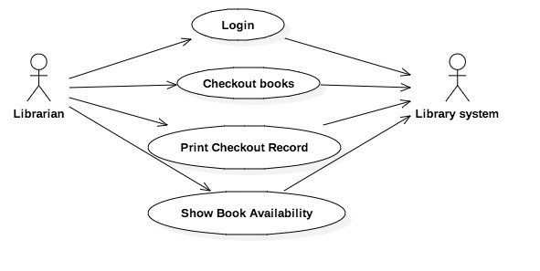
Use Case diagram – librarian access

Slide 7
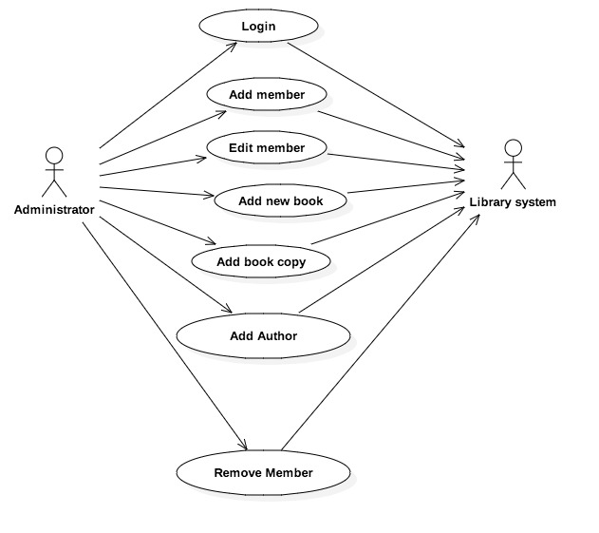
Use case diagram administrator access

Slide 8
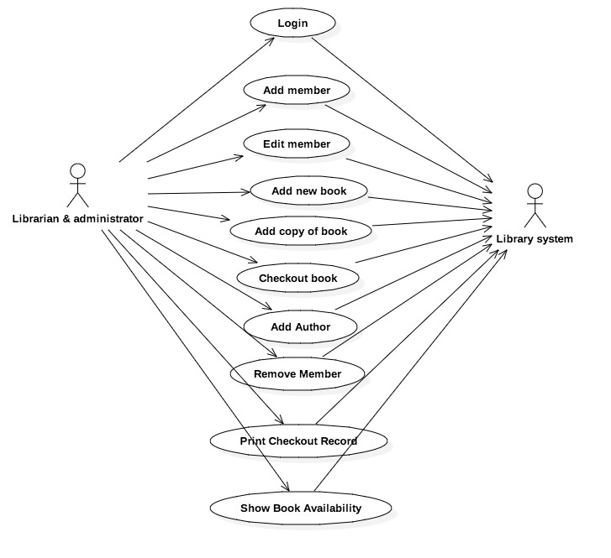
Use case diagram for librarian and administrator access

Slide 9
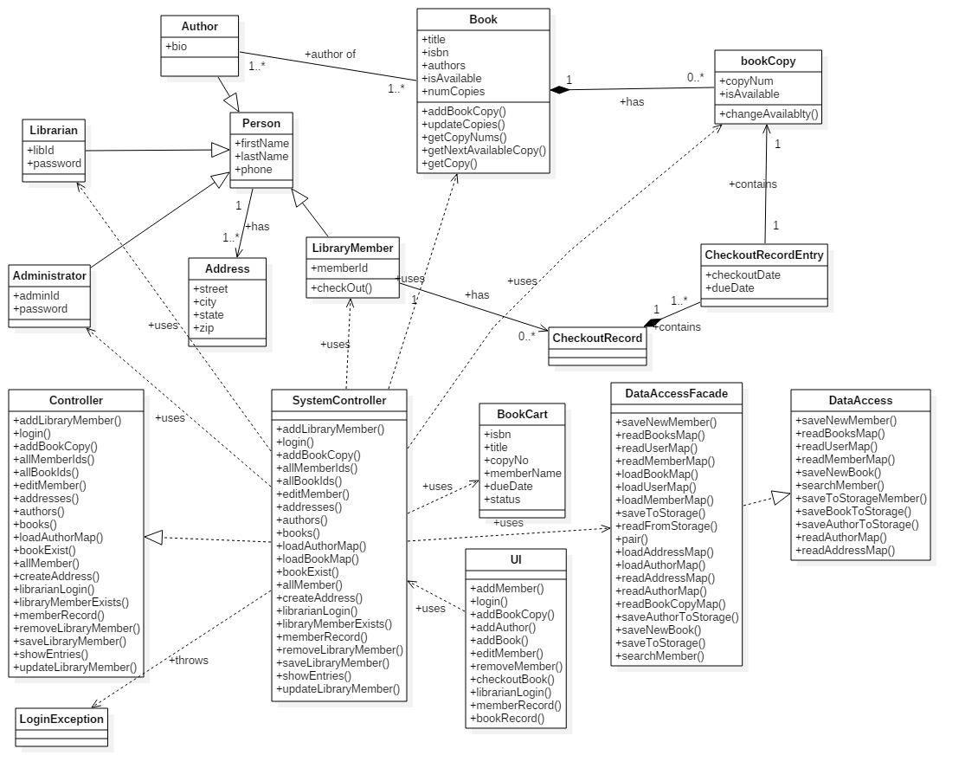
Class diagram

Slide 10
Sequence diagram
Login
Add new Library Member
Check-out Book
Add copy of Book to Library Collection
Add a book to Library Collection
Add an author to Library Collection
Print Checkout Record to Console
Display Book Status

Slide 11
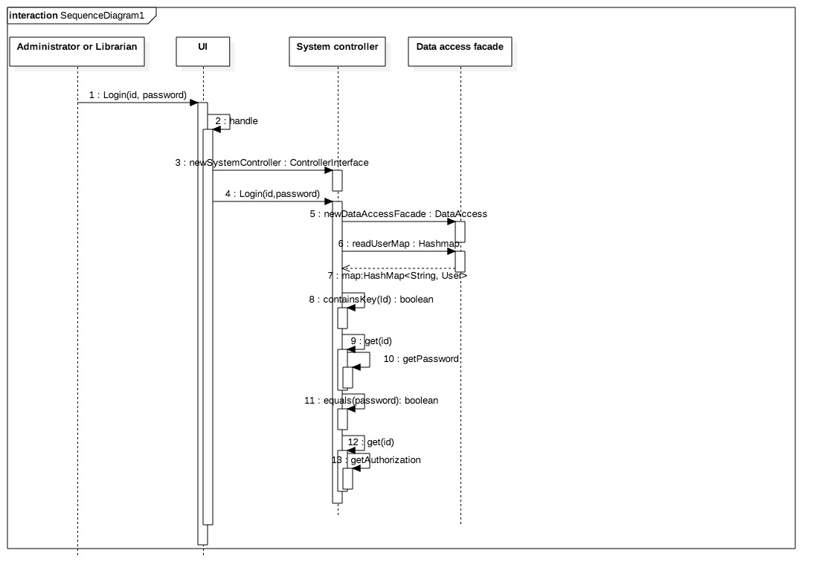
Login

Slide 12
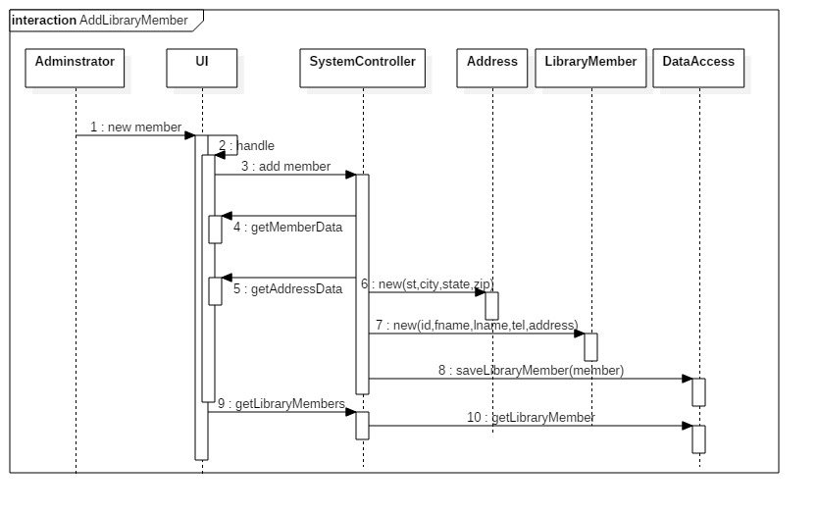
Add new library member

Slide 13
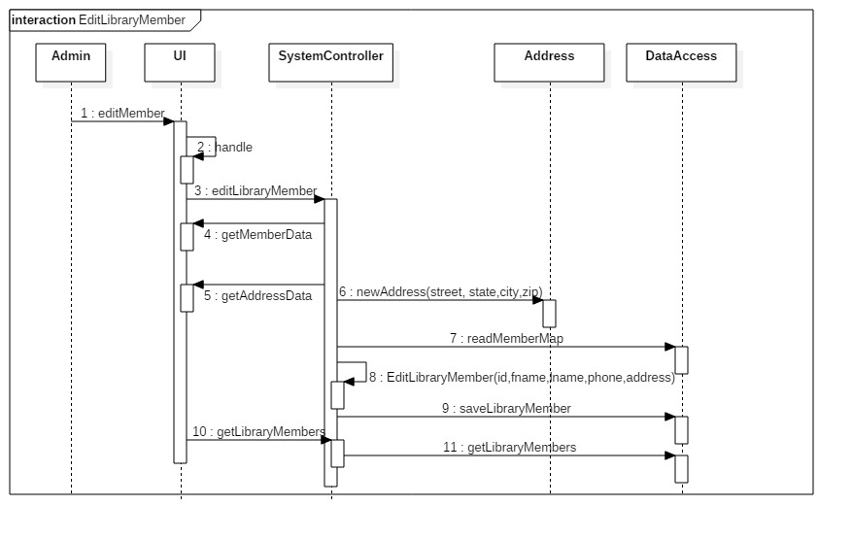
EDIt library member

Slide 14
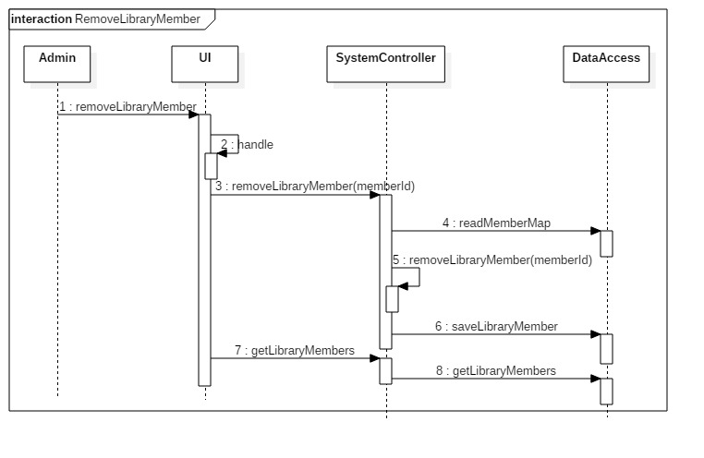
REMOVE library member

Slide 15
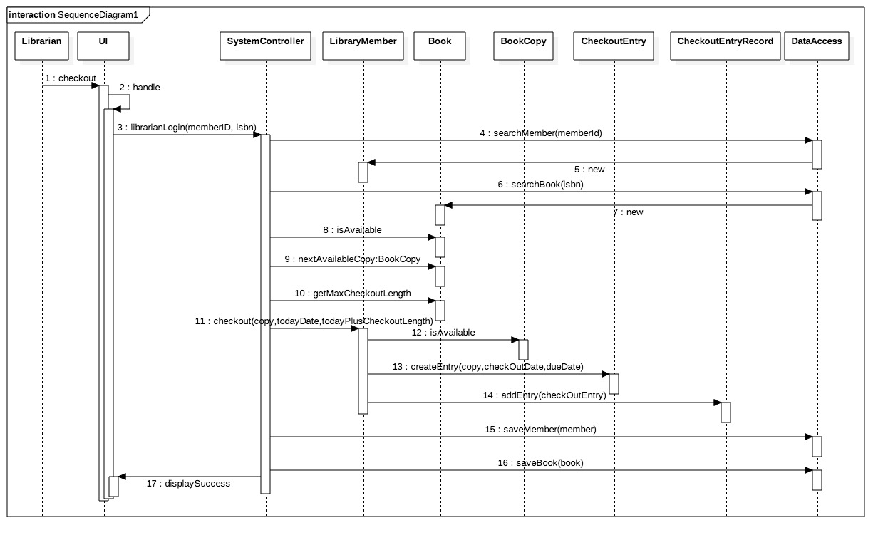
Check-out book

Slide 16
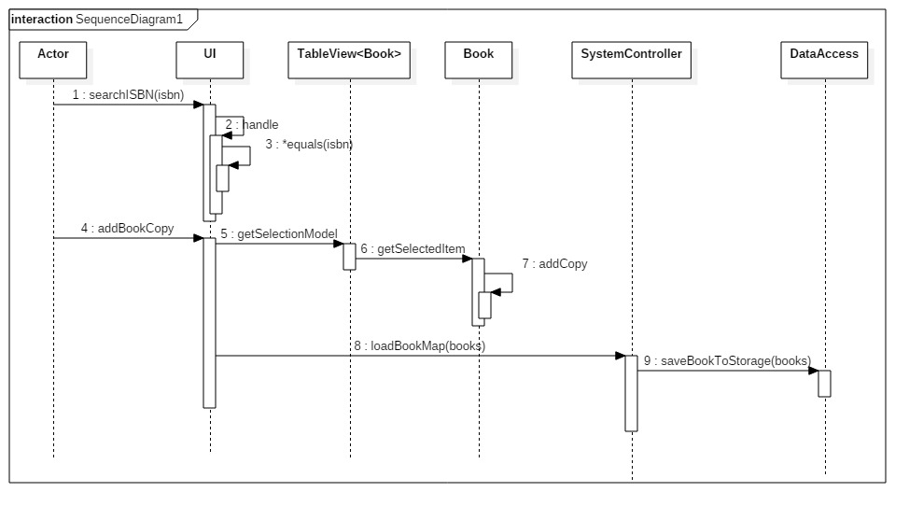
Add copy of existing book to collection

Slide 17
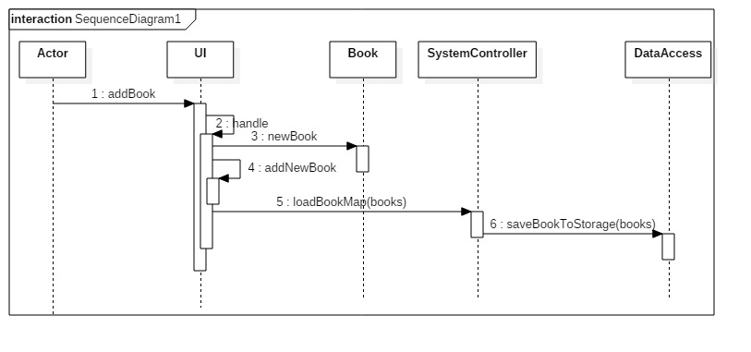
Add book to collection

Slide 18
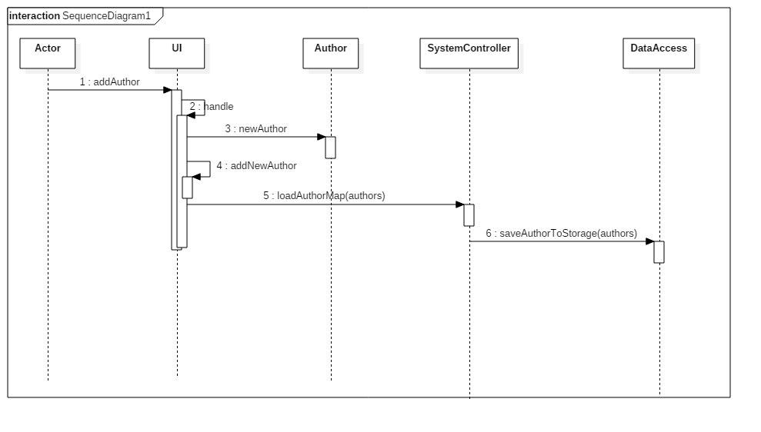
Add AUTHOR to collection

Slide 19
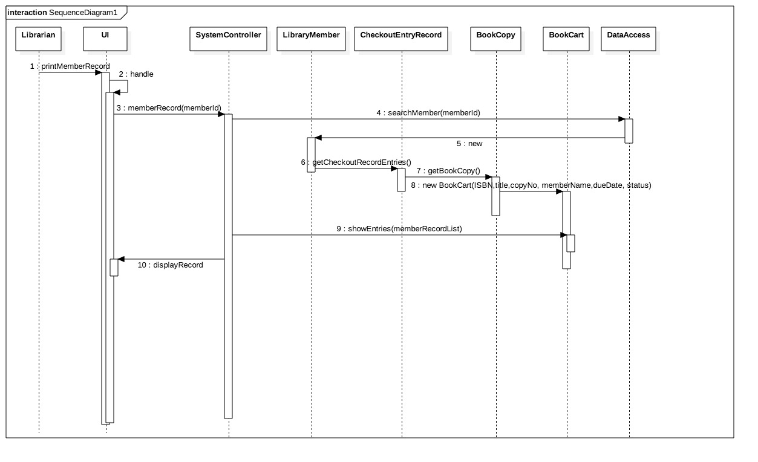
Print check-out record

Slide 20
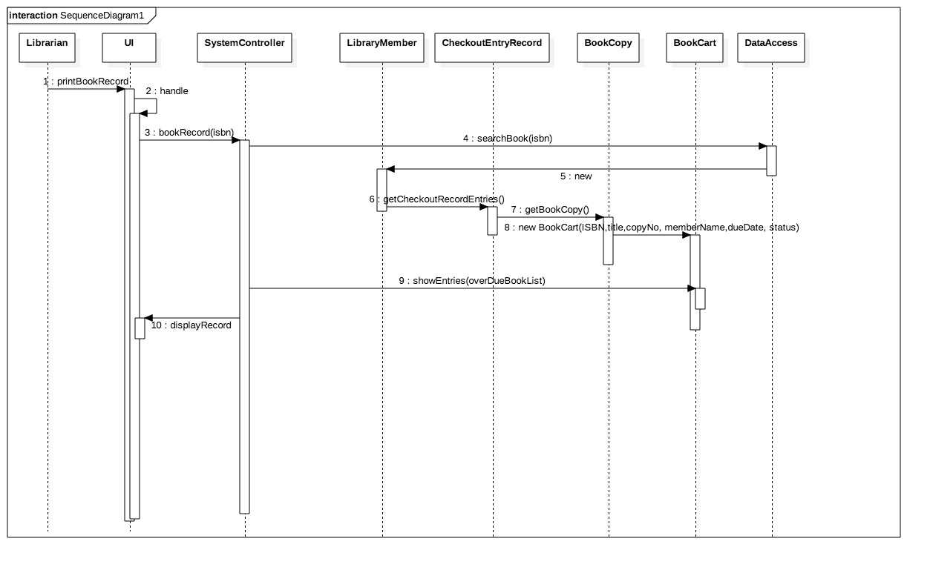
Display book availability

Slide 21
limitations
Since we are only using JAVA Serialization, it is assumed that we are only storing a couple of data for the purpose of showing the Library Management System Functionality, hence if we will be using this Application on a Large Scale environment, a Database setup will best fit as our option.

Slide 22
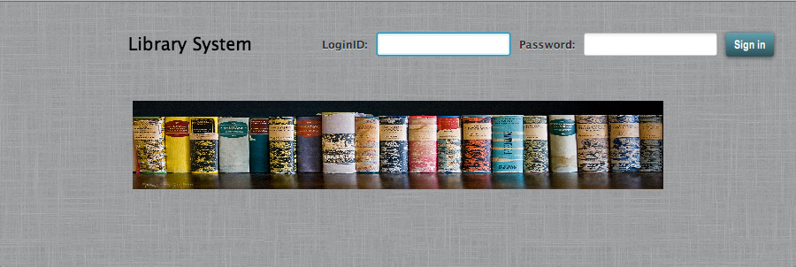
Application demonstration

Slide 23
Test cases
Logging-in to the System using 3 different Accounts (Librarian, Administrator or Both)
Adding a new library member to the System
Checking-out a book
Adding a copy of Existing Book to the Library Collection
Adding a Book to the Library Collection
Printing out the Check-out Record
Determine the Book Availability and as to who's Library Member has it in his/her possession.

Slide 24
Thank YOU!

