Slide 1
FIT3152 Assignment 1
Difference in predictors of Country level
about Pro-Social behaviors
31994695 June Jin

Slide 2
Question 1 a
Descriptive Analysis – Overall Data
40,000 rows and 52 columns
Column’s data types
Most of all is integer
rankOrdLife and coded_country data were character
Missing Values
Most of NA is in “Employment status”, “CoronaClose”
Those columns require to choose a few based on reponser’s enviornment

Slide 3


Question 1 A
“Employ status” 1 to 10, The presence of NA values is essential here.
Respondents should only select options that apply to their circumstances.
For instance, if options "1", "2", or "3" are available choices,
the respondent does not fall under "9" (retired).
If merging is required, we need to combine the response counts from 1 to 10.

Slide 4
Question 1 B Pre-processing
Exclude data where the value of "Coded_country" is blank.
Empty cells in "Employ_status" and "Coronaclose" have been filled with 0.
For other columns, empty cells have been filled with the median value.
Columns containing "Char" in "rankOrdLife" have been converted to numerical data from A to F in sequence, assigned values from 1 to 6.

Slide 5
Introduction of Question 2
Focus country = “Italy”
Focus country data
1241 rows and 51 columns (excluding coded_country)
Non – Focus country data (Others)
38608 rows and 51 columns (excluding coded_country)

Slide 6
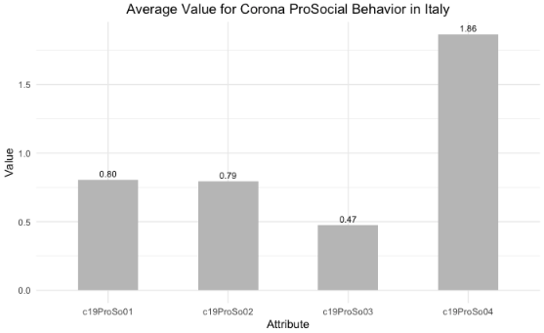
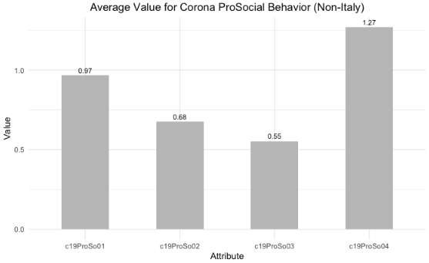
Question 2 A
Italy has more positive response on
c19ProSo02 and c19ProSo04 for behavior.
Other Countries’ values have
overall higher average value.

Slide 7
Question 2 B How well do participant responses predict pro-social attitudes for Italy?
Trying to get correlation between prosocial behavior and all the others attributes.
Optimize the predictors by selecting the attributes that have the biggest absolute number
Use Linear regression model for each Pro-Social Behaviour
 | c19ProSo01 | c19ProSo02 | c19ProSo03 | c19ProSo04
Best predictors | c19ProSo03 c19ProSo02 c19ProSo04 | c19ProSo3 c19Per Beh01 c19RCA03 c19ProSo01 | c19ProSo01 c19ProSo02 c19ProSo04 | c19perBeh02 c19RCA02 c19perBeh03 rankOrdLife_6 c19ProSo01 c19ProSo03
R-squared values | 0.2622 | 0.471 | 0.4879 | 0.3363

Slide 8
Question 2 C How well do participant responses predict pro-social attitudes for others?
Trying to get correlation between prosocial behavior and all the others attributes.
Optimize the predictors by selecting the attributes that have the biggest absolute number
Use Linear regression model for each Pro-Social Behaviour
 | c19ProSo01 | c19ProSo02 | c19ProSo03 | c19ProSo04
Best predictors | c19perBeh01 c19perBeh03 c19ProSo02 c19ProSo03 c19ProSo04 | c19RCA03 c19RCA01 MLQ lifeSat c19ProSo01 c19ProSo03 | c19ProSo01 c19ProSo02 c19ProSo04 lifeSat c19RCA02 rankOrdLife 1&6 | c19perBeh02 c19RCA03 c19RCA02 rankOrdLife_1 c19perBeh03 rankOrdLife_6 c19ProSo03
R-squared values | 0.3587 | 0.3743 | 0.438 | 0.3176
Notes:
대부분의 R-squred values 는 Italy 데이터에 비해 조금은 낮지만 best predictors 의 개수가 이탈리아보다 훨씬 더 많음을 알 수 있다.

Slide 9
Question 2 C – comparing country
Resposes from Italy have better prediction
for Pro-Social Behaviour attributes compare to other countries.
More best predictors fom Pro-Social Behaviour attributes in Other countries.
Average r-squared value Italy s : 0.38935 Others: 0.37215

Slide 10
Question 3 Introduction
Dataset chosen to find similar countries:
Political – Government achievement score
https://www.worldbank.org/en/publication/worldwide-governance-indicators
New vaccination counts & GDP per Capita
https://ourworldindata.org/covid-vaccinations
HAPPY - Ladder score (overall happeniess score) https://worldhappiness.report/ed/2021/#appendices-and-data
Mortality https://stats.oecd.org/viewhtml.aspx?datasetcode=HEALTH_MORTALITY&lang=en
Short-Term Labour Market Statistics (/1000 people) https://stats.oecd.org/index.aspx?lang=en

Slide 11
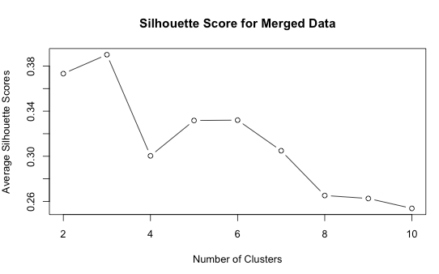
Question 3 A Introduction
Clustering
K means with 3 group of clusters
Total 12 countries founded in same cluster with Italy
Chile, Colombia, Costa Rica, Greece, Hungary, Latvia, Lithuania, Mexico, Poland, Portugal, Slovenia, Spain

Slide 12
Question 3 A How well do participant responses predict pro-social attitudes for Italy cluster?
 | c19ProSo01 | c19ProSo02 | c19ProSo03 | c19ProSo04
Best predictors | c19ProSo02 c19ProSo03 c19ProSo04 c190erBeh01 Ladder_score MLQ rankOrdLife_6 | c19ProSo01 c19ProSo03 Ladder_score c19RCA01 lifeSat | c19ProSo01 c19ProSo02 c19ProSo04 Ladder_score Age c19RCA02 | c1ProSo01 c19ProSo03 c19perBeh01 c19perBeh02 Ladder_score c19perBeh03 c19RCA02 rankOrdLife_6 edu
R-squared values | 0.3225 | 0.3274 | 0.3983 | 0.3126

Slide 13
Question 3 B How well do participant responses predict pro-social attitudes for The other country?
 | c19ProSo01 | c19ProSo02 | c19ProSo03 | c19ProSo04
Best predictors | c19ProSo02 c19ProSo03 c19ProSo04 c190erBeh01 isoFriends_onl c19perBeh03 rankOrdLife_6 | c19ProSo01 c19ProSo03 c19ProSo04 c19perBeh01 c19RCA01 MLQ lifeSat isoFriends_onlc19perBeh03 edu | c19ProSo01 c19ProSo02 c19ProSo04 c19perBeh02 Age c19RCA02 rankOrdLife_6 edu | c19ProSo01 c19ProSo02 c19ProSo03 c19perBeh01 c19perBeh02 Ladder_score isoFriends_onl Age c19perBeh03 c19RCA02 rankOrdLife_6 edu
R-squared values | 0.3384 | 0.3098 | 0.4272 | 0.3588

Slide 14
Question 3 B - Finalization
Resposes from Italy have better prediction (very less responses)
for Pro-Social Behaviour attributes compare to other countries.
More best predictors fom Pro-Social Behaviour attributes in Other countries.
Average r-squared value Italy: 0.38705 Cluster: 0.3402 Others: 0.35855

