Slide 1
FIT3152 data analytics 2024: assignment 3
31994695 June Jin

Slide 2
Collect a set of documents
Area of interests : CNN article
3 topic : World | Food | Tech
Reviews are collected all in CNN so that I can maintain the consistency of reference foramt (APA7)
Total of 15 documents collected. (each topic 5 documents)

Slide 3
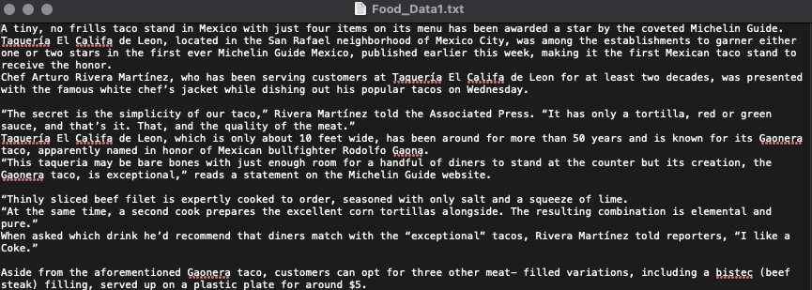
Create my corpus by converting into a text format
Corpus is built from the text data file

Slide 4
Create Document – Term Matrix (DTM)
Preprocessing:
Removed the numbers
Removed the punctuations
Make all lowercase
Removed “’s”, “ve” , “-” and so on.
Removed common word such as “can”, “take”, “also” etc.
2655 terms became to 16 terms
Notes:
The basic process has been done.
First, I removed the numbers as they are condered noise in the text analysis.
I also removed the punctuations as they are usually not relevant in the text analysis.
Converting the documents to lower case to standardize the documents.
Removing stop words as they do not carry much meaning and wil affect the highest frequency tokens.
Stemming as English language to reduce the words to their base from, where similar words are considered the same.
So Total of 2655 terms became to 16 terms

Slide 5
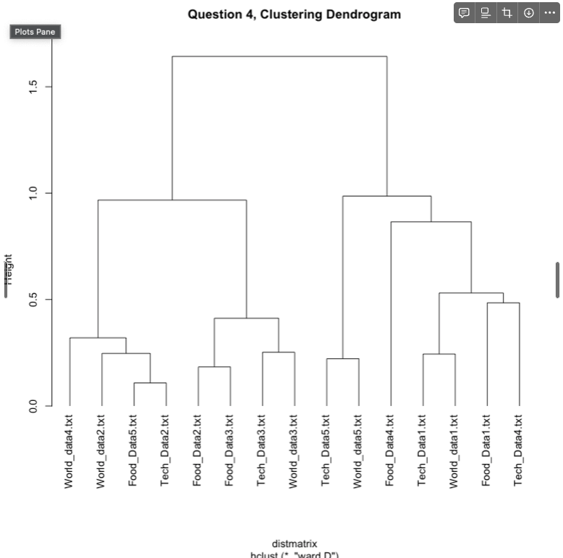
Create a hierarchical clustering
Hierarchical clustering was executed to minimize the overall within-cluster variance.
The dendrogram was partitioned into 15 clusters, matching the number of documents, with each document assigned a cluster label.
Notes:
So the clustering is performed by distance matrix using cosine distance measure. den

Slide 6
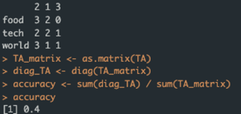
Qualitative description of quality of clustering
The accuracy of the clustering table was only 0.4, which means, less than half of data matches with the actual cluster.
Notes:
So based on that, I plot the cluster table.
The accuracy was 0.4, means that only 40% of documents in the cluster table matches with the true labels.

Slide 7
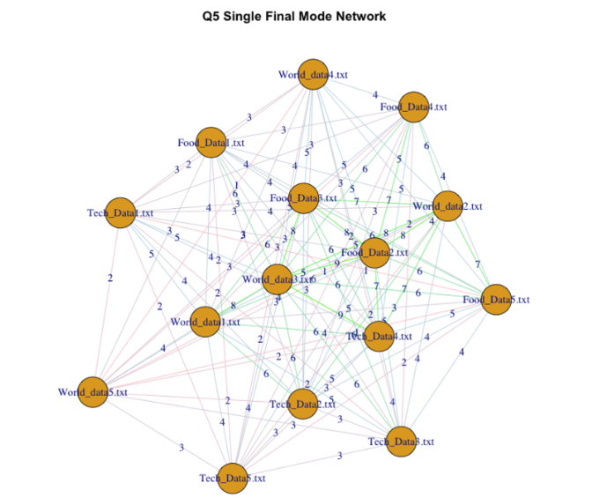
CreatE a single-mode network
The edges with the strongest weights are colored green, followed by light blue for moderate weights, and pink for the weakest weights. By using different colors for the edges, we can easily observe a distinct cluster in the center of the network.
Food3-World2-Food2-World3 are closely related to each other.
Notes:
I plot the single mode network with the weights, which means that how much is it important as number.

Slide 8
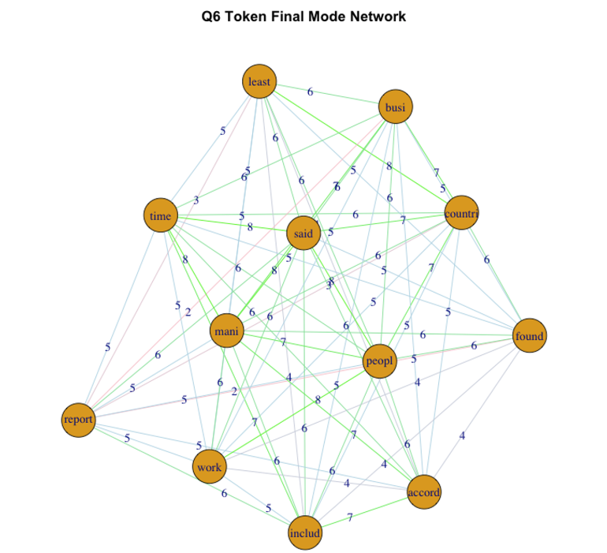
CreatE a single-mode network (token)
identify the nodes which are important by looking at the color of the edges.
the network doesn’t quite well in predicting the important words used in the article.
commonly used words for reviewing the “world”, “tech”, and “food” were overlapped.

Slide 9
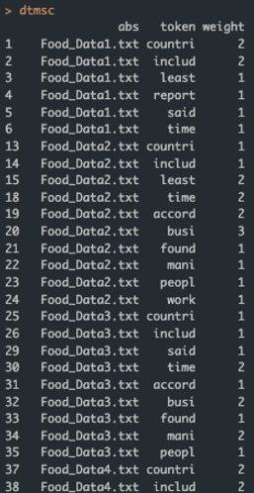
Create a bipartite (two-mode) network
We can see which token has how strong in the documents

Slide 10
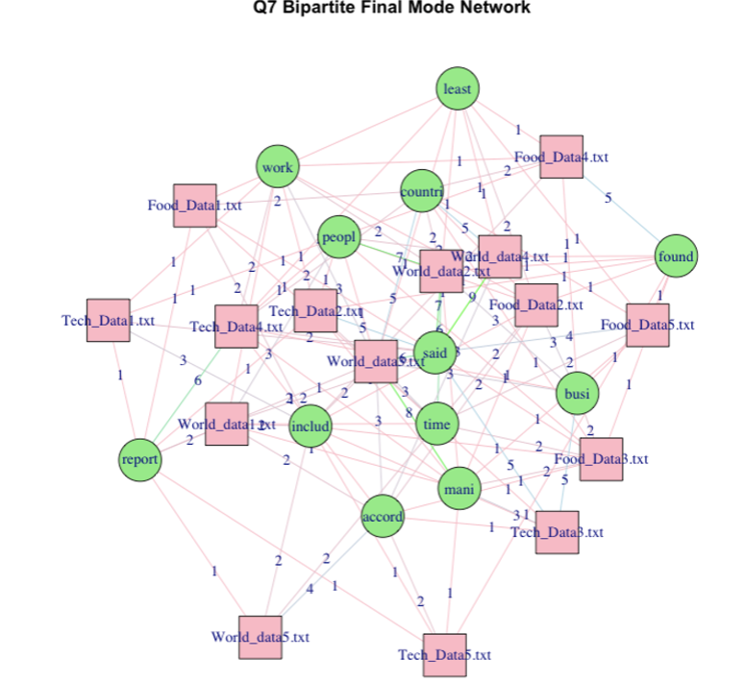
Create a bipartite (two-mode) network
Notes:
From the graph, we can observe distinct clusters of documents. For example, in the center, documents like world2, world4, people, and country form a cluster due to their close proximity. Notably, world2 has a strong connection with the words “people” and “said,” with a weight of 7. Similarly, Tech4, Tech2, and Tech1 are also part of this cluster, with Tech4 having a particularly strong relationship with the word “report.” Additionally, Food2, Food5, Food3, and Tech3 appear to form a cluster around the word “busy,” which is commonly used in restaurant-related articles.
In my opinion, the graph did not effectively form distinct clusters for Tech, World, and Food articles and their related words. This may be because these articles share many commonly used words regardless of their subject matter. For instance, articles about the world often include words like country and people, while tech and food articles also have their own common vocabulary. This results in the word “said” being centrally clustered with many articles.

Slide 11
Conclusion
Text analysis can be utilized to examine the connections between individual text documents.
Identify key similarities, differences, and the degree of their relatedness to each other.

