Slide 1
Fluid Resistance Model

Slide 2
Step 1: Validating Publication Data
Validate numerical results for figures 6 and 10 in the original paper

Slide 3
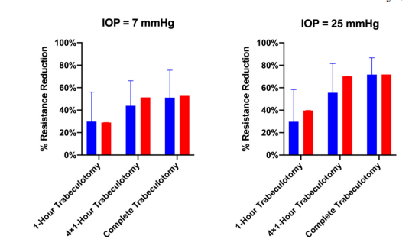
Replicating Figure 6
Original Paper
Our Simulated Data (% Resistance Reduction)
IOP = 25
1 Hour Trabeculotomy: 37.4 +/- 0.06%
4x1 Hour Trabeculotomy : 67.66 +/- 0.02%
IOP = 7
1 Hour Trabeculotomy : 26.23 +/- 0.01%
4x1 Hour Trabeculotomy : 47.73 +/- 0.01%
Red bars are simulated data in the original paper

Slide 4
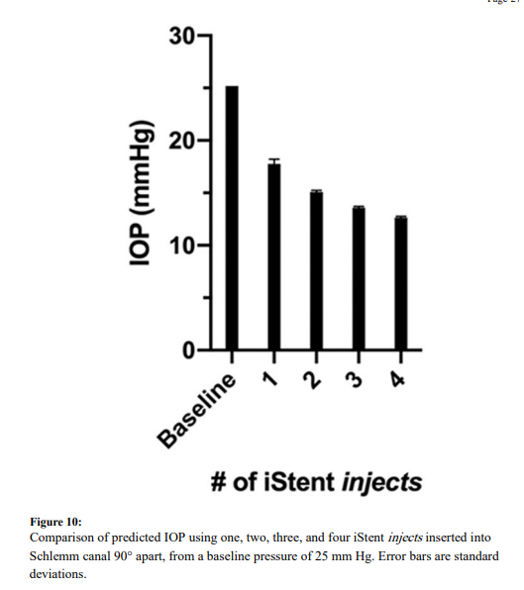
Replicating Figure 10
Original Paper
Our Results
Our Results (Plotted)
Baseline IOP: 25
1 iStents injects: 18.1 +/- 0.3
2 iStents injects : 15.2 +/- 0.2
3 iStents injects : 13.6 +/- 0.1
4 iStents injects : 12.7 +/- 0.1
IOP (mmHg)
1
2
3
4
Baseline

Slide 5
We wanted to See the Impact of Collector Channels on iStent Results. Placed iStent around various degrees in the eye and found final reuction in IOP

Slide 6
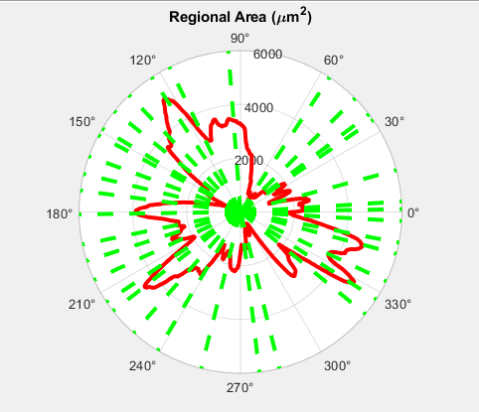
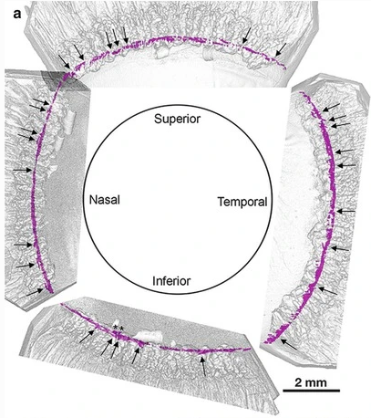
Step 1: Determine distribution of Collector Channels as Test Case
Mouse example: Green dotted lines demarcate the position of collector channels
Human example: Taken from Hann et al.

Slide 7
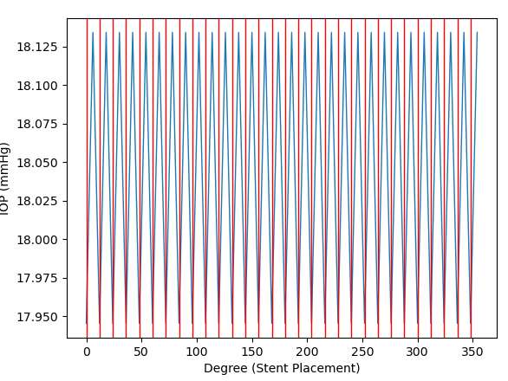
Step 2: Validate that even collector channel distribution gives expected results
Baseline IOP: 25 mmHg
Red vertical lines: Position of collector Channels
Y-axis: IOP after iStent Placement
X-axis: Position of iStent placement in the 360 degrees of the eye
For the plot to the left, a single iStent was moved around the 360 degrees of the eye and the resulting IOP reduction was simulated
Small variation whether stent was placed midway between 2 collector channels on a collector channel
No positional dependence of iStent

Slide 8
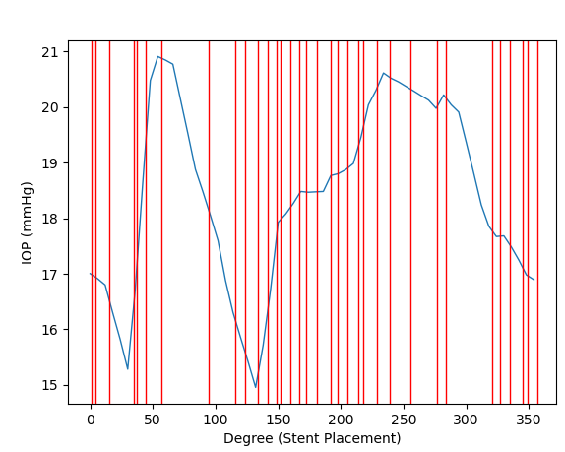
Step 3: Same as step 2 but for mouse distribution

Slide 9
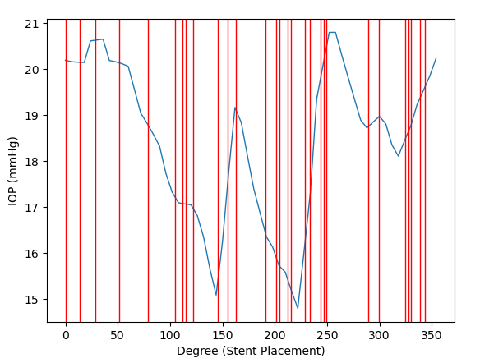
Step 4: Same as step 2 and 3 but for human distribution

