Slide 1
URL
정기훈

Slide 2
URL
http://opentutorials.org:3000/main?id=HTML&page=12
protocol
host(domain)
port
path
query string

Slide 3
var http = require('http');
var fs = require('fs');
var url = require('url'); //모듈 불러오기
var app = http.createServer(function(request,response){
var _url = request.url; //요청 url 저장
var queryData = url.parse(_url, true).query;
console.log(queryData.id);
if(_url == '/'){
_url = '/index.html';
}
if(_url == '/favicon.ico'){
return response.writeHead(404);
}
response.writeHead(200); //http 상태코드 => 정상응답
response.end(queryData.id); //응답종료
});
app.listen(3000);

Slide 4
Query string
var http = require('http');var fs = require('fs');var url = require('url');
var app = http.createServer(function(request,response){
var _url = request.url;
var queryData = url.parse(_url, true).query;
var title = queryData.id;
if(_url == '/'){ title = 'Welcome'; }
if(_url == '/favicon.ico') { return response.writeHead(404); }
response.writeHead(200);
var template = `
<!doctype html>
<html>
<head>
<title>WEB1 - ${title}</title>
<meta charset="utf-8">
</head>
<body>
<h1><a href="/">WEB</a></h1>
<ul>
<li><a href="/?id=HTML">HTML</a></li>
<li><a href="/?id=CSS">CSS</a></li>
<li><a href="/?id=JavaScript">JavaScript</a></li>
</ul>
<h2>${title}</h2>
<p><a href="https://www.w3.org/TR/html5/" target="_blank" title="html5 speicification">Hypertext Markup Language (HTML)</a> is the standard markup language for <strong>creating <u>web</u> pages</strong> and web applications.Web browsers receive HTML documents from a web server or from local storage and render them into multimedia web pages. HTML describes the structure of a web page semantically and originally included cues for the appearance of the document.<p>
</body>
</html>
`; response.end(template);
});
app.listen(3000);

Slide 5
CRUD

Slide 6
CRUD
CREATE
SQL -> INSERT
READ
SQL -> SELECT
UPDATE
SQL -> UPDATE
DELETE
SQL -> DELETE

Slide 7
fs
var http = require('http');var fs = require('fs');var url = require('url');
var app = http.createServer(function(request,response){
var _url = request.url;
var queryData = url.parse(_url, true).query;
var title = queryData.id;
if(_url == '/'){ title = 'Welcome'; }
if(_url == '/favicon.ico'){ return response.writeHead(404); }
response.writeHead(200);
fs.readFile(`data/${queryData.id}`, 'utf8', function(err, description){
var template = `
<!doctype html>
<html>
<head>
<title>WEB1 - ${title}</title>
<meta charset="utf-8">
</head>
<body>
<h1><a href="/">WEB</a></h1>
<ul>
<li><a href="/?id=HTML">HTML</a></li>
<li><a href="/?id=CSS">CSS</a></li>
<li><a href="/?id=JavaScript">JavaScript</a></li>
</ul>
<h2>${title}</h2>
<p>${description}</p>
</body>
</html> `;
response.end(template);
})
});
app.listen(3000);

Slide 8
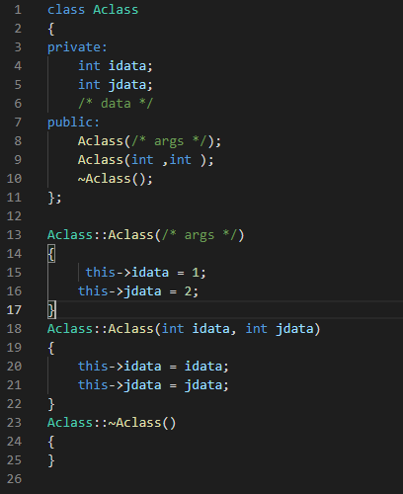
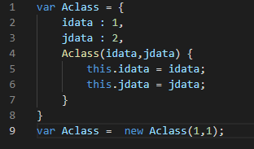
객체 생성 비교
C++
javaScript

