Slide 1
ECE570 Final Presentation VanillaNet: The Power of Minimalism
Alan Chen Breakout Room 6
Notes:
Hello everyone, I am Alan. Today, we will explore an efficient neural network architectures- VanillaNet. I will be focusing on the comparison between VanillaNet and ResNet.

Slide 2
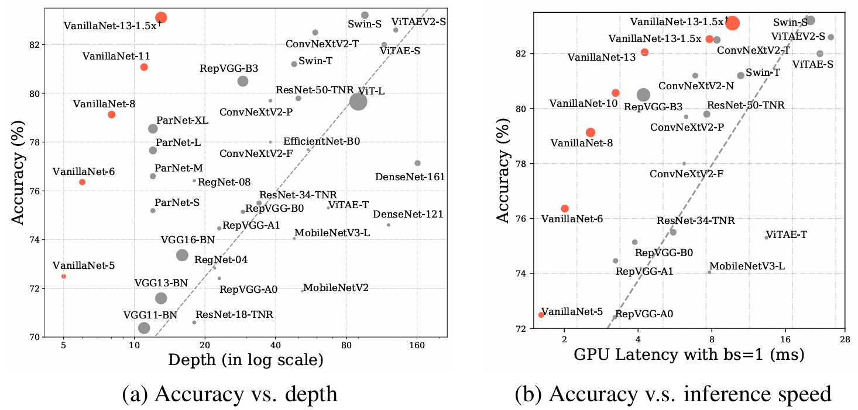
Introduction
Rapid growth in AI and neural network complexity
Need for lightweight models in latency-sensitive scenarios
Introduction to VanillaNet and ResNet
Focus on performance trade-offs and efficiency
Notes:
As artificial intelligence grows at a rapid pace, so does the complexity of neural networks. While this growth boosts performance, it also demands significant computational resources, which can be a bottleneck in real-world. In this context, lightweight models are essential, particularly for latency-sensitive applications like autonomous driving and virtual reality. VanillaNet emerges as a promising alternative, emphasizing simplicity and efficiency when inference. Let’s dive deeper into VanillaNet and ResNet and their performane.”

Slide 3
Problem Definition
Challenges of deploying models in resource-constrained environments
Edge devices: limited battery, memory, and computation
Balancing high accuracy with low latency
Importance of efficient architectures for real-world applications
VanillaNet – faster inference without compromising accuracy
Notes:
Deploying AI models in real-world environments comes with challenges. Most advanced neural networks are designed for devices that computational resources are abundant. However, edge devices like smartphones and IoT systems operate under severe constraints in terms of battery, memory, and computation. Users expect these models to deliver high accuracy and low latency, but achieving this balance is challenging. This is where architectures like VanillaNet aim to solve the problem, by offering faster inference speeds without significantly compromising on accuracy.

Slide 4
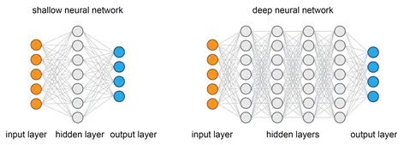
VanillaNet: A Minimalistic Approach
‘Train deep, deploy shallow’ philosophy
Simplified architecture avoids shortcuts and self-attention
Prioritizes faster inference speeds
Suitable for latency-critical applications like AR/VR and autonomous vehicles
The concept of
‘Train deep, deploy shallow’ philosophy
Notes:
VanillaNet, proposed by Huawei’s Noah’s Ark Lab, adopts a ‘train deep, deploy shallow’ philosophy to achieve faster inference without compromising accuracy.
During training, it incorporates complex architectures to ensure robust learning. However, in deployment, only essential components remain, reducing latency and resource requirements.
Unlike traditional models, VanillaNet avoids shortcuts, high depth, and self-attention mechanisms. Instead, it emphasizes simplicity, which not only reduces inference time but also makes it easier to deploy on resource-constrained devices. This unique design allows it to do well in scenarios where speed is critical, such as autonomous driving or real-time video analysis.

Slide 5
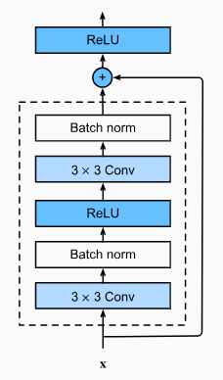
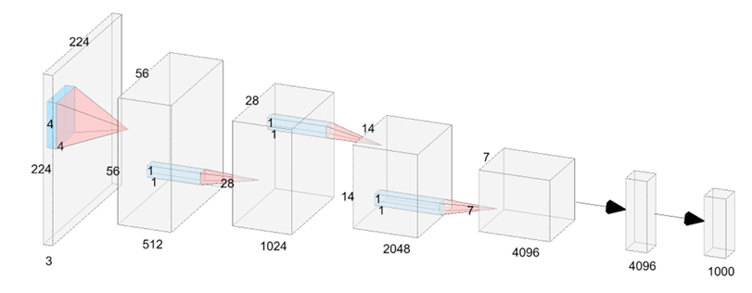
Comparison with ResNet
ResNet:
Shortcut connections for gradient flow
High depth improves performance but increases latency
VanillaNet:
Simpler design, faster inference
Challenges ResNet in latency-sensitive tasks
ResNet VanillaNet
Notes:
“ResNet, on the other hand, is a well-established architecture known for its shortcut connections. These connections improve gradient flow, enabling deeper networks and better performance. However, these shortcuts come at a cost: higher computational complexity and increased latency. While ResNet remains a popular choice for many applications, VanillaNet challenges its dominance in latency-sensitive tasks by prioritizing speed over accuracy. This comparison forms the foundation of our study.”

Slide 6

Methodology: VanillaNet Architecture
Block structure: training mode vs. deployment mode
Training mode:
Deep architecture for robust learning
Series-informed activation functions
Deployment mode:
Fused batch normalization with convolutional layers
Simplified for low-latency environments
This learnable activation function, which incorporates convolution-like behavior, is used in VanillaNet as a series-informed activation function.
Notes:
To better understand VanillaNet’s efficiency, let’s examine its architecture.
It is designed around a block structure, with separate modes for training and deployment. In training mode, VanillaNet employs deep layers and a unique component called series-informed activation functions. These activation functions are learnable, adapting dynamically to input data and enhancing the model’s expressive power. During deployment, unnecessary layers and activations are fused or removed. For example, batch normalization operations are mathematically combined with convolutional layers to reduce runtime computations. This ensures faster inference without sacrificing performance

Slide 7
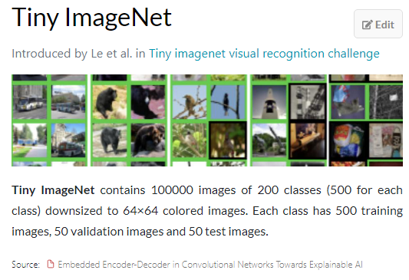
Methodology and Implementation
Dataset: Tiny ImageNet (200 classes, 64x64 images)
Consistent preprocessing: normalization and augmentation
Metrics: accuracy, latency, parameter count, and FLOPs
Ensured fair comparison in identical environments
Notes:
“To compare VanillaNet and ResNet, we used the Tiny ImageNet dataset. This dataset consists of 200 classes with images resized to 64x64 pixels, making it ideal for testing lightweight models. Both models were trained and validated using the same preprocessing techniques, including data augmentation and normalization. Our evaluation metrics focused on accuracy, latency, parameter count, and floating-point operations per second. By maintaining a consistent testing environment, we ensured a fair comparison between these architectures.”

Slide 8

Evaluation: Accuracy
VanillaNet: 46.15% accuracy
ResNet: 51.38% accuracy
Both perform comparably on the challenging Tiny ImageNet dataset
Accuracy vs. speed trade-off in real-world applications
Notes:
“In terms of accuracy, ResNet slightly outperformed VanillaNet, achieving 51% compared to VanillaNet’s 46% on the Tiny ImageNet dataset. both models perform similarly when benchmarked against other people’s models on this dataset, where achieving over 50% accuracy is challenging. For many real-world applications, VanillaNet’s lower accuracy might be an acceptable trade-off for its faster inference speed.”

Slide 9

Evaluation: Inference Latency
VanillaNet latency: 2.47 ms
ResNet latency: 3.95 ms
37% faster inference with VanillaNet
Ideal for real-time decision-making scenarios
Notes:
“Latency is where VanillaNet shines. During inference, VanillaNet achieved an average latency of 2.47 milliseconds, compared to ResNet’s 3.95 milliseconds. This represents a 37% reduction in inference time. For applications like autonomous driving or augmented reality, where split-second decisions are critical, this reduction can make a huge difference. This efficiency is primarily due to VanillaNet’s simplified deployment architecture, which minimizes runtime computations.”

Slide 10

Evaluation: Resource Utilization
VanillaNet: 15.5M parameters, 5.2B FLOPs
ResNet: 11.7M parameters, 1.8B FLOPs
Higher training demands for VanillaNet
Deployment optimizations ensure fast inference
efficiency in
deployment
resource-intensive during training
Notes:
“While VanillaNet is faster during inference, this speed comes at a cost. VanillaNet has 15 million parameters and requires 5 billion FLOPs, compared to ResNet’s 11 million parameters and 1 billion FLOPs during trainig. This makes VanillaNet more resource-intensive during training. However, these higher demands are mitigated by its efficiency in deployment, which is tailored for low-latency applications.”

Slide 11
Future Work
Address overfitting challenges during training
Investigate accuracy gaps on datasets like Tiny ImageNet
Test VanillaNet in new tasks: feature extraction, object detection
Optimizations for resource-constrained environments
Notes:
“In terms of future work, there are several avenues to explore. First, both VanillaNet and ResNet faced challenges with overfitting during training. Techniques like early stopping, weight decay, and data augmentation helped to some extent, but overfitting still exist, so a deeper investigation is necessary to understand and mitigate this issue.
Additionally, we observed an accuracy gap in VanillaNet's performance compared to ResNet on datasets like Tiny ImageNet. The paper suggest that them have same accuracy.
Another direction is testing VanillaNet in new domains such as feature extraction or object detection, where low-latency inference is equally critical. This would help validate its potential across a broader range of tasks.
Finally, optimizing VanillaNet for even more resource-constrained environments, such as IoT devices or mobile platforms, could make it even more practical for widespread use.”

Slide 12

Conclusion
VanillaNet: 37% faster inference, ideal for latency-sensitive environments
ResNet: Easier training, better for accuracy-critical applications
Trade-offs: speed vs. accuracy and training complexity
Choice depends on application priorities
Notes:
To summarize, VanillaNet demonstrates that simpler architectures can deliver remarkable performance in latency-sensitive environments without sacrificing too much accuracy. It achieved a 37% faster inference time compared to ResNet, making it a compelling choice for real-time applications. However, its higher training demands and slightly lower accuracy may limit its use in resource-intensive or accuracy-critical tasks. Ultimately, the choice between VanillaNet and ResNet depends on the application. If reference speed is your priority, VanillaNet is the clear winner. For simpler, cost-effective training, ResNet remains a reliable option.

Slide 13
Reference
8.6. Residual Networks (ResNet) and ResNeXt — Dive into Deep Learning 1.0.3 documentation. (n.d.). https://d2l.ai/chapter_convolutional-modern/resnet.html
Chen, H., Wang, Y., Guo, J., & Tao, D. (2023, May 22). VanillaNet: the Power of Minimalism in Deep Learning. arXiv.org. https://arxiv.org/abs/2305.12972
Papers with Code - Tiny ImageNet Dataset. (n.d.). https://paperswithcode.com/dataset/tiny-imagenet
Notes:
Thank you for your attention. I hope this presentation gave you valuable insights into the trade-offs and advantages of VanillaNet and ResNet

