Slide 1
CIS016-1 – Principles of Programming / CIS096-1 – Principles of Programming and Data Structures / PAT001-1 – Principles of Programming
Week 1 – Introduction to Java

Slide 2
Agenda
Edit-Compile-Execute
Bugs, bugs bugs!
Naming things – variables, constants, literals, data types and objects
Practical exercises

Slide 3
Edit – compile – execute
How to get things running

Slide 4
Using BlueJ
Start new BlueJ project – MyAddress- best to save to your USB drive
Create a new class
Modify the skeleton program to output your name and address on separate lines – Compile
Execute using RH (Right Hand) button/context menu and main method.

Slide 5
Printing your Address
public class MyAddress
{
public static void main(String[] args)
{
System.out.println("Ingo Frommholz");
System.out.println("Park Square");
System.out.println("Luton LU1 3JU");
}
}

Slide 6
Strings and Concatenation
public class MyName
{
public static void main(String str[])
{
String firstName = "Ingo”;
String secondName = "Frommholz”;
String space = " ”;
System.out.println(firstName + space + secondName);
}
}

Slide 7
Standard Java files
Source files: *.java
Source code in readable form, as typed in by the programmer.
Class files: *.class
Byte code generated by the compiler
Interpreted by the virtual machine
Executed by the machine
Notes:
explain difference between source and compiled code
tell a bit about compiled and interpreted languages

Slide 8
The edit-compile-execute cycle
011010
110101
1001
10
source file
class file
011010
110101
010001
1
1
1
0111
0110110
compiler
(javac)
editor
virtual machine (java)
Notes:
explain the process from the editor to execution
explain virtual machine

Slide 9
Editing
A file can be edited in any text editor
Notepad, emacs, jEdit, PFE, vi, ...
Don't use Word: By default, Word does not save in text format
Make sure to save with a .java filename before compiling!
Notes:
some remarks about editing
warning: word is not good!

Slide 10
Command line invocation
Compilation and execution of Java in JDK can be done from a command line
On Microsoft systems: DOS shell
On Unix/Linux/MacOS: Unix shell
Must make sure that the commands for compiler and runtime are in the command path.
Notes:
On laptop: open DOS window, show command line commands

Slide 11
Compiling
Name of the JDK compiler: javac
To invoke: javac <source name>
compiles <source name> and all classes it depends on
Example: javac Game.java
Notes:
do the same live: edit, then compile a class

Slide 12
Error messages
E:\CIS020\week2\code>javac Game.java
E:\CIS020\week2\Java 2\code\Game>javac Game.java
Game.java:6: error: ';' expected
System.out.println("Java is a funny game!")
^
1 error
The programmer has to open the file in the editor, find the line number, fix the error and recompile.
Notes:
insert an error into the source and compile. Show error message format

Slide 13
Execution
> java Game
“java” starts the Java virtual machine.
The named class is loaded and execution is started.
Other classes are loaded as needed.
Only possible if class has been compiled.
Note that java Game.java or java Game.class don‘t work!
Notes:
show execution (at least an attempt). Do this first with a class that has no main.

Slide 14
Problem: Execute what?
E:\CIS020\week2\Java 2\code\Game>javac Game.java
E:\CIS020\week2\Java 2\code\Game>java Game
Error: Main method not found in class Game, please define the main method as:
public static void main(String[] args)
The problem: How does the system know which method to execute?
Notes:
This error should be reported.
Explain.

Slide 15
The main method
The answer: The java system always executes a method called main with a certain signature: public static void main(String[] args) { ... }
For this to work, such a method must exist!
Notes:
Now write a main method, then try again.

Slide 16
The main method (2)
“main” must exist
“main” must be public
“main” must be static (class method)
“main” must have a String array parameter
Only “main” can be invoked
Notes:
Explain “main”.

Slide 17
Main method - example
public static void main(String[] args)
{
Game game = new Game();
game.play();
}
The main method
creates an object
calls the first method

Slide 18
A Simple Calculator
public class MiniCalc {
public MiniCalc(){
int int3 = add(1,2);
int int4 = multiply(3,4);
System.out.println(int3 + " " + int4);
}
public int add(int int1, int int2){
return int1 + int2;
}
public int multiply(int int1, int int2){
return int1 * int2;
}
public static final void main(String[] str) {
System.out.println("MiniCalc");
MiniCalc mc = new MiniCalc();
}
}

Slide 19

Bugs, bugs, bugs!!!

Slide 20
Bugs!!
A mistake in a program is called a bug
Like real bugs they usually hide and are not easily detected
We neither want bugs at home nor in our programs
The process of eliminating mistakes (bugs) in our program is called debugging
Many IDEs offer a useful tool called a debugger
3 types of bugs (or errors):
Syntax error
Run-time error
Logic error

Slide 21
Syntax and Semantics
Syntax
Legal arrangement of words and punctuation
Grammar rules of a language
Symbols, words, etc
Semantics
Meaning of a program (adhering to the given syntax)
What happens when you run the program

Slide 22
Syntax Error
Grammatical mistake in your program, for instance
Misspelled keyword (e.g., calss)
Missing punctuation
Misspelled (or unknown) variable
Compiler catches syntax errors
You can‘t argue with the compiler!

Slide 23
Run-time Error
Not detected by the compiler, only when executing the code
Very common in Java: the notorious NullPointerException
Run-time errors may also be caused by failing communiction links, insufficient memory, etc

Slide 24
Logic Error
Mistake in the underlying algorithm
Not detected by the compiler – there may even not be an error message!
Program doesn‘t do what you want it to do - your intended semantics are different from the program‘s actual ones
Example: if you want to print 1+1 but write System.out.println(1 – 1);

Slide 25
Test your code!
Debugging and testing is an essential part in the software development process!
Especially test your code with respect to logic errors
Learn to read and understand error messages

Slide 26
Don‘t panic!
Don‘t be put off by error messages or logic errors – even experienced programmers make mistakes!
Own painful experience: the more stupid the bug, the harder it is to detect...
Own joyful experience: it is fantastic if your code finally does what you want! ☺

Slide 27
Naming things – variables, constants, literals, data types and objects
Once a person has understood the way variables are used in programming, (s)he has understood the quintessence of programming
E.W. DIJKSTRA

Slide 28
Naming things
How do we store temporary data in a program?

Slide 29
Symbolic Addressing
To do this we need to
identify the type of data we will be using and then
declare a memory location in which to hold the data.
We ask the Java interpreter (when executing) to supply a memory location in RAM to hold the data simply by giving the data a name.
This is known as symbolic addressing

Slide 30
Variables
For example if were dealing with temperature we might declare two symbolic addresses - known commonly as variable identifiers or variables.
To store the Celsius temperature we use
celsiusDegrees
To store the Kelvin temperature we use
kelvinDegrees

Slide 31
Naming things
Why not capital C and K for our variable identifiers as in CelsiusDegrees?

Slide 32
Naming things
Because they are not classes!

Slide 33
Variable Declaration
Declare the data type and variable identifier.
int celsiusDegrees;
int kelvinDegrees;
int means the data is integer (whole number such as 1, 23, 45, -127 etc)
Notes:
Anybody written any assembly code, maybe Intel 8080

Slide 34
Variable Initialisation
Variable declaration and initialisation
int celsiusDegrees = 0;
int kelvinDegrees = 32;
It is good practice to initialise data when possible, however number types are default initialised to zero in Java. This is not true for most languages. (String default initialisation is to null)

Slide 35
Variable Names
Always choose a name that says what data represents, we choose celsiusDegrees to suggest the type of temperature that was being used.
The identifier must start with a letter, a lower case letter a-z for a variable.
It can contain any number of letters (a-z, A-Z) or digits (0-9).

Slide 36
Variable Names/2
It can contain an underscore _ or a $ but its not good practice so don’t use either .
It MUST NOT have any spaces.
It MUST NOT be the same as an existing word such as main.
It MUST NOT begin with a capital – classes only.

Slide 37
Naming Convention
The naming convention in Java uses identifiers which are combined words with the second word starting with a capital.
Use of underscore, _, is discouraged.
So we have celsiusDegrees not celsius_degrees
Bad practice in Java (but not in C)
Not really wrong, just by convention

Slide 38
Naming Things: Examples
Examples are:
int i; and float scale;
boolean correct, valid;
double diamond, yourMoney;
char signature = 'X';
long startValue = 123456789L;
byte myByte = 0x12F, yourByte = 0x4F;
String aName = “Mehmet”;
Animal myDeadSheep = new Animal(“Larry the Lamb”);

Slide 39
Naming Things
What is wrong with these declarations?
int x = 2.5;
char MyInitial = ‘D’;
String myFirstnmae = “Des”;
float temperature;

Slide 40
Storing Data in Memory
How is the data actually stored in the computer’s memory?
Example: int celsiusDegrees = 35;

Slide 41
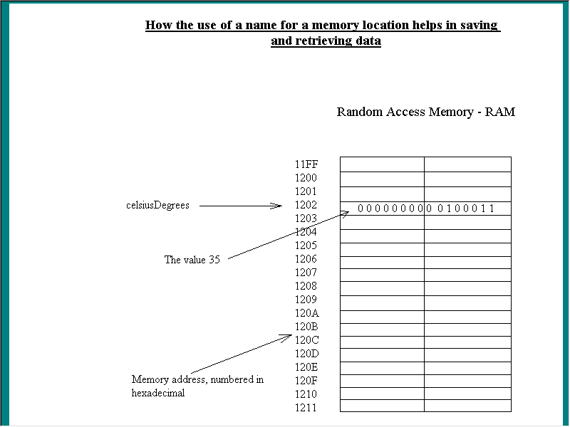
Data - variables
Notes:
0100011 (bin) = 35 (dec)
11FF(hex) = 4607 (dec)
F -

Slide 42
Hexadecimal System
Decimal | Hexadecimal
1 | 1
2 | 2
3 | 3
4 | 4
5 | 5
6 | 6
7 | 7
8 | 8
9 | 9
10 | A
11 | B
12 | C
13 | D
14 | E
15 | F
11FF(hex) = 15 x 1 +
15 x 16 +
1 x 256 +
1 x 4096 = 4607(dec)

Slide 43
Constants
Constants give meaning to mathematical expressions
Allow values to be changed consistently throughout a program.
Example: a double constant, value fixed
public static final double PI = 3.14159;

Slide 44
Constants
Example:
public static final double PI = 3.14159;
double diameter = 4.0;
double circumference = diameter * PI;
diameter = 2.0;
circumference = diameter * PI;

Slide 45
Constants
The line public static final double PI = 3.14159;
means that the value of PI can never be changed
This is indicated by the keyword final

Slide 46
Keywords
The use of capitals for constants is a way of alerting us to the constant
Note that keywords are reserved identifiers, that is, fixed parts of the language
How many keywords are there in the constant declaration on the previous slide?

Slide 47
Data types
The words public and static have meanings which we will investigate in another lecture.
double is the default data type for decimal numbers

Slide 48
Assignment
The = sign is an assignment
This means that the left hand side takes the value of the right hand side. So PI becomes 3.14159.
Every time we use PI in a formula 3.14159 is used.

Slide 49
Instantiation
If the type is a class then the variable instantiates as an object.
Practical task
Which variables on slide 38 are objects?
What does “instantiate” mean?

Slide 50
Java Primitive Data Types
The standard primitive data types (and their value ranges) are:
byte | 8 bit integer | -128 (-2^7) | +127 (2^7)
char | 16 bit character | Unicode character set
short | 16 bit integer | -32768 (-2^15) | +32767 (2^15)
int | 32 bit integer | -2,147,438,648 (-2^31) | +2,147,438,647 (2^31)
Notes:
May explain signed vs unsigned (signed needs 1 bit for the sign)

Slide 51
Java Primitive Data Types
long | 64 bit integer | big integer (-2^63 to 2^63)
float | 32 bit floating point | big with decimal point
double | 64 bit floating point | very big floating point
boolean | true or false | (Note not non zero and zero)

Slide 52

32 bit Single Precision
Here:
http://en.wikipedia.org/wiki/Single_precision (last accessed 14/10/2013)

Slide 53
Literals
These allow values of primitive or String types to be written as part of the program text.
These are one of the following types:
int and long (integers)
float and double (floating point numbers)

Slide 54
Literals
boolean (true/false)
char (character)
String
null (the null reference)

Slide 55
Literals
Some examples of literals:
inches = centimeters / 2.54;
(firstName + ‘ ‘ + secondName);
hexaDecimal = 0xADB4;
myDouble = 2.345;
myFirstName = “Des”;
Literals

Slide 56
Literals
So a literal simply means that the value is written directly into the program

Slide 57
Summary and Exercises

Slide 58
Summary – what we take home
Edit-compile-execute cycles (.class and .java files, command line invocation)
Strings and concatenation
Error messages
The main() method (calculator example)
Bugs, bugs bugs! (Syntax, run-time and logic error)
Naming things (variables, constants, literals, (primitive) data types and objects)

Slide 59
Exercises
Exercises for Week 1 on BREO
Please attempt all these in the practicals – the technical assistants should view your work before you leave.

Slide 60
Directed Learning
In the 12 hours that you should be attempting outside of these scheduled sessions, please read Chapter 1 of Savitch and attempt the exercises.

