Slide 1
CIS016-1 – Principles of Programming
Week 2

Slide 2
Agenda
Exercise recap
e Notation
Program Layout
Classes, Objects and Methods
Operators

Slide 3
Discussion Board
We’ve got a discussion board now!
Please use it – whether you’ve got a question or a solution
Discuss the exercise sheets and other Java-related questions
Find it on BREO under “Discussion Board”

Slide 4
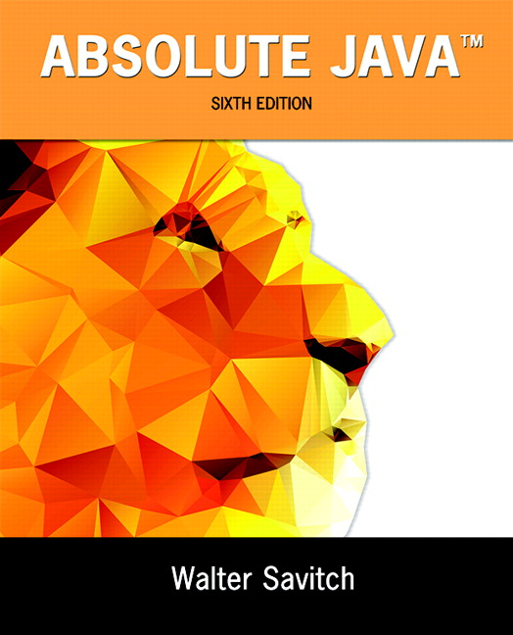
Literature
In general: use your favourite textbook
The lectures mainly follow Savitch’s “Absolute Java”
Other pointers can be found on BREO and in the unit handbook

Slide 5
EXERCISE RECAP
Understanding ranges

Slide 6
Exercise 5
Calculate the result of multiplying 2,000,000 by 4,000,000 and output its value. Note you should declare two constants and a variable to hold the answer. CHECK your answer, is it reasonable?

Slide 7
Exercise 5 Example
public class Exercise5 {
final static long number1 = 2000000;
final static long number2 = 4000000;
public static void main(String[] args) {
long product = number1 * number2;
System.out.println(number1 + " * "
+ number2
+ " = " + product);
}
}
Use long since the product is out of range of int!

Slide 8
THE E NOTATION
These aren’t really numbers, are they?

Slide 9
Division Example
Calculate and output the result of dividing 0.0000345 by 1234. What does the answer mean?

Slide 10
Division Example
public class DivisionExample {
public static void main(String[] args){
System.out.println(0.0000345/1234);
}
}
And the answer is...
2.7957860615883304E-8
?!

Slide 11
e Notation
Also called scientific notation or floating point notation
Handy for writing very large numbers and very small fractions
E or e stands for exponent
"multiply by 10 the power that follows"
Example:
3.67 x 10⁵ = 367,000.0 = 3.67e5
5.89 x 10⁻⁴ = 0.000589 = 5.89e-4

Slide 12
e Notation
e tells us the direction and number of digits to move the decimal point
2.7957860615883304E-8 (negative value after the e) means: move the decimal point 8 digits to the left
We then get
0.00000002795786061588333
3.67e5 (positive value after the e) means we move the decimal point 5 digits to the right: 367000.0
.
8 digits

Slide 13
PROGRAM LAYOUT
Indentation, comments, the main() method again – how to properly write Java programs

Slide 14
Program Layout
Remember humans are good at pattern recognition so use this to minimise errors!
Layout your program carefully
Leave plenty of white space
Indent as appropriate
As programs become bigger layout becomes more and more important

Slide 15
Program Layout
Indentation helps to understand the structure of a program
Indentation is used to suggest that a block of code is contained inside another structure
Look at example Indent.java

Slide 16
Program Layout
The basic form is :
  xxxxxxxxxxxxxxxxx
  {
      xxxxxxxxxx
      …….
      xxxxxxxxxx
      {
        xxxxxxxx
        xxxxxxxx
      }
  }
Don't forget to close
every bracket you open with a matching closing bracket!

Slide 17
Comments
Two types of comments in Java:
  Line comments
  Block comments
Comments are ignored by the compiler
  You can write whatever you want!
Comments are good practise
  Make your code understandable to others and also to yourself
So please comment your code!

Slide 18
Line Comments
// indicates the beginning of a comment
All text between these symbols and the end of the line are ignored.
Place // at each line if you want multiline comments (or use block comments)
Example:
int x = 1 + 1 – 2; // x is 0

Slide 19
Block Comments
Anything between the symbol pairs /* and */ is considered a comment
This can span multiple lines
This is used to explain what a whole block, a method or a class is for
It can also hold other information like author etc.
Variant: /** ... */ (used by javadoc)

Slide 20
Comment Example
/*
* This class prints my address.
* My address is actually my working address.
* It prints name, street and town of my office.
*/
public class MyAddress
{
public static void main(String[] args)
{
/* Print the address */
System.out.println("Ingo Frommholz"); // Name
System.out.println("Park Square"); // Street
System.out.println("Luton LU1 3JU"); // Town
}
}

Slide 21
Recap: The main method
A java program always needs the main method with a certain signature to be executed:
public static void main(String[] args)
{ ...
}
For this to work, such a method must exist!
Notes:
Now write a main method, then try again.

Slide 22
The main method (2)
“main” must exist
“main” must be public
“main” must be static (class method)
“main” must have a String array parameter
Only “main” can be invoked
main is the gateway for a class to go for execution.
Notes:
Explain “main”.

Slide 23
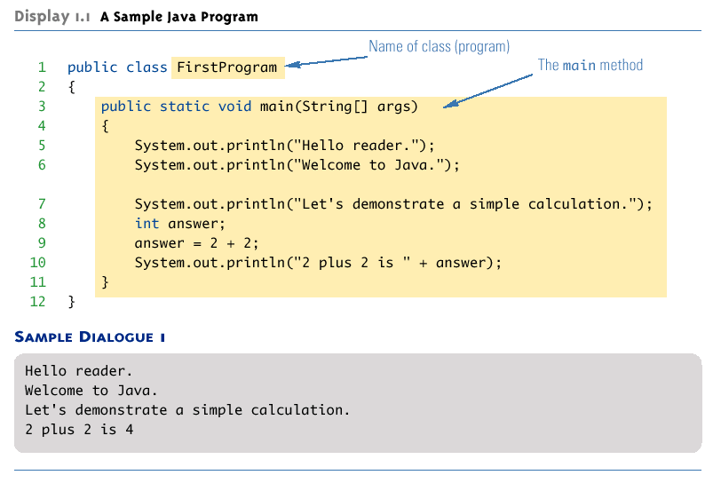
A Java Application Program

Slide 24
CLASSES, OBJECTS AND METHODS
A Glympse into Object-Oriented Programming

Slide 25
Objects and Methods
System.out.println
Java programs work by having things called objects perform actions
  System.out: an object used for sending output to the screen
The actions performed by an object are called methods
  println: the method or action that the System.out object performs

Slide 26
Calling a Method
Invoking or calling a method: When an object performs an action using a method
  Also called sending a message to the object
  Method invocation syntax (in order): an object, a dot (period), the method name, and a pair of parentheses
  Arguments: Zero or more pieces of information needed by the method that are placed inside the parentheses
System.out.println("This is an argument");

Slide 27
Objects and Classes
Objects are modelled into classes considering the properties of the objects captured:
  Attributes (Variables)
  Behaviours (Methods)
An attribute substantiates as a Variable
A behaviour is an operation done by the procedure (piece of program) with a Method.

Slide 28
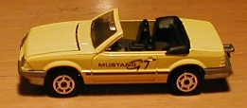
Class: Car Object: a car
Attributes:
String model
Color color
int numPassengers
double amountOfGas
Behaviors:
Add/remove a passenger
Get the tank filled
Report when out of gas
Attributes:
model = "Mustang"
color = Color.YELLOW
numPassengers = 0
amountOfGas = 16.5
Notes:
The values of some attributes (e.g., model, color) remain constant. The values of other attributes (e.g., number of passengers, amount of gas) may change while the program is running.
An object has a reference to the table of entry points for the methods of its class.

Slide 29
Objects and Classes
public class Car
{
String model;
String color;
int numPassengers = 0;
double amountOfGas = 0;
public void addPassenger()
{
numPassengers =
numPassengers + 1;
}
……….
public double getAmountOfGas()
{
return amountOfGas;
}
public static void main(String[] args)
{
Car aCar = new Car();
}
}
attributes (variables)
Methods to create behaviours

Slide 30
OPERATORS

Slide 31
Variable declarations
Variable declarations in Java are similar to those in other programming languages
  Simply give the type of the variable followed by its name and a semicolon
int answer;

Slide 32
Assignments and Concatenations
Using = and +
In Java, the equal sign (=) is used as the assignment operator
  The variable on the left side of the assignment operator is assigned the value of the expression on the right side of the assignment operator
  answer = 2 + 2;
In Java, the plus sign (+) can be used to denote addition (as above) or concatenation
  Using +, two strings can be connected together
System.out.println("2 plus 2 is " + answer);

Slide 33
Addition vs Concatenation
Practical exercise: check the output of
System.out.println("2" + "2");
and
System.out.println(2 + 2);
and
System.out.println("2" + (2 + 2));

Slide 34
Java Arithmetic Operators
List of arithmetic operators:
        ( )
        * / %
        + -
Operators are shown in order, that is () are always performed first followed by *, /, % -modulus then + -.

Slide 35
Operators – Order matters!
Expressions are evaluated left to right if there are a sequence of operators of equal precedence, however the precedence rules are dominant.
Eg, 6 + 4 * 5 / 2 - 4 is
12 not 21

Slide 36
Operators – Use of Brackets
  What is the result of:
      x = 2 + (14 - 7) * 3
      is it 27 or 23?

Slide 37
Operators – Use of Brackets
  What is the result of:
      x = 2 + (14 - 7) * 3
      23

Slide 38
Operators – Integer Division
Integer division in Java only gives whole part
  x = 5 / 2;
  So x = 2

Slide 39
Operators – Modulo
  % is the modulo operator
  a%b returns the remainder of a/b
      x = 5 % 2
  So the answer is?
  x = 1

Slide 40
Equality Operators
Is the left hand side equal to the right hand side?
==
Note we cannot use this for strings, it is only for primitive data types. For strings we need the equals() method as in
"Des".equals("Jim");

Slide 41
Equality Operators
Is the left hand side NOT equal to the right hand side?
!=

Slide 42
Equality Operators
Equality - practical test
If x = 3 and y = 4
then what is the result of:
  x == y

Slide 43
Equality Operators
Equality - practical test
If x = 3 and y = 3
then what is the result of:
  x != y

Slide 44
Relational Operators
Relational (comparison)
Is LHS greater than the RHS?
x > y
Is LHS less than the RHS?
x < y

Slide 45
Relational Operators
Relational (comparison)
Is LHS (left hand side) greater than or equal to the RHS?
x >= y
Is LHS less than or equal to the RHS?
x <= y

Slide 46
Relational Operators
Relational - practical test
State true or false.
3 > 4
4 > 3
5 >= 6
6 <= 6

Slide 47
Logical Operators
Logical operators (incomplete - operand not bitwise)
    && is and
    || is or
    ! is (not)

Slide 48
Logical Operators
Logical operators (incomplete operand not bitwise)
    true && false is false
    true || false is true
    ! true is false

Slide 49
Logical Operators Practical
(3 >= 4) && (3 <= 4) is
false
(x == (2 * x)) ||(false) is
false (if x != 0)
If x is 14 and y is 15
!(x == y) is
true

Slide 50
Logical Operators
They can be used to print the truth value of an expression – is it true or false?
Later we will use them for the program flow (e.g. in if-then statements)

Slide 51
Exercises
Please have a look at the example code on BREO (“Week 2”) – compile it, run it, try to understand it!
Check the exercises on BREO
Please attempt all these – it is very important that you practice!

Slide 52
Directed learning
In the 12 hours that you should be attempting outside of these scheduled sessions, please read chapter 2 of Savitch and attempt the exercises.

Slide 53
Summary
e Notation
Program Layout
Classes, Objects and Methods
Operators

