Slide 1
CIS016-1 – Principles of Programming / CIS096-1 – Principles of Programming and Data Structures / PAT001-1 – Principles of Programming
Week 2

Slide 2
Agenda
Classes and Objects Recap
String Class
More Operators
Program Input/Output
Bugs, Bugs Bugs!

Slide 3
CLASSES AND OBJECTS
RECAP

Slide 4

Class: Car Object: my car
Attributes:
String model
Color color
int numPassengers
double amountOfGas
Behaviours:
Add/remove a passenger
Get the tank filled
Report amount of gas
Attributes:
model = "Mustang"
color = Color.YELLOW
numPassengers = 0
amountOfGas = 16.5
Notes:
The values of some attributes (e.g., model, color) remain constant. The values of other attributes (e.g., number of passengers, amount of gas) may change while the program is running.
An object has a reference to the table of entry points for the methods of its class.

Slide 5
Car Class and Objects in Java
public class Car
{
String model;
String color;
int numPassengers = 0;
double amountOfGas;
public void initialise()
{
model = "Mustang";
amountOfGas = 15.5;
}
……….
public double getAmountOfGas()
{
return amountOfGas;
}
public static void main(String[] args)
{
Car myCar = new Car(); // create my car object
myCar.initialise(); // initialise my car object
System.out.println("The amount of gas is "
+ myCar.getAmountOfGas() );
}
}
Variables to model
attributes
Methods to create
behaviours
new creates a new
object of class Car
(identified by myCar)
Tell my car object to
set some initial values
Tell my car object to
return the current
amount of gas

Slide 6
Objects and Classes
The main method is used to create an object of Car class, myCar, then make use of its properties:
  Initializes its variables with myCar, initialize()
  Invokes getAmountOfGas() method to use the value it returns alongside a string, “the amount of gas is “ as an argument of System.out.println().

Slide 7
Classes, Objects, and Methods Recap
A class is the name for a type whose values are objects
Objects are entities that store data and take actions
  Objects of the String class store data consisting of strings of characters
The actions that an object can take are called methods
  Methods can return nothing, a value of a single type and/or perform an action
  All objects within a class have the same methods, but each can have different data values

Slide 8
Classes, Objects, and Methods Recap
Invoking or calling a method: a method is called into action by writing the name of the calling object, followed by a dot, followed by the method name, followed by parentheses
  This is sometimes referred to as sending a message to the object
  The parentheses contain the information (if any) needed by the method
  This information is called an argument (or arguments)

Slide 9
THE STRING CLASS

Slide 10
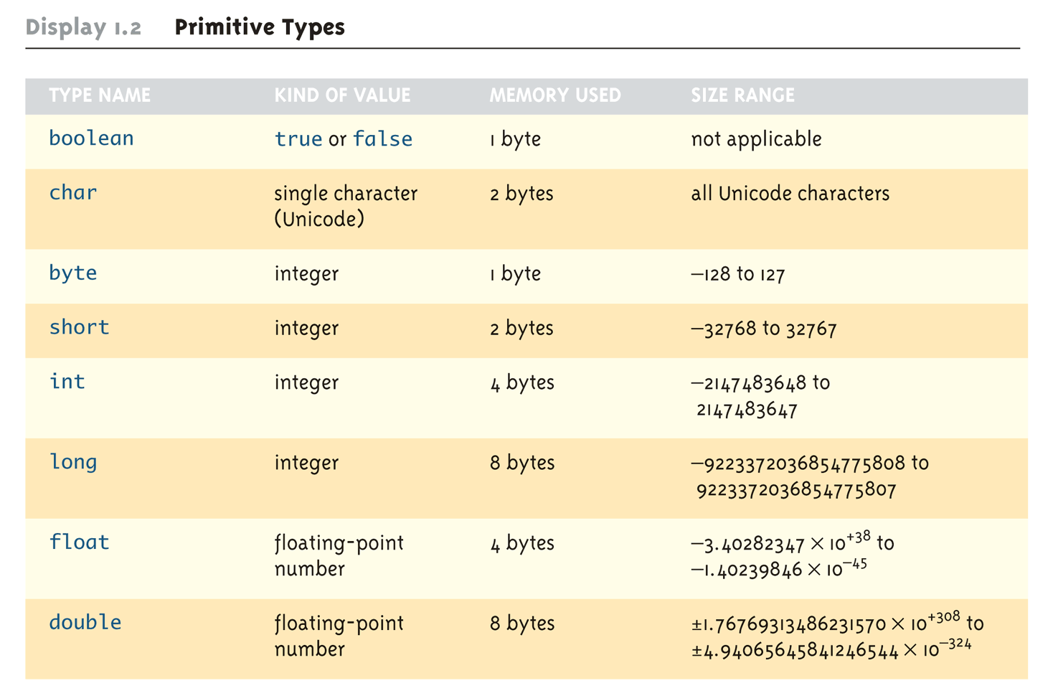
Primitive Data Types
(Taken from Savitch, Absoulute Java, 4th edition)

Slide 11
The Class String
There is no primitive type for strings in Java
The class String is a predefined class in Java that is used to store and process strings
Objects of type String are made up of strings of characters that are written within double quotes
  Any quoted string is a constant of type String
    "Live long and prosper."
A variable of type String can be given the value of a String object
  String blessing = "Live long and prosper.";

Slide 12
String Indexes
The 12 characters in the string “Java is fun.” have indexes 0 to 11
J | a | v | a |  | i | s |  | f | u | n | .
0 | 1 | 2 | 3 | 4 | 5 | 6 | 7 | 8 | 9 | 10 | 11

Slide 13
Concatenation of Strings
Concatenation: Using the + operator on two strings in order to connect them to form one longer string
  If greeting is equal to "Hello ",
  and javaClass is equal to "class",
  then greeting + javaClass is equal to "Hello class"
Any number of strings can be concatenated together
When a string is combined with almost any other type of item, the result is a string
  "The answer is " + 42 evaluates to
  "The answer is 42"

Slide 14
String Methods
The String class contains many useful methods for string-processing applications
  A String method is called by writing a String object, a dot, the name of the method, and a pair of parentheses to enclose any arguments
  If a String method returns a value, then it can be placed anywhere a value of its type can be used
    String greeting = "Hello";
    int count = greeting.length();
    System.out.println("Length is " + greeting.length());
  Always count from zero when referring to the position or index of a character in a string

Slide 15
String Methods
Strings can be compared using another string method, equals(“…”) which returns a boolean value:
  greeting.equals("Hello") returns true
  greeting.equals("Good bye") returns false
  greeting.equals("hello") returns false
String methods to convert the cases if
  greeting.toLowerCase() returns “hello”
  greeting.toUpperCase() returns “HELLO”

Slide 16
Escape Sequences
What happens if we want to print the string
"Java is fun", she says
? Try this:
System.out.println(""Java is fun", she says");
The compiler won't
like this!

Slide 17
Escape Sequences
A backslash (\) immediately preceding a character (i.e., without any space) denotes an escape sequence or an escape character
  The character following the backslash does not have its usual meaning
  Although it is formed using two symbols, it is regarded as a single character

Slide 18
Escape Sequences
\” | Double quote
\’ | Single quote
\\ | Backslash
\n | New line: go to the beginning of the next line
\r | Carriage return: go to the beginning of the current line
\t | Tab: white space to the next tab stop

Slide 19
Escape Sequences
To print
"Java is fun", she says
use
System.out.println("\"Java is fun\", she says");
Escape character for
the double quote

Slide 20
String Processing
A String object in Java is considered to be immutable, i.e., the characters it contains cannot be changed
  There is another class in Java called StringBuffer that has methods for editing its string objects
However, it is possible to change the value of a String variable by using an assignment statement
    String name = "Soprano";
    name = "Anthony " + name;
    The output will be :
    Anthony Soprano

Slide 21
System.out.println
(console output)
System.out is an object that is part of the Java language
println is a method invoked by the System.out object that can be used for console output
  The data to be output is given as an argument in parentheses
  A plus sign is used to connect more than one item
  Every invocation of println ends a line of output
  System.out.println("The answer is "+42);

Slide 22
println Versus print
Another method that can be invoked by the System.out object is print
The print method is like println, except that it does not end a line
  With println, the next output goes on a new line
  With print, the next output goes on the same line

Slide 23
Formatting Output with printf
Starting with version 5.0, Java includes a method named printf that can be used to produce output in a specific format
The Java method printf is similar to the print method
  Like print, printf does not advance the output to the next line
System.out.printf can have any number of arguments
  The first argument is always a format string that contains one or more format specifiers for the remaining arguments
  All the arguments except the first are values to be output to the screen

Slide 24
printf Format Specifier
The code
  double price = 19.8;
  System.out.print("$");
  System.out.printf("%6.2f", price);
  System.out.println(" each");
will output the line
  $ 19.80 each
The format string "%6.2f" indicates the following:
  End any text to be output and start the format specifier (%)
  Display up to 6 right-justified characters, pad fewer than six characters on the left with blank spaces (i.e., field width is 6)
  Display exactly 2 digits after the decimal point (.2)
  Display a floating point number, and end the format specifier (i.e., the conversion character is f)

Slide 25
public class StringClass
{
public static void main(String [ ] str)
{
String greeting = "Hello";
int count = greeting.length();
System.out.println("Length of "+greeting +" is " + count);
System.out.println("The greeting is Hello:" + greeting.equals("Hello"));
System.out.println("The greeting is Good Bye:" +
greeting.equals("Good Bye"));
System.out.println("The greeting is hello:" + greeting.equals("hello"));

Slide 26
System.out.println("The new output is :" + greeting.toLowerCase());
System.out.println("The new output is :" + greeting.toUpperCase());
System.out.println();
double price = 19.8133333;
System.out.print("The price is ");
System.out.print("£");
System.out.printf("%3.2f", price);
System.out.println(" each");
}
}

Slide 27
MORE OPERATORS

Slide 28
More Operators
We are going to look at further operators
First let us have a look at Boolean operators again

Slide 29
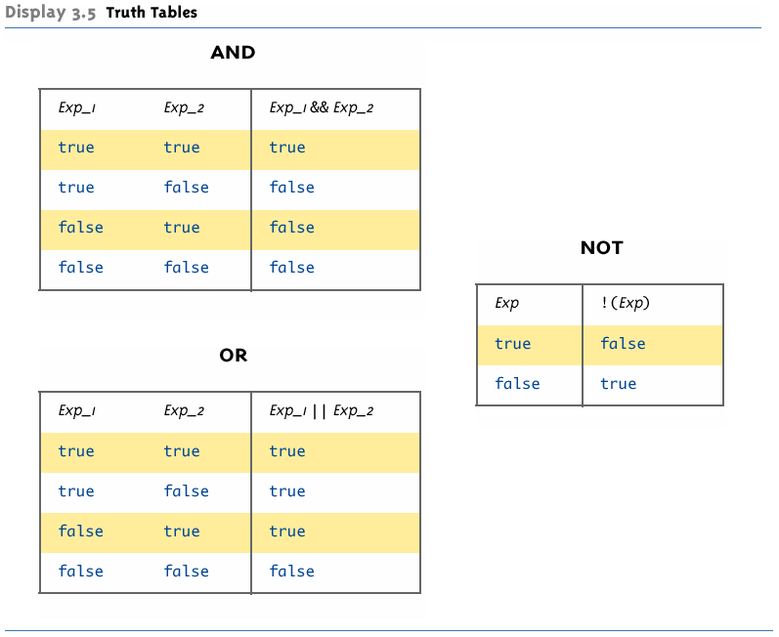
Boolean Operators: Truth Tables
(Taken from Savitch, Absoulute Java, 4th edition)

Slide 30
Incremental Operators
Incremental operators (arithmetic):
++i // increment first, then use new value
i++ // use old value, then increment
--i // decrement first, then use new value
i-- // use old value, then decrement

Slide 31
Incremental Operators
Increment means to increase by 1 the contents of the variable, in this case i. Decrement is the reverse operation.
++i is known as the pre-increment operator and has the effect of adding 1 to the value of i, so i is updated immediately.

Slide 32
Incremental Operators
i++ is known as the post-increment operator and has the effect of using i before adding one, so i is updated after the current value of i has been used.

Slide 33
Incremental Operators
So
        int i = 0;
        System.out.println(i++);
prints out the value 0
and
        int i = 0;
        System.out.println(++i);
prints out the value 1. In both cases i has the value 1 afterwards.

Slide 34
Incremental Operators
Example Equivalent
  j = p + i++; j = p + i;
  i = i + 1;
  ----------------------------------------------------
  j = p + ++i; i = i + 1;
  j = p + i;
  ----------------------------------------------------
  j = p + (++i); i = i + 1;
  j = p + i;

Slide 35
Assignments
Assignments can be performed during or after declaration of a variable
During declaration
    double decimal = 0.3456;
After declaration
    You can assign in a line
    i = j = k = 10;

Slide 36
Assignments
You can declare several variables of the same type in a compact way, but each must have its own assignment
int i = 0, j = 0, k = 0;
This does not work:
int i = j = k = 0;

Slide 37
Assignment Shortcuts
Assignment Shortcuts
  i += 4; // plus = becomes i = i + 4
  i -= j; // minus = becomes i = i – j;
  i *= 4; // multiply = becomes i = i * 4
  i /= j; // divide = becomes i = i / j;

Slide 38
Practical Task
What is the value of i and j?
        i = 14; j = 23;
        i = ++i + j++;
---------------------------------------------------
        i = 10; j = 14;
        i += i-- + ++j;
See Incrementors package!
i is 14
j is 23
i becomes 15
j becomes 24
i now becomes 15+23=38
j is still 23
i now becomes 10+10+15=35
j becomes 15
i is still 10

Slide 39
Operators
There are further operators which we will consider in the future
Now it’s time to consider input into our programs
So far data has been declared and assigned inside the program text, but most programs take input from a keyboard etc.

Slide 40
KEYBOARD (CONSOLE) INPUT
A bit more interaction

Slide 41
Interacting with the System
You already know how to print things (console output)
  System.out.println
  System.out.print
  System.out.printf
But how can we input data into the system (console input)?
  This would allow for much more flexible programs!

Slide 42
Keyboard Input
Basically two ways to interact with the system
  GUI components, ie. a dialog box (later)
  The Scanner class

Slide 43
Scanner Class
Java (J2SE 5.0 upwards) provides a class called Scanner that provides for keyboard input
It performs more sophisticated keyboard input
It involves regular expression processing

Slide 44

The Scanner Class
Scanner is provided in the java.util package, which needs to be imported first
Wait...packages? Importing them?

Slide 45
Importing Packages and Classes
Libraries in Java are called packages
  A package is a collection of classes that is stored in a manner that makes it easily accessible to any program
  In order to use a class that belongs to a package, the class must be brought into a program using an import statement
  Classes found in the package java.lang are imported automatically into every Java program
  Examples
    import javax.swing.JOptionPane;
  // imports JOptionPane class only
    import javax.swing.*;
  // imports all the classes in package
  // javax.swing
Class name
Package name
2-<number>

Slide 46
Importing the Scanner Class
Scanner can be found in the java.util package
So to import the Scanner class, use
import java.util.Scanner;
This statement tells Java to
  Make the Scanner class available to your program
  Find the scanner class in a library of classes named java.util

Slide 47
Using Scanner
In your code (ie. within the main() method), you have to create a Scanner object first:
Scanner keyboard =
new Scanner(System.in);

Slide 48
Using Scanner
Scanner provides methods to read int and double values as well as strings (words and entire lines):
int n1 = keyboard.nextInt();
double d1 = keyboard.nextDouble();
String word = keyboard.next();
String line = keyboard.nextLine();
See also the ScannerDemo

Slide 49

BUGS, BUGS, BUGS!!!
And again...

Slide 50
What's wrong with this program?
public class Bug1 {
public static void main(String[] args){
int n1 = 3;
int n2 = 4;
string text = "3 * 4 is ";
System.out.println(text + n1 * n2);
}
}

Slide 51
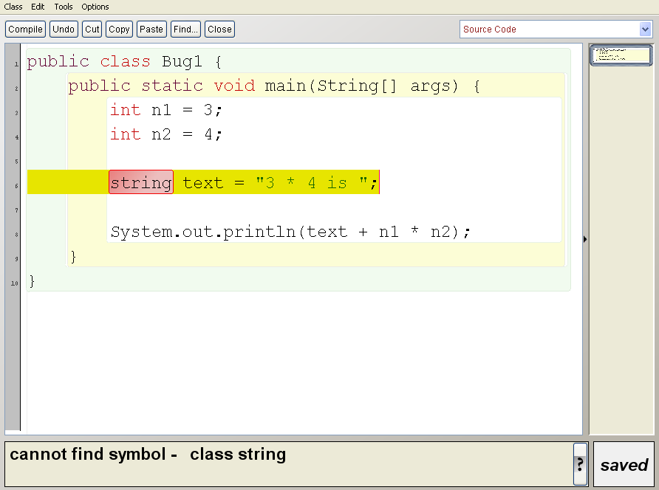
Here's what BlueJ says

Slide 52
Command line output
C:\Documents and Settings\Ingo\Desktop>javac Bug1.java
Bug1.java:6: error: cannot find symbol
string text = "3 * 4 is ";
^
symbol: class string
location: class Bug1
1 error

Slide 53
What's wrong with this program?
public class Bug1 {
public static void main(String[] args) {
int n1 = 3;
int n2 = 4;
string text = "3 * 4 is ";
System.out.println(text + n1 * n2);
}
}
public class Bug1 {
public static void main(String[] args) {
int n1 = 3;
int n2 = 4;
String text = "3 * 4 is ";
System.out.println(text + n1 * n2);
}
}
String must start with an
upper case character as
it's a class and not a data
type!

Slide 54
What's wrong here?
public class Bug2 {
public static void main(String[] args) {
int nummer = 25;
System.out.println("The number is "
+ number);
}
}

Slide 55
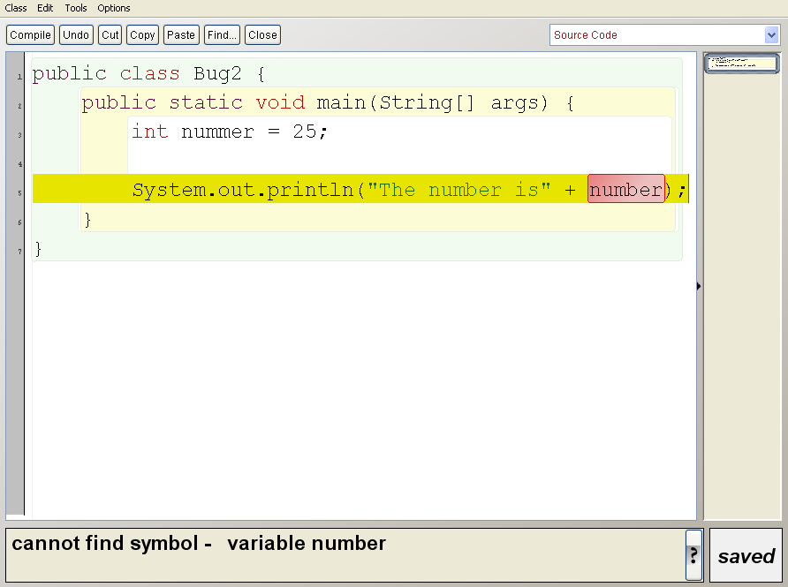
BlueJ doesn't like it...

Slide 56
...nor does javac
C:\Documents and Settings\Ingo\Desktop>javac Bug2.java
Bug2.java:5: error: cannot find symbol
System.out.println("The number is" + number);
^
symbol: variable number
location: class Bug2
1 error

Slide 57
What's wrong here?
public class Bug2 {
public static void main(String[] args) {
int number = 25;
System.out.println("The number is "
+ number);
}
}
public class Bug2 {
public static void main(String[] args) {
int nummer = 25;
System.out.println("The number is "
+ number);
}
}
number is unknown (typo?). Change
this to nummer or change nummer
above to number!

Slide 58

Bug First Aid
Discovered a bug?
Got strange error messages?
Yes, it's frustrating!
But:
Don't panic!!
Try to understand what's going on (and how to fix the problem)
  This may take some attempts, be patient and don't give up!
Ask your colleagues, post in our discussion board (this is why we have it!) or ask us
  Submit error messages and the code that produced them

Slide 59
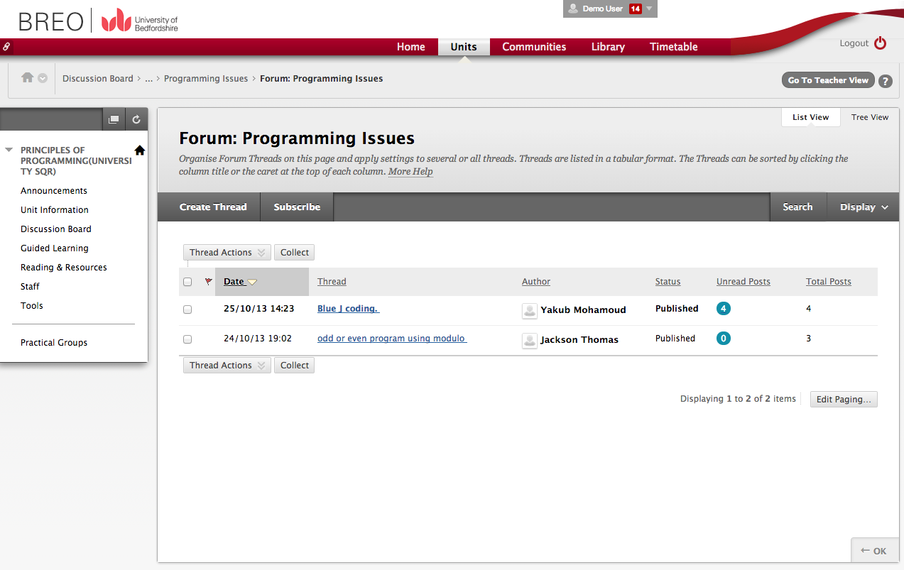
Use the Discussion Board!

Slide 60
Summary
Classes and Object Recap
String Class
More Operators
Program Input/Output
Bugs, Bugs Bugs!
For your self study and practicing purposes:
Please attempt the exercises (will be up on Wednesday) and read chapters 1 and 2 of the Savitch book “Absolute Java”!

