Slide 1
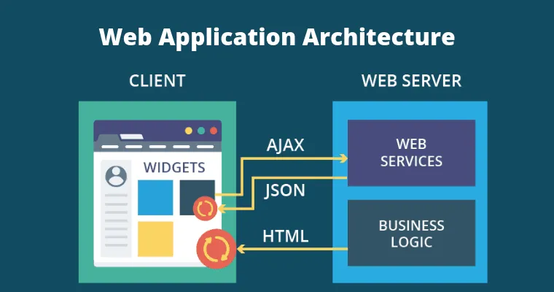
CS 128 – Web Design & Development
Ratana SOTH
rsoth@paragoniu.edu.kh
088 898 8085

Slide 2
What is PHP?
What is PHP?
  Language developed by Rasmus Lerdorf Its primary use is for server-side scripting
    Ex: To process HTML forms
    Ex: To perform a DB query and pass on results
    Ex: To dynamically generate HTML
  PHP scripts are often embedded within HTML documents
    The server processes the HTML document, executing the PHP segments and substituting the output within the HTML document

Slide 3
What is PHP?
The modified document is then sent to the client
As mentioned previously, the client never sees the PHP code
  The only reason the client even knows PHP is involved is due to the file extension → .php

Slide 4
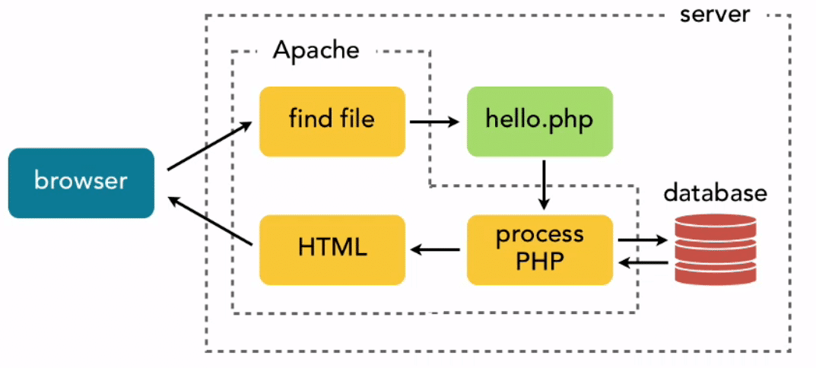
What is PHP? - Process
HTML
CSS
Javascript
Text
Images

Slide 5
What is PHP? – Write Code
<!DOCTYPE html>
<html>
<head>
<title>Simple PHP Example</title>
<?php
echo "<style>
.cl{
}
</style>";
?>
</head>
<body>
<?php echo "<p><h1>Output</h1>";
echo "<h2>Output</h2>";
echo "<h3>Output</h3></p>";
?>
This is HTML
</body>
</html>

Slide 6






What is PHP Alternative?

Slide 7
PHP - Variable
PHP variables must begin with a “$” sign
Case-sensitive ($Foo != $foo != $fOo)
Global and locally-scoped variables
  Global variables can be used anywhere
  Local variables restricted to a function or class
Certain variable names reserved by PHP
  Form variables ($_POST, $_GET)
  Server variables ($_SERVER)
  Etc.

Slide 8
PHP – Variable Constants
<?php
// Valid constant names
define("FOO", "something");
define("FOO2", "something else");
define("FOO_BAR", "something more");
// Invalid constant names (they shouldn’t start
// with a number!)
define("2FOO", "something");
// This is valid, but should be avoided:
// PHP may one day provide a “magical” constant
// that will break your script
define("__FOO__", "something");
?>

Slide 9
PHP - Variable
Example Is the same as
x+=y x=x+y
x-=y x=x-y
x*=y x=x*y
x/=y x=x/y
x%=y x=x%y
Arithmetic Operators: +, -, *,/ , %, ++, --
Assignment Operators: =, +=, -=, *=, /=, %=
Comparison Operators: ==, !=, >, <, >=, <=
Logical Operators: &&, ||, !
String Operators: . and .= (for string concatenation)
$a = "Hello ";
$b = $a . "World!";
// now $b contains "Hello World!"
$a = "Hello ";
$a .= "World!";

Slide 10
PHP - Variable
<?php
$foo = 25; // Numerical variable
$bar = “Hello”; // String variable
echo $bar; // Outputs Hello
echo $foo,$bar; // Outputs 25Hello
echo “5x5=”,$foo; // Outputs 5x5=25
echo “5x5=$foo”; // Outputs 5x5=25
echo ‘5x5=$foo’; // Outputs 5x5=$foo
?>

Slide 11
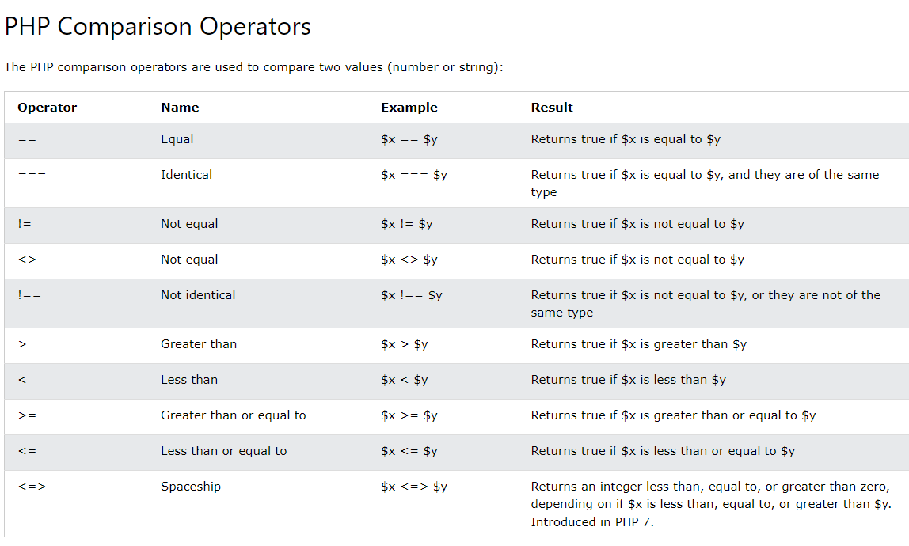
Backend – PHP

Slide 12
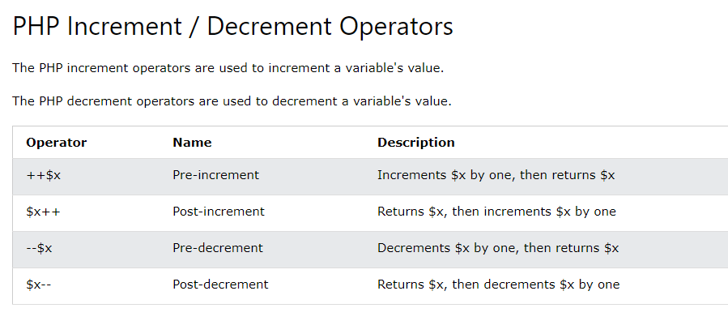
Backend – PHP

Slide 13
PHP - IF
Example if/else if/else statement:
    if ($foo == 0) {
    echo ‘The variable foo is equal to 0’;
    }
    else if (($foo > 0) && ($foo <= 5)) {
    echo ‘The variable foo is between 1 and 5’;
    }
    else {
    echo ‘The variable foo is equal to ‘.$foo;
    }

Slide 14
PHP - While
While (condition)
{
Statements;
}
<?php
$count=0;
While($count<3)
{
Print “hello PHP. ”;
$count += 1;
// $count = $count + 1;
// or
// $count++;
?>

Slide 15
PHP - for and foreach
<?php
for ($i=1; $i<=5; $i++)
{
echo "Hello World!<br />";
}
?>
<?php
$a_array = array(1, 2, 3, 4);
foreach ($a_array as $value)
{
$value = $value * 2;
echo “$value <br/> \n”;
}
?>
loops through a block of code a specified number of times
<?php
$a_array=array("a","b","c");
foreach ($a_array as $key => $value)
{
echo $key." = ".$value."\n";
}
?>

Slide 16
PHP - Switch
<html><head></head>
<body>
<!–- switch-cond.php -->
<?php
$x = rand(1,5); // random integer
echo “x = $x <br/><br/>”;
switch ($x)
{
case 1:
echo "Number 1";
break;
case 2:
echo "Number 2";
break;
case 3:
echo "Number 3";
break;
default:
echo "No number between 1 and 3";
break;
}
?>
</body>
</html>
switch (expression)
{
case label1:
code to be executed if expression = label1;
break;
case label2:
code to be executed if expression = label2;
break;
default:
code to be executed
if expression is different
from both label1 and label2;
break;
}

Slide 17
PHP - Array
array() = creates arrays
<?php
$arr = array("foo" => "bar", 12 => true);
echo $arr["foo"]; // bar
echo $arr[12]; // 1
?>
key = either an integer or a string.
value = any PHP type.
<?php
array(5 => 43, 32, 56, "b" => 12);
array(5 => 43, 6 => 32, 7 => 56, "b" => 12);
?>
<?php
$arr = array(5 => 1, 12 => 2);
foreach ($arr as $key => $value) { echo $key, ‘=>’,
$value); }
$arr[] = 56; // the same as $arr[13] = 56;
$arr["x"] = 42; // adds a new element
unset($arr[5]); // removes the element
unset($arr); // deletes the whole array
$a = array(1 => 'one', 2 => 'two', 3 => 'three');
unset($a[2]);
$b = array_values($a);
?>
can set values in an array
unset() removes a key/value pair
array_values() makes reindexing effect (indexing numerically)

Slide 18
PHP - Function
<?php
// This is a function
  function foo($arg_1, $arg_2)
  {
  $arg_2 = $arg_1 * $arg_2;
  return $arg_2;
  }
  $result_1 = foo(12, 3); // Store the function
  echo $result_1; // Outputs 36
  echo foo(12, 3); // Outputs 36
?>

Slide 19
PHP - Function
<?php
function foo($arg_1, $arg_2, /* ..., */ $arg_n)
{
echo "Example function.\n";
return $retval;
}
?>
Can also define conditional functions, functions within functions, and recursive functions.
Can return a value of any type
<?php
function square($num)
{
return $num * $num;
}
echo square(4);
?>
<?php
function small_numbers()
{
return array (0, 1, 2);
}
list ($zero, $one, $two) = small_numbers();
echo $zero, $one, $two;
?>
<?php
function takes_array($input)
{
echo "$input[0] + $input[1] = ", $input[0]+$input[1];
}
takes_array(array(1,2));
?>

Slide 20
PHP – Include file
vars.php
<?php
$color = 'green';
$fruit = 'apple';
?>
test.php
<?php
echo "A $color $fruit"; // A
include 'vars.php';
echo "A $color $fruit"; // A green apple
?>
<?php
function foo()
{
global $color;
include ('vars.php‘);
echo "A $color $fruit";
}
/* vars.php is in the scope of foo() so *
* $fruit is NOT available outside of this *
* scope. $color is because we declared it *
* as global. */
foo(); // A green apple
echo "A $color $fruit"; // A green
?>
The include() statement includes and evaluates the specified file.

Slide 21
PHP - Form
Access to the HTTP POST and GET data is simple in PHP
The global variables $_POST[] and $_GET[] contain the request data
<?php
  if ($_POST["submit"])
  echo "<h2>You clicked Submit!</h2>";
  else if ($_POST["cancel"])
  echo "<h2>You clicked Cancel!</h2>";
  ?>
  <form action="form.php" method="post">
  <input type="submit" name="submit" value="Submit">
  <input type="submit" name="cancel" value="Cancel">
  </form>

Slide 22
PHP - Session
Sessions store their identifier in a cookie in the client’s browser
Every page that uses session data must be proceeded by the session_start() function
Session variables are then set and retrieved by accessing the global $_SESSION[]
Save it as session.php
<?php
  session_start();
  if (!$_SESSION["count"])
  $_SESSION["count"] = 0;
  if ($_GET["count"] == "yes")
  $_SESSION["count"] = $_SESSION["count"] + 1;
  echo "<h1>".$_SESSION["count"]."</h1>";
  ?>
  <a href="session.php?count=yes">Click here to count</a>

Slide 23
PHP – Session Destroy
<?php
// start the session
session_start();
header("Cache-control: private"); //IE 6 Fix
$_SESSION = array();
session_destroy();
echo "<strong>Step 5 - Destroy This Session </strong><br />";
if($_SESSION['name']){
echo "The session is still active";
} else {
echo "Ok, the session is no longer active! <br />";
echo "<a href=\"page1.php\"><< Go Back Step 1</a>";
}
?>

Slide 24
PHP - Database
<html><head><title>MySQL Table Viewer</title></head><body>
<?php
// change the value of $dbuser and $dbpass to your username and password
$dbhost = ‘ codd.cs…….. ';
$dbuser = 'nruan';
$dbpass = ‘*****************’;
$dbname = $dbuser;
$table = 'account';
$conn = mysql_connect($dbhost, $dbuser, $dbpass);
if (!$conn) {
die('Could not connect: ' . mysql_error());
}
if (!mysql_select_db($dbname))
die("Can't select database");

Slide 25
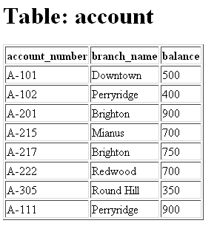
PHP - MySQL
<html><head>
<title>MySQL Table Viewer</title>
</head>
<body>
<?php
$dbhost = 'hercules.cs.kent.edu:3306';
$dbuser = 'nruan';
$dbpass = ‘**********’;
$dbname = 'nruan';
$table = $_POST[“table”];
$conn = mysql_connect($dbhost, $dbuser, $dbpass);
if (!$conn)
die('Could not connect: ' . mysql_error());
if (!mysql_select_db($dbname))
die("Can't select database");
$result = mysql_query("SELECT * FROM {$table}");
if (!$result) die("Query to show fields from table failed!" . mysql_error());

Slide 26
PHP - MySQL
$fields_num = mysql_num_fields($result);
echo "<h1>Table: {$table}</h1>";
echo "<table border='1'><tr>";
// printing table headers
for($i=0; $i<$fields_num; $i++) {
$field = mysql_fetch_field($result);
echo "<td><b>{$field->name}</b></td>";
}
echo "</tr>\n";
while($row = mysql_fetch_row($result)) {
echo "<tr>";
// $row is array... foreach( .. ) puts every element
// of $row to $cell variable
foreach($row as $cell)
echo "<td>$cell</td>";
echo "</tr>\n";
}
mysql_free_result($result);
mysql_close($conn);
?>
</body></html>

Slide 27
PHP - MySQL
mysql_connect()
  mysql_select_db()
  mysql_query()
  mysql_num_rows()
  mysql_fetch_array()
  mysql_fetch_assoc()
mysql_close()

