Slide 1
Wrappers
Jose Luis Ambite
University of Southern California
Based on slides by Craig Knoblock, Ion Muslea, Kristina Lerman; Doan, Halevy, and Ives.

Slide 2
Introduction
Wrappers are components of data integration (DI) systems that communicate with the data sources
Sending queries from DI system to the sources
Converting replies to format that can be manipulated DI system
Complexity of wrapper depends on nature of data source
RDBMS: wrapper’s task is to interact with JDBC driver
Web service: invoke it, parse results (e.g. XML)
Semi-structured data (HTML): parse and transform into tuples
This lecture: Focus on HTML

Slide 3
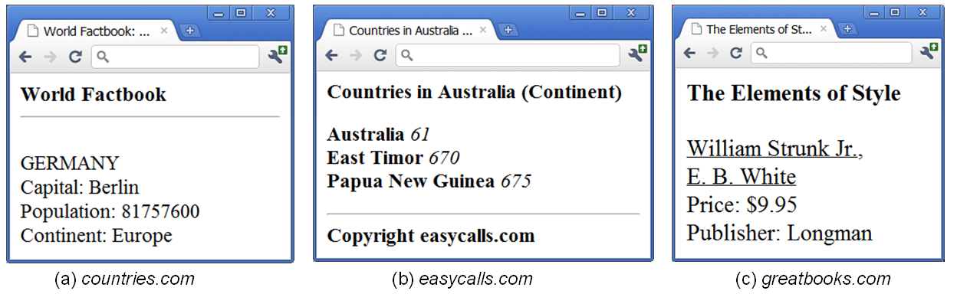
HTML Data Sources
Consider data sources that consist of a set of Web pages
For each source S, each Web page displays data conforming to schema T_{S} and following format F_{S}
T_{S}, F_{S} common across all pages of the source

Slide 4
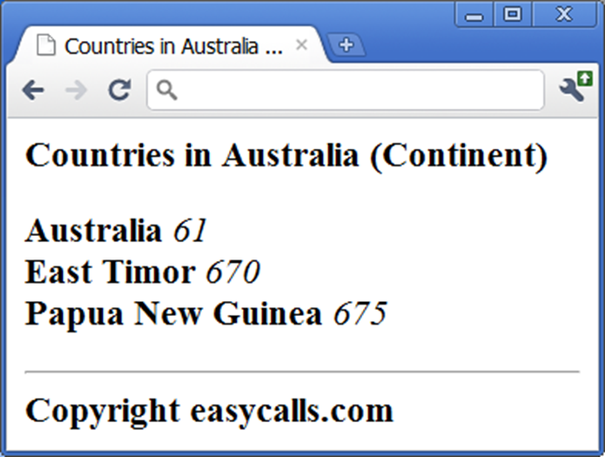
HTML Data Sources
Templated pages are very common on the Web
often created in sites powered by database systems
user sends a query to the database system
e.g., list all countries and calling codes in the continent Australia
system produces a set of tuples
scripting program creates an HTML page that embeds the tuples, using a schema Ts and a format Fs
HTML is sent to browser

Slide 5
Wrapper Learning
Jose Luis Ambite
University of Southern California
Thanks to Craig Knoblock for making these slides available. These slides are based originally on the presentation by Ion Muslea and Kristina Lerman.

Slide 6
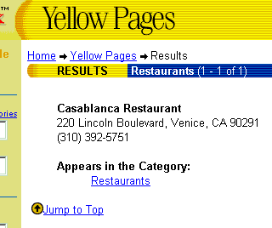
Extracting Data from Semi-structured Sources
NAME Casablanca Restaurant
STREET 220 Lincoln Boulevard
CITY Venice
PHONE (310) 392-5751
Notes:
As the quantity and diversity of the information available online increases, more of the common information access tasks are done by program such as web wrappers. Wrappers faciliate access to Web-based information sources by providing a uniform querying and data extraction capability. For example, a Web wrapper for the yellow pages source can take a query for a Mexican restaurant near Marina del Rey, CA, and extract the restaurant’s name, its address and the phone number, in the same way as the information is extracted from a database.

Slide 7
Definition of wrapper
A tuple (T_{W}, E_{W}) where:
T_{W}: target schema
E_{W}: extraction program that uses the format F_{S} to extract from each page a data instance (tuple) conforming to T_{W}
[Doan, Halevy, Ives. Principles of Data Integration, 2012]

Slide 8
Main Solution Approaches
Manual
Developer manually creates TW and EW
Learning (Supervised)
Developer gives examples, e.g, highlights the attributes of TW in a set of Web pages, then applies learning algorithm to learn EW
Automatic (Unsupervised)
Automatically learn both TS and EW from a set of Web pages
Interactive
Combines aspects of learning and automatic approaches
Developer provides feedback to a program until convergence

Slide 9

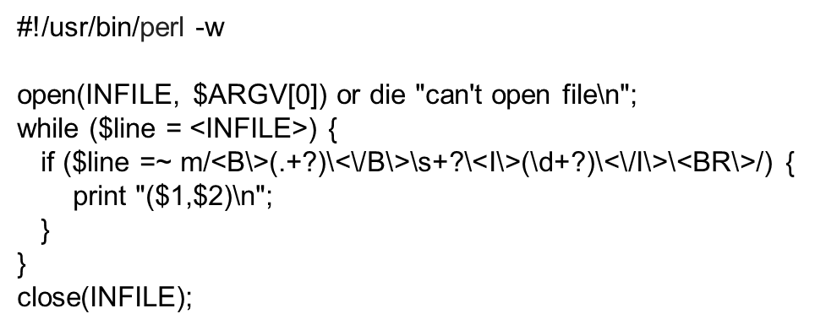
Manual Wrapper Construction
Developer examines a set of Web pages
manually creates target schema TW and extraction program EW
often writes EW using a procedural language such as Perl

Slide 10
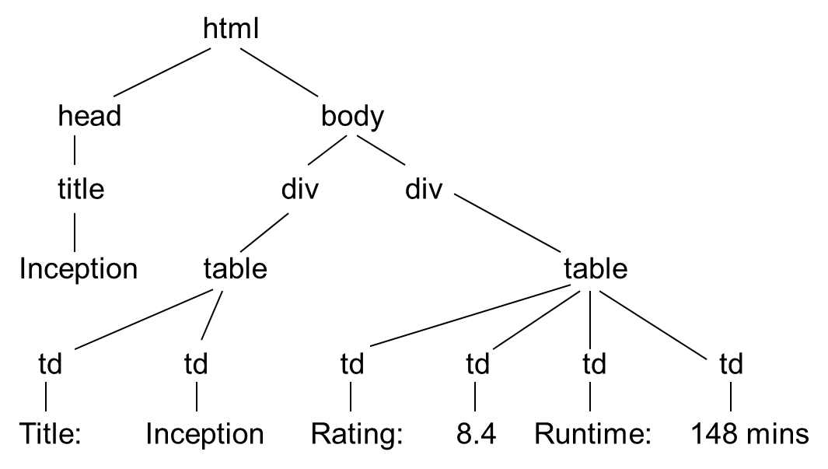
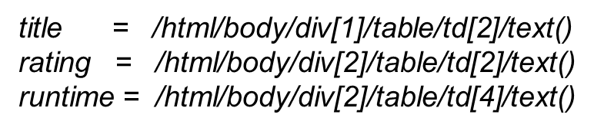
Manual Wrapper Construction
There are multiple ways to view a page
as a string ➔ write wrapper as Python program
as a DOM tree ➔ write wrapper using XPath
as a visual page, consisting of blocks

Slide 11
Some Scrapping Libraries
BeautifulSoup: Python library for web scraping
https://www.crummy.com/software/BeautifulSoup/
Jsoup: Java library for web scraping
http://jsoup.org/
Scrapy.org: Crawler and extraction framework
Dryscrape:
https://github.com/niklasb/dryscrape
Spynner: Embedded web browser to deal with Javascript
https://github.com/makinacorpus/spynner
https://www.quora.com/Which-are-some-of-the-best-web-data-scraping-tools
Tell us if you find a good one!
[BTW, check if there is an API before scraping!!!]

Slide 12
Manual Wrapper Construction
Regardless of page model (string, DOM tree, visual, etc.), using a low-level procedural language to write EW can be very laborious
High-level wrapper languages have been proposed
E.g., HLRT language
see the next part on learning
Using high-level language often result in loss of expressiveness
But they are often easier to understand, debug, and maintain

Slide 13
Wrapper Induction
Problem description:
Web sources present data in human-readable format
take user query
apply it to data base
present results in “template” HTML page
To integrate data from multiple sources, one must first extract relevant information from Web pages
Task: learn extraction rules based on labeled examples
Hand-writing rules is tedious, error prone, and time consuming

Slide 14
Wrapper Induction from Examples
Wrapper Induction Systems
WIEN:
The rules
Learning WIEN rules
STALKER [Muslea, Minton, Knoblock, 1999, 2001]
The rules
The ECTs
Learning the rules
Wrapper validation and maintenance

Slide 15
WIEN [Kushmerick et al 1997, 2000]
Assumes items are always in fixed, known order
… Name: J. Doe; Address: 1 Main; Phone: 111-1111. <p>
Name: E. Poe; Address: 10 Pico; Phone: 777-1111. <p> …
Introduces several types of wrappers
LR:
Name:
; :
Addr
; :
Phone
.
Name
Notes:
Our objective is to learn the structure of common data fields, such as street addresses. One way to represent information is as a sequence of characters, such as a regular expression. This description is very powerful; however, many common data types don’t have a well defined grammar, or it may be computationally expensive to learn it.
Another way to represent information is as a collection of global features, such as the number of words and the density of numeric characters. These descriptions can be learned very quickly, but we believe that representation level is too coarse for some information management tasks.
We propose an intermediate token-level representation that balances the descriptive power and specificity of the character-level representation with the compactness and computational efficiency of the global representation.

Slide 16
Wrapper Types
LR
L and R delimit each of the k attributes
HLRT
Two additional strings:
H marks the end of the header
T marks the beginning of the tail
BELR
B & E mark the beginning and end of each tuple (row of data in the page)
HBELRT
??

Slide 17
Learning Extraction Rules
Machine learning:
Goal: Find a instance of the given wrapper type that covers the given examples
INPUT:
Labeled examples: training & testing data
Admissible rules (hypotheses space)
Search strategy
Desired output:
Rule that performs well both on training and testing data
Termination
Train on sufficient data to be probably approximately correct (PAC)

Slide 18
Learning LR extraction rules
<html> Name:<b> Kim’s </b> Phone:<b> (800) 757-1111 </b> …
<html> Name:<b> Joe’s </b> Phone:<b> (888) 111-1111 </b> …

Slide 19
Learning LR extraction rules
Admissible rules:
prefixes & suffixes of items of interest
Search strategy:
start with shortest prefix & suffix, and expand until correct
<html> Name:<b> Kim’s </b> Phone:<b> (800) 757-1111 </b> …
<html> Name:<b> Joe’s </b> Phone:<b> (888) 111-1111 </b> …

Slide 20
Learning LR extraction rules
Admissible rules:
prefixes & suffixes of items of interest
Search strategy:
start with shortest prefix & suffix, and expand until correct
<html> Name:<b> Kim’s </b> Phone:<b> (800) 757-1111 </b> …
<html> Name:<b> Joe’s </b> Phone:<b> (888) 111-1111 </b> …
>
< >
<
Name
Phone

Slide 21
Learning LR extraction rules
Admissible rules:
prefixes & suffixes of items of interest
Search strategy:
start with shortest prefix & suffix, and expand until correct
<html> Name:<b> Kim’s </b> Phone:<b> (800) 757-1111 </b> …
<html> Name:<b> Joe’s </b> Phone:<b> (888) 111-1111 </b> …
b>
< >
<
Name
Phone

Slide 22
Learning LR extraction rules
Admissible rules:
prefixes & suffixes of items of interest
Search strategy:
start with shortest prefix & suffix, and expand until correct
<html> Name:<b> Kim’s </b> Phone:<b> (800) 757-1111 </b> …
<html> Name:<b> Joe’s </b> Phone:<b> (888) 111-1111 </b> …
b>
< b>
<
Name
Phone

Slide 23
Learning LR extraction rules
Admissible rules:
prefixes & suffixes of items of interest
Search strategy:
start with shortest prefix & suffix, and expand until correct
<html> Name:<b> Kim’s </b> Phone:<b> (800) 757-1111 </b> …
<html> Name:<b> Joe’s </b> Phone:<b> (888) 111-1111 </b> …
b>
< <b>
<
Name
Phone

Slide 24
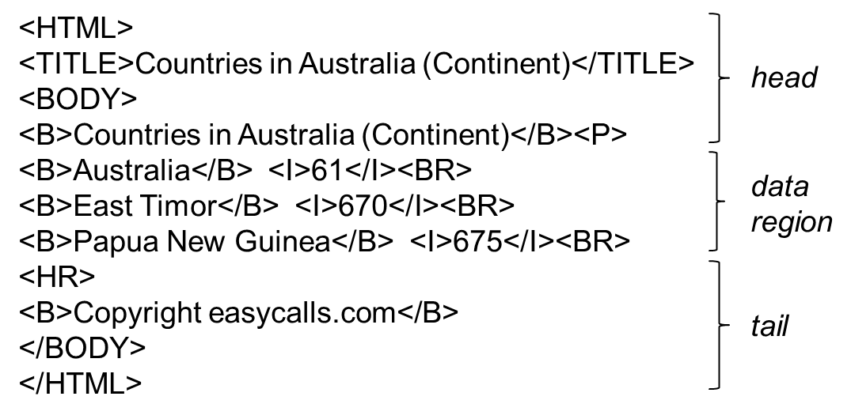

HLRT Wrappers
Use string delimiters to specify how to extract tuples
To extract (country, code), an HLRT wrapper can
chop off the head using <P>, chop off the tail using <HR>
extract strings between <B> and </B> in the data region as countries, and between <I> and </I> as codes

Slide 25
Labeling Data
Instead of labeling all of the data, use recognizers to find instances of a particular attribute
Recognizers may be:
Perfect
Accept all positive instances and reject all negatives
Incomplete
Reject all negative instances but reject some positives
Unsound
Accept all positive, but accept some negatives
Unreliable
Reject some positive instances and accept some negatives

Slide 26
Summary
Advantages:
Fast to learn & extract
Some sources could be labeled automatically given an appropriate set of recognizers
Drawbacks:
Cannot handle permutations and missing items
Entire page must be labeled
Requires large number of examples
Do not handle nested structures

Slide 27
In this part of the lecture …
Wrapper Induction Systems
WIEN:
The rules
Learning WIEN rules
The STALKER approach to wrapper induction
The rules
The ECTs
Learning the rules
Wrapper validation and maintenance

Slide 28
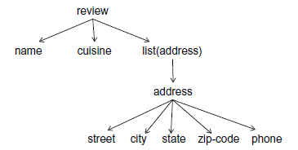
STALKER [Muslea et al, ’98 ’99 ’01]
Hierarchical wrapper induction
Can extract nested structures
assumes nested schema is given as input
Decomposes a hard problem in several easier ones
Extracts items independently of each other
Each rule is a finite automaton

Slide 29
Embedded Catalog Tree (ECT)
RESTAURANT
Name List ( Locations ) Cuisine
City List (PhoneNumbers)
AreaCode Phone
Name: KFC
Cuisine: Fast Food
Locations:
Venice (310) 123-4567,
(800) 888-4412.
L.A. (213) 987-6543.
Encino (818) 999-4567,
(888) 727-3131.
ECT = Nested Schema

Slide 30
Learning the Extraction Rules
GUI
Inductive
Learning
System
Extraction
Rules
Labeled Pages
EC Tree

Slide 31
STALKER: Wrapper Architecture
Query
Data
Information Extractor
EC Tree
Extraction
Rules

Slide 32
Extraction Rules
Extraction rule: sequence of landmarks
SkipTo(Phone) SkipTo(<i>)
SkipTo(</i>)
Name: Joel’s <p> Phone: <i> (310) 777-1111 </i><p> Review: …

Slide 33
Extraction Rules
Name: Joel’s <p> Phone: <i> (310) 777-1111 </i><p> Review: …
Name: Kim’s <p> Phone (toll free) : <b> (800) 757-1111 </b> …
Name: Kim’s <p> Phone:<b> (888) 111-1111 </b><p>Review: …
Start: EITHER SkipTo( Phone : <i> )
OR SkipTo( Phone ) SkipTo(: <b>)

Slide 34
Example of Rule Induction
Training Examples:
Name: Del Taco <p> Phone (toll free) : <b> ( 800 ) 123-4567 </b><p>Cuisine ...
Name: Burger King <p> Phone : ( 310 ) 987-9876 <p> Cuisine: …

Slide 35
Example of Rule Induction
Training Examples:
Name: Del Taco <p> Phone (toll free) : <b> ( 800 ) 123-4567 </b><p>Cuisine ...
Name: Burger King <p> Phone : ( 310 ) 987-9876 <p> Cuisine: …
Initial candidate: SkipTo( ( )

Slide 36
Example of Rule Induction
Training Examples:
Name: Del Taco <p> Phone (toll free) : <b> ( 800 ) 123-4567 </b><p>Cuisine ...
Name: Burger King <p> Phone : ( 310 ) 987-9876 <p> Cuisine: …
SkipTo( <b> ( ) ... SkipTo(Phone) SkipTo( ( ) ... SkipTo(:) SkipTo(()
Initial candidate: SkipTo( ( )

Slide 37
Example of Rule Induction
Training Examples:
Name: Del Taco <p> Phone (toll free) : <b> ( 800 ) 123-4567 </b><p>Cuisine ...
Name: Burger King <p> Phone : ( 310 ) 987-9876 <p> Cuisine: …
Initial candidate: SkipTo( ( )
… SkipTo(Phone) SkipTo(:) SkipTo( ( ) ...
SkipTo( <b> ( ) ... SkipTo(Phone) SkipTo( ( ) ... SkipTo(:) SkipTo(()

Slide 38
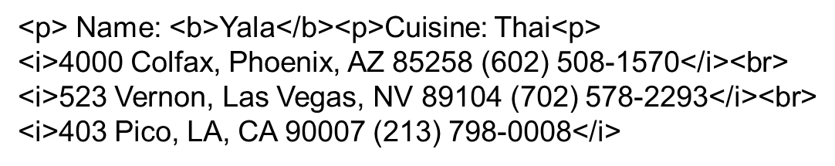
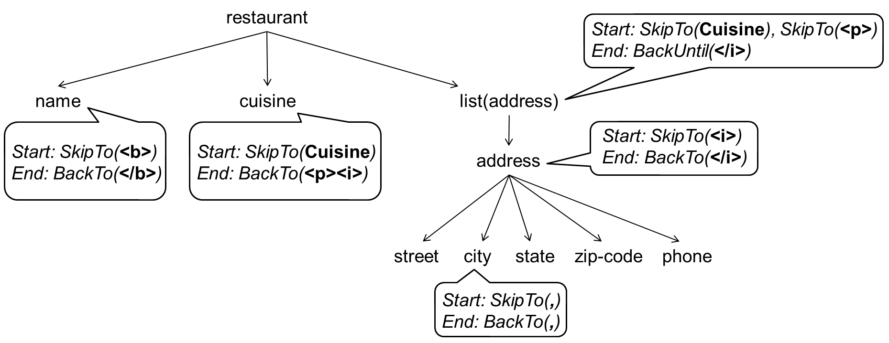
An Example of Executing the Wrapper
Iterate: (*)
(*) Within lists, Stalker iterates between the landmarks to find the boundaries of the list of records. So it repeatedly looks for <i> to find the beginning of records, and </i> to find the ends.

Slide 39
An Example of Executing the Wrapper
Iterate: (*)
(*) Within lists, Stalker iterates between the landmarks to find the boundaries of the list of records. So it repeatedly looks for <i> to find the beginning of records. Once it has found the beginnings, then it looks for end landmarks, within each record

Slide 40
Active Learning & Wrappers
Active Learning
Idea: system selects most informative examples to label
Advantage: fewer examples to reach same accuracy
Wrappers
One wrapper may use hundreds of extraction rules
Small reduction of examples per rule => big impact on user
Need more than 95% accuracy!
That would be 5% incorrect data
Select most informative examples to get to 100% accuracy

Slide 41
Which example should be labeled next?
SkipTo( Phone: )
Training Examples
Name: Joel’s <p> Phone: (310) 777-1111 <p>Review: The chef…
Name: Kim’s <p> Phone: (213) 757-1111 <p>Review: Korean …
Unlabeled Examples
Name: Chez Jean <p> Phone: (310) 666-1111 <p> Review: …
Name: Burger King <p> Phone:(818) 789-1211 <p> Review: ...
Name: Café del Rey <p> Phone: (310) 111-1111 <p> Review: ...
Name: KFC <p> Phone:<b> (800) 111-7171 </b> <p> Review:...

Slide 42
Multi-view Learning
Two ways to find start of the phone number:
SkipTo( Phone: )
BackTo( ( Number ) )
Name: KFC <p> Phone: (310) 111-1111 <p> Review: Fried chicken …

Slide 43
Multi-view Learning: Co-Testing
+
-
Labeled data
RULE 1
RULE 2
Unlabeled data
+
-
+
+
-
-

Slide 44
Co-Testing for Wrapper Induction
SkipTo( Phone: )
BackTo( (Number) )
Name: Joel’s <p> Phone: (310) 777-1111 <p>Review: ...
Name: Kim’s <p> Phone: (213) 757-1111 <p>Review: ...
Name: Chez Jean <p> Phone: (310) 666-1111 <p> Review: ...
Name: Burger King <p> Phone: (818) 789-1211 <p> Review: ...
Name: Café del Rey <p> Phone: (310) 111-1111 <p> Review: ...
Name: KFC <p> Phone:<b> (800) 111-7171 </b> <p> Review:...

Slide 45
Not all queries are equally informative
SkipTo(Phone:)
BackTo( (Nmb) )
… Phone: (800) 171-1771 <p> Fax: (111) 111-1111 <p> Review: …
… Phone:<i> (310) 399-4275 </i><p> Review: In (1891) , this …

Slide 46
Weak Views
Learn “content description” for item to be extracted
Too general for extraction
( Nmb ) Nmb – Nmb can’t tell a phone number from a fax number
Useful at discriminating among query candidates
Learned field description
Starts with: ( Nmb )
Ends with: Nmb – Nmb
Contains: Nmb Punct
Length: [6,6]

Slide 47
Naïve & Aggressive Co-Testing
Naïve Co-Testing:
Query: randomly chosen contention point
Output: rule with fewest mistakes on queries
Aggressive Co-Testing:
Query: contention point that most violates weak view
Output: committee vote (2 rules + weak view)

Slide 48
Empirical Results: 33 Difficult Tasks
33 most difficult of the 140 extraction tasks
Each view: > 7 labeled examples for best accuracy
At least 100 examples for task

Slide 49
Results in 33 Difficult Domains
Extraction
Tasks

Slide 50
Results in 33 Difficult Domains
Extraction
Tasks

Slide 51
Results in 33 Difficult Domains
Extraction
Tasks

Slide 52
Summary
Advantages:
Powerful extraction language (eg, embedded list)
One hard-to-extract item does not affect others
Disadvantage:
Does not exploit item order (sometimes may help)

Slide 54
Automatic Wrapper Generation
Craig Knoblock
University of Southern California

Slide 55
Automatic Data Extraction
Learning wrappers for data extraction
Users specifies the schema of the information source
Single tuple
Nested type
List of tuples or nested types
Labels data on several example HTML pages
Tedious, especially for lists
Goal of Automatic Data Extraction is to eliminate user intervention
Automatically generate wrappers to extract data from Web pages
cf Information Extraction: Automatically extracts data from text

Slide 56
Overview
Methods for automatic wrapper generation and data extraction
Grammar Induction approach
Towards Automatic Data Extraction from Large Web Sites
Website structure-based approach
AutoFeed: An Unsupervised Learning System for Generating Webfeeds
Notes:
DOM-based:
Simile/Piggybank

Slide 57
Grammar Induction Approach
Pages automatically generated by scripts that encode results of db query into HTML
Script = grammar
Given a set of pages generated by the same script
Learn the grammar of the pages
Wrapper induction step
Use the grammar to parse the pages
Data extraction step

Slide 58
Limitations
Learnable grammars
Union-Free Regular Expressions (RoadRunner)
Variety of schema structure: tuples (with optional attributes) and lists of (nested) tuples
Does not efficiently handle disjunctions – pages with alternate presentations of the same attribute
Context-free Grammars
Limited learning ability
User needs to provide a set of pages of the same type

Slide 59
Website Structure-based Approach
Websites attempt to simplify user navigation and interaction with data by organizing how data is presented across the site
Hierarchical organization
List of results
Detail pages …
Machine learning methods take advantage of structure to extract data

Slide 60
RoadRunner: Towards Automatic Data Extraction from Large Web Sites by Crescenzi, Mecca, & Merialdo

Slide 61
RoadRunner Overview
Automatically generates a wrapper from large web pages
Pages of the same class
No dynamic content from javascript, ajax, etc
Infers source schema
Supports nested structures and lists
Extracts data from pages
Efficient approach to large, complex pages with regular structure
Notes:
“given a set of sample HTML pages belonging to the same class, find the nested type of the source dataset and extract the source dataset from which the
pages have been generated.”

Slide 62
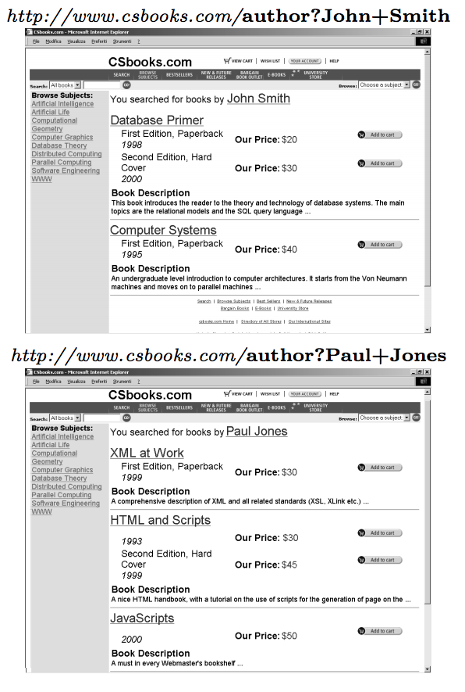
Example Pages
Compares two pages at a time to find similarities and differences
Infers nested structure (schema) of page
Extracts fields

Slide 63
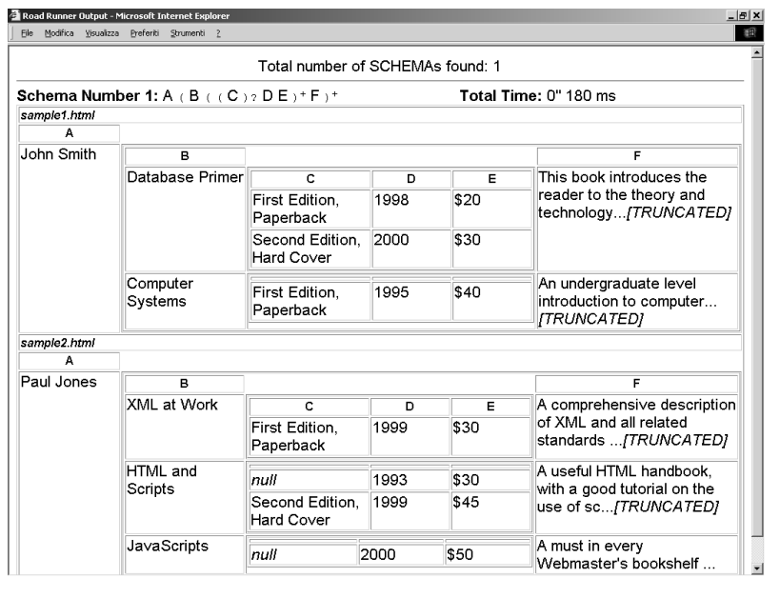
Extracted Result

Slide 64
Union-Free Regular Expression (UFRE)
Web page structure can be represented as Union-Free Regular Expression (UFRE)
UFRE is Regular Expressions without disjunctions
If a and b are UFRE, then the following are also UFREs
a.b
(a)+
(a)?

Slide 65
Union-Free Regular Expression (UFRE)
Web page structure can be represented as Union-Free Regular Expression (UFRE)
UFRE is Regular Expressions without disjunctions
If a and b are UFRE, then the following are also UFREs
a.b → string fields
(a)+ → lists (possibly nested)
(a)? → optional fields
Strong assumption that usually holds

Slide 66
Approach
Given a set of example pages
Generate the Union-Free Regular Expression which contains example pages
Find the least upper bounds on the RE lattice to generate a wrapper in linear time
Reduces to finding the least upper bound on two UFREs

Slide 67
Matching/Mismatches
Given a set of pages of the same type
Take the first page to be the wrapper (UFRE)
Match each successive sample page against the wrapper
Mismatches result in generalizations of wrapper
String mismatches
Tag mismatches

Slide 68
Matching/Mismatches
Given a set of pages of the same type
Take the first page to be the wrapper (UFRE)
Match each successive sample page against the wrapper
Mismatches result in generalizations of wrapper
String mismatches
Discover fields
Tag mismatches
Discover optional fields
Discover iterators

Slide 69
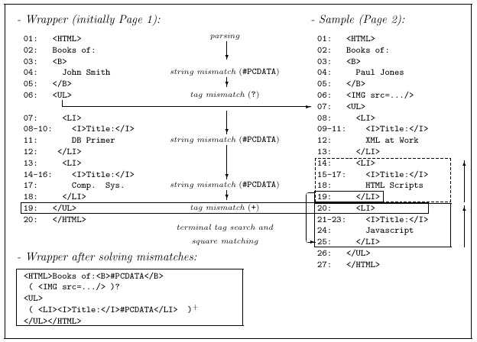
Example Matching
Notes:
Matching algorithm parses the sample using the wrapper. Mismatch happens when a token in the sample does not correspond to toke nin the wrapper.

Slide 70
String Mismatches: Discovering Fields
String mismatches are used to discover fields of the document
Wrapper is generalized by replacing “John Smith” with #PCDATA
<HTML>Books of: <B>John Smith
→ <HTML> Books of: <B>#PCDATA

Slide 71
Example Matching

Slide 72
Tag Mismatches: Discovering Optionals
First check to see if mismatch is caused by an iterator (described next)
If not, could be an optional field in wrapper or sample
Cross search used to determine possible optionals
Image field determined to be optional:
( <img src=…/>)?

Slide 73
Example Matching
String Mismatch
String Mismatch

Slide 74
Tag Mismatches: Discovering Iterators
Assume mismatch is caused by repeated elements in a list
End of the list corresponds to last matching token: </LI>
Beginning of list corresponds to one of the mismatched tokens: <LI> or </UL>
These create possible “squares”
Match possible squares against earlier squares
Generalize the wrapper by finding all contiguous repeated occurrences:
( <LI><I>Title:</I>#PCDATA</LI> )+

Slide 75
Example Matching

Slide 76
Internal Mismatches
Generate internal mismatch while trying to match square against earlier squares on the same page
Solving internal mismatches yield further refinements in the wrapper
List of book editions
<I>Special!</I>

Slide 77
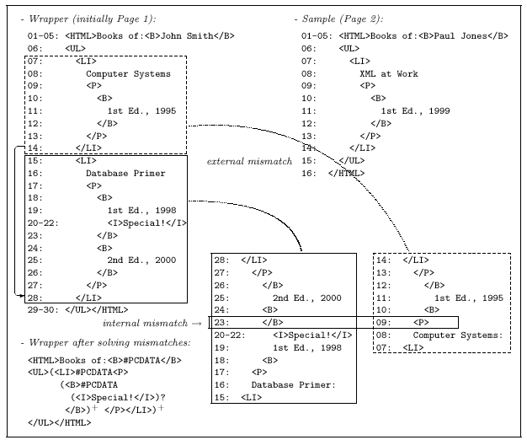
Recursive Example

Slide 78
Discussion
Assumptions:
Pages are well-structured
Structure can be modeled by UFRE (no disjunctions)
Search space for explaining mismatches is huge
Uses a number of heuristics to prune space
Limited backtracking
Limit on number of choices to explore
Patterns cannot be delimited by optionals
Will result in pruning possible wrappers

Slide 80
Wrapper Maintenance
Problem
Landmark-based extraction rules are fast and efficient…
but they rely on stable Web Page layout
If the page layout changes, the wrapper fails!
The average site on the Web changes layout more than twice a year
Requirement:
Need to detect changes and automatically re-induce extraction rules when layout changes

Slide 81
Learning Regular Expressions [Goan, Benson, & Etzioni, 1996]
Character level description of extracted data
Based on ALERGIA [Carrasco and Oncina, 1994]
Stochastic grammer induction algorithm
Merges too many states resulting in over-general grammar
WIL reduced faulty merges by imposing syntactic categories:
Number, lower upper, and delim
Only merges when nodes contain the same syntactic category
Requires large number of examples to learn
Computationally expensive
Notes:
Our objective is to learn the structure of common data fields, such as street addresses. One way to represent information is as a sequence of characters, such as a regular expression. This description is very powerful; however, many common data types don’t have a well defined grammar, or it may be computationally expensive to learn it.
Another way to represent information is as a collection of global features, such as the number of words and the density of numeric characters. These descriptions can be learned very quickly, but we believe that representation level is too coarse for some information management tasks.
We propose an intermediate token-level representation that balances the descriptive power and specificity of the character-level representation with the compactness and computational efficiency of the global representation.

Slide 82
Learning Global Properties for Wrapper Verification [Kushmerick, 1999]
Each data field described by a numeric features
Word count
Average word length
HTML density
Alphabetic density
Computationally efficient
Features are global (computed over all fields)
Notes:
Our objective is to learn the structure of common data fields, such as street addresses. One way to represent information is as a sequence of characters, such as a regular expression. This description is very powerful; however, many common data types don’t have a well defined grammar, or it may be computationally expensive to learn it.
Another way to represent information is as a collection of global features, such as the number of words and the density of numeric characters. These descriptions can be learned very quickly, but we believe that representation level is too coarse for some information management tasks.
We propose an intermediate token-level representation that balances the descriptive power and specificity of the character-level representation with the compactness and computational efficiency of the global representation.

Slide 83
Learned Features
Extracted data (wrapper working correctly)
(Kim’s, (800) 757-1111)
(John’s, (888) 111-1111)
Name field
Average word count = 1
Average word length = 5.5
Alphabetic density =(4/5+5/6)/2=0.82
Phone field
Average word count = 2 (depends on tokenization)
Average word length = 6.5
Alphabetic density = 0.74

Slide 84
Using Learned Features to Verify Wrappers
Learn features on one set of data extracted when wrapper is working correctly
See if learned features apply to new data

Slide 85
Learned Features
Extracted data (page changed)
( , Kim’s)
( , John’s)
Name field
Average word count = 0 (was 1)
Average word length = 0 ( was 5.5)
Alphabetic density = 0 (was 0.82)
Phone field
Average word count = 1 (was 2)
Average word length = 4 (was 6.5)
Alphabetic density = 0.8 (was 0.74)

Slide 86
Learned Features
Extracted data → wrapper not working correctly
( , Kim’s)
( , John’s)
Name field
Average word count = 0 (was 1)
Average word length = 0 ( was 5.5)
Alphabetic density = 0 (was 0.82)
Phone field
Average word count = 1 (was 2)
Average word length = 4 (was 6.5)
Alphabetic density = 0.8 (was 0.74)

Slide 87
Using Learned Features to Verify Wrappers
Evaluated on a data set consisting of pages which have changed
HTML density alone could account for many changes in the test set
Large number of false negatives on real changes to web sources [Lerman, Knoblock, Minton, 2002]

Slide 88
Learning Data Prototypes [Lerman & Minton, 2000]
Approach to learning the structure of data
Token level syntactic description
descriptive but compact
computationally efficient
Structure is described by a sequence of general and specific tokens – pattern
Phone
(310) 448-8714
(310) 448-8775
(424) 555-1212
start with:
(Number)
end with:
Number-Number
Notes:
We claim that the structure of many common data types can be described by a sequence of specific and general tokens, or a pattern. For complex data fields it is sufficient to use only the starting and ending patterns as the description of the data field.
The collection of starting and ending patterns is data prototype.

Slide 89
Learning Data Prototypes [Lerman & Minton, 2000]
Also can apply to data with less structure
STREET_ADDRESS
220 Lincoln Blvd
420 S Fairview Ave
2040 Sawtelle Blvd
start with:
_NUM _CAPS
end with:
_CAPS Blvd
_CAPS _CAPS
Notes:
We claim that the structure of many common data types can be described by a sequence of specific and general tokens, or a pattern. For complex data fields it is sufficient to use only the starting and ending patterns as the description of the data field.
The collection of starting and ending patterns is data prototype.

Slide 90
Token Syntactic Hierarchy
Tokens = words
Syntactic types
e.g., NUMBER, ALPHA
Hierarchy of types
allows generalization
Extensible
new types
domain-specific information
TOKEN
PUNCT
ALPHANUM
HTML
ALPHA
NUM
CAPS
LOWER
310
ALLCAPS
apple
Notes:
Tokens are words that contain different types of characters. We use the token's character types to assign it to one or more general syntactic types: numeric, alphabetic, etc. These types form a hierarchy depicted in the Figure, where the arrows point from more general to more specific types. This allows for multi-level generalization. Thus, the token “apple” belongs to the specific type representing the word “apple”, as well as to general types of lowercased words, alphabetic as well as alphanumeric strings.
This representation is flexible and may be extended to include new types and domain specific information.

Slide 91
Prototype Learning Algorithm
No explicit negative examples
Learn from positive examples of data
Find patterns that
describe many of the positive examples of data
highly unlikely to describe a random token sequence (implicit negative examples)
are statistically significant patterns
at α=0.05 significance level
DataPro – efficient (greedy) algorithm
Notes:
We do not have a source of explicit negative examples for each data field; therefore, we chose to frame the learning problem as learning from positive examples alone. The learning problem is to find the patterns that describe many of the positive examples of data but are highly unlikely to describe a random sequence of tokens. In this statement, all possible randomly generated sequences of tokens are treated as implicit negative examples.
Stated this way, the learning problem is to find statistically significant patterns, I.e. those that describe a significant number of positive examples and are unlikely to have been generated by chance. We use hypothesis testing at 5% significance level to determine whether a sequence of tokens is significant.
In the next slide, we introduce DataPro – a greedy algorithm that finds significant patterns in a set of token sequences.

Slide 92
DataPro Algorithm
Process examples
Seed patterns
Specialize patterns loop
Extend the pattern
find a more specific description
is the longer pattern significant given the shorter pattern?
Prune generalizations
is the pattern ending with general type significant given the patterns ending with specific tokens
Examples:
220 Lincoln Blvd
420 S Fairview Ave
2040 Sawtelle Blvd
_NUM
_CAPS
_AL
Blvd
_CAPS
_AL
Notes:
During the preprocessing step, the examples are tokenized, or broken into separate words. Each token is assigned to one or more general types and a specific type. Each token’s baseline probability is calculated from the proportion of tokens in the examples that are of that type.
The algorithm starts by seeding the starting patterns, or finding a token with which a significant number of the examples start. Consider the examples of address I used earlier. Each example starts with a different number token; therefore, general type _NUMBER is a good seed.
Next, the algorithm tries to specialize the pattern by alternately extending the pattern and pruning nonsignificant generalizations. In the examples given here, the number token is followed by an ALPHABETIC token and by CAPITALIZED token. It can also be followed by the token “Lincoln”, “S” and “Sawtelle”, but since each of these tokens appears only once, it cannot be significant.
Next, we prune generalizations. The pattern NUMBER followed by ALPHABETIC token is a generalization of the pattern NUMBER followed by a CAPITALIZED word. Because the more general pattern does not describe significantly more examples than the specific pattern, we delete this token from the tree.
We can extend the remaining pattern further. The tokens that follow the sequence NUMBER CAPS are ALPHA, CAPS, and a specific token “Blvd”. We can prune ALPHA again because it does not describe any extra examples. However, we chose to keep the pattern NUM CAPS CAPS because it describes 3 examples and the pattern NUM CAPS Blvd because it describes 2 of the examples.
Pruning introduces a bias for the specific patterns into the algorithm, but it also makes the algorithm efficient by preventing the tree from growing too wide.

Slide 93
Examples: PHONE
( 310 ) 577 - 8182
( 310 ) 652 - 9770
( 310 ) 396 - 1179
( 310 ) 477 - 7242
( 626 ) 792 - 9779
( 310 ) 823 - 4446
( 323 ) 870 - 2872
( 310 ) 855 - 9380
( 310 ) 578 - 2293
( 310 ) 392 - 5751
( 805 ) 683 - 8864
( 310 ) 301 - 1004
( 626 ) 793 - 8123
( 310 ) 822 - 1511
starting patterns:
( _NUM ) _NUM - _NUM
ending patterns:
( _NUM ) _NUM - _NUM
Notes:
A simpler example with lots of structure. The learned patterns resemble regular expressions.

Slide 94
Example: STREET_ADDRESS
13455 Maxella Ave
903 N La Cienega Blvd
110 Navy St
2040 Sawtelle Blvd
87 E Colorado Blvd
4325 Glencoe Ave
2525 S Robertson Blvd
998 S Robertson Blvd
523 Washington Blvd
220 Lincoln Blvd
420 S Fairview Ave
13490 Maxella Ave
363 S Fair Oaks Ave
4676 Admiralty Way
starting patterns:
_NUM S _CAPS Blvd
_NUM _CAPS Ave
_NUM _CAPS
ending patterns:
_NUM _CAPS _CAPS
_NUM S _CAPS Blvd
_NUM _CAPS Ave
_NUM _CAPS Blvd

Slide 95
Wrapper Verification
Data prototypes can be used for web wrapper maintenance applications.
Automatically detect when the wrapper is no longer correctly extracting data from an information source
(Kushmerick 1999)
Notes:
For the remainder of the talk I will show how data prototypes can be used for wrapper maintenance applications.
As I described earlier, Web wrappers use the layout of HTML pages in order to extract data, so if the layout of the page changes, the wrapper may stop extracting correctly. The wrapper verification task is to determine whether the wrapper is correctly extracting data from an information source.

Slide 96
Going back to our example
Extracted data
(Kim’s, (800) 757-1111)
(John’s, (888) 111-1111)
Patterns
Name: _CAPS
Describes 2 examples of Name
Phone: ( _NUM ) _NUM - _NUM
Describes 2 examples of Phone
New data extracted by wrapper
( , Kim’s)
( , John’s)

Slide 97
Wrapper Verification
Given
Set of correct old examples of data
Set of new examples
Do the patterns describe the same proportions of new examples as old examples?
old exs
new exs
% of examples
patterns
Notes:
The verification task can be stated in the following way. Given a set of old examples that are known to be correct, and a set of test examples extracted by the wrapper from the new pages. Do the patterns learned from the old examples describe the same number of the new examples? If yes, the wrapper is extracting correctly, otherwise, the source may have changed.
Learn data prototypes for the old examples. Each tickmark on the horizontal axis corresponds to a different pattern.
Compute the proportion of the old examples described by each pattern.
Compute the distribution of new examples over the patterns
If two distributions are statistically diferent, the wrapper is not extracting correctly.
Goodness of fit method to decide whether the two distributions are the same.

Slide 98
Wrapper Verification
Results
Monitored 27 wrappers (23 distinct sources)
There were 37 changes over ~ 1 year
Algorithm discovered 35/37 changes with 15 mistakes
13 false positives
Overall:
Average precision = 73%
Average recall = 95%
Average accuracy = 97%
Notes:
Though the precision was low, the recall and overall accuracy are high.
Several factors were responsible for the high number of false positives. The main reason the distributions differed was because of changes in the experimental setup. These included changes in the query set, either because new queries were added or for dated queries, they were modified. Another experimental factor was Web site performance, if the web site was too slow, the wrapper did not get results for every single query.
A more interesting reason for false positive was a few cases in which the data on the web site has actually changed. For example, we were extracting company names with one wrapper, and when the name of one of the companies changed, we detected this as a wrapper change. In another case, on amazon site, the availability of several books changed from “Ships in 24 hours” to “Ships in 2-3 days”. This was also detected as a wrapper change. We are investigating methods that will decrease the rate of false positives in wrapper verification.

Slide 99
Wrapper Reinduction
Rebuild the wrapper automatically if it is not extracting data correctly from new pages
Data extraction step
Identify correct examples of data on new pages
Wrapper induction step
Feed the examples, along with the new pages, to the wrapper induction algorithm to learn new extraction rules
Notes:
Once we have determined that the wrapper is not working correctly, the next task is to rebuild it automatically. This task involves identifying correct examples of data on the new changed pages and feeding these examples, along with the new pages to the wrapper induction algorithm, which will learn the new extraction rules.

Slide 100
The Lifecycle of A Wrapper
To be
labeled
Web
pages
GUI
Extracted
data
Wrapper
Induction
System
Wrapper
Automatic
Re-labeling
Wrapper
Verification

Slide 101
Automatic Relabeling Algorithm
Given a set of examples of a field, learn patterns describing it
Used learned patterns to extract all matching strings on the new pages (possible candidates of a field)
Group candidates by context
Context= neighboring landmarks
Candidates surrounded by the same landmarks grouped together
Score the group by degree of overlap with old examples
High score if contains some of the same strings as the old examples

Slide 102
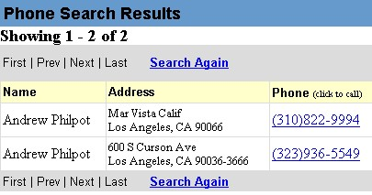
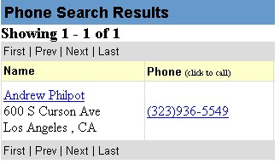
Example Source Change

Slide 103
Whitepages Wrapper
…
NAME item
Begin_Rule
__ST__ _*_
End_Rule
__ST__ </td> <td nowrap >
ADDRESS item
Begin_Rule
__ST__ </td> <td nowrap >
End_Rule
__ST__ <br>
…
NAME ADDRESS CITY
Andrew Philpot Mar Vista Calif Los Angeles
Andrew Philpot 600 S Curson Ave Los Angeles

Slide 104
Wrapper Applied to Changed Source
…
NAME item
Begin_Rule
__ST__ _*_
End_Rule
__ST__ </td> <td nowrap >
ADDRESS item
Begin_Rule
__ST__ </td> <td nowrap >
End_Rule
__ST__ <br>
…
NAME ADDRESS CITY
NIL NIL 600 S Curson Ave<BR> Los Angeles

Slide 105
After Reinduction
…
NAME item
Begin_Rule
__ST__ _*_
End_Rule
__ST__ </a> <br>
ADDRESS item
Begin_Rule
__ST__ </a> <br>
End_Rule
__ST__ <br>
…
NAME ADDRESS CITY
Andrew Philpot 600 S Curson Ave Los Angeles

Slide 106
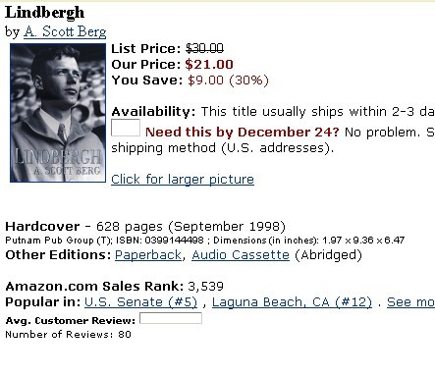
Amazon Source
TITLE item
Begin_Rule
__ST__ " colid "
value = " " > <font size
= + 1 > <b>
End_Rule
__ST__ </b> </font>
<br> by <a href = " /
PRICE item
Begin_Rule
__ST__ <b> Our Price :
<font color = # 990000 > $
End_Rule
__ST__ </font> </b>
<br> _HT
AUTHOR TITLE PRICE AVAILABILITY
A.Scott Berg Lindbergh 21.00 This title usually ships…

Slide 107
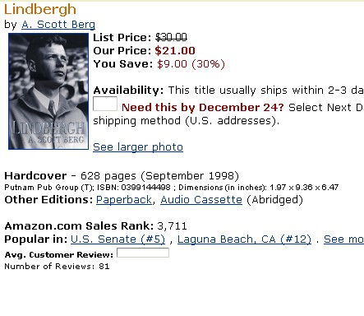
Changed Amazon Source
AUTHOR TITLE PRICE AVAILABILITY
NIL NIL 21.00 This title usually ships…

Slide 108
After Reinduction
TITLE item
Begin_Rule
__ST__ > <strong> <font
color = # CC6600 >
End_Rule
__ST__ </font> </strong>
<font size
PRICE item
Begin_Rule
__ST___ <b> Our Price :
<font color = # 990000 > $
AUTHOR TITLE PRICE AVAILABILITY
A.Scott Berg Lindbergh 21.00 This title usually ships…

Slide 109
Wrapper Reinduction
Results
Monitored 10 distinct sources
There were 8 changes over ~ 1 year
Extracting examples:
277/338 correct (82%)
31 false positives/30 false negatives
Reinduction:
Average recall = 90%
Average precision = 80%
Notes:
Though the precision was low, the recall and overall accuracy are high.
Several factors were responsible for the high number of false positives. The main reason the distributions differed was because of changes in the experimental setup. These included changes in the query set, either because new queries were added or for dated queries, they were modified. Another experimental factor was Web site performance, if the web site was too slow, the wrapper did not get results for every single query.
A more interesting reason for false positive was a few cases in which the data on the web site has actually changed. For example, we were extracting company names with one wrapper, and when the name of one of the companies changed, we detected this as a wrapper change. In another case, on amazon site, the availability of several books changed from “Ships in 24 hours” to “Ships in 2-3 days”. This was also detected as a wrapper change. We are investigating methods that will decrease the rate of false positives in wrapper verification.

Slide 110
Discussion
Flexible data representation scheme
Algorithm to learn description of data fields
Used in wrapper maintenance applications
Limitations:
Needs to be extended to lists and tables
Excellent recall, but lower precision will result in many false positives

