Slide 1
Information Extraction from Unstructured, Ungrammatical Text
Jose Luis Ambite
University of Southern California
Thank you to Matt Michelson, Craig Knoblock for slides

Slide 2
Outline
Introduction
Alignment
Extraction
Results
Discussion

Slide 3
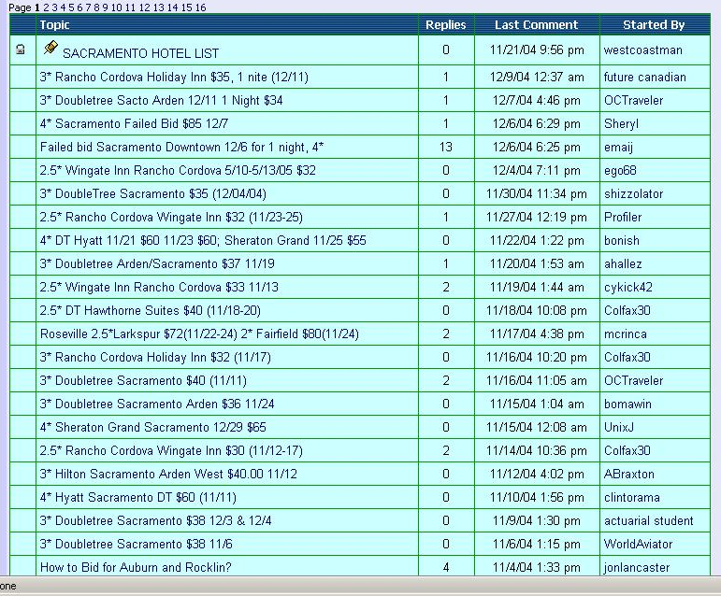
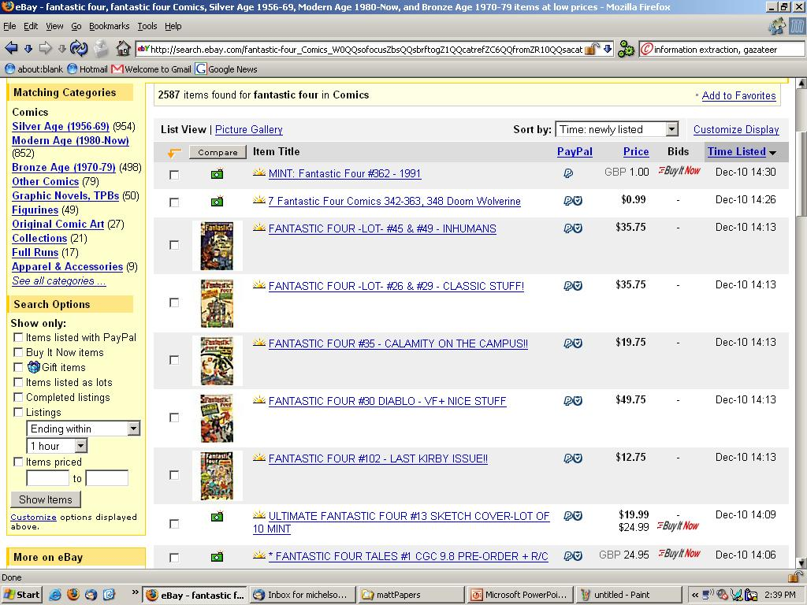
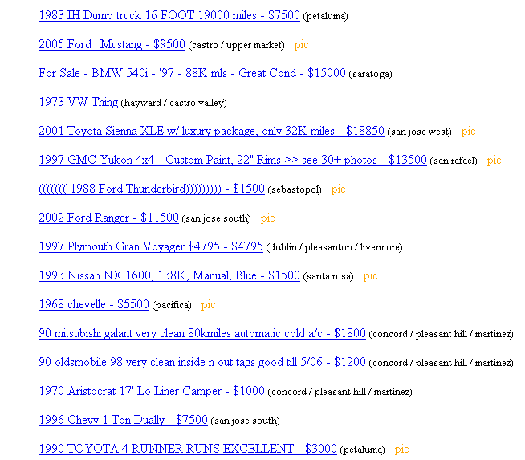
Ungrammatical & Unstructured Text

Slide 4
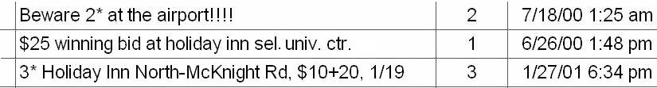
Ungrammatical & Unstructured Text
For simplicity → “posts”
Goal:
<hotelArea>univ. ctr.</hotelArea>
<price>$25</price>
<hotelName>holiday inn sel.</hotelName>
Wrapper based IE does not apply (e.g. Stalker, RoadRunner)
NLP based IE does not apply (e.g. Rapier)

Slide 5
Reference Sets
IE infused with outside knowledge
“Reference Sets”
Collections of known entities and the associated attributes
Online (offline) set of docs
CIA World Fact Book
Online (offline) database
Comics Price Guide, Cars from Edmunds, etc.
Build from ontologies on Semantic Web

Slide 6
Leverage Reference Sets
Align post to a member of the reference set
Exploit the matching member of reference set for extraction/annotation

Slide 7
Algorithm Overview – Use of Ref Sets

Slide 8
Outline
Introduction
Alignment
Extraction
Results
Discussion

Slide 9

Our Record Linkage Problem
Posts not yet decomposed attributes.
Extra tokens that match nothing in Ref Set.
Post:
“$25 winning bid at holiday inn sel. univ. ctr.”
hotel name
hotel area
Reference Set:
Holiday Inn | Greentree
Holiday Inn Select | University Center
Hyatt Regency | Downtown
hotel name
hotel area

Slide 10
Our Record Linkage Solution
P = “$25 winning bid at holiday inn sel. univ. ctr.”
Record Level Similarity + Field Level Similarities
V_{RL} = < RL_scores(P, “Hyatt Regency Downtown”),
RL_scores(P, “Hyatt Regency”),
RL_scores(P, “Downtown”)>
Binary Rescoring
SVM
Best matching member of the reference set for the post

Slide 11
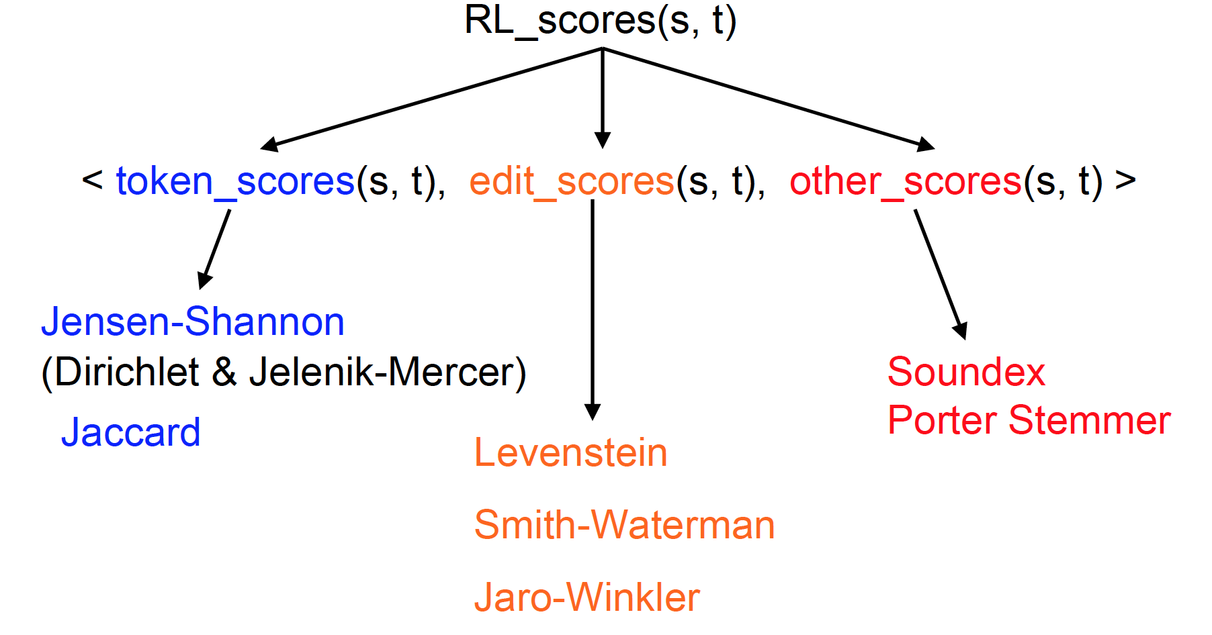
Record Linkage Scores (RL_scores)

Slide 12
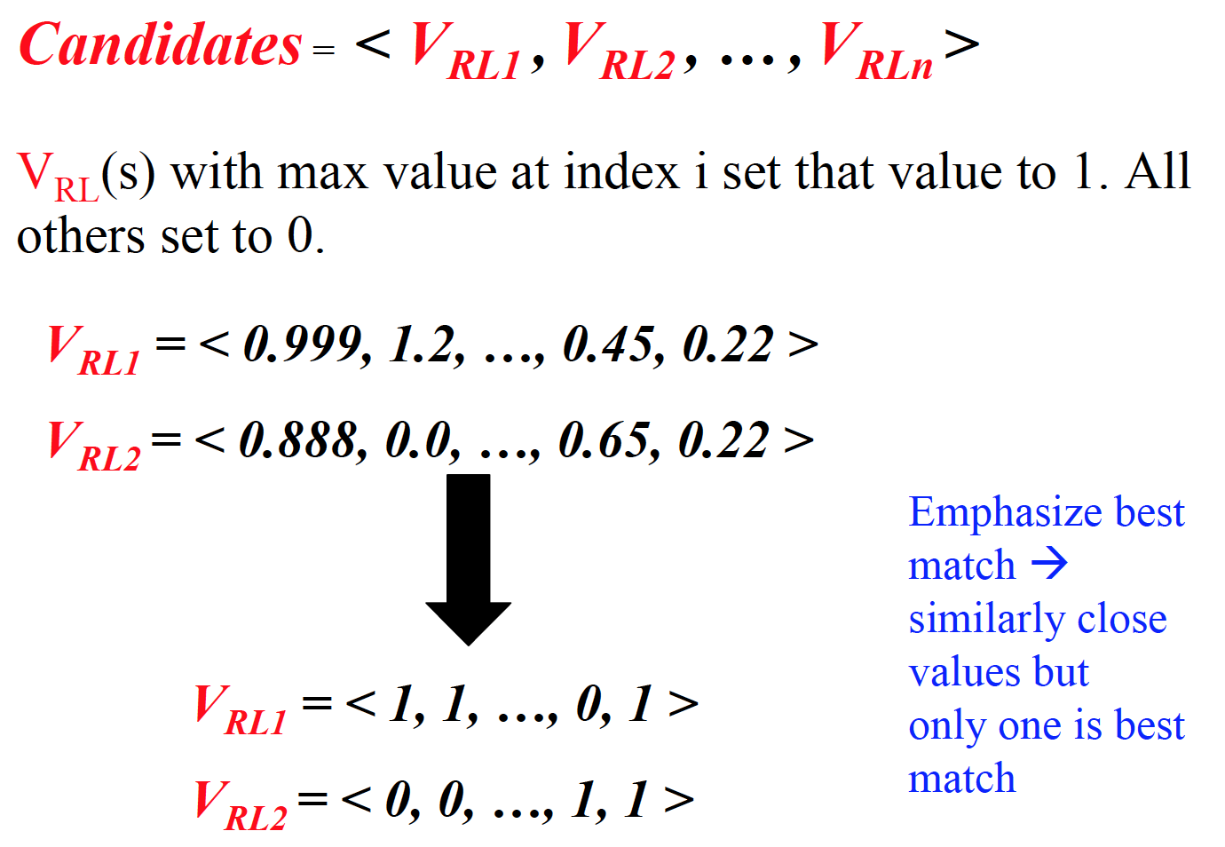
Binary Rescoring

Slide 13
SVM Classification
Support Vector Machine (SVM)
Trained to classify matches/ non-matches
Returns score from decision function
Best Match: Candidate that is a match and has max. score from decision function
1-1 mapping: If more than one candidate with max. score → throw them all away
1-N mapping: If more than one candidate with max. score → keep first one or keep random one w/in set of max.

Slide 14
Last Alignment Step
Return reference set attributes as annotation for the post
Post:
$25 winning bid at holiday inn sel. univ. ctr.
<Ref_hotelName>Holiday Inn Select</Ref_hotelName>
<Ref_hotelArea>University Center</Ref_hotelArea>

Slide 15
Outline
Introduction
Alignment
Extraction
Results
Discussion

Slide 16
Extraction Algorithm
Post:
$25 winning bid at holiday inn sel. univ. ctr.
V_{IE} = <common_scores(token),
IE_scores(token, attr1),
IE_scores(token, attr2),
… >
Generate V_{IE}
Multiclass SVM
$25 winning bid at holiday inn sel. univ. ctr.
price
hotel name
hotel area
$25 holiday inn sel. univ. ctr.
Clean Whole Attribute

Slide 17
Common Scores
Some attributes not in reference set
Reliable characteristics
Infeasible to represent in reference set
E.g. prices, dates
Can use characteristics to extract/annotate these attributes
Regular expressions, for example
These types of scores are what compose common_scores

Slide 18
Outline
Introduction
Alignment
Extraction
Results
Discussion

Slide 19
Experimental Data Sets
Hotels
Posts
1125 posts from www.biddingfortravel.com
Pittsburgh, Sacramento, San Diego
Star rating, hotel area, hotel name, price, date booked
Reference Set
132 records
Special posts on BFT site.
Per area – list any hotels ever bid on in that area
Star rating, hotel area, hotel name

Slide 20
Experimental Data Sets
Comics
Posts
776 posts from EBay
“Incredible Hulk” and “Fantastic Four” in comics
Title, issue number, price, condition, publisher, publication year, description (1st appearance the Rhino)
Reference Sets
918 comics, 49 condition ratings
Both come from ComicsPriceGuide.com
Title, issue number, description, publisher

Slide 21
Comparison to Existing Systems
Record Linkage
WHIRL
RL allows non-decomposed attributes
Information Extraction
Simple Tagger (CRF)
State-of-the-art IE
Amilcare
NLP based IE

Slide 22
Record linkage results
 | Prec. | Recall | F-Measure
Hotel
Phoebus | 93.60 | 91.79 | 92.68
WHIRL | 83.52 | 83.61 | 83.13
Comic
Phoebus | 93.24 | 84.48 | 88.64
WHIRL | 73.89 | 81.63 | 77.57
10 trials – 30% train, 70% test

Slide 23
Token level Extraction results: Hotel domain
 |  | Prec. | Recall | F-Measure | Freq
Area | Phoebus | 89.25 | 87.50 | 88.28 | 809.7
 | Simple Tagger | 92.28 | 81.24 | 86.39
 | Amilcare | 74.2 | 78.16 | 76.04
Date | Phoebus | 87.45 | 90.62 | 88.99 | 751.9
 | Simple Tagger | 70.23 | 81.58 | 75.47
 | Amilcare | 93.27 | 81.74 | 86.94
Name | Phoebus | 94.23 | 91.85 | 93.02 | 1873.9
 | Simple Tagger | 93.28 | 93.82 | 93.54
 | Amilcare | 83.61 | 90.49 | 86.90
Price | Phoebus | 98.68 | 92.58 | 95.53 | 850.1
 | Simple Tagger | 75.93 | 85.93 | 80.61
 | Amilcare | 89.66 | 82.68 | 85.86
Star | Phoebus | 97.94 | 96.61 | 97.84 | 766.4
 | Simple Tagger | 97.16 | 97.52 | 97.34
 | Amilcare | 96.50 | 92.26 | 94.27
Not Significant

Slide 24
Token level Extraction results: Comic domain
 |  | Prec. | Recall | F-Measure | Freq
Condition | Phoebus | 91.8 | 84.56 | 88.01 | 410.3
 | Simple Tagger | 78.11 | 77.76 | 77.80
 | Amilcare | 79.18 | 67.74 | 72.80
Descript. | Phoebus | 69.21 | 51.50 | 59.00 | 504.0
 | Simple Tagger | 62.25 | 79.85 | 69.86
 | Amilcare | 55.14 | 58.46 | 56.39
Issue | Phoebus | 93.73 | 86.18 | 89.79 | 669.9
 | Simple Tagger | 86.97 | 85.99 | 86.43
 | Amilcare | 88.58 | 77.68 | 82.67
Price | Phoebus | 80.00 | 60.27 | 68.46 | 10.7
 | Simple Tagger | 84.44 | 44.24 | 55.77
 | Amilcare | 60.00 | 34.75 | 43.54

Slide 25
Token level Extraction results: Comic domain (cont.)
 |  | Prec. | Recall | F-Measure | Freq
Publisher | Phoebus | 83.81 | 95.08 | 89.07 | 61.1
 | Simple Tagger | 88.54 | 78.31 | 82.83
 | Amilcare | 90.82 | 70.48 | 79.73
Title | Phoebus | 97.06 | 89.90 | 93.34 | 1191.1
 | Simple Tagger | 97.54 | 96.63 | 97.07
 | Amilcare | 96.32 | 93.77 | 94.98
Year | Phoebus | 98.81 | 77.60 | 84.92 | 120.9
 | Simple Tagger | 87.07 | 51.05 | 64.24
 | Amilcare | 86.82 | 72.47 | 78.79

Slide 26
Extraction results: Summary
 | Token Level |  |  | Hotel | Field Level
 | Prec. | Recall | F-Mes. |  | Prec. | Recall | F-Mes.
Phoebus | 93.60 | 91.79 | 92.68 |  | 87.44 | 85.59 | 86.51
Simple Tagger | 86.49 | 89.13 | 87.79 |  | 79.19 | 77.23 | 78.20
Amilcare | 86.12 | 86.14 | 86.11 |  | 85.04 | 78.94 | 81.88
 | Token Level |  |  | Comic | Field Level
 | Prec. | Recall | F-Mes. |  | Prec. | Recall | F-Mes.
Phoebus | 93.24 | 84.48 | 88.64 |  | 81.73 | 80.84 | 81.28
Simple Tagger | 84.41 | 86.04 | 85.43 |  | 78.05 | 74.02 | 75.98
Amilcare | 87.66 | 81.22 | 84.29 |  | 90.40 | 72.56 | 80.50

Slide 27
Outline
Introduction
Alignment
Extraction
Results
Discussion

Slide 28
Summary extraction results
Expensive to label training data…
 | Prec. | Recall | F-Mes. | # Train.
Hotel (30%) | 93.6 | 91.79 | 92.68 | 338
Hotel (10%) | 93.66 | 90.93 | 92.27 | 113
Comic (30%) | 93.24 | 84.48 | 88.64 | 233
Comic (10%) | 91.41 | 83.63 | 87.34 | 78
Token Level
Hotel (30%) | 87.44 | 85.59 | 86.51
Hotel (10%) | 86.52 | 84.54 | 85.52
Comic (30%) | 81.73 | 80.84 | 81.28
Comic (10%) | 79.94 | 76.71 | 78.29
Field Level

Slide 29
Reference Set Attributes as Annotation
Standard query values
Include info not in post
If post leaves out “Star Rating” can still be returned in query on “Star Rating” using ref. set annotation
Perform better at annotation than extraction
Consider Rec. link results as field level extraction
E.g. no system did well extracting comic desc.
+20% precision, +10% recall using rec. link

Slide 30
Reference Set Attributes as Annotation
Then why do extraction at all?
Want to see actual values
Extraction can annotate when record linkage is wrong
Better in some cases at annotation than rec. link
If wrong rec. link, usually close enough record to get some extraction parts right
Learn what something is not
Helps to classify things not in reference set
Learn which tokens to ignore better

