Slide 1
Logical Information Integration
Jose Luis Ambite
University of Southern California

Slide 2
Information Integration
Information Integration: provide semantically unified view to collection of data stored in multiple, autonomous, and heterogeneous sources
multiple: more than 1 (even 2 is hard)
autonomous: integrator has no control over sources
heterogeneous:
different data models: relational, XML, RDF, ...
schemas: different conceptualizations (even in same domain)
access methods: JDBC, REST, XML web services, http, …
Unified view achieved by defining common schema
[based on slide by Lenzerini]

Slide 3
Information Integration: Architectures
Unified view achieved by defining common schema
common = global = mediated = target = domain schema: schema preferred by the integrator
Two approaches to realize global schema:
Data Exchange: materialized database
copy data from sources into system under integrator’s control
clean, normalize, deduplicate, index
Virtual Data Integration:
leaves data at the sources
answer user queries over global schema at runtime, by rewriting and executing queries over sources
[based on slide by Lenzerini]

Slide 4
Information Integration Challenges
Syntactic (Access/Format) heterogeneity:
Structured Sources: DBMS → ODBC, JDBC
Semistructured Sources: HTML, text, pdf, XML → Wrappers, Information Extraction
Web services → XML, SOAP, WSDL, REST
Geospatial Data → Maps, Images, Vector Data
Semantic heterogeneity
Schema → Describe sources in common domain schema
Data → Record Linkage
Scalability:
Mediation
Record Linkage
Efficient Query Execution

Slide 5
Schema Heterogeneity
Schema heterogeneity is a fact of life
Whenever schemas are designed by different people/organizations, they will be different, even if they model the same domain!
The goal of schema mappings is to reconcile schema heterogeneity
Mostly between the mediated schema and the schema of the data sources.
[based on slide by Doan, Halevy, Ives]

Slide 6
Schema Heterogeneity by Example
Movie: title, director, year, genre
Actors: title, name
Mediated Schema
Plays: movie, location, startTime
Reviews: title, rating, description
Sources
S1
Movie(title, director, year, genre)
Actor(AID, firstName, lastName, nationality, yearofBirth)
ActorPlays(AID, MID)
MovieDetails(MID, director, genre, year)
S5
MovieGenres(title, genre)
S6
MovieDirectors(title, dir)
S7
MovieYears(title, year)
S2
Cinemas(place, movie, start)
S3
NYCCinemas(name, title, startTime)
S4
Reviews(title, date, grade, review)
[based on slide by Doan, Halevy, Ives]

Slide 7
Table and Attribute Names
Movie: title, director, year, genre
Actors: title, name
Mediated Schema
Plays: movie, location, startTime
Reviews: title, rating, description
Different element names
Sources
S1
Movie(title, director, year, genre)
Actor(AID, firstName, lastName, nationality, yearofBirth)
ActorPlays(AID, MID)
MovieDetails(MID, director, genre, year)
S5
MovieGenres(title, genre)
S6
MovieDirectors(title, dir)
S7
MovieYears(title, year)
S2
Cinemas(place, movie, start)
S3
NYCCinemas(name, title, startTime)
S4
Reviews(title, date, grade, review)
[based on slide by Doan, Halevy, Ives]

Slide 8
Organization of Schema
Movie: title, director, year, genre
Actors: title, name
Mediated Schema
Plays: movie, location, startTime
Reviews: title, rating, description
Different tabular organization
Sources
S1
Movie(title, director, year, genre)
Actor(AID, firstName, lastName, nationality, yearofBirth)
ActorPlays(AID, MID)
MovieDetails(MID, director, genre, year)
S5
MovieGenres(title, genre)
S6
MovieDirectors(title, dir)
S7
MovieYears(title, year)
S2
Cinemas(place, movie, start)
S3
NYCCinemas(name, title, startTime)
S4
Reviews(title, date, grade, review)
[based on slide by Doan, Halevy, Ives]

Slide 9
Schema Coverage
Movie: title, director, year, genre
Actors: title, name
Mediated Schema
Plays: movie, location, startTime
Reviews: title, rating, description
Different coverage and detail
Sources
S1
Movie(title, director, year, genre)
Actor(AID, firstName, lastName, nationality, yearofBirth)
ActorPlays(AID, MID)
MovieDetails(MID, director, genre, year)
S5
MovieGenres(title, genre)
S6
MovieDirectors(title, dir)
S7
MovieYears(title, year)
S2
Cinemas(place, movie, start)
S3
NYCCinemas(name, title, startTime)
S4
Reviews(title, date, grade, review)
[based on slide by Doan, Halevy, Ives]

Slide 10
Semantic Heterogeneity Summary
Differences in:
Naming of schema elements
Organization of predicates (tables)
Coverage and detail of schema
Objects/Data values (IBM vs. International Business Machines) … [Record Linkage]
Reason: different perspectives
Schemas probably designed for different applications/contexts
[based on slide by Doan, Halevy, Ives]

Slide 11
Integration: Schema Mappings
Mediated
Schema*
Agreed-upon view of the application domain
Schema
Mappings
Source
Schema1
Source
Schema1
. . .
Source
Schema1
*Mediated/global/domain/target schema/ontology

Slide 12
Dimensions of Data Integration
Query / Update
Architecture
Warehouse/ETL
Virtual Data Integration
Schema Mappings
Global-as-View (GAV)
Local-as-View (LAV)
GLAV (st-tgds)
Language for mappings and queries
conjunctive queries (CQ)
union of CQs (UCQ)
first-order logic (∧,∨,¬)
Datalog (recursion)
XML, RDF, OWL (description logics) …
Source data models
Relational, XML, RDF, …
Global Schema Constraints
Inclusion, functional, ontologies, …
Source Capabilities:
Input/Output restrictions
Source type
RDBMS, triplestore, XML DB, web services, formatted files, …

Slide 13
Data Integration Architectures
Virtual data integration: Mediators
Garlic [IBM]; Hermes [UMD]; Tsimmis, InfoMaster [Stanford]; DISCO [INRIA]; Information Manifold [AT&T]; BIRN-Mediator/SIMS/Ariadne[USC]; Emerac/Havasu[ASU], …
Warehousing: Data exchange
[Fagin+ TCS'05, Kolaitis PODS'05]
P2P data integration
[Halevy+ ICDE'03, Calvanese+ PODS'04, De Giacomo+ PODS'07]

Slide 14
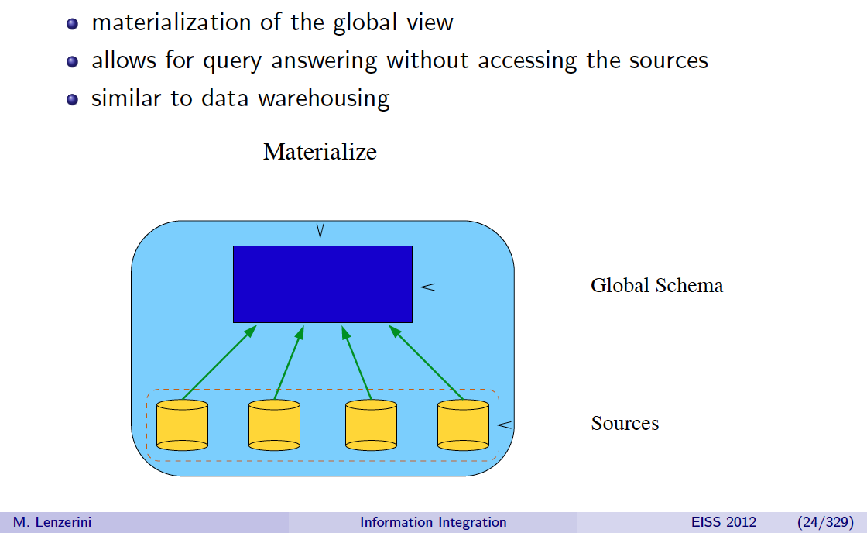
Data Exchange

Slide 15
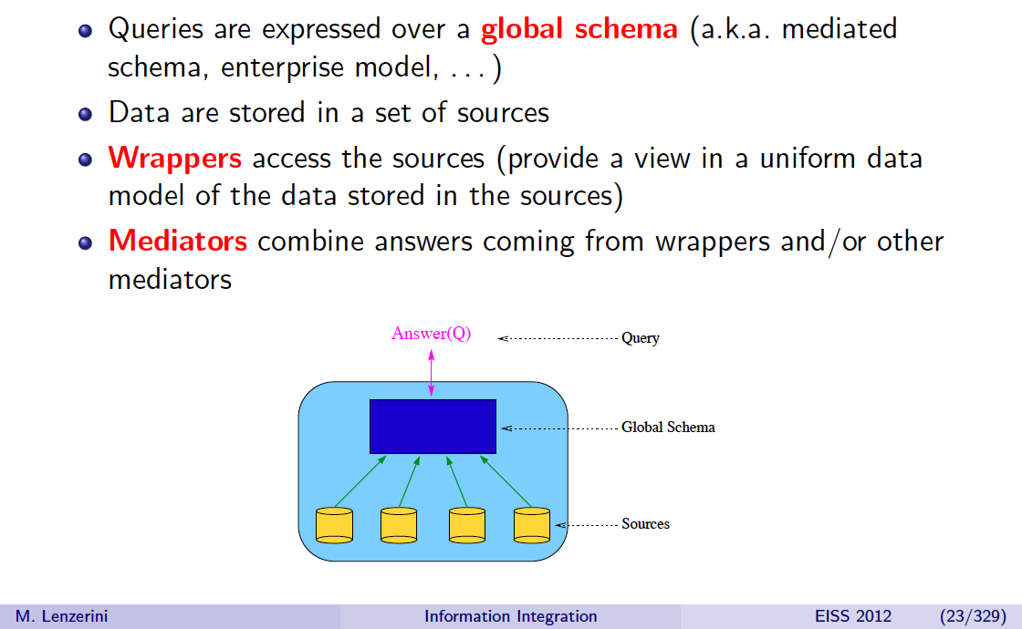
Virtual Data Integration
domain model, target schema/ontology/model )

Slide 16
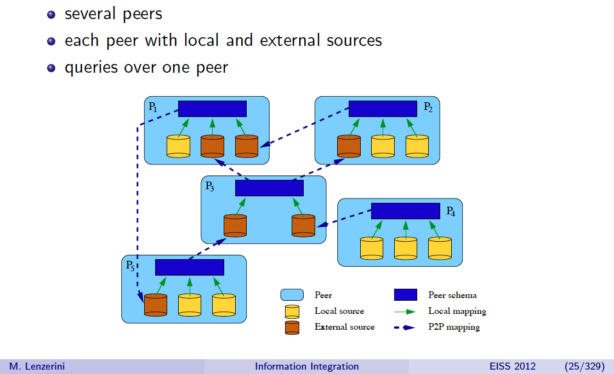
Peer-to-Peer Data Integration

Slide 17
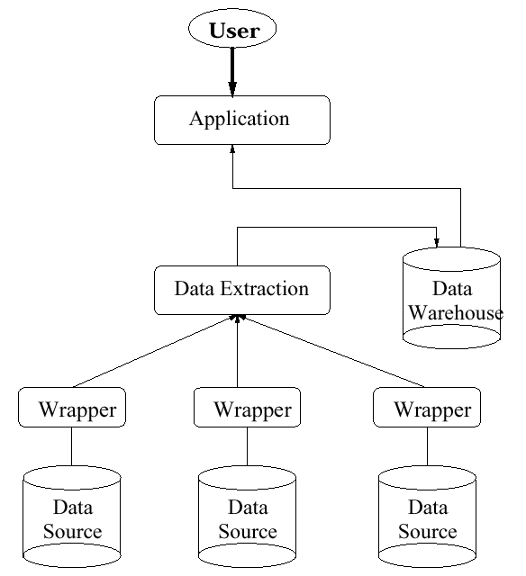
Materialized Architecture: Data Warehouse/ETL
ETL: Extract, Transform, Load
Common in industry
Many products
Informatica
IBM InfoSphere DataStage
Oracle Data Integrator
…
Open source:
Talend
Pentaho
CloverETL
…
Global
schema
Transform
Source
schemas

Slide 18
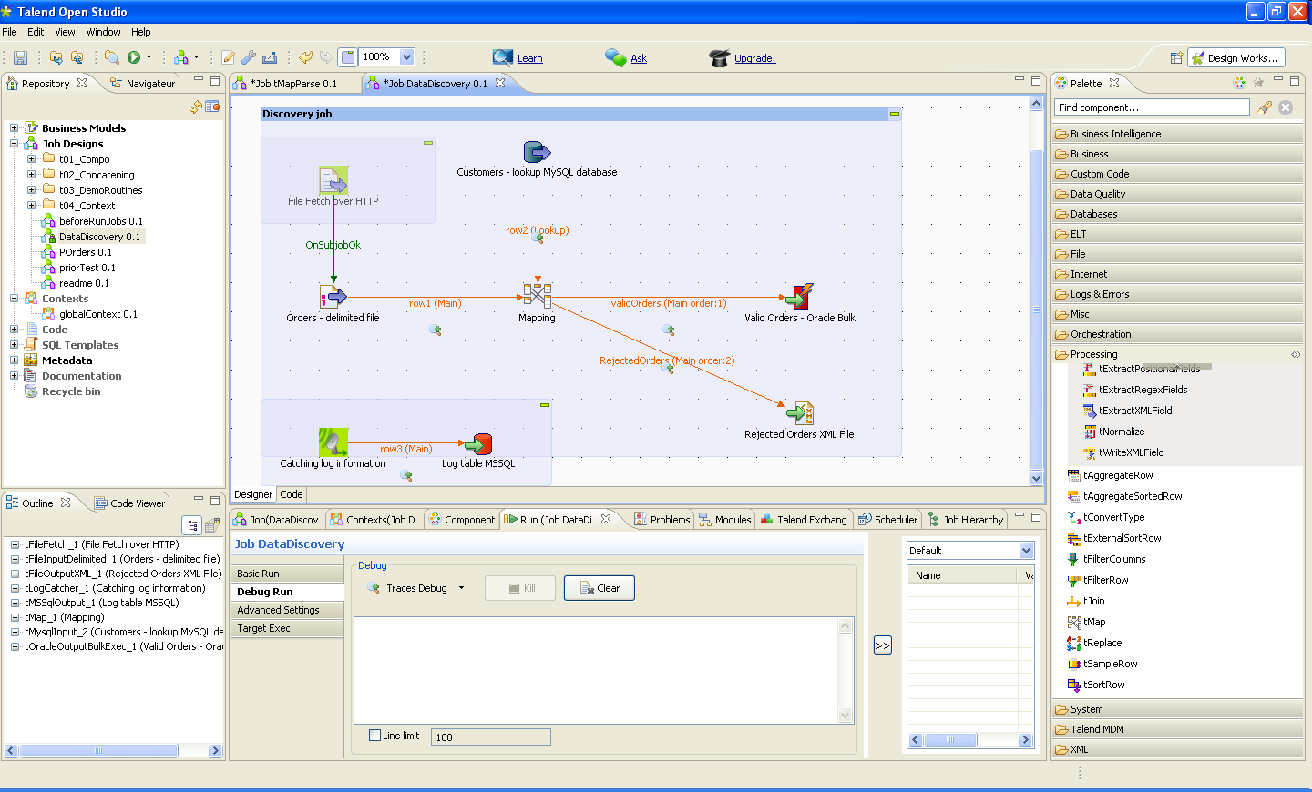
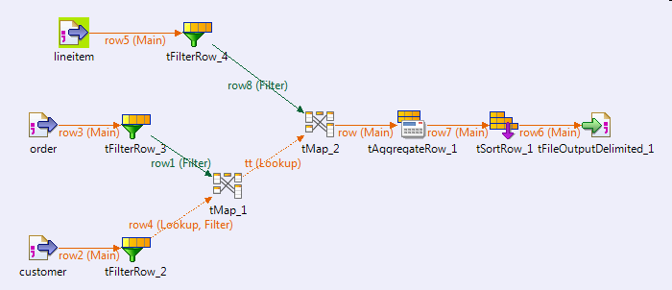
GUIs for composing ETL workflows (ex: Talend)

Slide 19
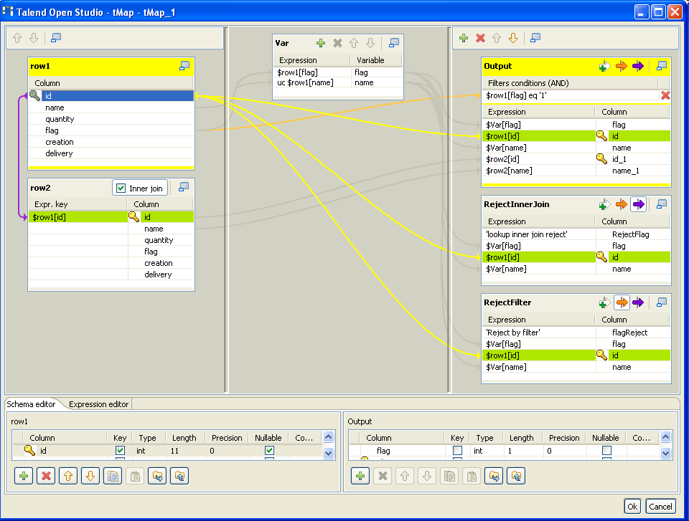
Specify data mappings graphically

Slide 20
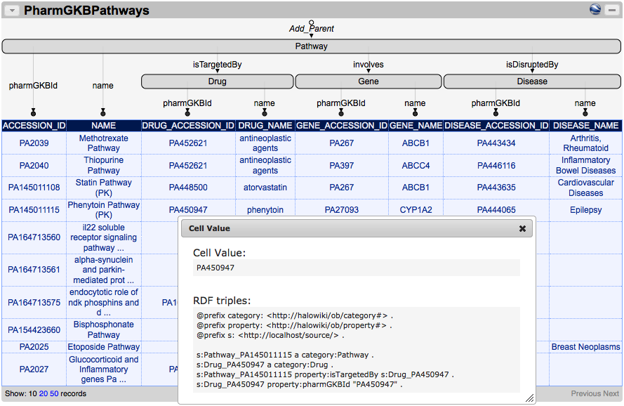
Karma as ETL tool

Slide 21
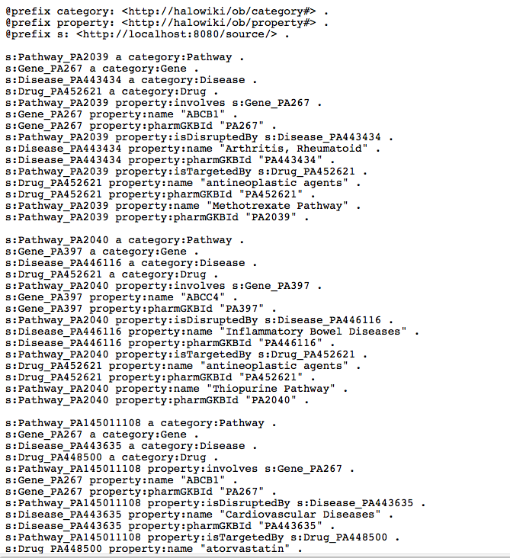
Karma as ETL tool: Export RDF to load into Triplestore

Slide 22
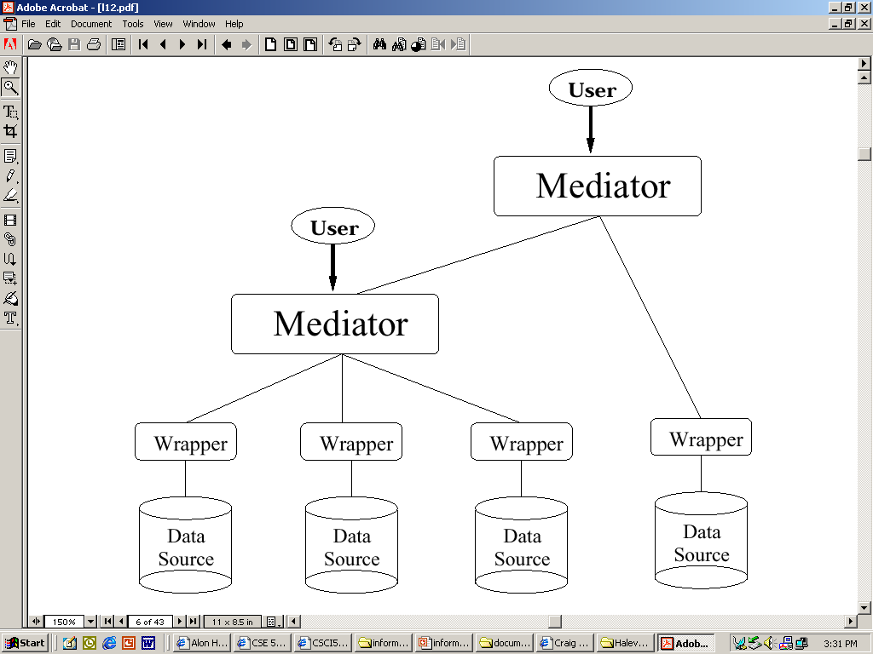
Virtual Integration Architecture: Mediator
Global
schema
Schema
Mappings
Source
schemas

Slide 23
Virtual Integration Architecture: Mediator
Leave data at sources
When a user query comes in:
Determine the relevant sources to the query
Break down the query into sub-queries for the sources
Get the answers from the sources, and combine them appropriately
Data is fresh. Approach scalable
Issues:
Relating Sources & Mediator
Rewriting the query
Efficient planning & execution
User queries
Mediated schema
Reformulation engine
Source Catalog
Schema Mappings
Mediator:
optimizer
Execution engine
wrapper
wrapper
wrapper
Source
Schemas
Data
Data
Data
source
source
source
Garlic [IBM]; Hermes [UMD]; Tsimmis, InfoMaster [Stanford]; DISCO [INRIA]; Information Manifold [AT&T]; SIMS/Ariadne[USC]; Emerac/Havasu[ASU]

Slide 24
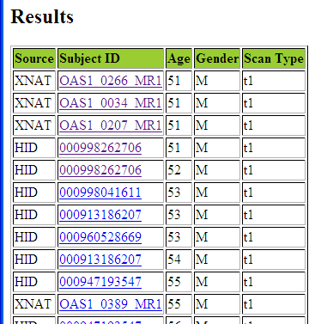
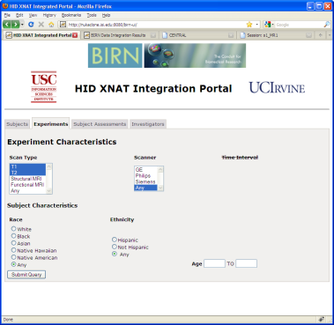
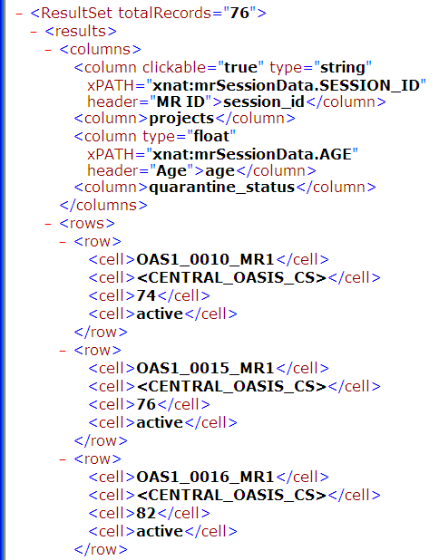
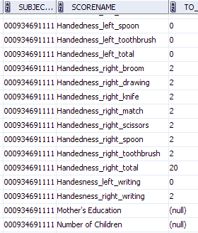
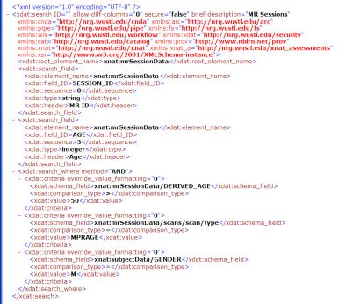
Virtual Data Integration: BIRN mediator
[Ashish, Ambite, et al. Frontiers in Neuroinformatics 4:118, 2010]
User query:
find all male patients over 50 with t1 scans
Results integrated
from XNAT and HID
Domain query
Integrated results
Logical Source
descriptions
BIRN Mediator
XNAT
results
(XML)
SQL
query
HID
results
XML
query
HID
@UCI
HID
@MRN
…
XNAT
Human Imaging Database(s)
Oracle DB
EXtensible Neuroimaging Archive Toolkit
Web service API

Slide 25
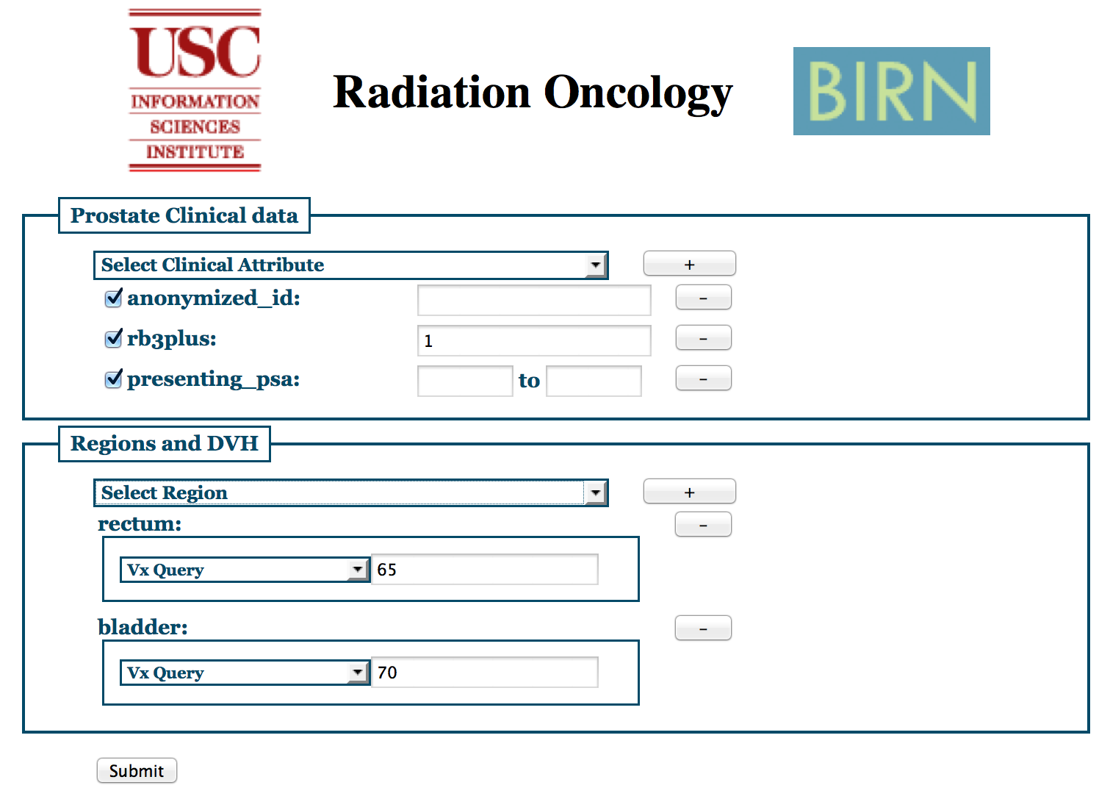
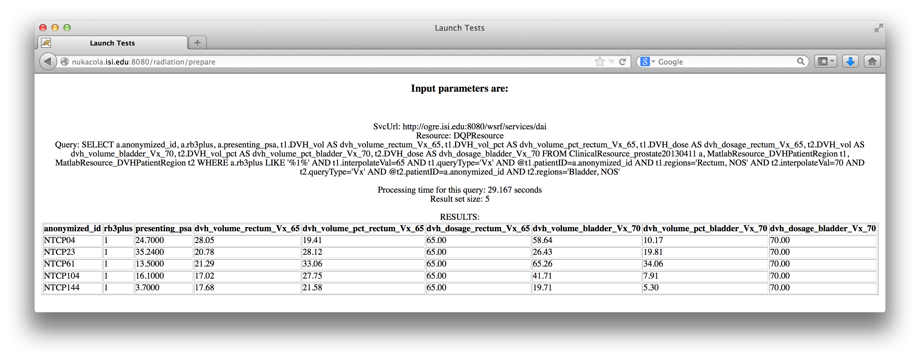
Radiation Oncology
User query:
patients with rectal bleeding grade 3+ that received doses of 70Gy to the rectum and 65Gy to the bladder and resp. volumes radiated, and psa levels
Integrated
results
Domain query
Logical Source
descriptions
BIRN Mediator
wrapped Matlab for
DICOM-RT processing
Source queries/
results
Matlab
Wrapper
DVH.m
Prostate
Clinical
Head/Neck
Clinical
Prostate
DICOM-RT
files
Head/Neck
DICOM-RT
files

Slide 26
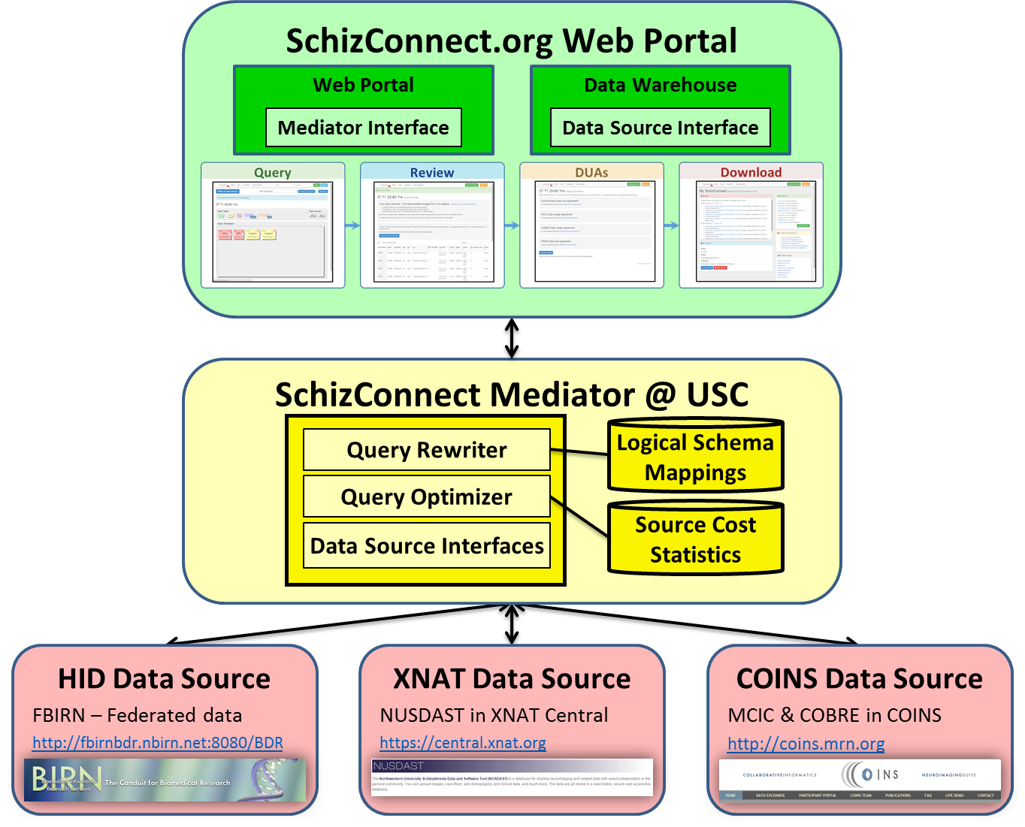
SchizConnect
Wang et al, SchizConnect: Mediating Schizophrenia Neuroimaging Databases for Large-Scale Integration, Neuroimage 2015 (in press).

Slide 27
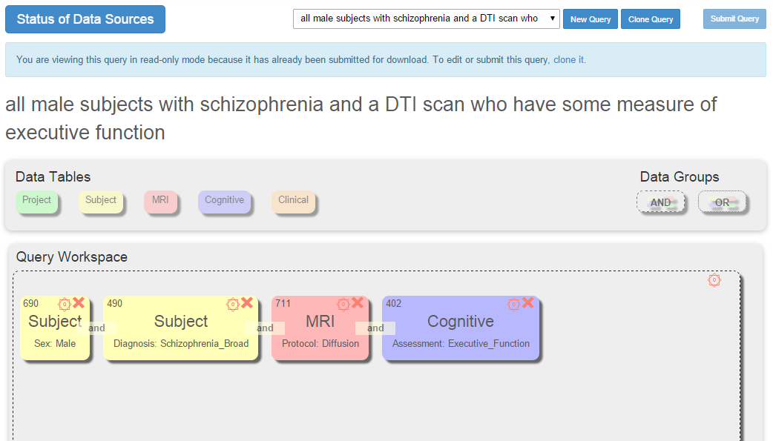
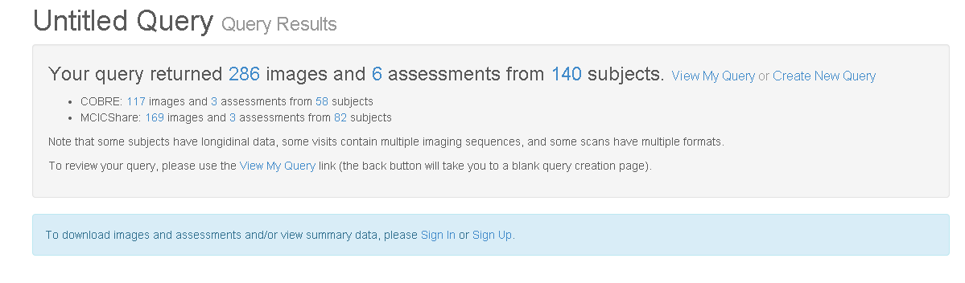
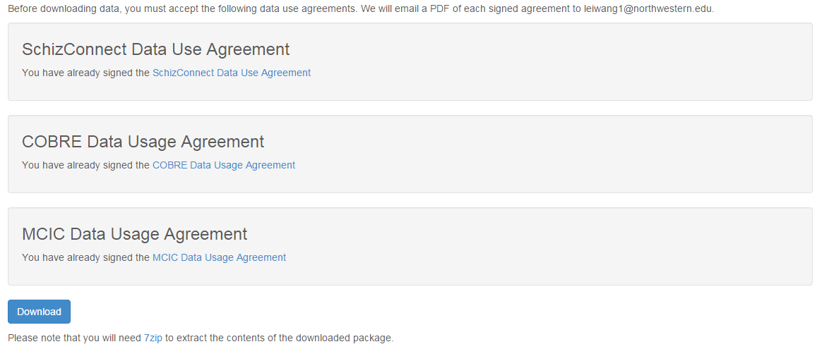
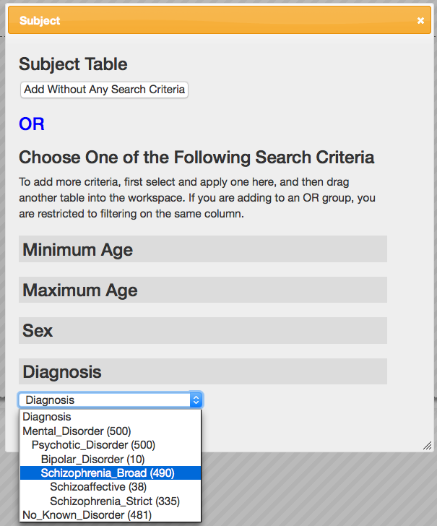
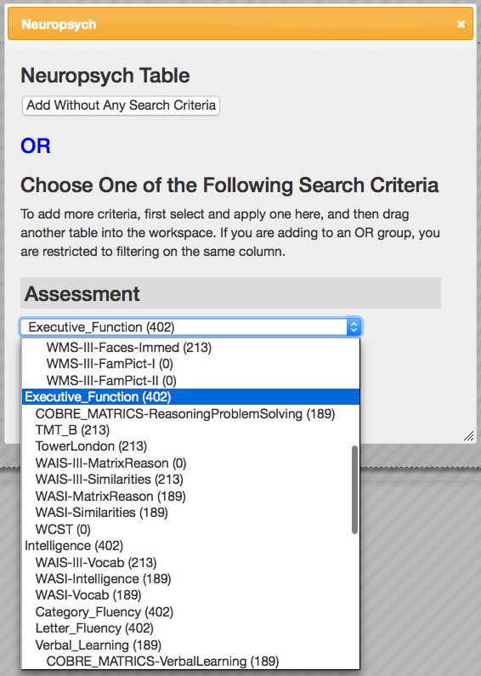
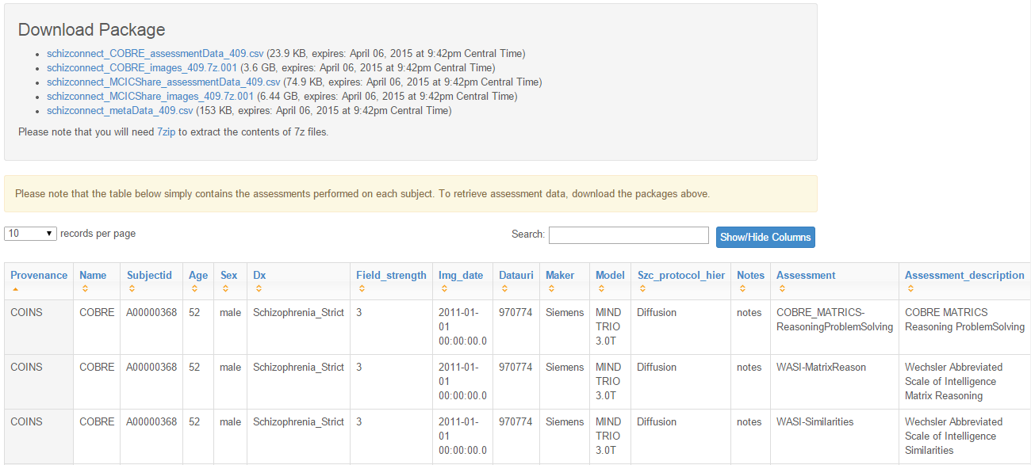
Sample Query: Male with Schizophrenia and a DTI scan, who have measures of Executive Function

Slide 28
Query Rewriting (aka query reformulation)
Problem: rewrite user query expressed in mediated schema into query expressed over source schemas
Given
Query Q in terms of the mediated-schema relations, and
Schema mappings (source descriptions)
(Mediated schema constraints)
Find
Query Q' that uses only the source relations, such that
Q' provides only correct answers to Q, (i.e., Q' |= Q, i.e., Q' ⊆ Q), and
Q' provides all possible answers to Q given the sources
Note: I'll use the terms “schema mappings” and “source descriptions” interchangeably

Slide 29
Desiderata for Source Descriptions
Expressive power: distinguish between sources with closely related data. Hence, be able to prune access to irrelevant sources.
Easy addition: easy to add new data sources.
Reformulation: be able to reformulate a user query into a query over the sources efficiently and effectively.
Nonlossy: be able to handle all queries that can be answered by directly accessing the sources

Slide 30
Source Descriptions
Elements of source descriptions:
Contents: source contains movies, directors, cast.
Constraints: only movies produced after 1965.
Completeness: contains all American movies.
Source Limitations/Capabilities:
Limitations: source requires movie title or director as input
Capabilities: source can perform selections, joins, …

Slide 31
Languages for Schema Mapping
Q
Mediated Schema
GAV
LAV
GLAV
Q'
Q'
Q'
Q'
Q'
Source
Source
Source
Source
Source
[based on slide by Doan, Halevy, Ives]
Notes:
What these languages need to do (how we come up with the expressions we'll discuss later)
Basically use query expressions, but in different ways.
GAV -- goes way back. Only got name in the late 90's. What it does, and what's the problem: need to consider all possible interactions.
LAV -- started in mid-90's. What's the advantage. Challenge: algorithms. See answering queries using views.
For more details, see Lenzerini's paper. For more on aquv, see my paper.

Slide 32
Schema Mappings
Global-as-View (GAV): Φs(X,Y) --> g(X)
Mediator relation defined as a view over source relations
Ex: TSIMMIS (Stanford), HERMES (Maryland), SIMS, BIRN (USC)
Local-as-View (LAV): s(X) --> ∃Y Φg(X,Y)
Source relation defined as view over mediator relations
Ex: Information Manifold (AT&T), Tukwila (UW), InfoMaster (Stanford), Prometheus, BIRN Mediator/GQR (USC)
General (GLAV): Φs(X,Y) --> ∃Z Ψg(X,Z)
BIRN Mediator (USC), …
View ~ named query ~ logical formula

Slide 33
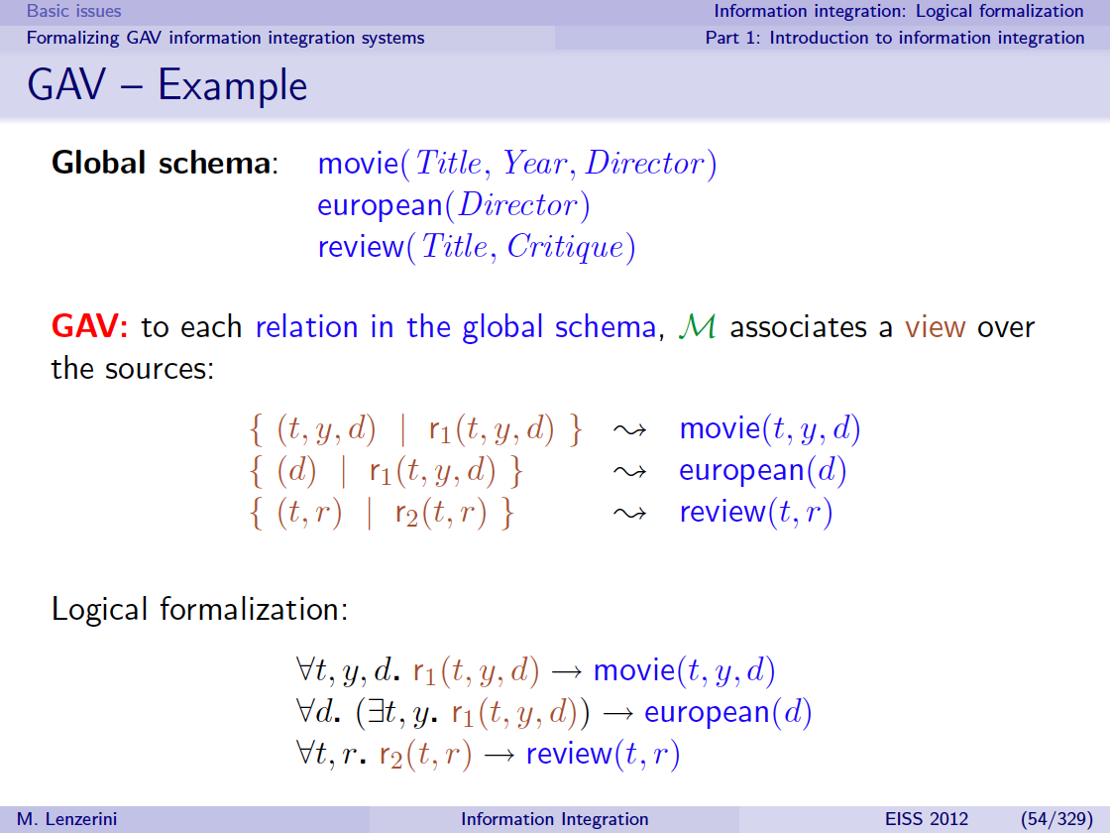

Slide 34
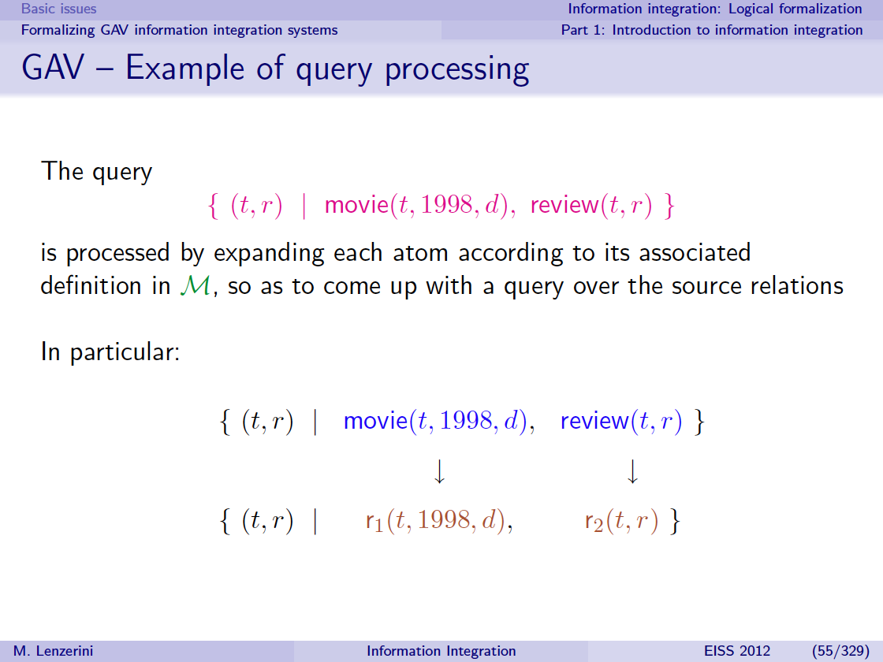
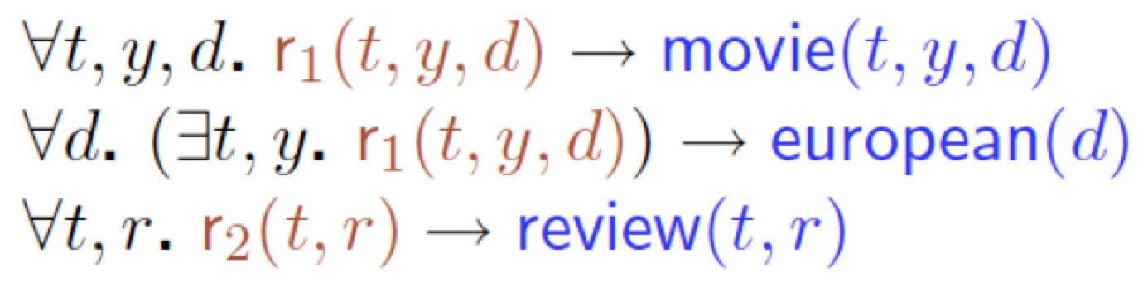

Slide 35
Global-as-View (GAV) Schema Mapping
Each mediator relation is defined as a view over source relations: Φ_{s}(X,Y) --> g(X)
review(Title,Year,Review) ← s1(ID,Title,Director,Year) ^ s3(ID,Review)
CREATE VIEW review AS
SELECT Title, Year, Review
FROM s1, s3
WHERE s1.ID = s3.ID

Slide 36
Query Reformulation in GAV
Query reformulation = rule unfolding + simplification
Domain Query: Find reviews after 1997
q(T,R) ← review(T,Y,R), Y >= 1997
rewritten to
Source Query:
q'(T,R) ← s1(I,T,D,Y), s3(I,R), Y >= 1997
using GAV schema mapping:
review(Title,Year,Review) ← s1(ID,Title,Director,Year) ^ s3(ID,Review)

Slide 37
Global-as-View (GAV)
Each mediator relation is defined as a view over source relations: Φ_{s}(X,Y) --> g(X)
movie(Title,Year,Director) ← s1(ID,Title,Director,Year)
movie(Title,Year,Director) ← s2(Title,Director, Studio,Year)
review(Title,Year,Review) ← s1(ID,Title,Director,Year) ^ s3(ID,Review)
Assume s1 and s3 are in the same database db1, and s2 is in a different source

Slide 38
Query Reformulation in GAV
Query reformulation = rule unfolding + simplification
Query: Find reviews for movies directed by Scott after 1997
q(T,R) ← movie(T,Y, 'Scott'), review(T,Y,R), Y >= 1997
1. q'(T,R) ← s1(I,T,'Scott',Y), Y >= 1997, s1(I',T,D,Y), s3(I',R)
movie(Title,Year,Director) ← s1(ID,Title,Director,Year)
movie(Title,Year,Director) ← s2(Title,Director, Studio,Year)
review(Title,Year,Review) ← s1(ID,Title,Director,Year) ^ s3(ID,Review)

Slide 39
Query Reformulation in GAV
Query reformulation = rule unfolding + simplification
Query: Find reviews for movies directed by Scott after 1997
q(T,R) ← movie(T,Y, 'Scott'), review(T,Y,R), Y >= 1997
1. q'(T,R) ← s1(I,T,'Scott',Y), Y >= 1997, s1(I,T,D,Y), s3(I,R)
Assume (T,Y) and (I)
are keys of s1,
then I=I'
movie(Title,Year,Director) ← s1(ID,Title,Director,Year)
movie(Title,Year,Director) ← s2(Title,Director, Studio,Year)
review(Title,Year,Review) ← s1(ID,Title,Director,Year) ^ s3(ID,Review)

Slide 40
Query Reformulation in GAV
Query reformulation = rule unfolding + simplification
Query: Find reviews for movies directed by Scott after 1997
q(T,R) ← movie(T,Y, 'Scott'), review(T,Y,R), Y >= 1997
1. q'(T,R) ← s1(I,T,'Scott',Y), Y >= 1997, s1(I,T,D,Y), s3(I,R)
Assume (T,Y) and (I)
are keys of s1,
then I=I' and 2nd s1 is redundant
movie(Title,Year,Director) ← s1(ID,Title,Director,Year)
movie(Title,Year,Director) ← s2(Title,Director, Studio,Year)
review(Title,Year,Review) ← s1(ID,Title,Director,Year) ^ s3(ID,Review)

Slide 41
Query Reformulation in GAV
Query reformulation = rule unfolding + simplification
Query: Find reviews for movies directed by Scott after 1997
q(T,R) ← movie(T,Y, 'Scott'), review(T,Y,R), Y >= 1997
1. q'(T,R) ← s1(I,T,'Scott',Y), Y >= 1997, s3(I,R)
Assume (T,Y) and (I)
are keys of s1,
then I=I' and 2nd s1 is redundant
movie(Title,Year,Director) ← s1(ID,Title,Director,Year)
movie(Title,Year,Director) ← s2(Title,Director, Studio,Year)
review(Title,Year,Review) ← s1(ID,Title,Director,Year) ^ s3(ID,Review)

Slide 42
Query Reformulation in GAV
Query reformulation = rule unfolding + simplification
Query: Find reviews for movies directed by Scott after 1997
q(T,R) ← movie(T,Y, 'Scott'), review(T,Y,R), Y >= 1997
1. q'(T,R) ← s1(I,T,'Scott',Y), Y >= 1997, s3(I,R)
2. q'(T,R) ← s2(T,’Scott’,S,Y), Y >= 1997,
s1(I',T,D,Y), s3(I',R)
Assume (T,Y) and (I)
are keys of s1,
then I=I' and 2nd s1 is redundant
movie(Title,Year,Director) ← s1(ID,Title,Director,Year)
movie(Title,Year,Director) ← s2(Title,Director, Studio,Year)
review(Title,Year,Review) ← s1(ID,Title,Director,Year) ^ s3(ID,Review)

Slide 43
Query Reformulation in GAV
Query reformulation = rule unfolding + simplification
Query: Find reviews for movies directed by Scott after 1997
q(T,R) ← movie(T,Y, 'Scott'), review(T,Y,R), Y >= 1997
1. q'(T,R) ← s1(I,T,'Scott',Y), Y >= 1997, s3(I,R)
2. q'(T,R) ← s2(T,’Scott’,S,Y), Y >= 1997,
s1(I,T,D,Y), s3(I,R)
Assume (T,Y) and (I)
are keys of s1,
then I=I' and 2nd s1 is redundant
Assume (T,Y) and (I)
are keys of s1, then I=I'
movie(Title,Year,Director) ← s1(ID,Title,Director,Year)
movie(Title,Year,Director) ← s2(Title,Director, Studio,Year)
review(Title,Year,Review) ← s1(ID,Title,Director,Year) ^ s3(ID,Review)

Slide 44
Query Reformulation in GAV
Query reformulation = rule unfolding + simplification
Query: Find reviews for movies directed by Scott after 1997
q(T,R) ← movie(T,Y, 'Scott'), review(T,Y,R), Y >= 1997
1. q'(T,R) ← s1(I,T,'Scott',Y), Y >= 1997, s3(I,R)
2. q'(T,R) ← s2(T,’Scott’,S,Y), Y >= 1997,
s1(I,T,D,Y), s3(I,R)
Assume (T,Y) and (I)
are keys of s1,
then I=I' and 2nd s1 is redundant
Assume (T,Y) and (I)
are keys of s1, then I=I'
If s1 and s3 have same movies, then q2 is redundant wrt q1
movie(Title,Year,Director) ← s1(ID,Title,Director,Year)
movie(Title,Year,Director) ← s2(Title,Director, Studio,Year)
review(Title,Year,Review) ← s1(ID,Title,Director,Year) ^ s3(ID,Review)

Slide 45
Query Reformulation in GAV
Query reformulation = rule unfolding + simplification
Query: Find reviews for movies directed by Scott after 1997
q(T,R) ← movie(T,Y, 'Scott'), review(T,Y,R), Y >= 1997
q'(T,R) ← s1(I,T,'Scott',Y), s3(I,R), Y >= 1997,
movie(Title,Year,Director) ← s1(ID,Title,Director,Year)
movie(Title,Year,Director) ← s2(Title,Director, Studio,Year)
review(Title,Year,Review) ← s1(ID,Title,Director,Year) ^ s3(ID,Review)

Slide 46
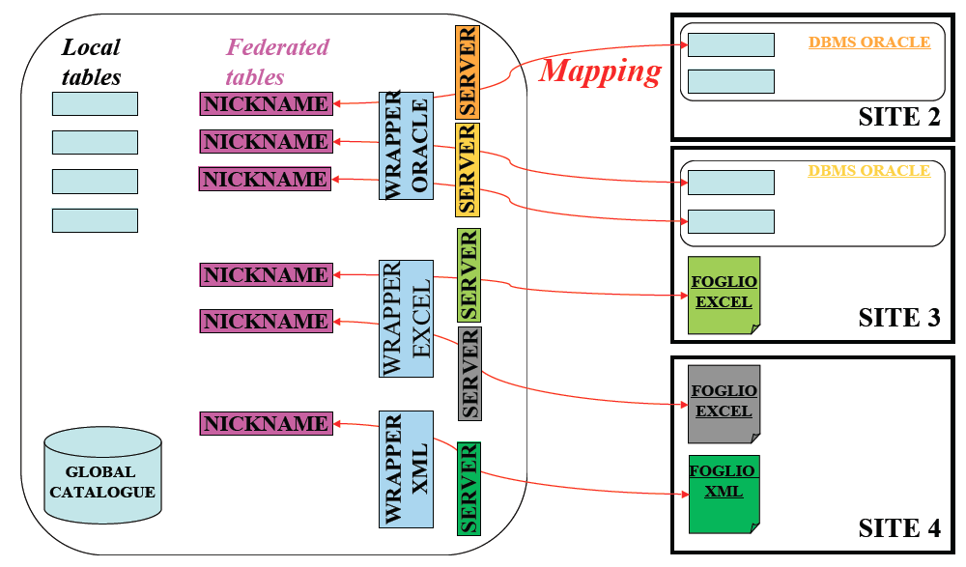
Distributed/Federated Queries vs. Integration
Some systems allow to query remote databases
Ex:
IBM
Information
Integrator*
However, If we just expose the source schemas, the user would quickly get overloaded
For integration, we need to create global schema
(*) IBM marketing changes the name of the system quite often, today it is called “IBM InfoSphere Information Server for Data Integration”:
https://www.ibm.com/us-en/marketplace/information-server-for-data-integration

Slide 47
Local-as-View (LAV) Schema Mappings
Each source relation is defined as a view over mediator relations: s(X) --> ∃Y ψ_{g}(X,Y)
s1(title, year, director) --> Movie(title,year,director,genre) ^ American(director) ^ year ≥1960 ^ genre = 'Comedy’
s2(title, review) --> Movie(title,year,director,genre) ^ year≥1990 ^ hasReview(title, review)
∃genre
⊆
⊆
∃year, director, genre
Existentials! Invent values! Skolem functions, aka labelled nulls
Open world! Tuples in sources guaranteed to satisfy the
definitions, but sources don't have all possible tuples

Slide 48
Query Reformulation in LAV
Query: Reviews for comedies produced after 1950
q(title,review) <-- Movie(title,year,director,'Comedy') ^ year ≥1950 ^ hasReview(title,review)
s1(title, year, director) --> Movie(title,year,director,genre) ^
American(director) ^ year ≥1960 ^ genre = 'Comedy'
s2 (title, review) --> Movie(title,year,director,genre) ^ year≥1990 ^ hasReview(title, review)

Slide 49
Query Reformulation in LAV
Query: Reviews for comedies produced after 1950
q(title,review) <-- Movie(title,year,director,'Comedy') ^ year ≥1950 ^ hasReview(title,review)
Is s2 enough?
Only s2 provides hasReview
Reformulated query:
q'(title,review) <-- s2(title,review)
s1(title, year, director) --> Movie(title,year,director,genre) ^
American(director) ^ year ≥1960 ^ genre = 'Comedy'
s2 (title, review) --> Movie(title,year,director,genre) ^ year≥1990 ^ hasReview(title, review)

Slide 50
Query Reformulation in LAV
Query: Reviews for comedies produced after 1950
q(title,review) <-- Movie(title,year,director,'Comedy') ^ year ≥1950 ^ hasReview(title,review)
Is s2 enough? No!
Need s1 to ensure Genre='Comedy'
Reformulated query:
q'(title,review) <-- s1(title,year,director) ^ s2(title,review)
s1(title, year, director) --> Movie(title,year,director,genre) ^
American(director) ^ year ≥1960 ^ genre = 'Comedy'
s2 (title, review) --> Movie(title,year,director,genre) ^ year≥1990 ^ hasReview(title, review)

Slide 51
Query Reformulation in LAV
Query: Reviews for comedies produced after 1950
q(title,review) <-- Movie(title,year,director,'Comedy') ^ year ≥1950 ^ hasReview(title,review)
Are we done?
What about year ≥ 1950 and Genre = 'Comedy'?
Reformulated query:
q'(title,review) <-- s1(title,year,director) ^ s2(title,review)
s1(title, year, director) --> Movie(title,year,director,genre) ^
American(director) ^ year ≥1960 ^ genre = 'Comedy'
s2 (title, review) --> Movie(title,year,director,genre) ^ year≥1990 ^ hasReview(title, review)

Slide 52
Query Reformulation in LAV
Query: Reviews for comedies produced after 1950
q(title,review) <-- Movie(title,year,director,'Comedy') ^ year ≥1950 ^ hasReview(title,review)
Are we done? Yes!
What about year ≥ 1950 and Genre = 'Comedy'? Constraints are implied
Reformulated query:
q'(title,review) <-- s1(title,year,director) ^ s2(title,review)
s1(title, year, director) --> Movie(title,year,director,genre) ^
American(director) ^ year ≥1960 ^ genre = 'Comedy'
s2 (title, review) --> Movie(title,year,director,genre) ^ year≥1990 ^ hasReview(title, review)

Slide 53
Query Reformulation in LAV
Query: Reviews for comedies produced after 1950
q(title,review) <-- Movie(title,year,director,'Comedy') ^ year ≥1950 ^ hasReview(title,review)
Does q' answers what q asks?
Reformulated query:
q'(title,review) <-- s1(title,year,director) ^ s2(title,review)
s1(title, year, director) --> Movie(title,year,director,genre) ^
American(director) ^ year ≥1960 ^ genre = 'Comedy'
s2 (title, review) --> Movie(title,year,director,genre) ^ year≥1990 ^ hasReview(title, review)

Slide 54
Query Reformulation in LAV
Query: Reviews for comedies produced after 1950
q(title,review) <-- Movie(title,year,director,'Comedy') ^ year ≥1950 ^ hasReview(title,review)
Does q' answers what q asks?
Not quite, it gives a subset ...
q' ⊆q
Reformulated query:
q'(title,review) <-- s1(title,year,director) ^ s2(title,review)
… but it's the best we can do given the available sources
s1(title, year, director) --> Movie(title,year,director,genre) ^
American(director) ^ year ≥1960 ^ genre = 'Comedy'
s2 (title, review) --> Movie(title,year,director,genre) ^ year≥1990 ^ hasReview(title, review)

Slide 55
Answering queries using views
Given query q and view definitions V = {V1…Vn}
q' is a Maximally-Contained Rewriting of q using V if:
q' refers only to views in V, and
q' ⊆ q, and
there is no rewriting q1, such that q' ⊆ q1 ⊆ q and q1 ≠ q
q' is an Equivalent Rewriting of q using V if:
q' refers only to views in V, and
q' = q

Slide 56
GAV vs. LAV
Φs(X,Y) --> g(X)
Not modular
adding new sources may require changes to all integration rules
Query reformulation is easier
reduces to view unfolding
(though query simplification not so easy)
Best when
Few, stable, data sources
well-known to the mediator (e.g. corporate integration)
s(X) --> ∃Y Φg(X,Y)
Modular
adding new sources is easier, does not affect previous rules
Expressive
power of entire query language available to describe sources
Query reformulation is hard
answering queries using views
Best when
Many, relatively unknown data sources
possibility of addition/deletion of sources

Slide 57
Query Reformulation in LAV: The Bucket Algorithm
[Levy+1996]
Given: user query q, source descriptions {Vi}
Find relevant sources (fill buckets)
For each predicate g in query q
Find view Vj that contains predicate g
Check that constraints in Vj are compatible with q
Combine source relations {Vj} from each bucket into a conjunctive query q' and check for containment (q' ⊆ q)

Slide 58
The Bucket Algorithm: Example
Global Schema
Movie(ID, title,year,genre) Director(ID,director)
Actor(ID,actor) Revenues(ID, Amount)
LAV Schema Mappings
V1(I, Y) → Movie(I,T,Y,G), Revenues(I,A), I > 5000, A > $200M
V2(I, A) → Movie(I,T,Y,G), Revenues(I,A)
V3(I, A) → Revenues(I,A), A < $50M
V4(I, D, Y) → Movie(I,T,Y,G), Director(I,D), I < 3000
User Query
q(ID,Dir) ← Movie(ID,Title,Year,Genre), Revenues(ID, Amount), Director(ID,Dir), Amount > $100M

Slide 59
1. Filling the Buckets
A goal g_{v} in a view v is relevant to a goal g_{q} in a query q if:
The goals are on the same predicate
The interpreted predicates on variables of g_{v}, after appropriate variable substitutions, are satisfiable
If g_{q} includes a head variable of q, then the corresponding variable in g_{v} is also in the head of v

Slide 60
1. Filling the Buckets
V1(I, Y) → Movie(I,T,Y,G), Revenues(I,A), I > 5000, A > $200M
V2(I, A) → Movie(I,T,Y,G), Revenues(I,A)
V3(I, A) → Revenues(I,A), A < $50M
V4(I, D, Y) → Movie(I,T,Y,G), Director(I,D), I < 3000
q(ID,Dir) ←
Movie(ID,Title,Year,Genre), Revenues(ID, Amt), Director(ID,Dir), Amt > $100M
Notes:
V4 is not in the first bucket because V4 does not provide department, which is needed in the query answer

Slide 61
1. Filling the Buckets
V1(I, Y) → Movie(I,T,Y,G), Revenues(I,A), I > 5000, A > $200M
V2(I, A) → Movie(I,T,Y,G), Revenues(I,A)
V3(I, A) → Revenues(I,A), A < $50M
V4(I, D, Y) → Movie(I,T,Y,G), Director(I,D), I < 3000
q(ID,Dir) ←
Movie(ID,Title,Year,Genre), Revenues(ID, Amt), Director(ID,Dir), Amt > $100M
V1(ID,Year)
V2(ID,A’)
V4(ID,D’,Year)
Notes:
V4 is not in the first bucket because V4 does not provide department, which is needed in the query answer

Slide 62
1. Filling the Buckets
V1(I, Y) → Movie(I,T,Y,G), Revenues(I,A), I > 5000, A > $200M
V2(I, A) → Movie(I,T,Y,G), Revenues(I,A)
V3(I, A) → Revenues(I,A), A < $50M
V4(I, D, Y) → Movie(I,T,Y,G), Director(I,D), I < 3000
q(ID,Dir) ←
Movie(ID,Title,Year,Genre), Revenues(ID, Amt), Director(ID,Dir), Amt > $100M
V1(ID,Year) V1(ID,Y’)
V2(ID,A’) V2(ID,Amt)
V4(ID,D’,Year)
Notes:
V4 is not in the first bucket because V4 does not provide department, which is needed in the query answer

Slide 63
1. Filling the Buckets
V1(I, Y) → Movie(I,T,Y,G), Revenues(I,A), I > 5000, A > $200M
V2(I, A) → Movie(I,T,Y,G), Revenues(I,A)
V3(I, A) → Revenues(I,A), A < $50M
V4(I, D, Y) → Movie(I,T,Y,G), Director(I,D), I < 3000
q(ID,Dir) ←
Movie(ID,Title,Year,Genre), Revenues(ID, Amt), Director(ID,Dir), Amt > $100M
V1(ID,Year) V1(ID,Y’) V4(ID,Dir,Y’’)
V2(ID,A’) V2(ID,Amt)
V4(ID,D’,Year)
Notes:
V4 is not in the first bucket because V4 does not provide department, which is needed in the query answer

Slide 64
1. Filling the Buckets
V1(I, Y) → Movie(I,T,Y,G), Revenues(I,A), I > 5000, A > $200M
V2(I, A) → Movie(I,T,Y,G), Revenues(I,A)
V3(I, A) → Revenues(I,A), A < $50M
V4(I, D, Y) → Movie(I,T,Y,G), Director(I,D), I < 3000
q(ID,Dir) ←
Movie(ID,Title,Year,Genre), Revenues(ID, Amt), Director(ID,Dir), Amt > $100M
V1(ID,Year) V1(ID,Y’) V4(ID,Dir,Y’’)
V2(ID,A’) V2(ID,Amt)
V4(ID,D’,Year)
Notes:
V4 is not in the first bucket because V4 does not provide department, which is needed in the query answer

Slide 65
2. Checking Containment
Construct a rewritten query q’ by choosing one view from each bucket
Check for containment: q’ ⊆ q
Collect all such rewritten queries {q’}, then maximally-contained rewriting is the union

Slide 66
2. Checking Containment
q(ID,Dir) ←
Movie(ID,Title,Year,Genre), Revenues(ID, Amt), Director(ID,Dir), Amt > $100M
V1(ID,Year) V1(ID,Y’) V4(ID,Dir,Y’’)
V2(ID,A’) V2(ID,Amt)
V4(ID,D’,Year)
V1(I, Y) → Movie(I,T,Y,G), Revenues(I,A), I > 5000, A > $200M
V2(I, A) → Movie(I,T,Y,G), Revenues(I,A)
V3(I, A) → Revenues(I,A), A < $50M
V4(I, D, Y) → Movie(I,T,Y,G), Director(I,D), I < 3000

Slide 67
2. Checking Containment
q(ID,Dir) ←
Movie(ID,Title,Year,Genre), Revenues(ID, Amt), Director(ID,Dir), Amt > $100M
V1(ID,Year) V1(ID,Y’) V4(ID,Dir,Y’’)
V2(ID,A’) V2(ID,Amt)
V4(ID,D’,Year)
V1(ID,Year), V1(ID,Y’), V4(ID,Dir,Y’’) →
Movie(ID,T,Year,G), Revenues(ID,A), ID > 5000, A > $200M,
Movie(ID,T’,Y’,G’), Revenues(ID,A’), ID > 5000, A’ > $200M,
Movie(ID,T’’,Y’’,G’’), Director(ID,Dir), ID < 3000,
V1(I, Y) → Movie(I,T,Y,G), Revenues(I,A), I > 5000, A > $200M
V2(I, A) → Movie(I,T,Y,G), Revenues(I,A)
V3(I, A) → Revenues(I,A), A < $50M
V4(I, D, Y) → Movie(I,T,Y,G), Director(I,D), I < 3000

Slide 68
2. Checking Containment
q(ID,Dir) ←
Movie(ID,Title,Year,Genre), Revenues(ID, Amt), Director(ID,Dir), Amt > $100M
V1(ID,Year) V1(ID,Y’) V4(ID,Dir,Y’’)
V2(ID,A’) V2(ID,Amt)
V4(ID,D’,Year)
V1(ID,Year), V1(ID,Y’), V4(ID,Dir,Y’’) →
Movie(ID,T,Year,G), Revenues(ID,A), ID > 5000, A > $200M,
Movie(ID,T’,Y’,G’), Revenues(ID,A’), ID > 5000, A’ > $200M,
Movie(ID,T’’,Y’’,G’’), Director(ID,Dir), ID < 3000,
Inconsistent!
V1(I, Y) → Movie(I,T,Y,G), Revenues(I,A), I > 5000, A > $200M
V2(I, A) → Movie(I,T,Y,G), Revenues(I,A)
V3(I, A) → Revenues(I,A), A < $50M
V4(I, D, Y) → Movie(I,T,Y,G), Director(I,D), I < 3000

Slide 69
2. Checking Containment
q(ID,Dir) ←
Movie(ID,Title,Year,Genre), Revenues(ID, Amt), Director(ID,Dir), Amt > $100M
V1(ID,Year) V1(ID,Y’) V4(ID,Dir,Y’’)
V2(ID,A’) V2(ID,Amt)
V4(ID,D’,Year)
V2(ID,A’), V2(ID,Amt), V4(ID,Dir,Y’’), Amt > $100M →
V2(ID,Amt), V4(ID,Dir,Y’’), Amt > $100M →
Movie(ID,T’,Y’,G’), Revenues(ID,Amt),
Movie(ID,T’’,Y’’,G’’), Director(ID,Dir), ID < 3000, Amt > $100M →
Movie(ID,T’,Y’,G’), Revenues(ID,Amt), Director(ID,Dir), ID < 3000, Amt > $100M →
q(ID,Dir)
V1(I, Y) → Movie(I,T,Y,G), Revenues(I,A), I > 5000, A > $200M
V2(I, A) → Movie(I,T,Y,G), Revenues(I,A)
V3(I, A) → Revenues(I,A), A < $50M
V4(I, D, Y) → Movie(I,T,Y,G), Director(I,D), I < 3000

Slide 70
2. Checking Containment
q(ID,Dir) ←
Movie(ID,Title,Year,Genre), Revenues(ID, Amt), Director(ID,Dir), Amt > $100M
V1(ID,Year) V1(ID,Y’) V4(ID,Dir,Y’’)
V2(ID,A’) V2(ID,Amt)
V4(ID,D’,Year)
V2(ID,A’), V2(ID,Amt), V4(ID,Dir,Y’’), Amt > $100M →
V2(ID,Amt), V4(ID,Dir,Y’’), Amt > $100M →
Movie(ID,T’,Y’,G’), Revenues(ID,Amt),
Movie(ID,T’’,Y’’,G’’), Director(ID,Dir), ID < 3000, Amt > $100M →
Movie(ID,T’,Y’,G’), Revenues(ID,Amt), Director(ID,Dir), ID < 3000, Amt > $100M →
q(ID,Dir)
Only movies
with ID < 3000
⊆
V1(I, Y) → Movie(I,T,Y,G), Revenues(I,A), I > 5000, A > $200M
V2(I, A) → Movie(I,T,Y,G), Revenues(I,A)
V3(I, A) → Revenues(I,A), A < $50M
V4(I, D, Y) → Movie(I,T,Y,G), Director(I,D), I < 3000

Slide 71
2. Checking Containment
q(ID,Dir) ←
Movie(ID,Title,Year,Genre), Revenues(ID, Amt), Director(ID,Dir), Amt > $100M
V1(ID,Year) V1(ID,Y’) V4(ID,Dir,Y’’)
V2(ID,A’) V2(ID,Amt)
V4(ID,D’,Year)
V2(ID,A’), V2(ID,Amt), V4(ID,Dir,Y’’), Amt > $100M →
q’(ID, Amt) ← V2(ID,Amt), V4(ID,Dir,Y’’), Amt > $100M →
Movie(ID,T’,Y’,G’), Revenues(ID,Amt),
Movie(ID,T’’,Y’’,G’’), Director(ID,Dir), ID < 3000, Amt > $100M →
Movie(ID,T’,Y’,G’), Revenues(ID,Amt), Director(ID,Dir), ID < 3000, Amt > $100M →
q(ID,Dir)
⊆
V1(I, Y) → Movie(I,T,Y,G), Revenues(I,A), I > 5000, A > $200M
V2(I, A) → Movie(I,T,Y,G), Revenues(I,A)
V3(I, A) → Revenues(I,A), A < $50M
V4(I, D, Y) → Movie(I,T,Y,G), Director(I,D), I < 3000

Slide 72
Query Reformulation in LAV: Inverse-Rules Algorithm
[Duschka+1997]
Idea: Construct an equivalent logic program which evaluation yields the answer to user query
“Invert the rules”: simply use standard logical manipulations (conversion to clausal form)
Oliver M. Duschka, Michael R. Genesereth, Alon Y. Levy. Recursive Query Plans for Data Integration. Journal of Logic Programming 43(1): 49-73 (2000)

Slide 73
The Inverse-Rules Algorithm Conversion to Clausal Form
V1(dept,course) --> Enrolled(student,dept) ^ Registered(student,course)
∀D,C [v1(D,C) --> ∃S [ e(S,D) ∧ r(S,C)]]
≡ ∀D,C [¬ v1(D,C) ∨ ∃S [ e(S,D) ∧ r(S,C)]]
≡ ¬v1(D,C) ∨ [e(f(D,C),D) ∧ r(f(D,C),C)]
≡ [¬v1(D,C) ∨ e(f(D,C),D)] ∧ [¬v1(D,C) ∨ r(f(D,C),C)]
≡ [v1(D,C) --> e(f(D,C),D)] ∧ [v1(D,C) --> r(f(D,C),C)]
≡
e(f(D,C),D) ← v1(D,C)
r(f(D,C),C) ← v1(D,C)
This is essentially converting the rules to clausal form. See for example:
http://logic.stanford.edu/intrologic/notes/chapter_12.html
a --> b ≡ ¬a ∨ b

Slide 74
The Inverse-Rules Algorithm: Example
q(D) ← Enrolled(S,D) ^ Registered(S,’DB’)
v1(D,C) --> Enrolled(S,D) ^ Registered(S,C)
q(D) ← Enrolled(S,D) ^ Registered(S,’DB’)
Enrolled(f(D,C),D) ← v1(D,C)
Registered(f(D,C),C) ← v1(D,C)
Ext(v1) = {(‘CS’, ‘DB’), (‘EE’, ‘DB’), (‘CS’, ‘AI’)}
Ext(Enrolled) = {(f(‘CS’,‘DB’),‘CS’), (f(‘EE’,‘DB’),‘EE’), (f(‘CS’,‘AI’),‘CS’)}
Ext(Registered) = {(f(‘CS’,‘DB’),‘DB’), (f(‘EE’,‘DB’),‘DB’), (f(‘CS’,‘AI’),‘AI’)}
Ext(q) = {(‘CS’), (‘EE’)}
q(D) ← v1(D,’DB’)

Slide 75
GLAV mappings
φ_{s}(X,Y) --> ∃Z ψ_{G} (X,Z)
Example:
s1(id, title, year, director) ^ s2(id, review) --> Movie(title,year,director,genre) ^ American(director) ^ year ≥1960 ^ genre = 'Comedy'^ year≥1990 ^ hasReview(title, review)
Note we did not model the id attribute (i.e., it’s not in the consequent of the rule), perhaps it’s an internal id to the sources that we don’t care about

Slide 76
GLAV = LAV + GAV
A GLAV mapping Φ_{S} (X,Y) --> ∃Z Ψ_{G}(X,Z)
can be converted to a LAV and a GAV mapping
Just invent intermediate predicate v:
Φ_{S}(X,Y) --> v(X) [GAV]
v(X) -->∃Z Ψ_{G}(X,Z) [LAV]
So we can process GLAV rules by a combination of LAV and GAV query rewriting algorithms

Slide 77
Modeling Source Capabilities
Negative capabilities:
A web-site (HTML form) or a web service may require certain inputs in order to provide outputs.
- Ex: to output current temperature, Yahoo weather needs ZIP as input
Need to consider only valid query execution plans
- Consistent orderings of source calls
Positive capabilities:
Query capabilities:
A source may be database (understands SQL)
A web form may allow only some selections and projections
decide placement of operations according to capabilities
Problem: how to describe and exploit source capabilities

Slide 78
Negative Capabilities: Binding Patterns
Sources:
AAAIdb^{f} (X) --> AAAIPapers(X)
CitationDB^{bf}(X,Y) --> Cites(X,Y)
AwardDB^{b}(X) --> AwardPaper(X)
Query: find all the award winning papers:
q(X) ← AwardPaper(X)

Slide 79
Recursive Rewritings
q(X) ← AwardPaper(X)
Problem: Unbounded union of conjunctive queries
q1(X) ← AAAIdb(X), AwardDB(X)
q1(X) ← AAAIdb(X1), CitationDB(X1,X), AwardDB(X)
…
q1(X) ← AAAIdb(X1), CitationDB(X1,X2), …, CitationDB(Xn,X), AwardDB(X)
Solution: Recursive Rewriting
papers(X) ← AAAIdb(X)
papers(X) ← papers(Y), CitationDB(Y,X)
q'(X) ← papers(X), AwardDB(X)
AAAIdb^{f} (X) --> AAAIPapers(X)
CitationDB^{bf}(X,Y) --> Cites(X,Y)
AwardDB^{b}(X) --> AwardPaper(X)

Slide 80
LAV query rewriting with sources with binding restrictions: Inverse-Rules Algorithm
Sources:
AAAIdb^{f} (X) --> AAAIPapers(X)
CitationDB^{bf}(X,Y) --> Cites(X,Y)
AwardDB^{b}(X) --> AwardPaper(X)
Query: find all the award winning papers:
q(X) ← AwardPaper(X)

Slide 81
Inverse-Rules Algorithm under binding restrictions: Domain predicate and rules
Invent a new predicate, dom(X), that represents all objects in our domain
Use dom predicate to satisfy binding patterns
Given source descriptions (SD):
AAAIdb^{f} (X) --> AAAIPapers(X)
CitationDB^{bf}(X,Y) --> Cites(X,Y)
AwardDB^{b}(X) --> AwardPaper(X)
Modify SD by introducing dom
AAAIdb(X) --> AAAIPapers(X)
[no restrictions on AAAIdb, just remove binding annotation]
dom(X) ^ CitationDB(X,Y) --> Cites(X,Y)
[we need to input objects as 1st argument of CitationDB]
dom(X) ^ AwardDB(X) --> AwardPaper(X)
[we need to input objects to AwardDB to test them]
… and add dom rules, which define the behavior of dom
AAAIdb(X) --> dom(X)
[we can get objects from AAAIdb,since it has no restrictions]
dom(X) ^ CitationDB(X,Y) --> dom(Y)
[if we input an object to CitationDB, we get another object out]

Slide 82
Inverse-Rules Algorithm under binding restrictions
Evaluating this datalog program generates the answers to query q
q(X) ← AwardPaper(X)
AAAIPapers(X) ← AAAIdb(X)
Cites(X,Y) ← dom(X) ^ CitationDB(X,Y)
AwardPaper(X) ← dom(X) ^ AwardDB(X)
dom(Y) ← dom(X) ^ CitationDB(X,Y)
dom(X) ← AAAIdb(X)
query
inverse
rules
with dom
dom rules

Slide 83
Inverse-Rules Algorithm under binding restrictions
Simplifying the program
q(X) ← AwardPaper(X)
AAAIPapers(X) ← AAAIdb(X)
Cites(X,Y) ← dom(X) ^ CitationDB(X,Y)
AwardPaper(X) ← dom(X) ^ AwardDB(X)
dom(Y) ← dom(X) ^ CitationDB(X,Y)
dom(X) ← AAAIdb(X)

Slide 84
Inverse-Rules Algorithm under binding restrictions
Simplifying the program
q(X) ← AwardPaper(X)
AAAIPapers(X) ← AAAIdb(X)
Cites(X,Y) ← dom(X) ^ CitationDB(X,Y)
AwardPaper(X) ← dom(X) ^ AwardDB(X)
dom(Y) ← dom(X) ^ CitationDB(X,Y)
dom(X) ← AAAIdb(X)

Slide 85
Inverse-Rules Algorithm under binding restrictions
Simplifying the program:
q(X) ← dom(X) ^ AwardDB(X)
dom(Y) ← dom(X) ^ CitationDB(X,Y)
dom(X) ← AAAIdb(X)

Slide 86
Karma as Data Exchange (logical ETL): Generate RDF by processing (G)LAV rules
Input
Tuple
[Name:PhenytoinPathway(PK); Gene_Accession_ID:PA27093; Accession_Id:PA145011115; Disease_Name:Epilepsy; Gene_Name:CYP1A2; Disease_Accession_Id:PA444065; Drug_Name:phenytoin; Drug_Accession_Id:PA450947;]
GLAV
Rule
@prefix s: <http://www.semanticweb.org/ontologies/bio/> .
s:Pathway_PA145011115 a category:Pathway .
s:Gene_PA27093 a category:Gene .
s:Drug_PA450947 a category:Drug .
s:Disease_PA444065 a category:Disease .
s:Pathway_PA145011115 property:Label "Phenytoin Pathway (PK)" .
s:Pathway_PA145011115 property:Involves s:Gene_PA27093 .
s:Pathway_PA145011115 property:IsTargetedBy s:Drug_PA450947 .
s:Pathway_PA145011115 property:IsDisruptedBy s:Disease_PA444065 .
s:Gene_PA27093 property:Label "CYP1A2" .
s:Drug_PA450947 property:Label "phenytoin" .
s:Disease_PA444065 property:Label "Epilepsy" .
Output
RDF
86

