Slide 1
LAV Rewriting under Constraints
Jose Luis Ambite
USC/Information Sciences Institute

Slide 2
Generalized dependencies
Tuple-generating dependencies:
If tuples with this pattern of equal symbols appear in a relation instance, then a certain tuple must also appear.
Generalize inclusion dependencies, ...
Equality-generating dependencies:
If tuples pattern of equal symbols appear in a relation instance, then certain symbols must also be equal.
Generalize FD, keys,

Slide 3
LAV Query Rewriting under Functional Dependencies
Domain schema:
Functional
Dependencies:
Source Descriptions:
Query:
Rewriting:
→
→
Notes:
Informally, the query plan proceeds as follows. It first finds some paper presented at PODS '89 using s1 , and then finds the location of the conference this paper was presented at using s2 . This plan is correct only because every paper is presented at one conference and in one year. In fact, if these dependencies would not hold, there would be no way of answering this query using the given sources. It is also important to note that source relation s1 is needed in the query plan even though the predicates in s1 , conference and year , do not appear in the query at all. Without functional dependencies, only source descriptions that contain predicates appearing in the user query need to be considered [22].

Slide 4
Inverse Rules with Functional Dependencies (1)
[Duschka 1997]
Source Descriptions:
Inverse Rules:
→
→
←
←
←
←
←

Slide 5
Chase Rules
←
Functional
Dependencies:
Chase Rules:
Equality Theory: to ensure that e is an equivalence relation, add:
e(X,Y) ← e(X,Z) ^ e(Z,Y) (transitivity)
(also assume e(x,x) holds for every x, reflexivity)
←
←
←

Slide 6
Rectified Query
To compute the rectified query Q’ of query Q, apply the following rules iteratively:
If c is a constant in a subgoal of Q, replace it by a new variable Z, and add the subgoal e(Z, c)
If X is a variable in the head of Q, replace X in the body of Q by a new variable X’, and add the subgoal e(X’ X)
If a variable Y that is not in the head of Q appears in two subgoals of Q, replace one of its occurrences by Y’, and add subgoal e(Y’,Y)
Example:
q(L) ← location(pods, 1989, L)
q’(L) ← location(C,Y,L’) ^ e(C,pods) ^ e(Y,1989) ^ e(L,L’)

Slide 7
Inverse Rules under Functional Dependencies
The following logic program computes the query:
q(L) ← location(C,Y,L’) ^ e(C,pods) ^ e(Y,1989) ^ e(L,L’)
e(C,C’) ← conference(P,C) ^ conference(P’,C’) ^ e(P,P’)
e(Y,Y’) ← year(P,Y) ^ year(P’,Y’) ^ e(P,P’)
e(L,L’) ← location(C,Y,L) ^ location(C’,Y’, L’) ^ e(C,C’) ^ e(Y,Y’)
e(X,Y) ← e(X,Z) ^ e(Z,Y)
conference(P,C) ← s1(P,C,Y)
year(P,Y) ← s1(P,C,Y)
conference(P,f1(P,L)) ← s2(P,L)
year(P, f2(P,L)) ← s2(P,L)
location(f1(P,L), f2(P,L), L) ← s2(P,L)
Rectified Query
Chase Rules
Transitivity
Inverse Rules

Slide 8
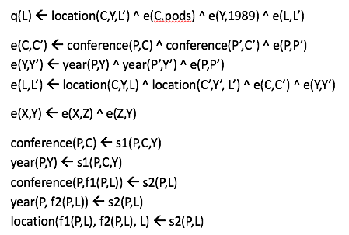
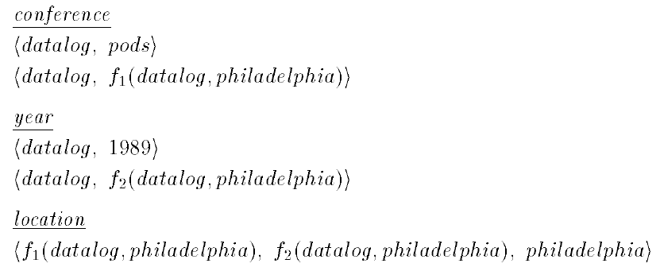
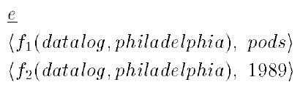
Evaluating the logic program
Assuming the sources contain the data:
s1(datalog, pods, 1989) s2(datalog, philadelphia)

Slide 9
Simplifying the program
This is not part of the inverse algorithm, but just for illustration:
q(L) ← l(C Y L’) ^ e(C pods) ^ e(Y 1989) ^ e(L L’)
Unify: {C/f1(P5 L5) , Y/f2(P5 L5) , L’/L5
q(L) ← s2(P5 L5) ^ e(f1(P5 L5) pods) ^ e(f2(P5 L5) 1989) ^ e(L L5)
e(f1(P5 L5) pods) ← c(P6 f1(P5 L5)) ^ c(P6 pods)
e(f1(P5 L5) pods) ← s2(P5 L5) ^ s1(P5 pods Y2)
e(f2(P5 L5) 1989) ← y(P7 f2(P5 L5)) ^ y(P7 1989)
e(f2(P5 L5) 1989) ← s2(P5 L5) ^ s1(P5 C1 1989)
q(L) ← s2(P5 L5) ^ s2(P5 L5) ^ s1(P5 pods Y2) ^ s2(P5 L5) ^ s1(P5 C1 1989) ^ e(L L5)
q(L) ← s2(P5 L) ^ s1(P5 pods Y2) ^ s1(P5 C1 1989) // to simplify further need to
chase the FDs:
q(L) ←s2(P5 L) ^ s1(P5 pods 1989)

Slide 10
LAV Query Rewriting under Functional Dependencies
Mediated schema:
Schedule(airline, flightNum, date, pilot, aircraft)
Functional dependencies:
Pilot → Airline and Aircraft → Airline
Data source:
S(date,pilot,aircraft) →
schedule(airline,fN,date,pilot,aircraft)
⊆
Query: (pilots in same airline as Mike)
q(p) :- schedule(a,fN,date,”mike”,aircraft)
schedule(a,f,d,p,a)
Without functional dependencies, no answers!

Slide 11
But We Do Have Answers…
Functional dependencies:
Pilot → Airline
Aircraft → Airline
Date | Pilot | Aircraft
1/1 | Mike | 111
5/2 | Ann | 111
1/3 | Ann | 222
4/3 | John | 222
Mike and Ann work for the same airline
111 and 222 belong to the same airline
John and Ann work for the same airline, …

Slide 12
Query rewriting under functional dependencies needs recursion
Mediated schema
Schedule(Airline, Flight#, Date, Pilot, Aircraft)
Pilot → Airline ; Aircraft → Airline
s(D, P, C) → schedule(A, N, D, P, C)
q(P) ← schedule(A, N, D, mike, C) ^ schedule(A, N’, D’, P, C’)
Possible rewritings:
Pilots that fly same aircraft work for same airline
q(P) ← s(D1, mike, C1) ^ s(D2, P, C1)
q(P) ← s(D1, mike, C1) ^ s(D1, P2, C1) ^ s(D2, P2, C2) ^ s(D1, P, C2)
…
q(P) ← s(D1, mike, C1) ^ s(D1, P2, C1) ^ s(D2, P2, C2) ^ s(D1, P, C2) ^
… ^ s(D_{2n-2}, P_{n}, C_{n-1}) ^ s(D_{2n-1}, P_{n}, C_{n}) ^ s(D_{2n}, P, C_{n})
Infinite union of conjunctive queries (~~> recursion)
Functional dependencies
Source
Query

Slide 13
Inverse Rules Recursive program gives Certain Answers
Rectified Query
q(P) ← schedule(A, N, D, mike, C) ^ schedule(A’, N’, D’, P’, C’) ^ e(A,A’) ^ e(P,P’)
Chase Rules
e(A,A’) ← schedule(A, N, D, P, C) ^ schedule(A’, N’, D’, P’, C’) ^ e(P,P’)
e(A,A’) ← schedule(A, N, D, P, C) ^ schedule(A’, N’, D’, P’, C’) ^ e(C,C’)
Transitivity
e(X,Y) ← e(X,Z) ^ e(Z,Y)
Inverse Rule
schedule(a(D,P,C), n(D,P,C), D, P, C) ← s(D, P, C)
Functional dependencies
Pilot → Airline
Aircraft → Airline

Slide 15
Integrity Constraints with LAV
Mediated schema:
Schedule(airline, flightNum, date, pilot, aircraft)
Functional dependencies:
Pilot → Airline and Aircraft → Airline
Data source:
S(date,pilot,aircraft) ⊆
schedule(a,fN,date,pilot,aircraft)
Query: (pilots in same airline as Mike)
q(p) :- schedule(a,fN,date,”mike”,aircraft)
schedule(a,f,d,p,a)
Without functional dependencies, no answers!

Slide 16
But We Do Have Answers…
Date | Pilot | Aircraft
1/1 | Mike | 111
5/2 | Ann | 111
1/3 | Ann | 222
4/3 | John | 222
Mike and Ann work for the same airline
111 and 222 belong to the same airline
John and Ann work for the same airline, …

Slide 17
No Limit to Rewriting Size
Does this sound familiar?
Recursive plans to the rescue!

Slide 18
Recursive Plan
Start with inverse rules and get:
But we know that:

Slide 19
The e relation
Let’s define a relation e(X,Y) that stores all pairs that are actually equal.
e(x,x) – holds for every x.
The other rules for inferring e(X,Y) are derived from the functional dependencies.
Add: e(X,Y) :- e(X,Z), e(Z,Y)

Slide 20
The Rules
Aircraft → Airline: So…
Pilot → Airline: So…

Slide 21
One More Step
Reformulate the query to use e(X,Y):

Slide 22
Integrity Constraints in GAV
Airline | flNum | Date | Pilot | Craft
United | 111 | 1/1 | Mike | 15
SAS | 222 | 1/3 | Ann | 17
flightNum | Origin | Dest
222 | Seattle | SFO
333 | SFO | CPH
q(fn) :- schedule(airline, fN, date, pilot, aircraft)
flight(fN, origin, destination)
111 should be in the answer, but won’t.

