Slide 1
Data Warehousing
Jose Luis Ambite
University of Southern California

Slide 2
Data Warehousing and Materialization
Virtual data integration
Queries are composed with mappings “on the fly” and data is fetched on demand
Data “lives” in the sources
Warehouse:
Data is transformed and materialized “in advance” of queries
Central “store” of all of our entities, concepts, metadata, and historical information
For data validation, complex mining, analysis, prediction, …
“Master” version in a central database
For performance reasons, availability reasons, archival reasons, …
[based on slides by Doan, Halevy & Ives]

Slide 3
Master Data Management (MDM)
Modern uses of data warehouse
Support analytics
Serve as a reference to all of the entities in the organization
Warehouse as repository of knowledge about entities, rules, and processes in an enterprise
Clean, normalized version of terms
Ex: addresses, names, products, …
Metadata: data constraints and assumptions
Basis for data governance
Data Governance: creation and modification of data entities in a systematic way
Ex: to comply with government regulations (Sarbanes-Oxley Act)
[based on slides by Doan, Halevy & Ives]

Slide 4
Data Warehouse Architecture
At the top – a centralized database
Generally configured for queries and appends – not transactions
Many indices, materialized views, etc.
Data is loaded and periodically updated via Extract/Transform/Load (ETL) tools
Data Warehouse
ETL pipeline
outputs
ETL
ETL
ETL
ETL
ETL
RDBMS
RDBMS
1
2
HTML
XML
1
1
[based on slides by Doan, Halevy & Ives]

Slide 5
ETL Tools
ETL tools are the equivalent of schema mappings in virtual integration, but are more powerful
Arbitrary pieces of code to take data from a source, convert it into data for the warehouse:
Import Filters: read and convert from data sources
Data Transformations: join, aggregate, filter, convert data
De-duplication: finds multiple records referring to the same entity, merges them
Profiling: builds tables, histograms, etc. to summarize data
Quality Management: test against master values, known business rules, constraints, etc.
[based on slide by Doan, Halevy & Ives]

Slide 6
Example ETL Pipeline
Item
Customer
records
records
Split
Filter
Filter
Filter
Group by
Date
-
invalid
Join
invalid
non
-
customer
time
match
Invoice
Customer
line items
balance
Invalid
Invalid
Invalid
dates
/
times
items
customers
Importing customer records
Multiple stages including: filtering (selection), composition (outer/inner join), logging bad records, grouping/aggregation, warehouse load
[based on slide by Doan, Halevy & Ives]

Slide 7
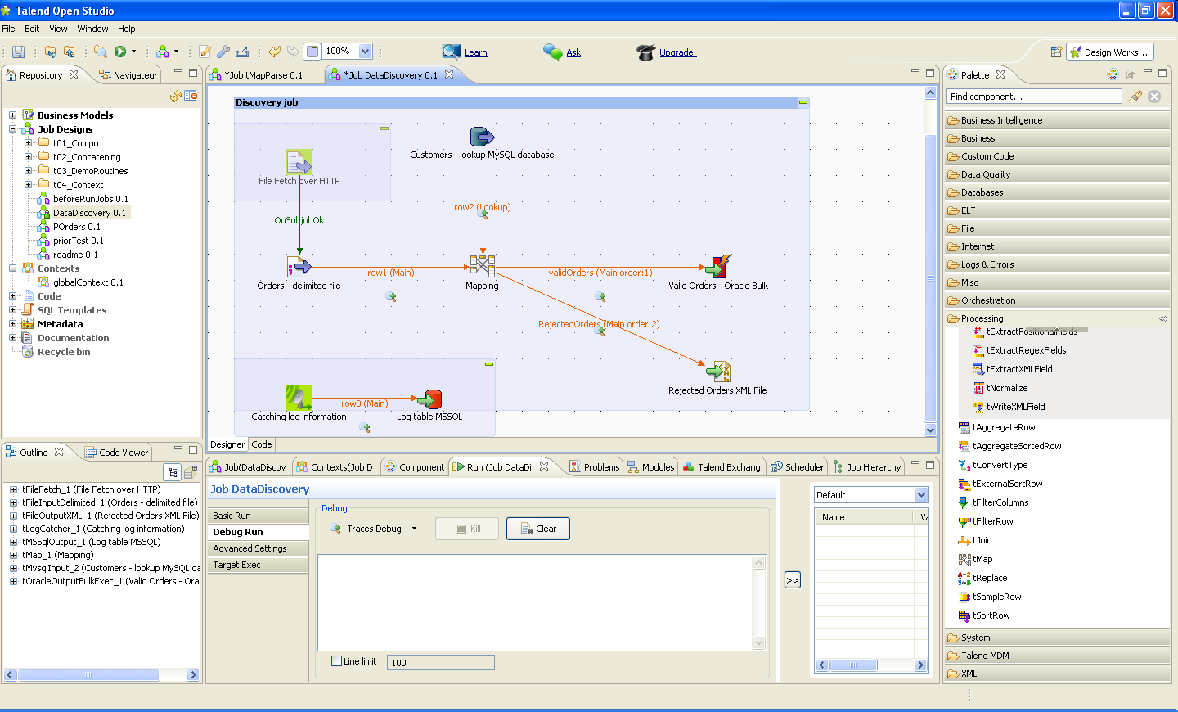
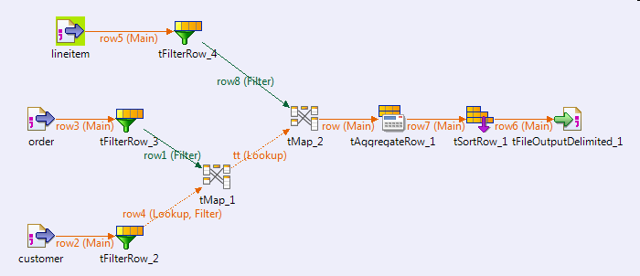
GUIs for composing ETL workflows (ex: Talend)

Slide 8
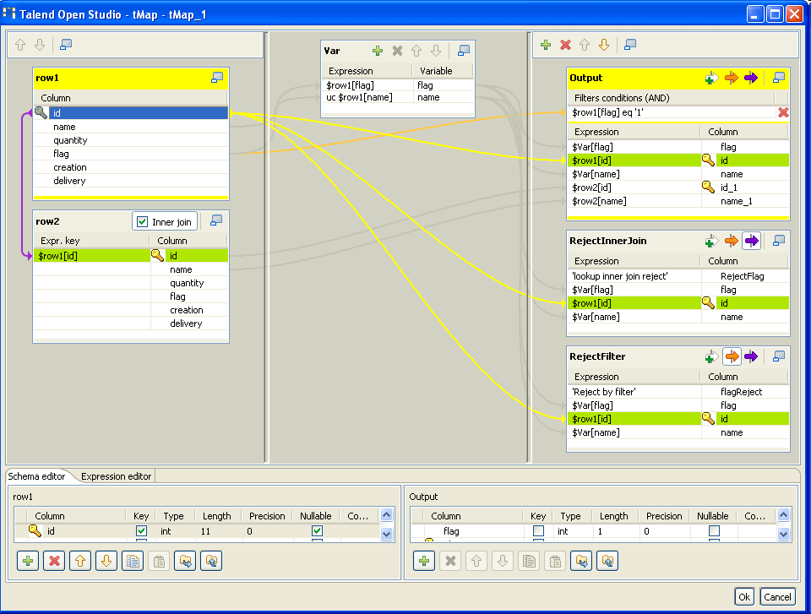
Specify data mappings graphically

Slide 9
Data Warehouse: Summary
Central DBMS optimized for appends and querying
“Master data instance” for reference
Data instance for efficient mining, analytics, and prediction
Procedural ETL “pipelines” to fetch, transform, filter, clean, and load data
Often these tools provide operations more expressive than standard conjunctive queries
… But not always!
This raises a question – can we do warehousing with declarative mappings?
[based on slide by Doan, Halevy & Ives]

Slide 10
Data Exchange: Logical Data Warehousing
Declarative formalism for data warehousing
Based on declarative schema mappings
Generate a materialized database
Allow for unknown values when we map from source to target (warehouse) instance
If we know a professor teaches a student, then there must exist a course C that the student took and the professor taught – but we may not know which … ---> skolems, labelled nulls, …
[based on slide by Doan, Halevy & Ives]

Slide 12
Database Integrity Constraints
Rules that govern the behavior of data at all times in a database
Expressions of business rules that emerge from user requirement specifications for database application
Database-version of ontology modeling
[based on slide by Jose Luis Ambite]

Slide 13
Classes of Integrity Constraints
Functional dependencies
Keys
Inclusion dependencies
Domain constraints
Referential integrity constraints
foreign keys
[based on slide by Jose Luis Ambite]

Slide 14
Functional Dependencies
Assume A → B
R
A’s
B’s
t
u
If t and u
agree here,
then they must
agree here

Slide 15
Inclusion Dependencies
Generalization of referential integrity constraints
Inclusion dependency R1[A1,...,An] ⊆ R2 [B1,...,Bn] means that if every tuple of attributes A1, …, An of R must also always appear in a tuple of R2 projected on attributes B1,...,Bn
Formally, R1[A1,...,An] ⊆ R2 [B1,...,Bn] iff
for all t1 in R1, there exists t2 in R2 such that t1[A1, …, An] = t2[B1, …, Bn]
A referential integrity constraint is an inclusion dependency in which {B1, …, Bn} is the primary key of R2

Slide 16
General Integrity Constraints
Tuple-generating dependencies (TGD’s)
Generalize inclusion dependencies, foreign keys, …
Equality-generating dependencies (EGD’s)
Generalize functional dependencies, keys, …
[Exercise: express previous constraints using general integrity constraints]

Slide 17
Many ontology constraints are either inclusion constraints or functional dependencies
For example, in DL-Lite (OWL2 QL):
A ⊑ B ≡ ∀x A(x) → B(x) ≡ ID: A[X] ⊆ B[X]
Ex: Professor ⊑ Person (professors are people)
∃r ⊑ A ≡ ∀x,y r(x,y) → A(x) ≡ ID: r[X] ⊆ A[X]
Ex: ∃teathesTo ⊑ Teacher
A ⊑ ∃r ≡ ∀x A(x) → ∃y r(x,y) ≡ ID: A[X] ⊆ r[X]
Ex: ∃teathesTo ⊑ Teacher
funct(r) ≡ ∀x,y,z r(x,y)^ r(x,z) → y = z
≡ FD: X → Y holds in r

Slide 19
Data Exchange
Declarative approach to data warehousing
Declarative schema mappings
Materialized database
Allow for unknown values when we map from source to target (warehouse) instance
If we know a professor teaches a student, then there must exist a course C that the student took and the professor taught – but we may not know which…

Slide 20
Data Exchange Problem = <S, T, M, C_{T}>
S: source schema representing all source tables
T: target schema
M: source-to-target schema mappings (st-tgds)
Tuple-generating dependencies (tgds)
C_{T}: Target constraints
Tuple-generating dependencies (tgds)
Equality-generating dependencies (egds)

Slide 21
An Example
Source S has
Teaches(prof, student)
Adviser(adviser, student)
Target T has
Advise(adviser, student)
TeachesCourse(prof, course)
Takes(course, student)
existential variables represent unknowns
[based on slide by Doan, Halevy & Ives]

Slide 22
The Data Exchange Solution
Given a data exchange setting D = (S,T,M,C_{T}) and an (database) instance I (over source schema S),
the goal of data exchange is to compute an instance (J) of the target schema (T)
An instance J of Schema T is a data exchange solution for D and I if
the pair (I,J) satisfies schema mapping M, and
J satisfies constraints C_{T}
[based on slide by Doan, Halevy & Ives]

Slide 23
Solution Example
Instance I(S) has
Teaches
Adviser
Instance J(T) has
Advise
TeachesCourse
Takes
prof | student
Ann | Bob
Chloe | David
adviser | student
Ellen | Bob
Felicia | David
prof | course
Ann | C₁
Chloe | C₂
adviser | student
Ellen | Bob
Felicia | David
labeled nulls represent unknown values
course | student
C₁ | Bob
C₂ | David
[based on slide by Doan, Halevy & Ives]

Slide 24
Another Solution
Instance I(S) has
Teaches
Adviser
Instance J(T) has
Advise
TeachesCourse
Takes
prof | student
Ann | Bob
Chloe | David
adviser | student
Ellen | Bob
Felicia | David
prof | course
Ann | C₁
Chloe | C₁
adviser | student
Ellen | Bob
Felicia | David
Same labelled null
course | student
C₁ | Bob
C₁ | David
[based on slide by Doan, Halevy & Ives]

Slide 25
Universal Solutions
Intuitively, first solution better than second
The second solution uses the same variable for the course taught by Ann and by Chloe – they are the same course
But this was not specified in the original schema!
We formalize that through the notion of the universal solution
must not lose any information
are most general solutions
[based on slide by Doan, Halevy & Ives]

Slide 26
Formalizing the Universal Solution
Instance homomorphism
Let J1, J2 be two instances of schema T
A mapping h: J1 → J2 is a homomorphism from J1 to J2 if
h(c) = c for every constant c ∈ C,
for every tuple R(a1,…,an) ∈ J1 the tuple R(h(a1),…,h(an)) ∈ J2
J1, J2 are homomorphically equivalent if there are homomorphisms h: J1 → J2 and h’: J2 → J1
Universal solution
Instance J is a universal solution for D= (S,T,M,CT) and I, if: for every other data exchange solution J’ for D and I, there exists a homomorphism h: J → J’
[based on slide by Doan, Halevy & Ives]

Slide 27
Computing Universal Solutions
The standard process is to use a procedure called the chase
The Chase (informally)
For each formula r in set of mappings M
If there is a variable substitution for the antecedent of r where the consequent (rhs) is not in the solution, add it
If we create a new tuple, for every existential variable in the consequent, substitute a new fresh “labelled null”
[See Chapter 10 Algorithm 10 for pseudocode]
[based on slide by Doan, Halevy & Ives]

Slide 28
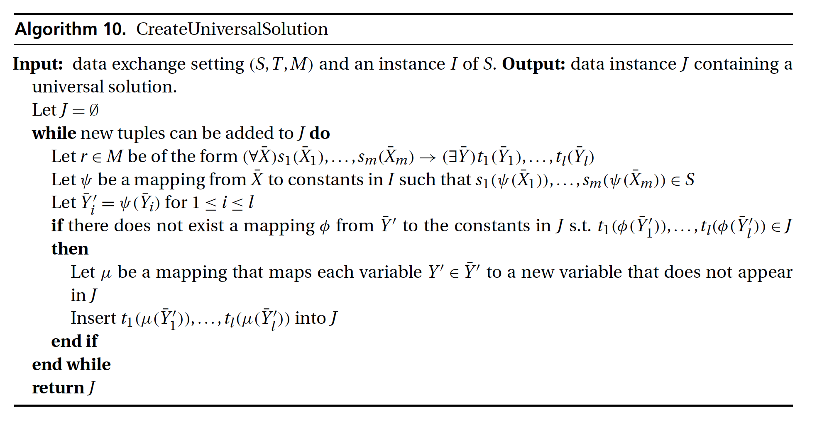
Computing Universal Solutions
[Chapter 10, Doan, Halevy & Ives]

Slide 29
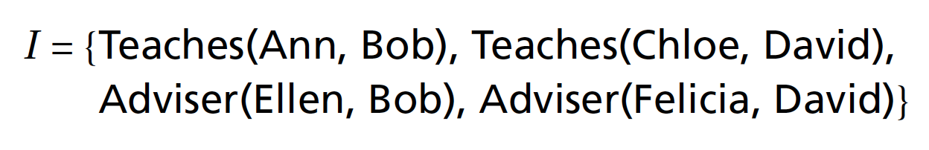
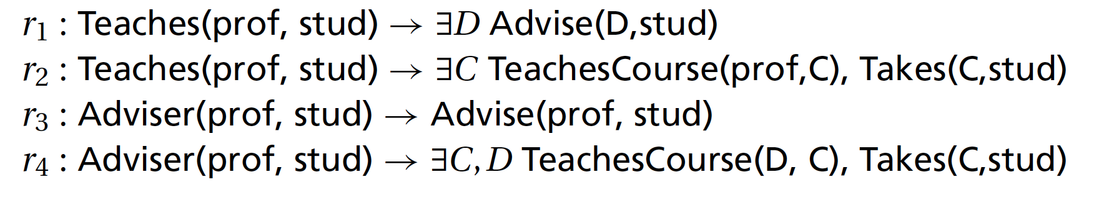
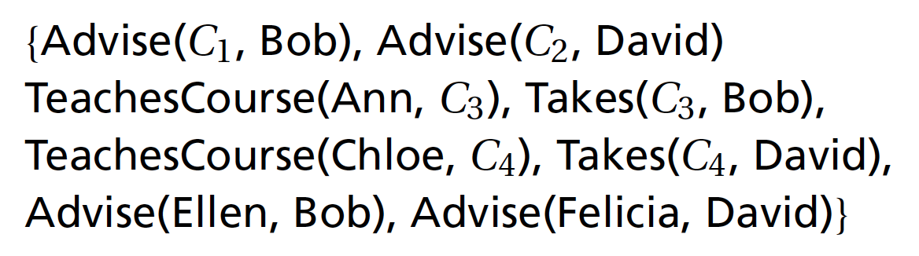
Computing Universal Solution
J=
(by applying r1)
(by applying r2)
(by applying r2)
(by applying r3)
(r4 does not provide additional tuples)

Slide 30
Computing Universal Solution
J=
(by applying r1)
(by applying r2)
(by applying r2)
(by applying r3)
(r4 does not provide additional tuples)

Slide 31
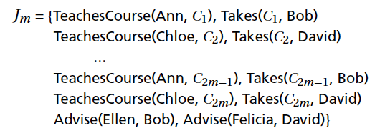
Core Universal Solutions
Universal solutions may be of arbitrary size
The core universal solution is the minimal universal solution
[based on slide by Doan, Halevy & Ives]

Slide 32
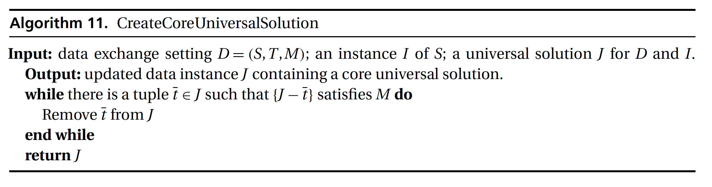
Computing Core Universal Solution
Finding a core universal solution is intractable
In some cases, it is polynomial time in the size of I:
Algorithm 11: greedy algorithm for finding the core universal solution when C_{T} is empty.

Slide 33
Computing Core Solution
J=
Notes:
In the core solution, the facts Advise(C1, Bob) and Advise(C2, David) will be removed because r1 is satisfied without them. All the other facts must remain in J.

Slide 34
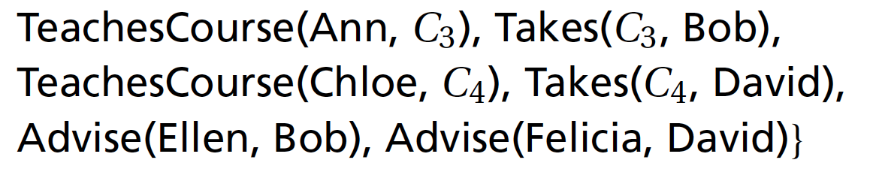
Computing Core Universal Solution
J=
J_{c}= {

Slide 35
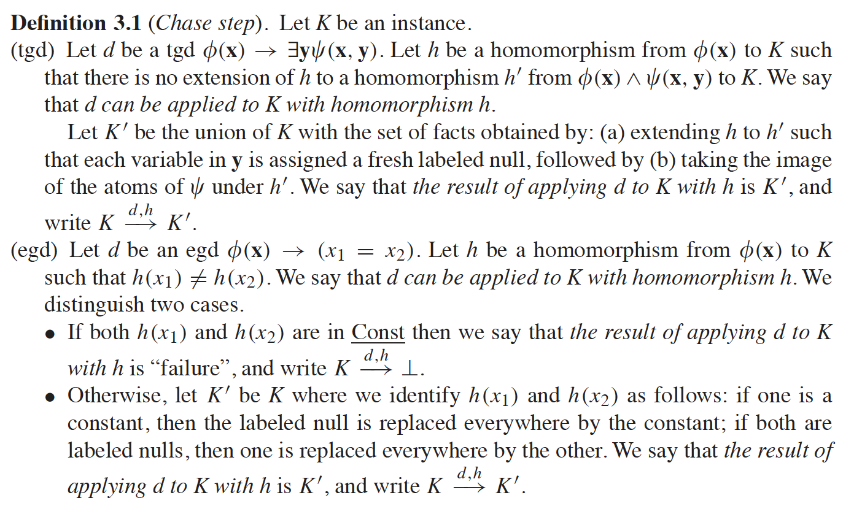
The Chase
Ronald Fagin, Phokion G. Kolaitis, Renée J. Miller, Lucian Popa
Data exchange: semantics and query answering. Theoretical Computer Science 336 (1) 2005, Pages 89–124

Slide 36
The Chase algorithm: TGDs
Computes the inference closure w.r.t to the constraints over a set of facts
Given a KB (a set/conjunction of atoms)
And a TGD constraint (omitting quantifiers)
applies to A if there exists a homomorphism h from φ to A such that h cannot be extended to map ψ to A (i.e., antecedent is satisfied, but consequent is not)
Apply by adding to A (f creates “fresh” variables).
Given a set Σ of constraints the chase is an exhaustive series of rules’ applications.
- It doesn’t always terminate! (e.g., for DL-Lite/ OWL 2QL)
- Even worse: Chase termination is an undecidable problem in general
- There are specific classes on decidable, chase terminating constraints
[based on slide by JL Ambite, G Konstantinidis]

Slide 37
The Chase algorithm: EGDs
Computes the inference closure w.r.t to the constraints over a set of facts
Given a KB (a set/conjunction of atoms)
And an EGD constraint (omitting quantifiers)
σ applies to A if there exists a homomorphism h from φ to A s.t. h(x₁) ≠ h(x₂)
Apply by:
if h(x₁) and h(x₂) are constants, then the result is failure
else ``enforce’’ x₁= x₂ in the KB
(i.e., equate variable to a constant, or replace one labelled null by the other)
[based on slide by Jl Ambite, G Konstantinidis]

Slide 38
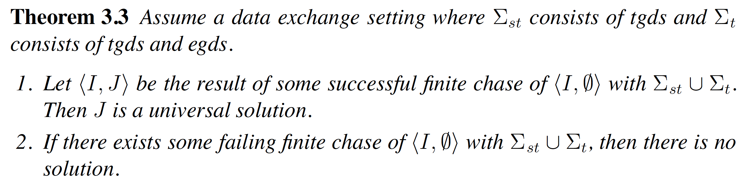
Computing Universal Solutions under Target Constraints
Ronald Fagin, Phokion G. Kolaitis, Renée J. Miller, Lucian Popa
Data exchange: semantics and query answering. Theoretical Computer Science 336 (1) 2005, Pages 89–124

Slide 39
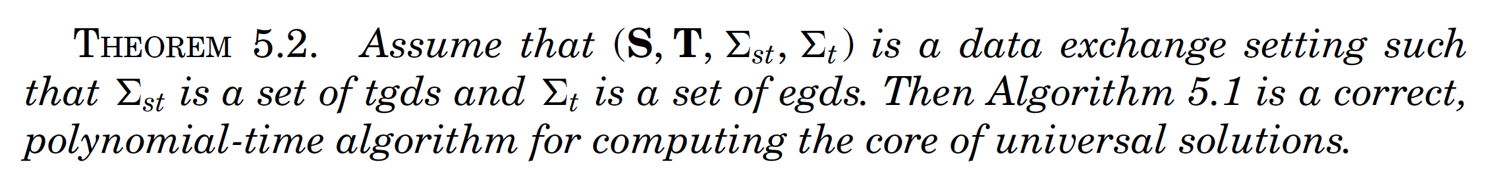
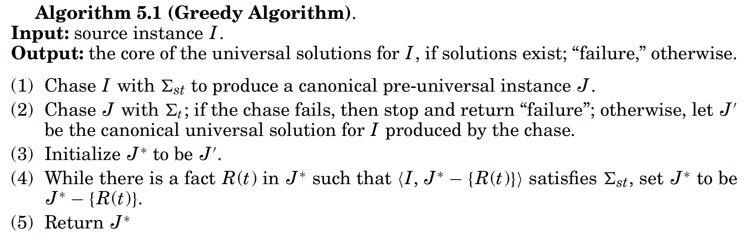
Computing the Core under target constraints (egds)
Ronald Fagin, Phokion G. Kolaitis, and Lucian Popa. 2005. Data exchange: getting to the core. ACM Trans. Database Syst. 30, 1 (March 2005), 174-210

Slide 40
Example with target EGDs (1)
Σ_{ST}
J_{C} =
Σ_{T}
Advise(P1,S)^Advise(P2,S) → P1=P2
OK! Σ_{T} satisfied
Notes:
In the core solution, the facts Advise(C1, Bob) and Advise(C2, David) will be removed because r1 is satisfied without them. All the other facts must remain in J.

Slide 41
Example with target EGDs (2)
, Adviser(Ellen, David) }
Σ_{ST}
J_{C} = ∅
J_{C} =
, Adviser(Ellen, David) }
Σ_{T} not satisfied
No solution!
Σ_{T}
Advise(P1,S)^Advise(P2,S) → P1=P2
Notes:
In the core solution, the facts Advise(C1, Bob) and Advise(C2, David) will be removed because r1 is satisfied without them. All the other facts must remain in J.

Slide 42
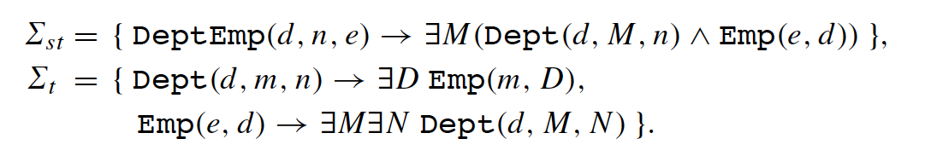
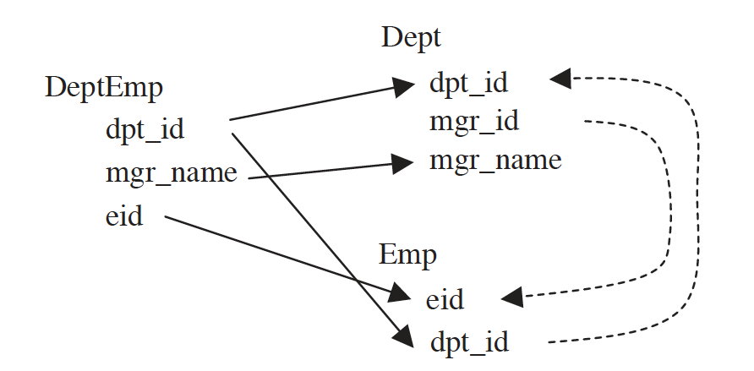
Data Exchange with Infinite Chase
Ronald Fagin, Phokion G. Kolaitis, Renée J. Miller, Lucian Popa
Data exchange: semantics and query answering. Theoretical Computer Science 336 (1) 2005, Pages 89–124
S: DeptEmp(dpt_id, mgr_name, eid)
T: Dept (dpt_id, mgr_id, mgr_name)
Emp(eid, dpt_id)
I = {DeptEmp(CS, Mary, E003)}
J1 = {Dept(CS, M, Mary), Emp(E003, CS)}
JN = {Dept(CS,M, Mary), Emp(E003, CS), Emp(M,D), Dept(D,M’,N’), . . . }.

Slide 43
Polynomial Chase / Universal Solution
Theorem 5.12. Assume a data exchange setting where Σ_{ST} is a set of tgds, and Σ_{T} is the union of a weakly acyclic set of tgds with a set of egds.
Existence of a solution can be checked in polynomial time
A universal solution exists if and only if a solution exists.
If a solution exists, then a universal solution can be produced in polynomial time using the chase.
Ronald Fagin, Phokion G. Kolaitis, Renée J. Miller, Lucian Popa
Data exchange: semantics and query answering. Theoretical Computer Science 336 (1) 2005, Pages 89–124

Slide 44
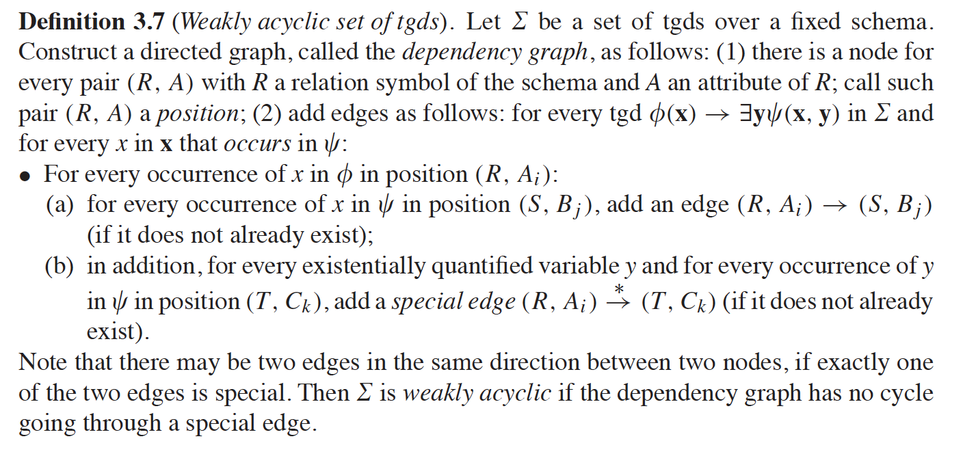
Weakly Acyclic TGDs
Informally, a set of tgds is weakly acyclic if it does not allow for cascading of labeled null creation during the chase.
Ronald Fagin, Phokion G. Kolaitis, Renée J. Miller, Lucian Popa
Data exchange: semantics and query answering. Theoretical Computer Science 336 (1) 2005, Pages 89–124

Slide 45
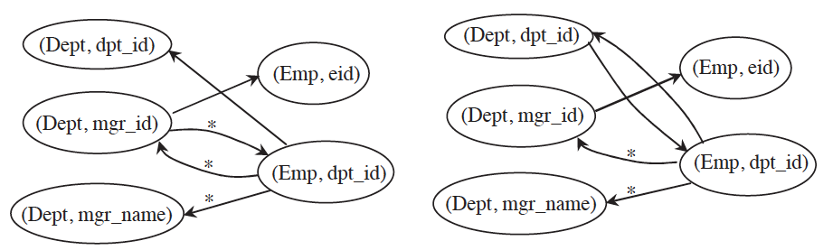
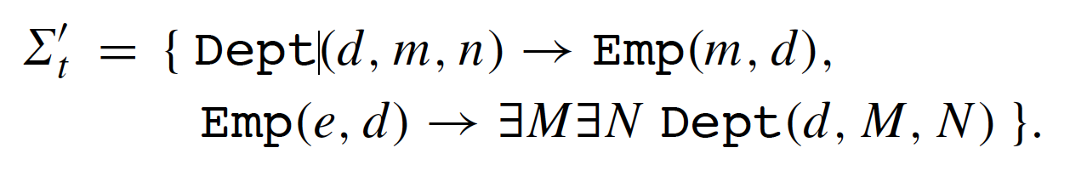
Weakly Acyclic TGDs
Ronald Fagin, Phokion G. Kolaitis, Renée J. Miller, Lucian Popa
Data exchange: semantics and query answering. Theoretical Computer Science 336 (1) 2005, Pages 89–124
Informally, a set of tgds is weakly acyclic if it does not allow for cascading of labeled null creation during the chase.
Weakly acyclic
Not weakly acyclic

Slide 46
Query Evaluation in Data Exchange
Assume certain answers semantics as in virtual data integration with st-tgds
To get the certain answers*
Construct universal (core) solution instance J
Evaluate query on J
Discard answers with labeled nulls (variables)
Queries directly executed over the target DB
No reformulation necessary
Same as typical data warehouse
(*) For unions of conjunctive queries without inequalities
[based on slide by Doan, Halevy & Ives, and Chomicki]

Slide 47
Data Exchange vs. Warehousing
From an external perspective, exchange and warehousing are essentially equivalent
But there are different trade-offs in procedural vs. declarative mappings
Procedural – more expressive
Declarative – easier to reason about, compose, invert, create materialized views for, etc.
[based on slide by Doan, Halevy & Ives]

Slide 48
The Spectrum of Materialization
Virtual integration
(EII)
Data exchange / data warehouse
sources materialized
all mediated relations materialized
caching or partial materialization –
some views materialized
Many real EII systems compute and maintain materialized views, or cache results
A “hybrid” point between the fully virtual and fully materialized approaches
[based on slide by Doan, Halevy & Ives]

Slide 49
Materialization Techniques
Cache results of prior queries
Take the results of each query, materialize them
Use answering queries using views to reuse
Expire using time-to-live… May not always be fresh!
Administrator-selected views
Someone manually specifies views to compute and maintain, as with a relational DBMS
System automatically maintains
Automatic view selection
Using query workload, update frequencies – a view materialization wizard chooses what to materialize

Slide 51
Many “Integration-Like” Scenarios over Historical Data
Many Web scenarios where we have large logs of data accesses, created by the server
Goal: put these together and query them!
Looks like a very simple data integration scenario – external data, but single schema
A common approach: use programming environments like MapReduce (or SQL layers above) to query the data on a cluster
MapReduce reliably runs large jobs across 100s or 1000s of “shared nothing” nodes in a cluster

Slide 52
MapReduce Basics
MapReduce is essentially a template for writing distributed programs – corresponding to a single SQL SELECT..FROM..WHERE..GROUP BY..HAVING block with user-defined functions
The MapReduce runtime calls a set of functions:
map is given a tuple, outputs 0 or more tuples in response
roughly like the WHERE clause
shuffle is a stage for doing sort-based grouping on a key (specified by the map)
reduce is an aggregate function called over the set of tuples with the same grouping key

Slide 53
MapReduce Dataflow “Template”: Tuples → Map “worker” → Shuffle → Reduce “worker”
emit aggregate results
emit tuples
Reduce
Worker
Map
Worker
Reduce
Worker
Map
Worker
Reduce
Worker
Map
Worker
Reduce
Worker
Map
Worker
Reduce
Worker

Slide 54
MapReduce as ETL
Some people use MapReduce to take data, transform it, and load it into a warehouse
… which is basically what ETL tools do!
The dividing line between DBMSs, EII, MapReduce is blurring as of the development of this book
SQL → MapReduce
MapReduce over SQL engines
Shared-nothing DBMSs
NoSQL

Slide 55
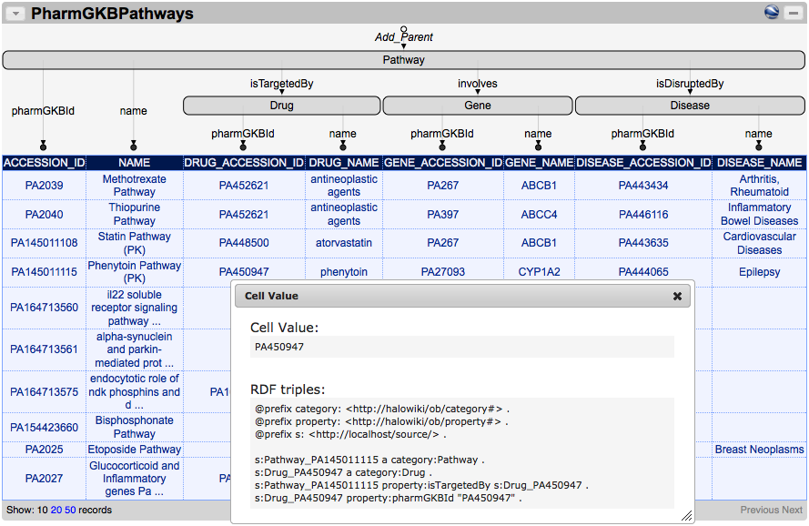
Karma as ETL tool

Slide 56
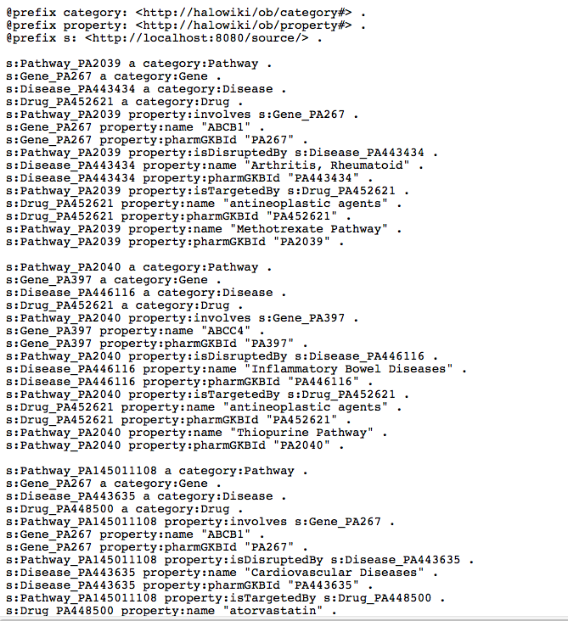
Karma as ETL tool: Export RDF to load into Triplestore

Slide 57
Warehousing & Materialization: Summary
There are benefits to centralizing & materializing data
Performance, especially for analytics / mining
Archival
Standardization / canonicalization
Data warehouses typically use procedural ETL tools to extract, transform, load (and clean) data
Data exchange replaces ETL with declarative mappings (where feasible)
Hybrid schemes exist for partial materialization
Increasingly we are integrating via MapReduce and its cousins
[based on slide by Doan, Halevy & Ives]

Slide 58
Combined Approach to Data Exchange
Some target constraints may lead to an infinite model
Human(X) --> hasMother(X,Y) ^ Human(Y)
infinite chain of mothers …
Cannot materialize an infinite database!
Solution: Combined Approach to Data Exchange
under some types of constraints it is possible to materialize part of the database and then execute a rewritten query over the target database
we’ll cover some of this in the Ontology-Based Data Integration lecture later in the course (DL-Lite, OWL2-QL)

