Slide 1
Introduction to the Semantic Web
Pedro Szekely
University of Southern California, ISI
slide by Pedro Szekely

Slide 2
Why Do We Want a Semantic Web?
slide by Pedro Szekely

Slide 3
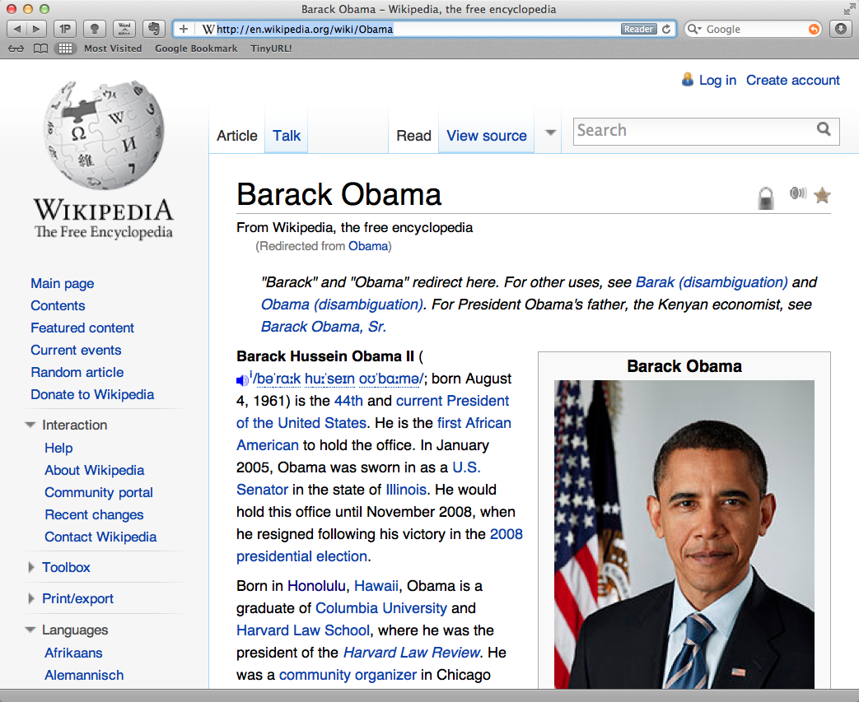
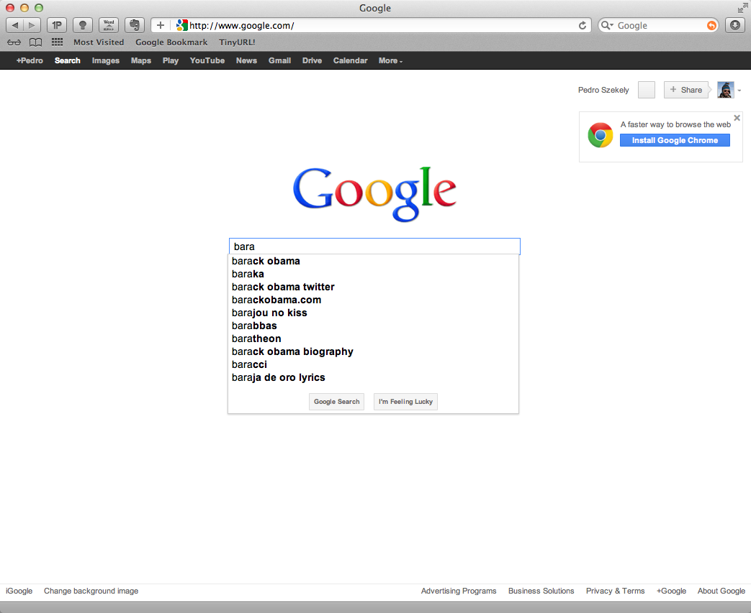
The Web of Documents
slide by Pedro Szekely

Slide 4
What We See
slide by Pedro Szekely

Slide 5
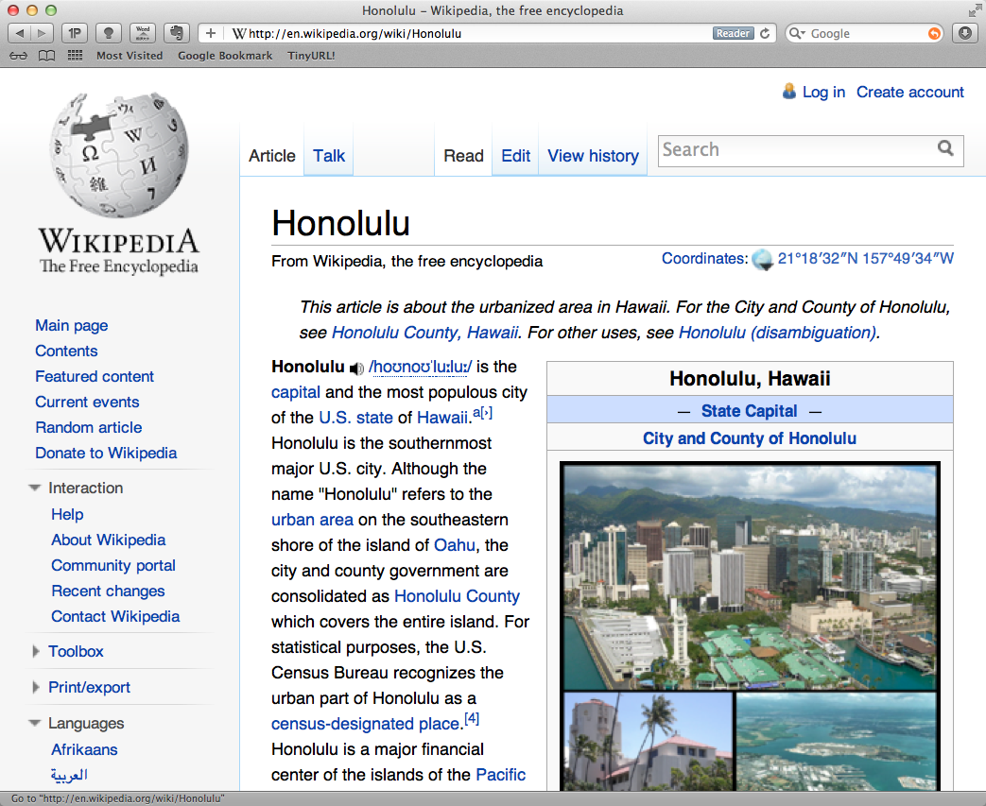
What We See
slide by Pedro Szekely

Slide 6
What the Computer Sees
blah blah blah blah
blah blah blah
blah blah blah
blah
blah blah blah
blah blah blah blah blah blah blah blah blah blah
blah blah blah blah
blah blah blah
blah blah
blah blah blah
blah blah blah blah
blah blah blah blah blah blah blah blah
blah blah blah
blah blah blah blah
blah blah blah
blah blah blah blah
blah blah blah blah blah blah blah blah
blah blah blah
blah blah blah blah
blah blah blah
blah blah blah
blah blah blah
blah blah blah blah blah blah blah blah blah blah blah blah blah blah blah blah blah blah blah blah blah blah blah blah blah blah blah blah blah blah blah blah blah blah blah blah blah blah blah blah blah blah blah blah blah blah blah blah blah blah blah
blah blah blah blah blah blah blah
blah blah blah
blah blah blah blah blah blah blah blah blah blah blah blah blah blah blah blah blah blah blah blah blah blah blah blah blah blah blah blah blah blah blah blah blah blah blah blah blah blah blah
blah blah blah blah blah blah blah blah blah blah blah blah blah blah blah blah blah blah blah blah blah blah blah blah blah blah blah blah blah blah blah blah blah blah blah blah blah blah blah blah blah blah blah blah blah blah blah
blah blah blah blah blah blah blah blah blah blah blah blah blah blah blah blah blah blah blah blah blah blah blah blah blah blah blah blah blah blah blah blah blah blah
slide by Pedro Szekely

Slide 7
What If the Computer Sees?
blah blah blah blah
<person>
blah blah blah
blah blah blah
blah
blah blah blah
<is-a>
blah blah blah blah blah blah blah blah blah blah
blah blah blah blah
blah blah blah
blah blah
blah blah blah
blah blah blah blah
blah blah blah blah blah blah blah blah
blah blah blah
blah blah blah blah
blah blah blah
blah blah blah blah
blah blah blah blah blah blah blah blah
blah blah blah
blah blah blah blah
blah blah blah
blah blah blah
blah blah blah
<name>
“Barack Obama”
blah blah blah blah blah blah blah blah blah blah blah blah blah blah blah blah blah blah blah blah blah blah blah blah blah blah blah blah blah blah blah blah blah blah blah blah blah blah blah blah blah blah blah blah blah blah blah blah blah blah blah
<barack-obama>
blah blah blah blah blah blah blah
blah blah blah
blah blah blah blah blah blah blah blah blah blah blah blah blah blah blah blah blah blah blah blah blah blah blah blah blah blah blah blah blah blah blah blah blah blah blah blah blah blah blah
blah blah blah blah blah blah blah blah blah blah blah blah blah blah blah blah blah blah blah blah blah blah blah blah blah blah blah blah blah blah blah blah blah blah blah blah blah blah blah blah blah blah blah blah blah blah blah
blah blah blah blah blah blah blah blah blah blah blah blah blah blah blah blah blah blah blah blah blah blah blah blah blah blah blah blah blah blah blah blah blah blah
<born-in>
<name>
“Honolulu”
<city-1>
… then it can use the data.
slide by Pedro Szekely

Slide 8
What If the Web Had?
Structured
Data
slide by Pedro Szekely

Slide 9
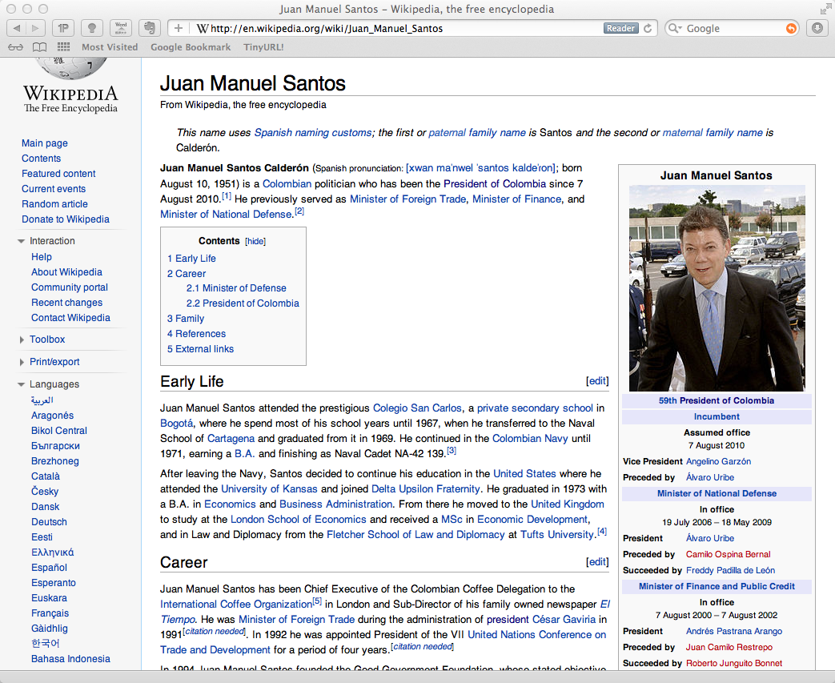
What We See
slide by Pedro Szekely

Slide 10
What If the Computer Sees
<person>
“Juan Manuel Santos”
<is-a>
<nombre>
<jm-santos>
<lugar de nacimiento>
“Bogota”
<ciudad-2>
<nombre>
slide by Pedro Szekely

Slide 11
What If the Computer Sees Both?
slide by Pedro Szekely
slide by Pedro Szekely

Slide 12
What If the Computer Sees Both?
???
???
slide by Pedro Szekely

Slide 13
What If the Web Had?
Structured
Data
Terminology
Standards
slide by Pedro Szekely

Slide 14
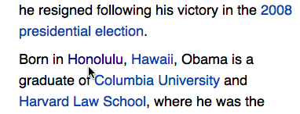
Web Has Links
<p>Born in
<a href="/wiki/Honolulu"
title="Honolulu">Honolulu</a>,
<a href="/wiki/Hawaii"
title="Hawaii">Hawaii</a>,
Obama is a graduate
slide by Pedro Szekely

Slide 15
Web Has No Data Relationships
???
<p>Born in
<a href="/wiki/Honolulu"
title="Honolulu">Honolulu</a>,
<a href="/wiki/Hawaii"
title="Hawaii">Hawaii</a>,
Obama is a graduate
<city>
<state>
???
slide by Pedro Szekely

Slide 16
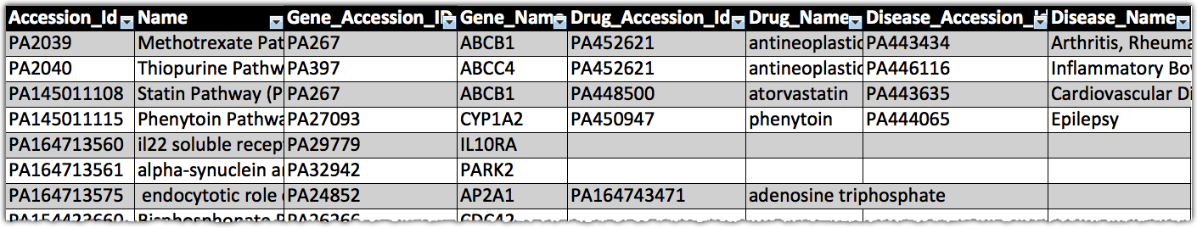
How About Structured Sources?
What is this?
Name of what?
slide by Pedro Szekely

Slide 17
What’s In the Columns?
<pathway>
<id>
<name>
slide by Pedro Szekely

Slide 18
What’s In the Columns?
<disease>
<drug>
<pathway>
<gene>
<id>
<name>
<name>
<name>
<id>
<id>
<id>
slide by Pedro Szekely

Slide 19
How Are Columns Related?
treats?
disrupts?
<drug>
<pathway>
<gene>
<disease>
<id>
<name>
<name>
<name>
<id>
<id>
<id>
slide by Pedro Szekely

Slide 20
What If the Web Had?
Data
Relationships
Structured
Data
Terminology
Standards
slide by Pedro Szekely

Slide 21
What If the Web Had?
Data
Relationships
Structured
Data
Terminology
Standards
Distributed
slide by Pedro Szekely

Slide 22
What If the Web Had?
Data
Relationships
Structured
Data
Terminology
Standards
Distributed
Large Scale
slide by Pedro Szekely

Slide 23
What If the Web Had?
Reasoning
Data
Relationships
Structured
Data
Terminology
Standards
Distributed
Large Scale
slide by Pedro Szekely

Slide 24
Semantic Web
Structured
Data
Reasoning
Terminology
Standards
Data
Relationships
Distributed
Large Scale
slide by Pedro Szekely

Slide 25
The Semantic Web Vision
W3C’s Tim Berners-Lee: “Weaving the Web”:
“I have a dream for the Web… and it has two parts.”
The first Web enables communication between people
The Web shows how computers and networks enable the information space while getting out of the way
The new Web will bring computers into the action
Step 1 -- Describe: putting data on the Web in machine-understandable form -- a Semantic Web
Step 2 -- Infer and reason: apply logic inference

Slide 26
Semantic Web and Data Integration
If all providers use
same terminologies, then data would be integrated at the schema level
reuse same standard object ids (canonical URLs), then data would be integrated at object level
=> Global object-oriented database
Even if they only do this partially, at least we now have structured data we can integrate using techniques we have seen
slide by Jose Luis Ambite

